Slide 1
Linux Security
2016 GenCyber JMU Bootcamp for High School Teachers

Slide 2
OS Security In General
Applications
Some common OS security topics
  Manage user accounts
  OS update
  Enable firewall
  Disable guest account
  Monitor logs
  Check file permissions
  Manage services
Services
OS
OS Kernel
CPU,
I/O

Slide 3
Ubuntu Security
Applications
Some common OS security topics
  Manage user accounts
  OS update
  Enable firewall
  Disable guest account
  Monitor logs
  Check file permissions
  Manage services
Services
OS
OS Kernel
CPU,
I/O

Slide 4
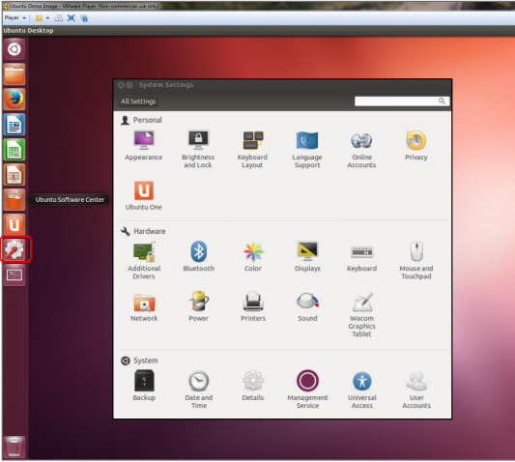
Manage User Accounts

Slide 5
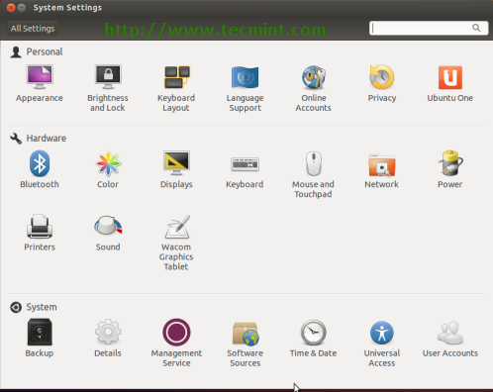
Manage User Accounts

Slide 6
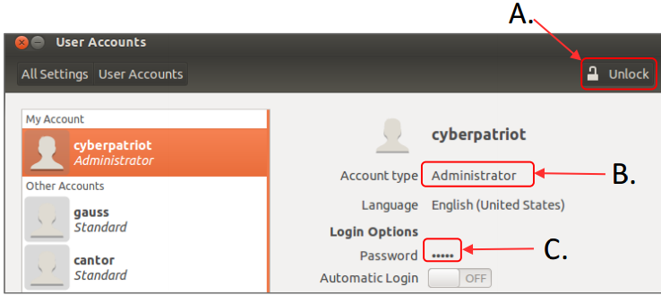
Manage User Accounts

Slide 7
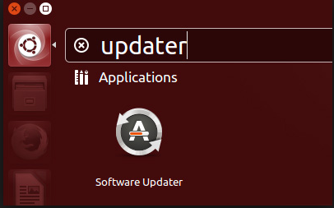
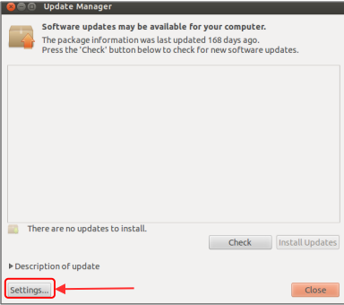
❖ OS Updates

Slide 8
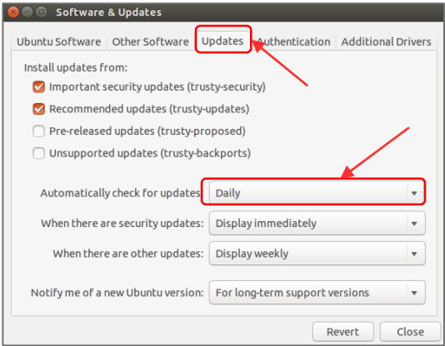
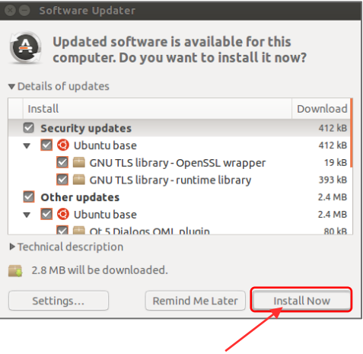
❖ OS Updates

Slide 9
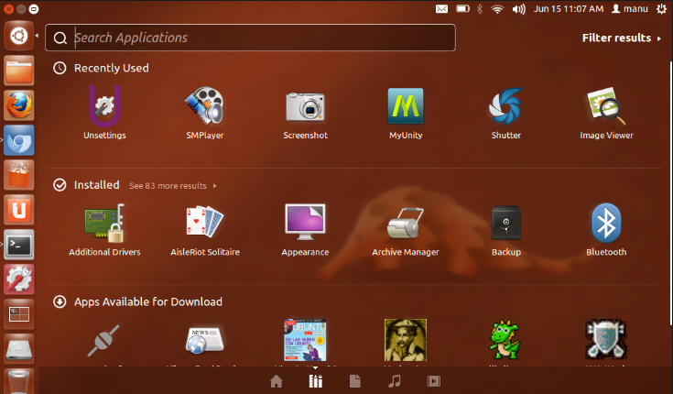
⬥ Ubuntu Firewall
Install Gufw

Slide 10
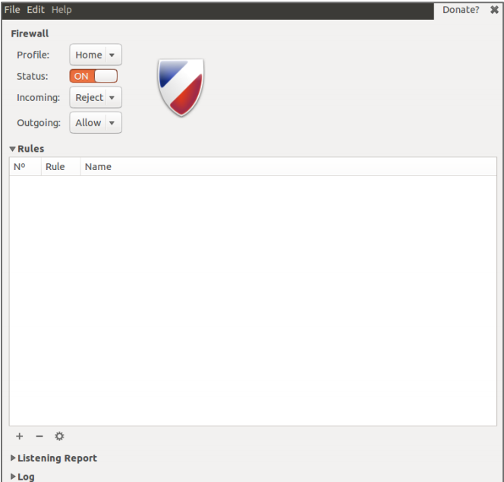
⬥ Ubuntu Firewall

Slide 11
Disable guest account
Save the change
Need to restart

Slide 12
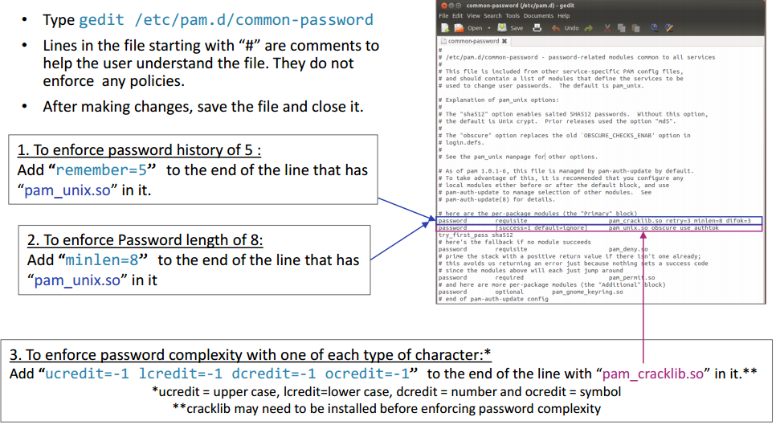
Set password policies

Slide 13
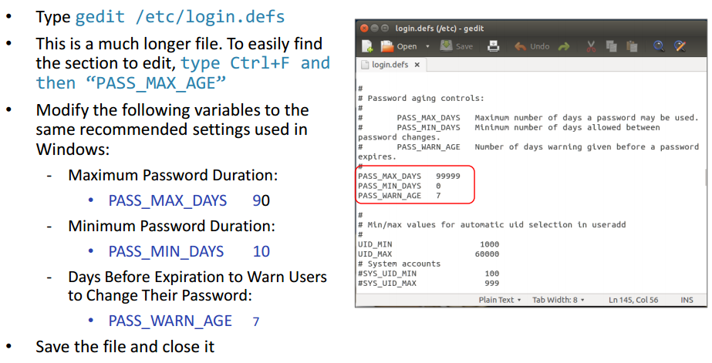
Set password history

Slide 14
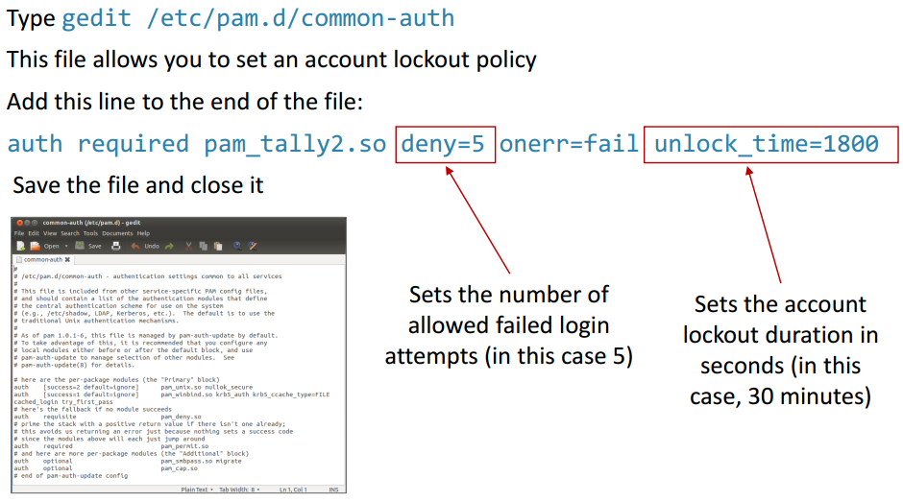
Set account policy

Slide 15
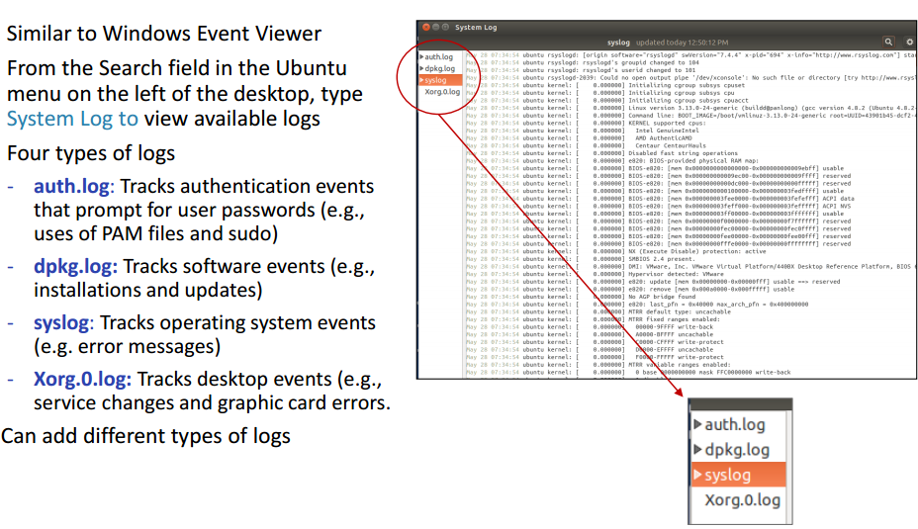
Monitor logs

Slide 16
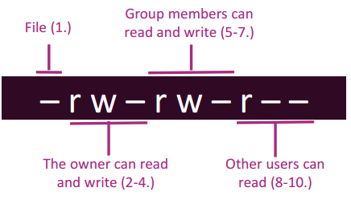
 Check file permissions
For a file,
  Can its owner read/write/execute it?
  Can other users in the same group read/write/execute it?
  Can other users in the system read/write/execute it?

Slide 17
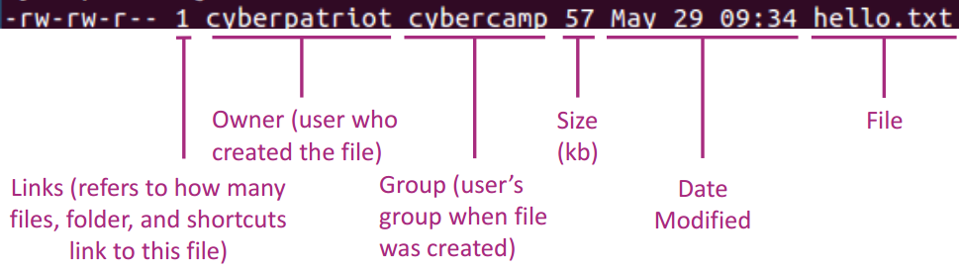
 Check file permissions
View file permission, ls –l myfile

Slide 18
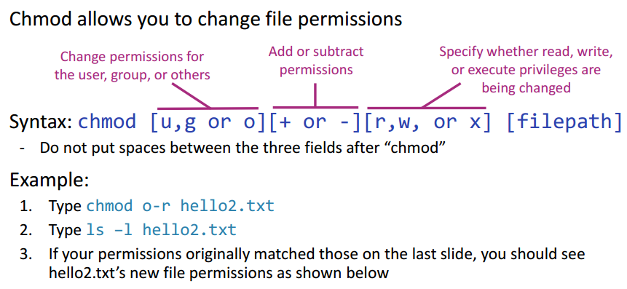
Change file permission: chmod

Slide 19
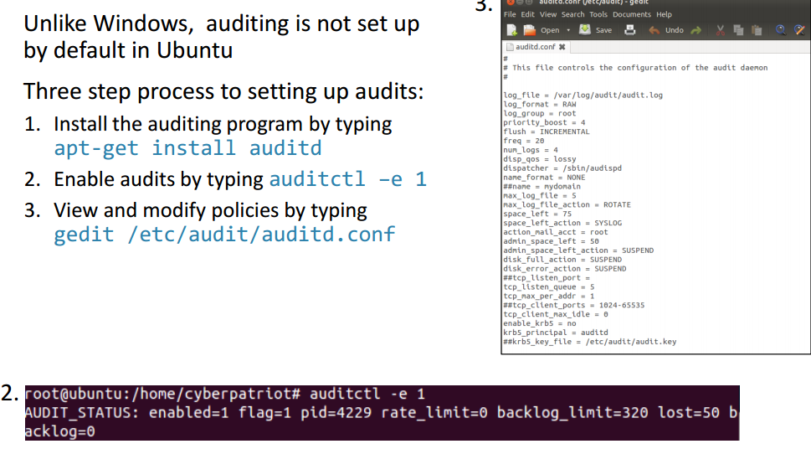
Set audit policy

Slide 20
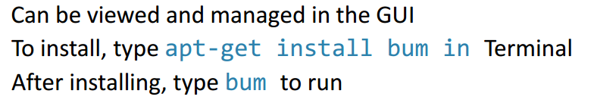
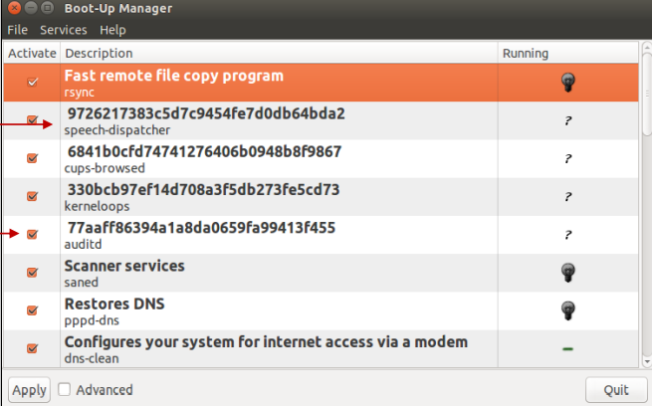
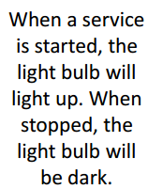


Manage services

Slide 21
The Linux File System
Every user has a home directory (default location for his/her files)
Find out what the current user’s home directory is:
echo $HOME
Associated with every shell is a location in the file system called the working directory
Find out what the current working directory is:
pwd

Slide 22
Listing Files and Directories
To see what files and directories are in the current working directory use the ls command:
ls
Most commands take options that affect their behaviour:
ls -l – show a “long” listing
ls -a – show all files and directories
ls -la – show a “long” listing of all files and directories

Slide 23
Creating, Removing, and Changing Directories
To create a new directory (in the current working directory) use the mkdir command:
mkdir foo
To change the current working directory use the cd command:
cd . – go to the current directory
cd .. – go to the parent directory
cd foo – go to the “foo” directory
cd – go to the user’s home directory
To remove an empty directory use the rmdir command:
rmdir foo

Slide 24
Absolute and Relative Paths
  Relative – specify a file or directory relative to the current directory
cd foo
cd ../..
Absolute – specify a file or directory starting from the top (root) of the file system
cd /
cd /home/elvis/foo

Slide 25
The Linux File System
A hierarchy of files and directories:
/
bin/ dev/ etc/ home/ root/ tmp/
alice/ bob/ fred/
memos/ report.doc

Slide 26
Important Linux Directories
/bin – common commands (e.g. ls and ps)
/boot – files used at boot time
/dev – files representing access points to system I/O devices (e.g. terminals, printers, disks, CDs)
/etc – system configuration files
/home – user home directories
/proc – information about system resources
/root – home directory for root user
/sbin – administrative command

Slide 27
Viewing and Editing Files
Many ways to display the contents of text files:
  cat command (no scrolling)
  more and less commands (scrolling)
Many editors available:
  pico/nano (simple)
  vi
  emacs

Slide 28
Permissions
Define access rights of various users to each file
View file permissions with the ls –l command:
drwxr-xr-x 2 elvis elvis 4096 Jan 12 18:32 Desktop
-rw-rw-r-- 1 elvis elvis 102 Jan 13 14:37 numbers
Note: 10 permission bits
  Bit 1 (leftmost): file type
  Bits 2-4 : owner’s permissions (read, write, and execute)
  Bits 5-7 : group’s permissions (read, write, and execute)
  Bits 8-10 : world’s permissions (read, write, and execute)

Slide 29
Permissions (cont)
Read (file) – view contents
Read (directory) – see what files and subdirectories it contains
Write (file) – change contents of , rename, or delete the file
Write (directory) – add files or subdirectories
Execute (file) – run the file as a program
Execute (directory) – cd into the directory

Slide 30
Modifying Permissions
Use the chmod command:
chmod 777 file rwxrwxrwx
chmod 755 file rwxr-xr-x
chmod 644 file rw-r--r--
chmod 600 file rw-------
chmod 000 file ---------

Slide 31
Modifying Permissions (cont)
Use the chmod command with +/-:
  a = all
  u = user
  g = group
  o = other (world)
Examples:
chmod a-w file r-xr-xr-x
chmod go-rwx file r-x------
chmod a+w file rwx-w--w-

Slide 32
Moving, Copying, and Removing Files
Moving:
mv file1 file2
Copying:
cp file1 file2
Removing:
rm file1

Slide 33
User database
Stored in /etc/passwd
Each line contains the account information for a single user:
  Username
  UID
  GID
  Home directory
  Default shell

Slide 34
Shadowed and Salted Passwords
Linux protects the password hashes:
  Password hashes usually stored in a protected file: /etc/shadow
  A salt value is used
Password hashes can still be cracked

Slide 35
Securing a Linux Server
Best Practices:
  Patches
  Accounts
  Audit
  Services
  Firewall
  Malware defense
  Mandatory Access Controls
Security guides and tools

Slide 36
Linux Patching
As with Windows, patches for the Linux OS and its applications and libraries are released often
Tools:
  Red Hat: up2date
  Debian (including Ubuntu): apt-get/aptitude
  RHEL, Fedora, CentOS: yum

Slide 37
Ubuntu Patching
o Tools:
- Update Manager (GUI)
- apt-get/aptitude
- Third party tools
(e.g. http://www.manageengine.com/products/security-manager)

Slide 38
Apt-get
Can be used to:
  Install/Remove/Update packages
Example:
  Sudo apt-get install emacs

Slide 39
Accounts
Delete/disable unnecessary accounts
  Users settings GUI
  useradd/userdel commands
Never have any account with no/default password
  Change all passwords to good ones
Account policies:
  /etc/pam.d/common-password – password policies
  chage command - used to view/set password expiration options of individual users

Slide 40
Logging
Most log files are text files located in /var/log:
  auth.log – account log in and log out
  lastlog – binary file used by lastlog program to display most recent log in of all users
  wtmp – binary file used by last program to display listing of last users logged in
  Certain applications also store their logs in subdirectories in /var/log:
    Apache, mysql, etc.

Slide 41
Reviewing Logs
Manually inspect log files
  System Log Viewer GUI
Automated tools:
  Logwatch
http://www.logwatch.org
  Logcheck/Logsentry http://sourceforge.net/projects/sentrytools/
  Others…

Slide 42
Services
Delete/disable unnecessary services and programs
  The services GUI
  Starting/stopping of all services is controlled by scripts in /etc/rcX.d (where X is a run level 0-6)
  Use invoke-rc.d program to start/stop services immediately
    sudo invoke-rc.d apache2 stop
  Use update-rc.d program to enable/disable a service at boot time

Slide 43
Services (cont)
Secure all necessary services
Don’t install untrusted software
  Consider the source
  Consider the signature
Notes:
The first command will start the Apache web server (if installed).
The second command will display the running status of the MySQL server (if installed).

Slide 44
Host-based Firewall
Uncomplicated Firewall (ufw) – firewall configuration utility
  $ sudo ufw allow ssh/tcp
  $ sudo ufw logging on
  $ sudo ufw enable
  $ sudo ufw status
Rules and configuration stored in /etc/ufw

Slide 45
Firewall (cont)
Block all unnecessary/unauthorized traffic
Allow traffic to necessary services
Other network security options:
  TCP Wrappers – network access control list
  PortSentry – protect against port scans
http://sourceforge.net/projects/sentrytools/
  Port scan attack detector (psad)
http://www.cipherdyne.org/psad/

Slide 46
Malicious Software Defence
Clam (http://www.clamav.net/lang/en/download/packages/packages-linux/)
Avast! (http://www.avast.com/linux-home-edition)
AVG (http://free.avg.com/in-en/download.prd-alf)
Chkrootkit (http://www.chkrootkit.org/)

Slide 47
Mandatory Access Controls
Users (thorough file permissions) can define discretionary access controls (DAC) on files
Mandatory Access Controls (MAC) are rules enforced by the system regardless of the users’ DAC
Several On-going Projects:
  Security-Enhanced Linux
  GRSecurity
  Linux Intrusion Detection System
  Rule-Set Based Access Control

Slide 48
SELinux
Project originally developed by National Security Agency to implement Mandatory Access Controls within the Linux Kernel
Incorporated into 2.6 Linux kernel
System Checks DAC then MAC policy before granting access to a resource
Ubuntu supports SELinux (but it is not installed by default)

Slide 49
Bastille Linux (cont)
An interactive Linux-hardening tool
See https://help.ubuntu.com/community/BastilleLinux
Helps check/configure:
  File permissions
  Account security
  System auditing
  Services
    Mail server
    Web server
    FTP server
  Firewall

Slide 50
Linux Security Guides
Many are available
Ubuntu Community:
https://help.ubuntu.com/community/Security

Slide 51
Summary
Best Practices:
  Patches
  Accounts
  Audit
  Services
  Firewall
  Malware defense
  Mandatory Access Control
Security guides and tools (i.e. Bastille)

