Slide 1
JMU GenCyber Boot Camp
Summer, 2016

Slide 2
Cyberspace Risks and Defenses
Facebook
Snapchat
P2P filesharing
Apps
Craigslist
Scams

Slide 3
Facebook
Facebook is a popular social media platform
“A Parent’s Guide to Facebook” by iKeepSafe.org:
  http://ikeepsafe.org/parents/parents-guide-to-facebook/
Minimum age is 13 years old
Many students use it to:
  Stay in touch with friends
  Share news, pictures, and (cat) videos
  Chat
  Etc.

Slide 4
Facebook (cont)
Special protections for users 13-17:
  Teens not listed in public searches
  Only friends and friends of friends can “tag” teens
  Teens cannot share with “the public” (only friends and friends of friends)
  Location sharing is off by default
  Friend requests only from friends and friends of friends
  Teens can only chat with friends
  Messaging is off by default
  No ads about adult content, alcohol, dating, gambling, and subscription services

Slide 5
Social Networking Risks
Harassment or online bullying (cyberbullying)
  Perpetrator and/or victim
Posting information about themselves that:
  Could be used to embarrass or manipulate them
  Could cause psychological harm
  Could be used by criminals to steal their identity or property
  Could be used by criminals to determine their physical location to cause physical harm

Slide 6
Social Networking Risks (cont)
Damage to reputation or future prospects:
  Unkind or angry posts
  Compromising photos or videos
  Group conflict depicted in text and/or imagery
Spending “too much time online” (subjective)
Exposure to inappropriate content (subjective)
Potential for inappropriate contact with adults

Slide 7
Snapchat
(Mobile) users take a photo or video
Add a caption
Send it to friends
User sets a time limit (1-10 seconds) of how long recipient can view photo/video
  Unless they take a screenshot

Slide 8
Apps
Many application programs (“apps”) can be installed via phone or social networking page
Risks include:
  Accidentally sharing information about yourself and your friends with the app developer
  Apps can contain spyware or malware
  You could wind up paying a lot for “free” apps
    Ads
    In-app purchase

Slide 9
P2P Filesharing Risks
Many easy-to-use apps allow people to share music, movies, and software online
Risks include:
  Accidentally sharing private files
  Legal issues from copyright violations
  Shared software could include spyware or malware

Slide 10
Craigslist
Free advertisement website
Rules of thumb:
  Deal locally
  Face-to-face (but safely!)

Slide 11
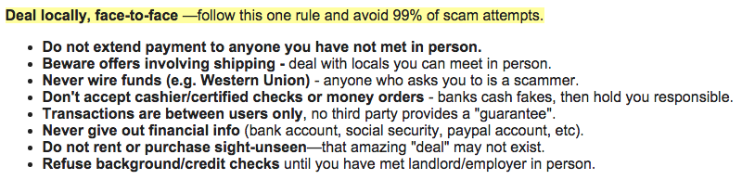
Craigslist (cont)
https://www.craigslist.org/about/scams
To these we add: use common sense when arranging to meet someone face-to-face

Slide 12
Scams
Before we get into specifics some rules of thumb:
  Protect your passwords
  Understand what information is private (SSN, account information, passwords) and be very suspicious when someone asks for it
    Check out requests and find out who you are really dealing with
    If warranted, give personal information over encrypted web connections only
  If something sounds too good to be true it probably is (especially on the Internet!)

Slide 13
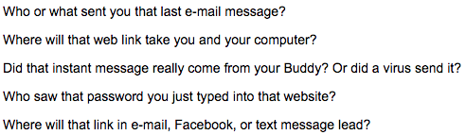
Scams (cont)
Common things to stop and think about:

Slide 14
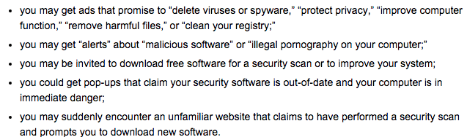
Scams – Scareware

Slide 15
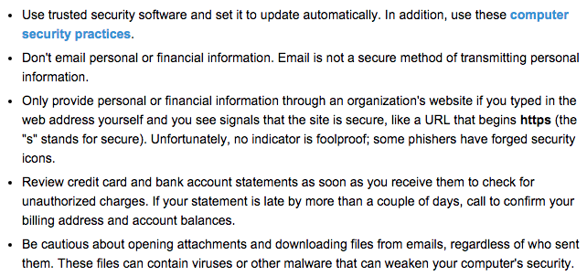
Scams – Scareware Defenses

Slide 16
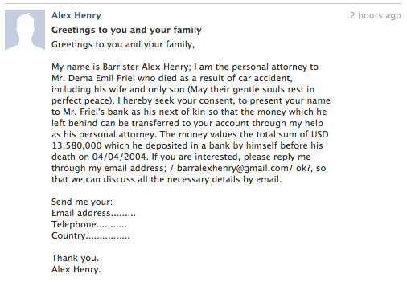
Scams – Nigerian Prince Scam

Slide 17
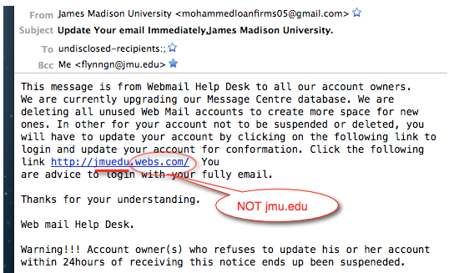
Scams – Phishing

Slide 18
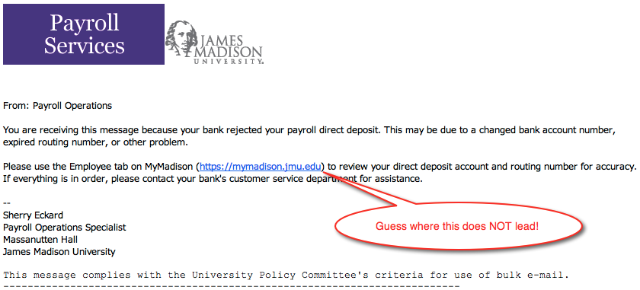
Scams – Phishing (cont)

Slide 19
Scams – Phishing Defenses
Be cautious/suspicious
  JMU policy: we will never ask you for your password over the phone or e-mail
  JMU policy: only a few trusted JMU websites as for your password
Look where you are going:
  Before clicking on a link hover over it with the mouse and view the URL
Look where you are at:
  If you click a link, check the address bar and make sure it took you to the proper domain and you weren’t redirected

Slide 20
Summary of Cyberspace Risks and Defenses
Be careful/suspicious:
  Facebook
  Snapchat
  P2P filesharing
  Apps
  Craigslist
  Scams

