Slide 1
Vulnerability Scanning

Slide 2
Manually Researching Vulnerabilities
Many sources for vulnerability information:
  Web sites:
    General:
      www.cert.org/
      http://www.securityfocus.com/
    Vendor:
      http://technet.microsoft.com/en-us/security/bulletin
      http://httpd.apache.org/security_report.html
    Questionable
  Books
    E.g. Hacking Exposed
  Other

Slide 3
Vulnerability Scanners
Vulnerability scanners are automated tools that scan hosts and networks for known vulnerabilities and weaknesses
Credentialed vs. non-credentialed
Used along with other reconnaissance information to prepare for and plan attacks

Slide 4
Credentialed Scanning
Uses user privileges to analyze the system and find issues
  Example: Microsoft Baseline Security Analysis
Used by system admins to get a detailed look at system configuration

Slide 5
Non-Credentialed Scanning
Scans are run with zero privileges, most of the time run from a different machine over the network
  Example: Nessus Vulnerability Scanner
Gives you a view of the computer from the standpoint of an attacker

Slide 6
How Vulnerability Scanners Work
Similar to virus scanning software:
  Contain a database of vulnerability signatures that the tool searches for on a target system
  Cannot find vulnerabilities not in the database
    New vulnerabilities are discovered often
    Vulnerability database must be updated regularly

Slide 7
Typical Vulnerabilities Checked
Network vulnerabilities
Host-based (OS) vulnerabilities
  Misconfigured file permissions
  Open services
  Missing patches
  Vulnerabilities in commonly exploited applications (e.g. Web, DNS, and mail servers)

Slide 8
Vulnerability Scanners: Benefits
Very good at checking for hundreds (or thousands) of potential problems quickly
  Automated
  Regularly
May catch mistakes/oversights by the system or network administrator
Defense in depth

Slide 9
Vulnerability Scanners: Drawbacks
Report “potential” vulnerabilities
Only as good as the vulnerability database
Can cause complacency
Cannot match the skill of a talented attacker
Can cause self-inflicted wounds

Slide 10
Attackers use Vulnerability Scanners Too
From network scanning an attacker has learned:
  List of addresses of live hosts
  Network topology
  OS on live hosts
  Open ports on live hosts
  Service name and program version on open ports
Now use vulnerability scanners to find vulnerable services

Slide 11
Popular Security Tools
“The network security community's favorite tools.”
We will talk about/demo many of these during this class
The list:
  http://sectools.org/

Slide 12
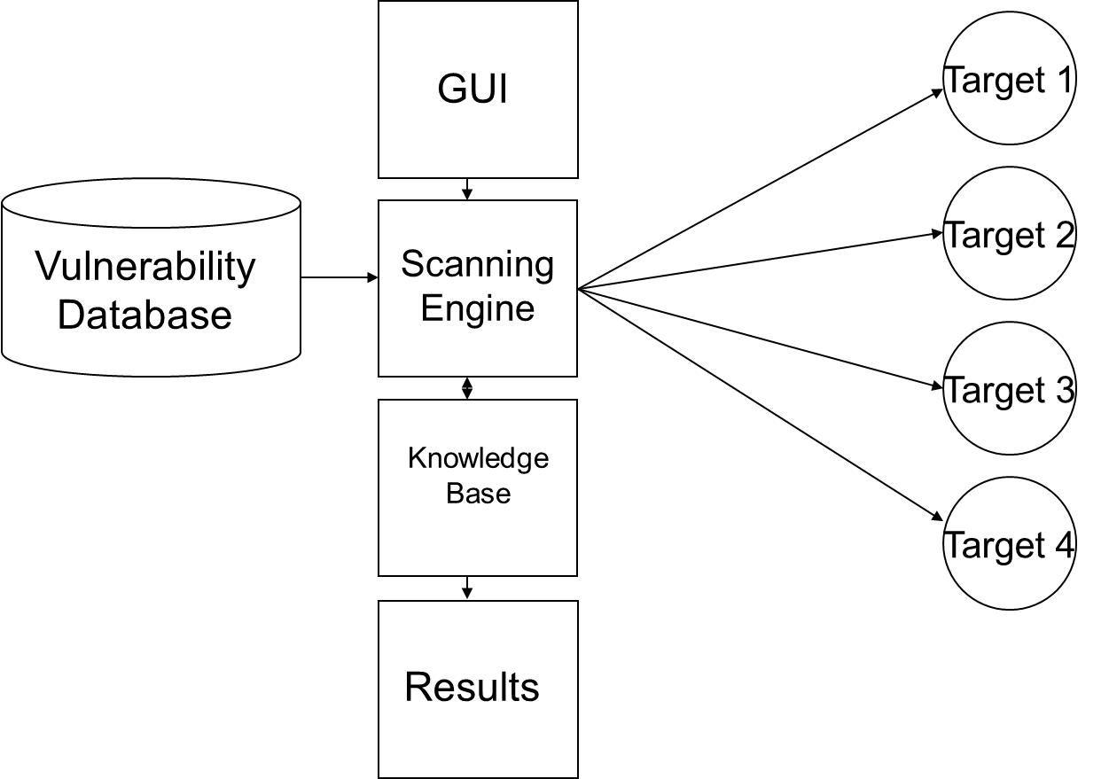
How Vulnerability Scanners Work

Slide 13
Typical Vulnerabilities Checked
Common configuration errors
  Examples: weak/no passwords
Default configuration weaknesses
  Examples: default accounts and passwords
Well-known system/application vulnerabilities
  Examples:
    Missing OS patches
    An old, vulnerable version of a web server

Slide 14
Nessus
Free, open-source vulnerability scanner
URL: http://www.tenable.com/products/nessus
Two major components:
  Server
    Vulnerability database
    Scanning engine
  (Web) Client
    Configure a scan
    View results of a scan

Slide 15
Nessus Plug-ins
Vulnerability checks are modularized:
  Each vulnerability is checked by a small program called a plug-in
  More than 20,000 plug-ins form the Nessus vulnerability database (updated regularly)
  Customizable – user can write new plug-ins
    In C
    In Nessus Attack-Scripting Language (NASL)

Slide 16
Vulnerabilities Checked by Nessus
Some major plug-in groups:
  Windows
  Backdoors
  CGI abuses
  Firewalls
  FTP
  Remote file access
  RPC
  SMTP
  DOS

Slide 17
Running a Nessus Scan
Make sure the server is running and has the latest vulnerability database
Start the client
Connect to the server
Select which plug-ins to use
Select target systems to scan
Execute the scan
View the results

Slide 18
Nessus Results
Vulnerabilities ranked as high, medium, or low risk
Need to be checked (and interpreted)
Can be used to search for/create exploits along with previous information collected:
  OS type
  List of open ports
  List of services and versions
  List of vulnerabilities

Slide 19
Nikto: A Web Vulnerability Scanner
URL: http://cirt.net/nikto2
Vulnerability scanner for web servers
  Similar to Nessus - runs off plug-ins
Tests for:
  Web server version
  Known dangerous files/CGI scripts
  Version-specific problems

Slide 20
Security Templates
A Windows security template is a file (.inf) that lists recommended configuration parameters for various system settings:
  Account policies
  Local policies
  Event log
  Restricted groups
  System services
  Registry
  File system

Slide 21
Security Templates (cont)
There are several default security templates defined by Microsoft:
  Default security – from a default installation of the OS
  Compatible – modifies permissions on files and registry to loosen security settings for user accounts (designed to increase application compatibility)
  Secure – increases security by modifying password, lockout, and audit settings
  Highly secure – does everything the secure template does plus more
There are templates defined by others, and an administrator can customize his/her own templates

Slide 22
Security Configuration and Analysis Utility
Can be used to:
  Save current system settings to a template
  Compare the current system settings against a preconfigured template
  Apply the settings in a preconfigured template to the system

Slide 23
Security Configuration and Analysis Utility (cont)
Running:
  Run Microsoft Management Console (MMC)
  Add Security Configuration and Analysis Snap-in
  Open a (new) database
  Analyze/Configure computer now
Demo

Slide 24
Security Configuration Wizard
An attack surface reduction tool
For Windows 2003 Server SP1 and later
Determines the minimum functionality for server’s role or roles
Disables functionality that is not required
Run off of a file (.xml) that lists recommended configuration parameters for various system settings

Slide 25
Security Configuration Wizard (cont)
Disables functionality that is not required
  Disables unneeded services
  Blocks unused ports
  Allows further address or security restrictions for ports that are left open
  Prohibits unnecessary IIS web extensions, if applicable
  Reduces protocol exposure to server message block (SMB), LanMan, and Lightweight Directory Access Protocol (LDAP)
  Defines a high signal-to-noise audit policy

Slide 26
Security Configuration Wizard (cont)
Running
  From Control Panel -> Add/Remove New Programs
  Add/Remove Windows Components
  Security Configuration Wizard
  Run from Administrative Tools
    Analyze system settings
    Configure system settings

Slide 27
Summary
Vulnerability scanners are automated tools that scan hosts and networks for known vulnerabilities and weaknesses
Used by defenders to automatically check for many known problems
Used by attackers to prepare for and plan attacks
Configuration tools can help reduce attack surface

