Slide 1
Cryptography for Dummies
2016 JMU Cyber Defense Boot Camp

Slide 2

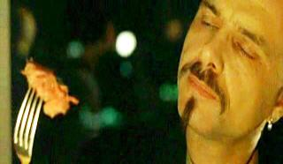
What is this unit about?
Cryptography!
Who is this guy?
Cypher
Cipher
“Ignorance is bliss”

Slide 3
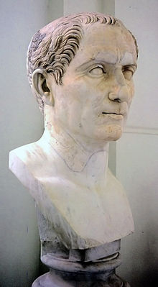
What is this unit about?
Lecturing about cryptography
  “Boring” lecturing (practice in next session)
A topic that has challenged the human kind for more than 2000 years
  Dated beyond Julius Caesar (around 56 BC)
Slides are available at https://users.cs.jmu.edu/tjadenbc/Bootcamp/3-crypto.pdf

Slide 4
Organization
The data confidentiality problem
Theory
  Numbers
  Encryption
Beyond encryption
  Digital signature
  Cryptographic hashing
  Digital certificates and PKI
Tie everything together: HTTPS
Focus on concepts/vocabulary;
Skip details

Slide 5
Road Map
The data confidentiality problem
Theory
  Numbers
  Encryption
Beyond encryption
  Digital signature
  Cryptographic hashing
  Digital certificates and PKI
Tie everything together: HTTPS

Slide 6
Questions
How do you protect (the confidentiality of) your Turbo Tax file on your computer?
  Full name, SSN, DOB, home address
How do you protect (the confidentiality of) the financial information on your computer?
  Bank accounts, retirement plan accounts, stock investment accounts
How to protect your files on your USB drive?
Encrypt them?
What is encryption?

Slide 7
What the heck is Cryptography?
We have heard “encryption” more
Cryptography
  Kryptos: hidden
  -graphy
    writing or representation in a (specified) manner or by a (specified) means or of a (specified) object
Traditionally, cryptography = encryption

Slide 8
Welcome to the Wonderful Land
Q: How many cryptographers does it take to change a light bulb?
A: XIGHCBS
“It is insufficient to protect ourselves with laws; we need to protect ourselves with mathematics.”
  Bruce Schneier
He was talking about cryptography!

Slide 9
Road Map
The data confidentiality problem
Theory
  Numbers
  Encryption
Beyond encryption
  Digital signature
  Cryptographic hashing
  Digital certificates and PKI
Tie everything together: HTTPS

Slide 10
Road Map
The data confidentiality problem
Theory
  Numbers
  Encryption
Beyond encryption
  Digital signature
  Cryptographic hashing
  Digital certificates and PKI
Tie everything together: HTTPS

Slide 11
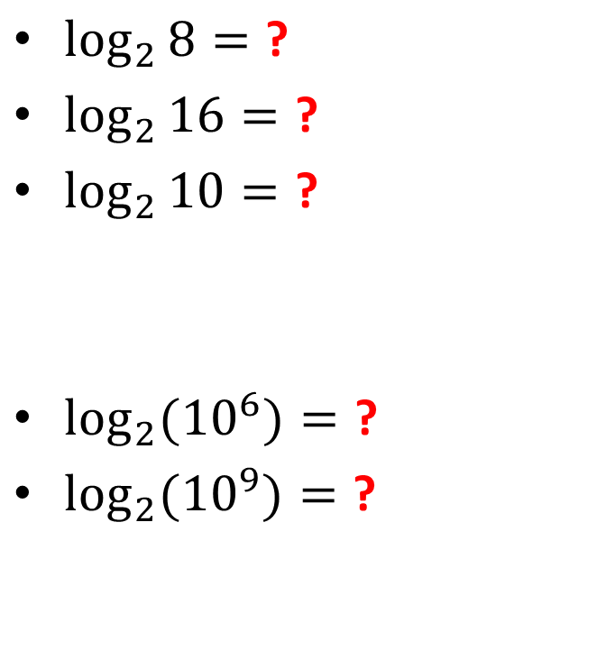
Warm-up Questions
2³ = ?
2⁴ = ?
2³ < 10 < 2⁴ ?
$\log_{2}{8}=\text{?}$
$\log_{2}{16}=\text{?}$
$\log_{2}{10}=\text{?}$
$\log_{2}{{(10}^{6})}=\text{?}$
$\log_{2}{{(10}^{9})}=\text{?}$

Slide 12

Back-of-Envelope Calculations
How many seconds are there in a day?
  24 × 60 × 60 = 86,400 seconds
  as 2^{x}?
  ≤ 2¹⁷
How?
86400 = 2^{x}
8 × 10⁴ ≈ 2^{x}
$$\log_{2}{(\text{8 }\text{× 10}\text{4})≈\log_{2}{(2^{x})}}$$
$$\log_{2}{\text{8 }\text{+}\log_{2}\text{(1}\text{0}\text{4})≈}x$$
$$3{\text{+}{4×log}_{2}\text{(10})≈}x$$
$$x≈16.3$$

Slide 13
Back-of-Envelope Calculations
How many seconds are there in a day?
  24 × 60 × 60 = 86,400 seconds
  as 2^{x}?
  ≤ 2¹⁷
How many seconds are there in a year?
  365 days × 86,400 = 31,536,000
  ≤ 2²⁵
How many seconds in 200 years?
  3,153,600,000×2 seconds = 3.1536×2×10⁹
  ≈ 3.1536 × 2³¹ ≤ 2³³
Why 200?
Most people won’t live 200 years
So, 200 years’ security is enough

Slide 14
Back-of-Envelope Calculations
How many seconds are there in a day?
  24 × 60 × 60 = 86,400 seconds
  as 2^{x}?
  ≤ 2¹⁷
How many seconds are there in a year?
  365 days × 86,400 = 31,536,000
  ≤ 2²⁵
How many seconds in 200 years?
  3,153,600,000×2 seconds = 3.1536×2×10⁹
  ≈ 3.1536 × 2³¹ ≤ 2³³
200 years ≈ 2³³ seconds

Slide 15
Back-of-Envelope Calculations
How many “operations” can a computer do in one second?

Slide 16
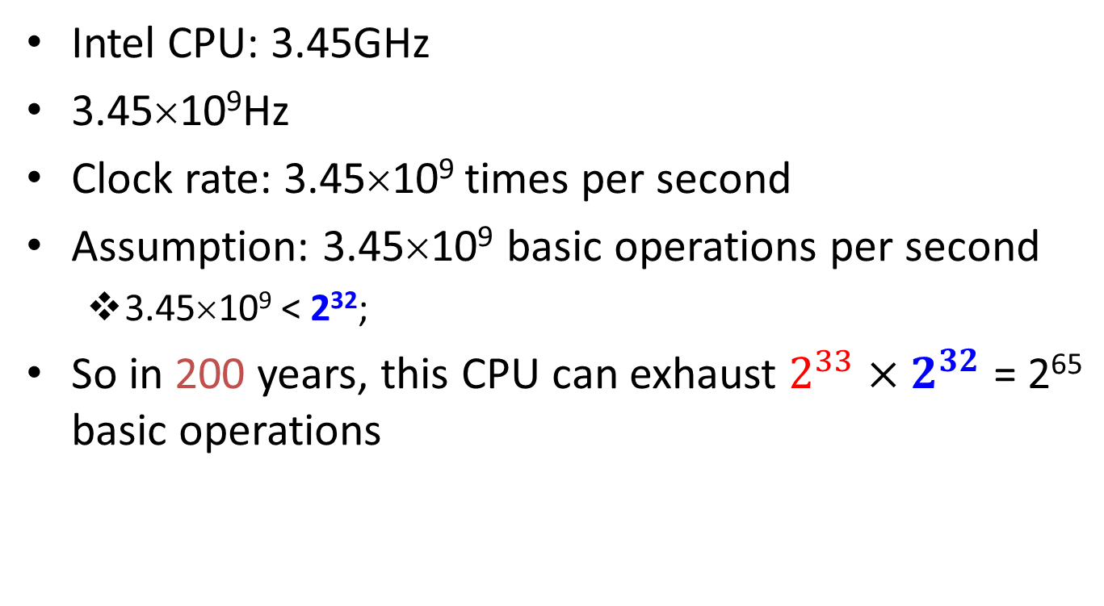
Intel CPU
Intel CPU: 3.45GHz
3.45×10⁹Hz
Clock rate: 3.45×10⁹ times per second
Assumption: 3.45×10⁹ basic operations per second
  3.45×10⁹ < 2³²;
So in 200 years, this CPU can exhaust $2^{33}×2^{32}$ = 2⁶⁵ basic operations

Slide 17
June. 2016
The fastest computer?
  http://www.top500.org/
  The most recent list was released on June 20, 2016
Sunway
  93.01 petaflop/s on the Linpack benchmark
  Quadrillions of calculations per second
  93.01 × 10¹⁵ ≈ 2⁵⁷ calculations per second
200 years ≈ 2³³ seconds
200 year’s calculations: 2⁵⁷ × 2³³ = 2⁹⁰
Notes:
http://www.classicshell.net/
http://whohasthefastestcomputer.com/flopsmeter/
DOE/SC/Oak Ridge National Laboratory
System URL: http://www.olcf.ornl.gov/titan/
Manufacturer: Cray Inc.
Cores: 560640
Linpack Performance (Rmax) 17590.0 TFlop/s
Theoretical Peak (Rpeak) 27112.5 TFlop/s
Power: 8209.00 kW
Memory: 710144 GB
Interconnect: Cray Gemini interconnect
Operating System: Cray Linux Environment
(710144 GB memory)

Slide 18
What if 1 million Such Supercomputers?
One supercomputer: 93.01 × 10¹⁵ ≈ 10^{16.97}
1000000 (10⁶) such computers
  10^{22.97} calculations per second
  ≈ 2^{76.3}
200 years: 2³³ seconds
200 years’ calculations = ?
  2^{76.3} × 2³³ ≤ 2¹¹⁰

Slide 19
What if 1 billion Such Supercomputers?
One supercomputer: 93.01 × 10¹⁵ ≈ 10^{16.97} ≈ 2^{56.4} calculations per second
1000000000 (10⁹ ≈ 2^{29.9}) such computers
  2^{56.4}×2^{29.9} ≈ 2^{86.3} calculations per second
200 years: 2³³ seconds
How many calculations in 200 years?
  2^{86.3}×2³³ ≈ 2¹²⁰
Lessons?
Computers have computing limits

Slide 20
 Numbers (Intel CPU)
# of seconds in a day?
# of seconds in a year?
# of seconds in 200 years?
Intel CPU (3.45GHz) in 200 years?
1 million Intel CPU (3.45GHz) in 200 years:
1 billion Intel CPU (3.45GHz) in 200 years:
2¹⁷
2²⁵
2³³
2⁶⁵
2⁸⁵
2⁹⁵

Slide 21
 Numbers (The Fastest Computer)
# of seconds in a day?
# of seconds in a year?
# of seconds in 200 years?
The fastest computer in 200 years?
1 million fastest computers in 200 years:
1 billion fastest computers in 200 years:
2¹⁷
2²⁵
2³³
2⁹⁰
2¹¹⁰
2¹²⁰

Slide 22

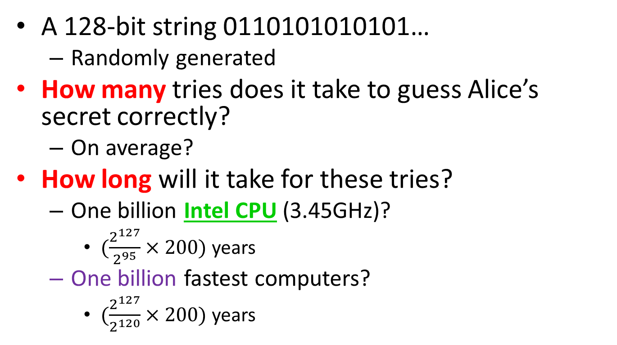

So?
A 128-bit string 0110101010101…
  Randomly generated
How many tries does it take to guess Alice’s secret correctly?
  On average?
How long will it take for these tries?
  One billion Intel CPU (3.45GHz)?
    $(\frac{2^{127}}{2^{95}}×200)$ years
  One billion fastest computers?
    $(\frac{2^{127}}{2^{120}}×200)$ years
800 billion years
25600 years
Encryption-wise, modern computers favor defenders

Slide 23
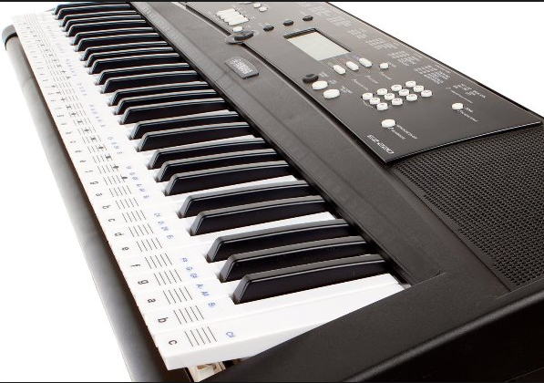
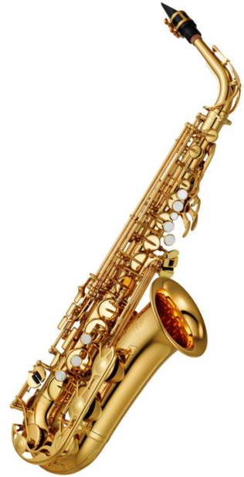
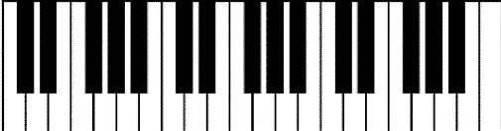
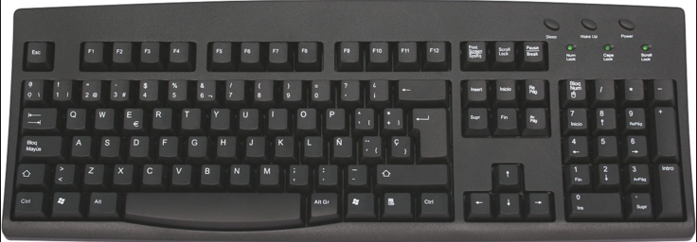
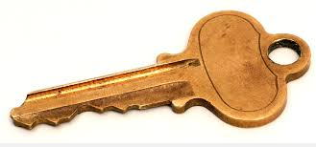

Slide 24
Road Map
The data confidentiality problem
Theory
  Numbers
  Encryption
Beyond encryption
  Digital signature
  Cryptographic hashing
  Digital certificates and PKI
Tie everything together: HTTPS

Slide 25
Symmetric Key Encryption
Eve
private channel
A symmetric key is a reasonably short binary string: 01110101010…
A secret!
Notes:
Now, let’s check how encryption and decryption work.

Slide 26
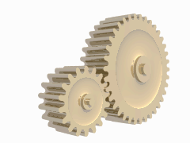
Symmetric Key Encryption
public channel
Dear Bob
Tell Albert
to get out of
there
$β♥♦♣
ƒϒ%ΩΛ
?}{|•℘
®gt…x
Dear Bob
Tell Albert
to get out of
there
Eve
private channel
A symmetric key is a reasonably short binary string: 01110101010…
Notes:
Now, let’s check how encryption and decryption work.

Slide 27

Symmetric Key Encryption
Cipher (cryptosystem
Encipher
public channel
Decipher
Dear Bob
Tell Albert
to get out of
there
$β♥♦♣
ƒϒ%ΩΛ
?}{|•℘
®gt…x
Dear Bob
Tell Albert
to get out of
there
Encrypt
Decrypt
Eve
Plaintext (cleartext)
Ciphertext (cryptogram)
Cryptanalyst
cryptanalyze
Key
In a box? It should be kept secret
private channel
Alice
Bob
Natural!
Notes:
In the symmetric key encryption, Alice and Bob use the same symmetric key and this key is distributed by some secure channels. Eve cannot read the symmetric keys distributed over this private channel. Otherwise, the game is over. To show this, I marked this channel in RED.
When Alice wants to send a secure message to Bob, she encrypts it with the symmetric key that she shares with Bob. Then, the ciphertext is sent over a public channel and everybody can read the ciphertext. This channel is marked as GREEN.
This model was first proposed by C.E. Shannon in his 1949 landmark paper.

Slide 28
After 2000 years, We “Know” How to Do this
public channel
Dear Bob
Tell Albert
to get out of
there
$β♥♦♣
ƒϒ%ΩΛ
?}{|•℘
®gt…x
Dear Bob
Tell Albert
to get out of
there
Eve
Advanced Encryption Standard (AES);
RC4
private channel
Are we cool?
A symmetric key is a reasonably short binary string: 01110101010…
Notes:
Now, let’s check how encryption and decryption work.

Slide 29
Personal Meetings?
Eve
private channel
A symmetric key is a reasonably short binary string: 01110101010…
Notes:
Now, let’s check how encryption and decryption work.

Slide 30


Too Many Meetings!
(10⁶–1) keys

Slide 31
What if …
Eve is able to monitor all communications between Alice and Bob (all the time)
Eve
Can Alice still send Bob a SECRET message?
Notes:
Let’s take another look at public key encryption. In the public key cryptography, to send a message to Bob, Alice has to possess Bob’s public key. Thus, before Alice does the encryption, she has to somehow get Bob’s public key. If she mistakenly uses somebody else’s public key, the game is over. Bob’s public key is distributed through a reliable channel, marked in YELLOW.
Different from the symmetric key cryptography, Eve can read the public key distribution channel and this won’t help her decrypt the ciphertext.
Like the symmetric key cryptography, the ciphertext is sent over a public channel. Eve can read the ciphertext. We will discuss the details of public key encryption later.

Slide 32
What if …
Eve is able to monitor all communications between Alice and Bob (all the time)
Eve
Can Alice still send Bob a secret message?
Notes:
Let’s take another look at public key encryption. In the public key cryptography, to send a message to Bob, Alice has to possess Bob’s public key. Thus, before Alice does the encryption, she has to somehow get Bob’s public key. If she mistakenly uses somebody else’s public key, the game is over. Bob’s public key is distributed through a reliable channel, marked in YELLOW.
Different from the symmetric key cryptography, Eve can read the public key distribution channel and this won’t help her decrypt the ciphertext.
Like the symmetric key cryptography, the ciphertext is sent over a public channel. Eve can read the ciphertext. We will discuss the details of public key encryption later.

Slide 33

What?
0110101010101…
Strange new key
0101000…
1-1 matching
1011010111…

Slide 34
Strong relationship
Strange new key
0101000…
1-1 matching
You know the corresponding private key is there/unique but you cannot find it
Just too hard: take too long
1011010111…

Slide 35
Key Generation
Strange new keys

Slide 36
What if …
Eve is able to monitor all communications between Alice and Bob (all the time)
public part
Eve
Two keys
Private part
One key, two parts!
Notes:
Let’s take another look at public key encryption. In the public key cryptography, to send a message to Bob, Alice has to possess Bob’s public key. Thus, before Alice does the encryption, she has to somehow get Bob’s public key. If she mistakenly uses somebody else’s public key, the game is over. Bob’s public key is distributed through a reliable channel, marked in YELLOW.
Different from the symmetric key cryptography, Eve can read the public key distribution channel and this won’t help her decrypt the ciphertext.
Like the symmetric key cryptography, the ciphertext is sent over a public channel. Eve can read the ciphertext. We will discuss the details of public key encryption later.

Slide 37
What if …
Eve is able to monitor all communications between Alice and Bob (all the time)
Bob’s
public key
Eve
Counter-intuitive!
Bob’s
private key
One key, two parts!
Notes:
Let’s take another look at public key encryption. In the public key cryptography, to send a message to Bob, Alice has to possess Bob’s public key. Thus, before Alice does the encryption, she has to somehow get Bob’s public key. If she mistakenly uses somebody else’s public key, the game is over. Bob’s public key is distributed through a reliable channel, marked in YELLOW.
Different from the symmetric key cryptography, Eve can read the public key distribution channel and this won’t help her decrypt the ciphertext.
Like the symmetric key cryptography, the ciphertext is sent over a public channel. Eve can read the ciphertext. We will discuss the details of public key encryption later.

Slide 38
Public Key Encryption
Telephone directory
Do-not-modify channel
Bob’s
public key
Bob’s
public key
Eve
Bob’s
private key
Notes:
Let’s take another look at public key encryption. In the public key cryptography, to send a message to Bob, Alice has to possess Bob’s public key. Thus, before Alice does the encryption, she has to somehow get Bob’s public key. If she mistakenly uses somebody else’s public key, the game is over. Bob’s public key is distributed through a reliable channel, marked in YELLOW.
Different from the symmetric key cryptography, Eve can read the public key distribution channel and this won’t help her decrypt the ciphertext.
Like the symmetric key cryptography, the ciphertext is sent over a public channel. Eve can read the ciphertext. We will discuss the details of public key encryption later.

Slide 39
Public Key Encryption
Do-not-modify channel
Bob’s
public key
Bob’s
public key
Eve
public channel
Dear Bob
Tell Albert
to get out of
there
$β♥♦♣
ƒϒ%ΩΛ
?}{|•℘
®gt…x
Dear Bob
Tell Albert
to get out of
there
Encrypt
Decrypt
Bob’s
private key
Notes:
Let’s take another look at public key encryption. In the public key cryptography, to send a message to Bob, Alice has to possess Bob’s public key. Thus, before Alice does the encryption, she has to somehow get Bob’s public key. If she mistakenly uses somebody else’s public key, the game is over. Bob’s public key is distributed through a reliable channel, marked in YELLOW.
Different from the symmetric key cryptography, Eve can read the public key distribution channel and this won’t help her decrypt the ciphertext.
Like the symmetric key cryptography, the ciphertext is sent over a public channel. Eve can read the ciphertext. We will discuss the details of public key encryption later.

Slide 40

Public Key Encryption
Do-not-modify channel
Bob’s
public key
Bob’s
public key
Eve
public channel
Dear Bob
Tell Albert
to get out of
there
$β♥♦♣
ƒϒ%ΩΛ
?}{|•℘
®gt…x
Encrypt
Bob’s
private key
Notes:
Let’s take another look at public key encryption. In the public key cryptography, to send a message to Bob, Alice has to possess Bob’s public key. Thus, before Alice does the encryption, she has to somehow get Bob’s public key. If she mistakenly uses somebody else’s public key, the game is over. Bob’s public key is distributed through a reliable channel, marked in YELLOW.
Different from the symmetric key cryptography, Eve can read the public key distribution channel and this won’t help her decrypt the ciphertext.
Like the symmetric key cryptography, the ciphertext is sent over a public channel. Eve can read the ciphertext. We will discuss the details of public key encryption later.

Slide 41
Public Key Encryption
Do-not-modify channel
Bob’s
public key
Bob’s
public key
Eve
public channel
Dear Bob
Tell Albert
to get out of
there
$β♥♦♣
ƒϒ%ΩΛ
?}{|•℘
®gt…x
Encrypt
Bob’s
private key
Notes:
Let’s take another look at public key encryption. In the public key cryptography, to send a message to Bob, Alice has to possess Bob’s public key. Thus, before Alice does the encryption, she has to somehow get Bob’s public key. If she mistakenly uses somebody else’s public key, the game is over. Bob’s public key is distributed through a reliable channel, marked in YELLOW.
Different from the symmetric key cryptography, Eve can read the public key distribution channel and this won’t help her decrypt the ciphertext.
Like the symmetric key cryptography, the ciphertext is sent over a public channel. Eve can read the ciphertext. We will discuss the details of public key encryption later.

Slide 42
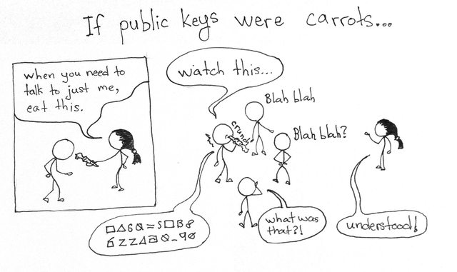
Public-key Encryption with Carrots

Slide 43
Public-key Encryption with Carrots

Slide 44
It is Simpler
Just 1 private key
Bob’s
public key
Bob’s
public key

Slide 45
Crypto Buzzwords
Symmetric key encryption algorithms
  Advanced Encryption Standard (AES)
  RC4 (Ron’s Cipher 4)
Public-key encryption algorithms
  RSA: Rivest-Shamir-Adleman
  Elliptic-curve encryption
Bob does not publish anything directly related to his key
Bob publishes his public key. He has to pay a price: Eve does not have to brute-force anymore

Slide 46
Road Map
The data confidentiality problem
Theory
  Numbers
  Encryption
Beyond encryption
  Digital signature
  Cryptographic hashing
  Digital certificates and PKI
Tie everything together: HTTPS

Slide 47
Signatures? Why?
Eat in a restaurant?
  Sign your credit card payment
Rent a house?
  Sign the contract
Get a car loan?
  Sign the contract
Non-repudiation
Can we implement the concept of signature in the digital world?
Handwritten signatures can be copied: does not work well in the digital world

Slide 48
Public-key Digital Signature
Alice’s
public key
Eve
Alice’s
private key
One key, two parts!
Notes:
Let’s take another look at public key encryption. In the public key cryptography, to send a message to Bob, Alice has to possess Bob’s public key. Thus, before Alice does the encryption, she has to somehow get Bob’s public key. If she mistakenly uses somebody else’s public key, the game is over. Bob’s public key is distributed through a reliable channel, marked in YELLOW.
Different from the symmetric key cryptography, Eve can read the public key distribution channel and this won’t help her decrypt the ciphertext.
Like the symmetric key cryptography, the ciphertext is sent over a public channel. Eve can read the ciphertext. We will discuss the details of public key encryption later.

Slide 49
Public Key Digital Signature
Do-not-modify channel
Alice’s public key
Alice’s public key
Eve
Telephone directory
Alice’s private key
Notes:
Public key is shown in this diagram. Note that the message is encrypted with Bob’s public key and the encrypted message is decrypted with Bob’s private key.
Public key encryption assumes a reliable channel to distributed public keys.

Slide 50

Public Key Digital Signature
Do-not-modify channel
Alice’s public key
Alice’s public key
“This message is self-explaining”
Eve
Dear Bob
Sell 20
shares of
my IBM
stock
010101010…
(DIGITAL SIGNATURE)
public channel
Dear Bob
Sell 20
shares of
my IBM
stock
Y/N?
Sign
Verify
Alice’s private key
“by stamping it, I endorse this message”
Notes:
Public key is shown in this diagram. Note that the message is encrypted with Bob’s public key and the encrypted message is decrypted with Bob’s private key.
Public key encryption assumes a reliable channel to distributed public keys.

Slide 51
Public Key Digital Signature
Do-not-modify channel
Alice’s public key
Alice’s public key
Eve
Dear Bob
Sell 20
shares of
My IBM
stock
010101010…
(DIGITAL SIGNATURE)
public channel
Dear Bob
Sell 20
shares of
my IBM
stock
Y/N?
Sign
Verify
Alice’s private key
Notes:
Public key is shown in this diagram. Note that the message is encrypted with Bob’s public key and the encrypted message is decrypted with Bob’s private key.
Public key encryption assumes a reliable channel to distributed public keys.

Slide 52
Public Key Encryption
Do-not-modify channel
Bob’s
public key
Bob’s
public key
Eve
public channel
Dear Bob
Tell Albert
to get out of
there
$β♥♦♣
ƒϒ%ΩΛ
?}{|•℘
®gt…x
Dear Bob
Tell Albert
to get out of
there
Encrypt
Decrypt
Bob’s
private key
Notes:
Let’s take another look at public key encryption. In the public key cryptography, to send a message to Bob, Alice has to possess Bob’s public key. Thus, before Alice does the encryption, she has to somehow get Bob’s public key. If she mistakenly uses somebody else’s public key, the game is over. Bob’s public key is distributed through a reliable channel, marked in YELLOW.
Different from the symmetric key cryptography, Eve can read the public key distribution channel and this won’t help her decrypt the ciphertext.
Like the symmetric key cryptography, the ciphertext is sent over a public channel. Eve can read the ciphertext. We will discuss the details of public key encryption later.

Slide 53
We Know How to Implement Digital Signature
Do-not-modify channel
Alice’s public key
Alice’s public key
Eve
Dear Bob
Sell 20
shares of
My IBM
stock
010101010…
(DIGITAL SIGNATURE)
public channel
Dear Bob
Sell 20
shares of
my IBM
stock
Y/N?
Sign
Verify
Alice’s private key
RSA digital signature; DSA, ECDSA
Notes:
Public key is shown in this diagram. Note that the message is encrypted with Bob’s public key and the encrypted message is decrypted with Bob’s private key.
Public key encryption assumes a reliable channel to distributed public keys.

Slide 54
Road Map
The data confidentiality problem
Theory
  Numbers
  Encryption
Beyond encryption
  Digital signature
  Cryptographic hashing
  Digital certificates and PKI
Tie everything together: HTTPS

Slide 55

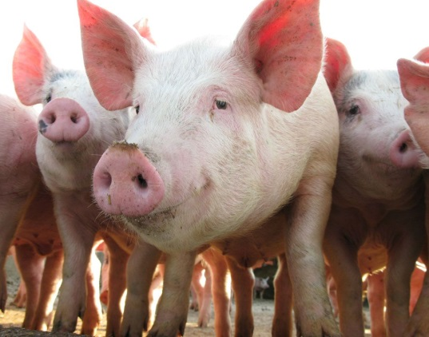
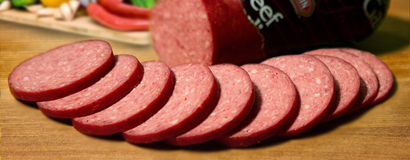
One Way?

Slide 56

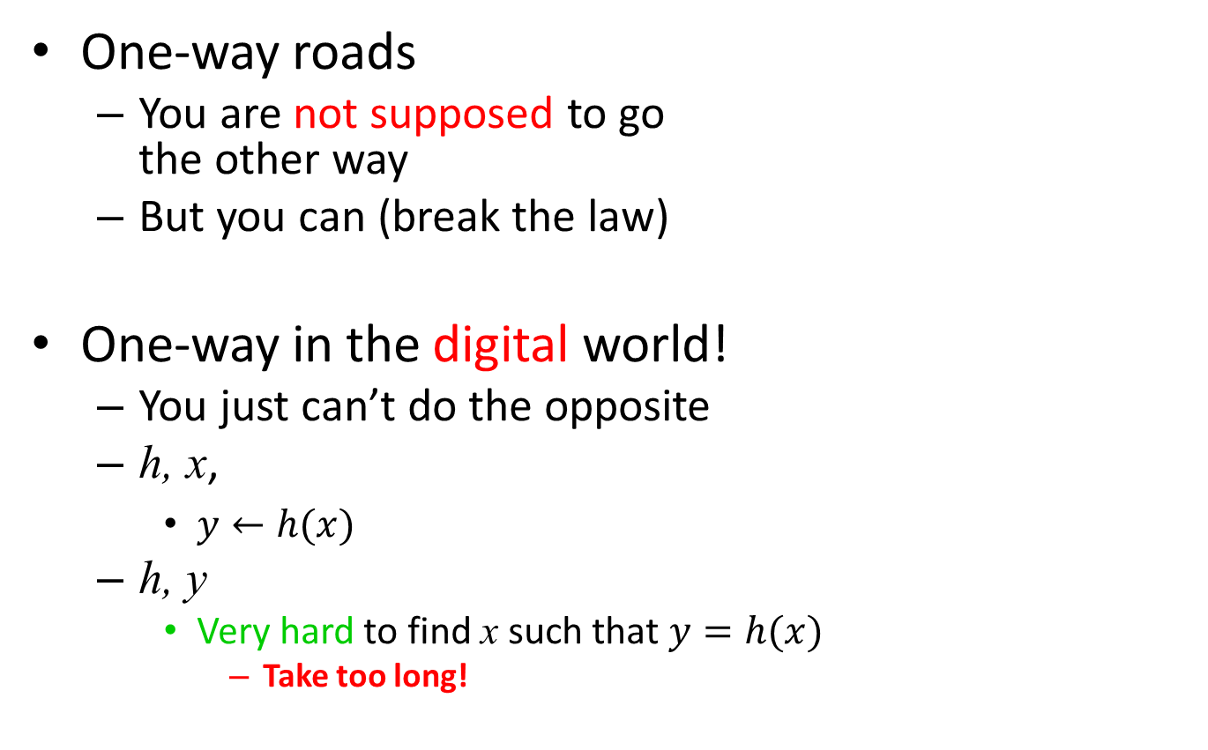
One-way?
One-way roads
  You are not supposed to go
  the other way
  But you can (break the law)
One-way in the digital world!
  You just can’t do the opposite
  h, x,
    $y←h(x)$
  h, y
    Very hard to find x such that $y=h(x)$
      Take too long!

Slide 57
Example
SHA512 is a one-way hash function
2016 JMU Cyber Defense Boot Camp
2015 JMU Cyber Defense Boot Camp
bdf9b90c91d65ae34c481e40ec8eb57575b5030afb01bd8f544b240d69f5f56b801be1e88f75dc2acd12924e3622bb505f4f845f7ac262f85cf6584a01c866e3
Most functions are not one-way
Notes:
sha512sum cyber13-01.txt

Slide 58
Collision Resistance
A second property
2016 JMU Cyber Defense Boot Camp
bdf9b90c91d65ae34c481e40ec8eb57575b5030afb01bd8f544b240d69f5f56b801be1e88f75dc2acd12924e3622bb505f4f845f7ac262f85cf6584a01c866e3
2016 JMU Cyber Defense Boot camp
251cd5f94c0d5a8f768a7aa737488d39d918ac6d04d74bde86dedf10234c883d6e0361c98a6ec7c942bcdcaae4dfdedf2b242530c4859991b0452adeb702fb79
Collision resistance
Notes:
sha512sum cyber15-01.txt

Slide 59
Cryptographic Hash Function
If h is both one-way and collision resistant, h is called a cryptography hash function
A very useful building block for data security

Slide 60
Road Map
The data confidentiality problem
Theory
  Numbers
  Encryption
Beyond encryption
  Digital signature
  Cryptographic hashing
  Digital certificates and PKI
Tie everything together: HTTPS

Slide 61
Public Key Encryption
Read-only paper telephone directory does not work well in the digital world!
Do-not-modify channel
Bob’s
public key
Bob’s
public key
Eve
public channel
Dear Bob
Tell Albert
to get out of
there
$β♥♦♣
ƒϒ%ΩΛ
?}{|•℘
®gt…x
Dear Bob
Tell Albert
to get out of
there
Encrypt
Decrypt
Bob’s
private key
Notes:
Let’s take another look at public key encryption. In the public key cryptography, to send a message to Bob, Alice has to possess Bob’s public key. Thus, before Alice does the encryption, she has to somehow get Bob’s public key. If she mistakenly uses somebody else’s public key, the game is over. Bob’s public key is distributed through a reliable channel, marked in YELLOW.
Different from the symmetric key cryptography, Eve can read the public key distribution channel and this won’t help her decrypt the ciphertext.
Like the symmetric key cryptography, the ciphertext is sent over a public channel. Eve can read the ciphertext. We will discuss the details of public key encryption later.

Slide 62
Public Key Signature
Read-only paper telephone directory does not work well in the digital world!
Do-not-modify channel
Alice’s public key
Alice’s public key
Eve
Dear Bob
Sell 20
shares of
My IBM
stock
DIGITAL
SIGNATURE
public channel
Dear Bob
Sell 20
shares of
my IBM
stock
Y/N?
Sign
Verify
Alice’s private key
Notes:
Public key is shown in this diagram. Note that the message is encrypted with Bob’s public key and the encrypted message is decrypted with Bob’s private key.
Public key encryption assumes a reliable channel to distributed public keys.

Slide 63
It is still not simple enough
“How can I get everybody’s public key?”

Slide 64


It is still not simple enough
“How can I get Cindy’s public key?”

Slide 65

Digital Certificate (1/6)
Notary public
Certification Authority (CA)
Cindy
 “Here is my
public key”

Slide 66
Digital Certificate (2/6)
Certification Authority (CA)
Cindy
 “Here is my
public key”
 “Here is your
digital certificate”
“by stamping it, I endorse this message”
“This public key really belongs to Alice”
What is inside?

Slide 67
Digital Certificate (3/6)
Dear Bob
Sell 20
shares of my
IBM stock
DIGITAL
SIGNATURE
Dear Bob
Sell 20
shares of
My IBM
stock
Sign
Cindy’s private key
Questions:
  How to verify the authenticity of the signed message?
  What do you need to verify?

Slide 68
Digital Certificate (4/6)
Dear Bob
Sell 20
shares of my
IBM stock
DIGITAL
SIGNATURE
Dear Bob
Sell 20
shares of
My IBM
stock
Sign
Cindy’s private key
You need the signer’s public key!
What if you mistook a bad guy’s public key as the signer’s public key?

Slide 69
Digital Certificate (5/6)
Why not digitally sign a public key before it is distributed?
How to verify the authenticity of the digitally signed public key?
Alice
“Alice” +
expiration date +
Sign
DIGITAL
SIGNATURE
Alice’s public key
CA’s private key

Slide 70
Inside a Digital Certificate
Alice
Expiration date
0110010… (DIGITAL
SIGNATURE)

Slide 71
Stealing a digital certificate?
Stealing a private key

Slide 72
Public Key Encryption
 Bob’s
digital certificate
DIGITAL
SIGNATURE
Verify
Bob’s
public key
DIGITAL
SIGNATURE
Eve
public channel
Dear Bob
Tell Albert
to get out of
there
$β♥♦♣
ƒϒ%ΩΛ
?}{|•℘
®gt…x
Dear Bob
Tell Albert
to get out of
there
Encrypt
Decrypt
Bob’s
private key
Notes:
Let’s take another look at public key encryption. In the public key cryptography, to send a message to Bob, Alice has to possess Bob’s public key. Thus, before Alice does the encryption, she has to somehow get Bob’s public key. If she mistakenly uses somebody else’s public key, the game is over. Bob’s public key is distributed through a reliable channel, marked in YELLOW.
Different from the symmetric key cryptography, Eve can read the public key distribution channel and this won’t help her decrypt the ciphertext.
Like the symmetric key cryptography, the ciphertext is sent over a public channel. Eve can read the ciphertext. We will discuss the details of public key encryption later.

Slide 73
Public Key Signature
 Alice’s digital certificate
DIGITAL
SIGNATURE
 Verify
DIGITAL
SIGNATURE
Eve
Alice’s public key
Dear Bob
Sell 20
Shares of my
IBM stock
DIGITAL
SIGNATURE
public channel
Dear Bob
Sell 20
shares of
my IBM
stock
Y/N?
Sign
Verify
Alice’s private key
Notes:
Public key is shown in this diagram. Note that the message is encrypted with Bob’s public key and the encrypted message is decrypted with Bob’s private key.
Public key encryption assumes a reliable channel to distributed public keys.

Slide 74
Everybody likes a quiz!
Quiz
The most common way to protect the confidentiality of information is by using (a)n
  Digital certificate
  Cryptographic hash function
  Digital signature
  Encryption algorithm
  None of the above

Slide 75
Everybody likes a quiz!
Quiz
For a public-key cryptosystem
  All users’ keys are known to a trusted certification authority (CA)
  Each user must have two keys
  A user’s public key must be known only to the user
  An adversary must brute-force to break a public-key encryption
  None of the above

Slide 76
Road Map
The data confidentiality problem
Theory
  Numbers
  Encryption
Beyond encryption
  Digital signature
  Cryptographic hashing
  Digital certificates and PKI
Tie everything together: HTTPS

Slide 77
Summary
The data confidentiality problem
Theory
  Numbers
  Encryption
Beyond encryption
  Digital signature
  Cryptographic hashing
  Digital certificates and PKI
Tie everything together: HTTPS

