Slide 1
JMU GenCyber Boot Camp
Summer, 2016

Slide 2
Welcome
GenCyber Boot Camp for High School Teachers
Department of Computer Science
James Madison University
Summer, 2016

Slide 3
Introductions
Hossain Heydari
Matt Jackson
Nick McDonnell
Dillon Paradis
Brett Tjaden
Xunhua (Steve) Wang

Slide 4
Goals
Have fun!
Teach you about Cyber Defense so that you can:
  Interest your students in Cyber Defense
  Teach your students about Cyber Defense
    Cyber Defense Clubs
    CyberPatriot Program (http://www.uscyberpatriot.org/)

Slide 5
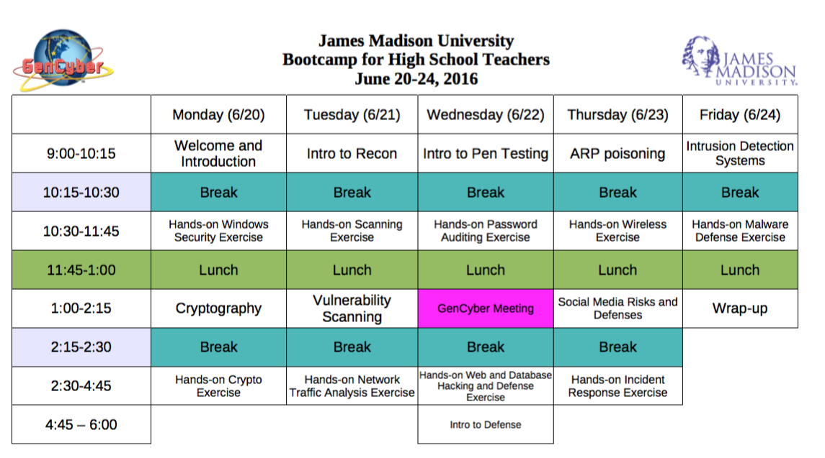
Schedule

Slide 6
General Information
No food or drinks near the laptops
Restrooms
If you have a car on campus see us for a parking permit
Fill out a W-9 form if you want your money

Slide 7
Questions
Always welcome!

Slide 8
Cyber Defense
Prepare
Protect
Detect
Triage
Respond

Slide 9
Threats
A threat is a potential violation of system security
Examples?

Slide 10
Attackers
Perform actions to try to cause security violations
  Outsiders:
    Competitors
    Hackers
    Organized crime
    Terrorists
    Foreign government, military, or law enforcement
  Insiders:
    Customers, suppliers, vendors, or business partners
    Disgruntled current (or former) employees
    Contractors, temps, or consultants

Slide 11
Why You Should Not Be an Attacker
It is illegal:
  United States Code, Title 18, Section 1030 (and others)
  USA Patriot Act, Homeland Security Act, PROTECT Act
  http://www.cybercrime.gov
Unauthorized access or use of a computer or network system is illegal
Unintentional attacks are illegal too

Slide 12
Understanding the Tools and Techniques of Attackers
Important for defenders:
  Can evaluate systems you defend as attackers will
  Can implement countermeasures designed to thwart attackers
  Better understand the implications of certain decisions

Slide 13
What do Cyber Defenders Protect?
Prepare
Protect
Detect
Triage
Respond

Slide 14
The Security Triad
Confidentiality – information is protected from unauthorized access
  Example?
Integrity – information is protected from unauthorized modification
  Example?
Availability – timely access to information (by authorized people) is ensured
  Example?

Slide 15
How do we Protect?
Prevention – mechanism(s) that cause attacks to fail
  Example?
Detection – mechanism(s) that determines that an attack is under way, or has occurred, and reports it
  Example?
Recovery – mechanism(s) that stop attacks and assess and repair any damage caused
  Example?

Slide 16
GenCyber Cybersecurity First Principles
Domain Separation
Process Isolation
Resource Encapsulation
Modularity
Least Privilege
Abstraction
Data Hiding
Layering
Conceptually Simple

Slide 17
Getting Started with Cyber Defense
What to do first?
  Get to know you systems
    You cannot effectively defend what you don't understand
    Attackers make it their job to understand systems better than the defenders and leverage their advantage in knowledge
    “If you know the enemy and know yourself, you need not fear the result of a hundred battles. If you know yourself but not the enemy, for every victory gained you will also suffer a defeat. If you know neither the enemy nor yourself, you will succumb in every battle” - Sun Tzu

Slide 18
Getting Started with Cyber Defense
What to do first?
  Get to know you systems
    You cannot effectively defend what you don't understand
    Attackers make it their job to understand systems better than the defenders and leverage their advantage in knowledge
    “If you know the enemy and know yourself, you need not fear the result of a hundred battles. If you know yourself but not the enemy, for every victory gained you will also suffer a defeat. If you know neither the enemy nor yourself, you will succumb in every battle” - Sun Tzu
    “You Don't Know Me” - Elvis

Slide 19
After You Know Your Systems
Think about threats and attackers
Think about what needs to be protected (security triad)
Think about your goals (prevention, detection, recovery)

Slide 20
After You Have Thought About Your Systems
Start to plan, implement, and test improvements to your systems' security posture
Respond to actions by attackers
Prepare
Protect
Detect
Triage
Respond

Slide 21
Hands-On Exercises
You will not just be listening, you will be doing
Virtual machines (VMs) – a simulated computer running on another computer
VMs are great for hands-on Cyber Defense exercises
You can create and use VMs with your students using free software:
  VirtualBox (https://www.virtualbox.org/)
  VMWare Player (http://www.vmware.com/products/player/)

Slide 22
Accessing your VM for this Boot Camp
Turn on laptop
Click on “CyberDefender” account to log in
Double click on Firefox icon to open web browser
If you are not already on it, go to the following page:
  https://vc.cyberdef.cs.jmu.edu:9443/vsphere-client/

Slide 23
Accessing your VM for this Boot Camp (cont)
Log in with the credentials you were given
Click on “Host and Clusters”
Expand the items on the left side until you see your “student” VM
Click on your student VM to highlight it
Power on the VM
In the center window click on the “Summary” tab
Click on “Launch Console”

