Slide 1
The Cyber Security Canon Project
Cyber Talks
Rick Howard - CSO

Slide 2
How technical are you?
Notes:
I want to get a sense about how technical the audience is. I am going to be talking about some fairly complex ideas here and I want to see if you are qualified to hear them.

Slide 3
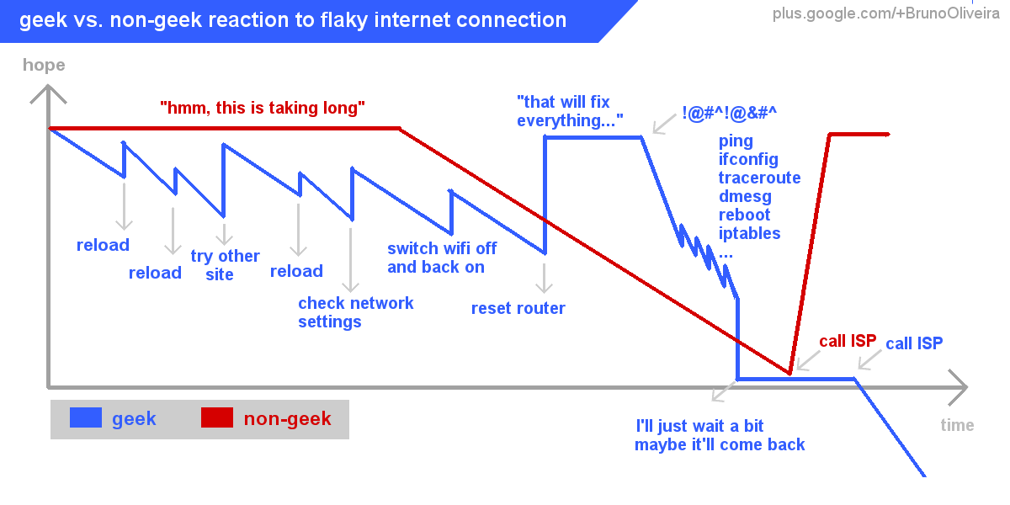
How technical are you?

Slide 4
How technical are you?
Bruno Oliveira
Notes:
I got this chart from Bruno Oliveria on Google Plus and I thought it was a good litmus test to distinguish between the technical people and the non-technical people.

Slide 5
How technical are you?
Notes:
What we are trying to determine is how do you react to a bad internet connection

Slide 6
How technical are you?
Y-Axis: Hope
Notes:
On the Y-Axis we are measuring hope

Slide 7
How technical are you?
X-Axis: Time
Notes:
On the X-Axis we are measuring time, so over time, how high is your optimism that you will fix the problem

Slide 8

How technical are you?
Non-Geeks – The Beautiful People
Notes:
The red line show the hope of the traditional non-geek

Slide 9

How technical are you?
Non-Geeks – The Beautiful People
Notes:
Non-geeks do fairly well

Slide 10
How technical are you?
Non-Geeks – The Beautiful People
Notes:
but even they start to lose hope over time

Slide 11
How technical are you?
Non-Geeks – The Beautiful People
Notes:
But, When they call their local ISP to get help

Slide 12
How technical are you?
Non-Geeks – The Beautiful People
Notes:
they replenish their well of hope that the problem will get solved.

Slide 13

How technical are you?
Geeks – My Peeps
Notes:
Contrast that to the geek on the blue line

Slide 14

How technical are you?
Geeks – My Peeps
Notes:
As soon as they see a problem, they go into Fix-it mode

Slide 15
How technical are you?
Geeks – My Peeps
Notes:
As soon as they see a problem, they go into Fix-it mode

Slide 16
How technical are you?
Geeks – My Peeps
Notes:
As soon as they see a problem, they go into Fix-it mode

Slide 17
How technical are you?
Geeks – My Peeps
Notes:
As soon as they see a problem, they go into Fix-it mode

Slide 18
How technical are you?
Geeks – My Peeps
Notes:
As soon as they see a problem, they go into Fix-it mode

Slide 19
How technical are you?
Geeks – My Peeps
Notes:
As soon as they see a problem, they go into Fix-it mode

Slide 20
How technical are you?
Geeks – My Peeps
Notes:
As soon as they see a problem, they go into Fix-it mode

Slide 21
How technical are you?
Geeks – My Peeps
Notes:
When they have exhausted the simple troubleshooting options, they go into ultra-geek mode

Slide 22
How technical are you?
Geeks – My Peeps
Notes:
When they have exhausted the simple troubleshooting options, they go into ultra-geek mode

Slide 23
How technical are you?
Geeks – My Peeps
Notes:
And as each attempt fails to resolve the issue, their hope dwindles

Slide 24
How technical are you?
Geeks – My Peeps
Notes:
And as each attempt fails to resolve the issue, their hope dwindles

Slide 25
How technical are you?
Geeks – My Peeps
Notes:
Finally, they have only one option left, call their local ISP

Slide 26
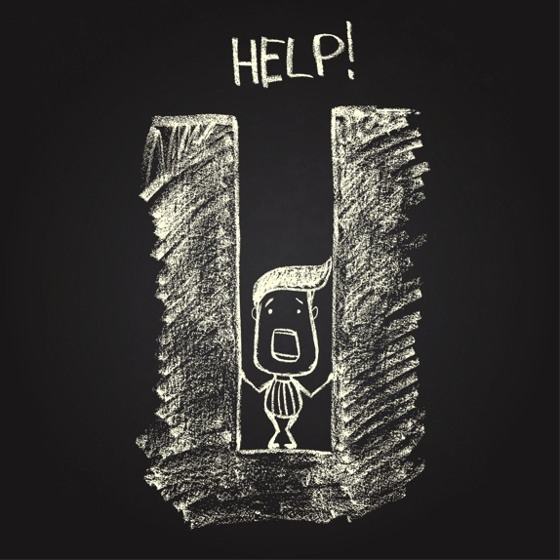
How technical are you?
Geeks – My Peeps
Notes:
And they fall into the pit of despair.

Slide 27

How technical are you?
Notes:
So – with a show of hands, how many non-geeks in the crowd?

Slide 28
How technical are you?
Notes:
So – with a show of hands, how many non-geeks in the crowd?

Slide 29



How technical are you?
Fear Uncertainty and Doubt Committee
State of California
Notes:
Well alright then – by the power vested in me by the Fear Uncertainty and Doubt Committee of the State of CA,

Slide 30
How technical are you?
✔ Worthy
Fear Uncertainty and Doubt Committee
State of California
Notes:
I dub you qualified to hear this presentation.

Slide 31

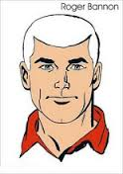

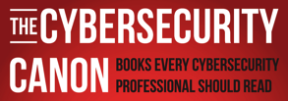

Who am I?
Rick Howard: CSO Palo Alto Networks
Email: rhoward@paloaltonetworks.com
Twitter: @raceBannon99
https://paloaltonetworks.com/threat-research.html
https://paloaltonetworks.com/threat-research/cybercanon.html
http://cyberthreatalliance.org/

Slide 32
Who am I?
Rick Howard: CSO Palo Alto Networks
Email: rhoward@paloaltonetworks.com
Twitter: @raceBannon99
https://paloaltonetworks.com/threat-research.html
https://paloaltonetworks.com/threat-research/cybercanon.html
http://cyberthreatalliance.org/

Slide 33
The Cybersecurity Canon Project
Books You Should Have Read by Now

Slide 34
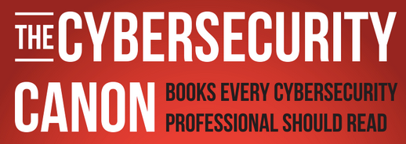

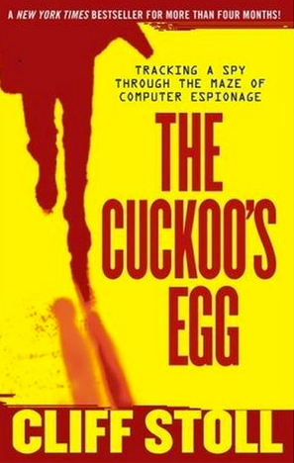
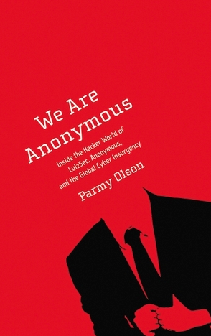
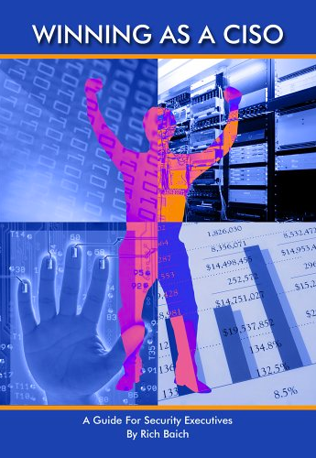
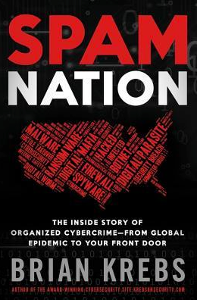
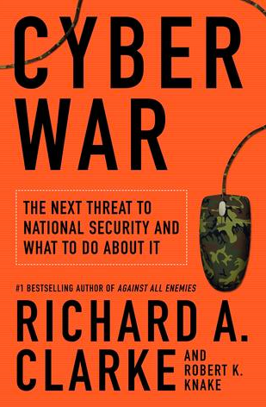
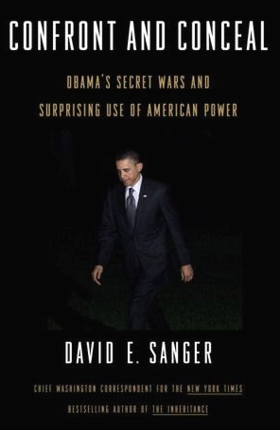
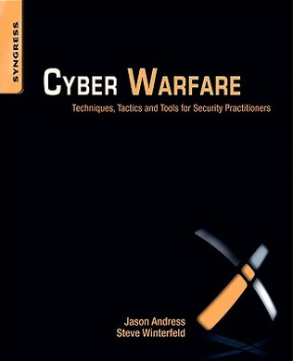
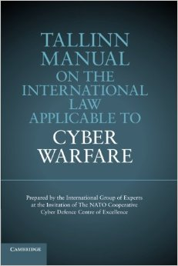
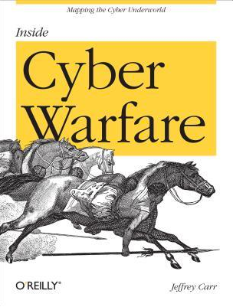
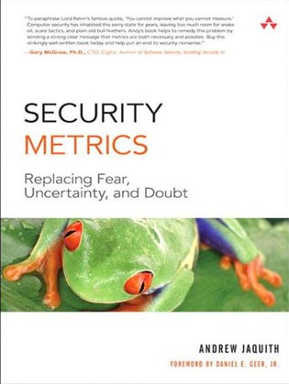
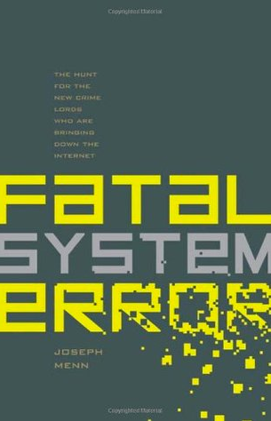
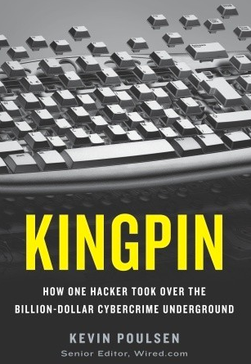
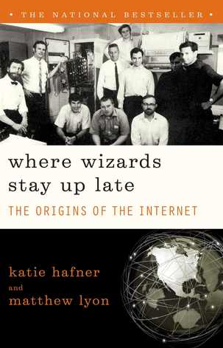
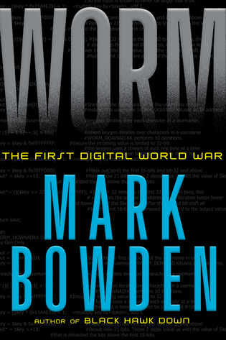
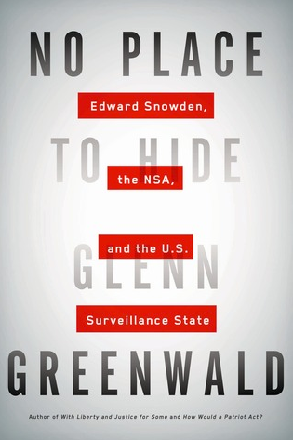
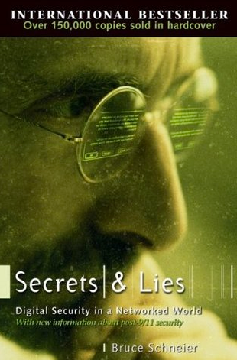
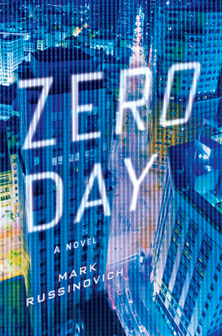
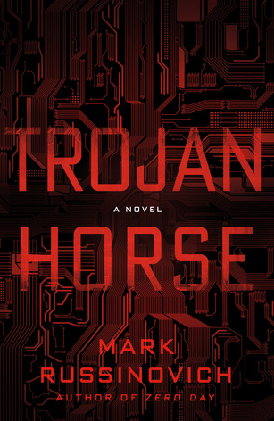
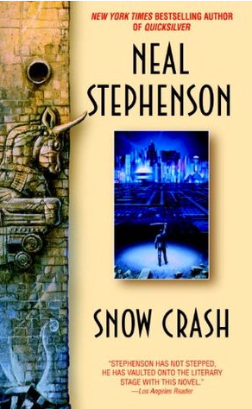
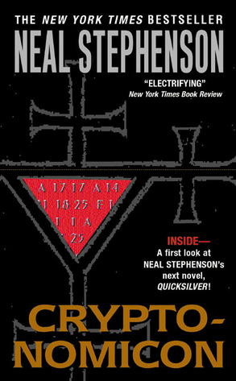

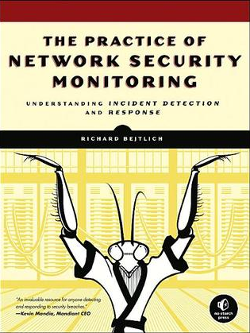
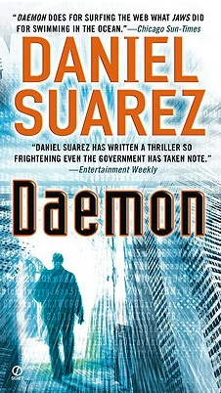
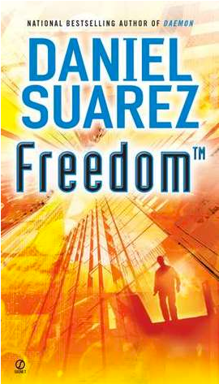
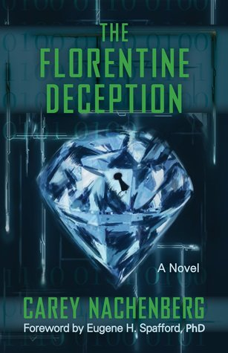
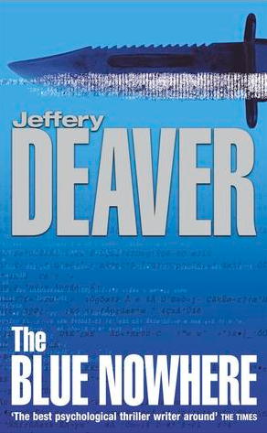
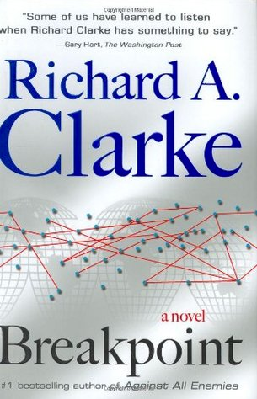
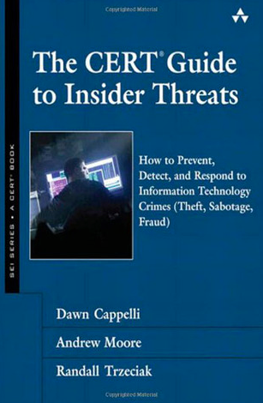
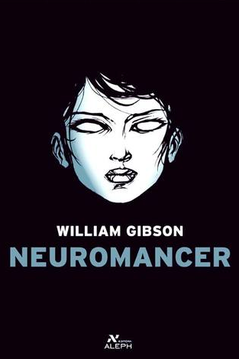


Slide 35
Canon

Slide 36
Canon Candidates

Slide 37
Cyber Warfare

Slide 38
Technical

Slide 39
Cyber Crime

Slide 40
History & Culture

Slide 41
Cyber Espionage

Slide 42
Novels

Slide 43
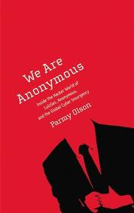
Culture and Hactivism
Notes:
The first one is We Are Anonymous by Parmy Olson

Slide 44

Culture and Hactivism
2010 - 2011
Notes:
The Anonymous Franchise really hit its stride between the years of 2010 and 2011. Hacktivism began earlier than that of course (1994 was the first documented case that I could find [12]), but it did not strike fear into the hearts of CEOs, CSOs and government officials until that two year run.

Slide 45

Culture and Hactivism
Technology
2010 - 2011
Notes:
It was the perfect storm of technology,

Slide 46
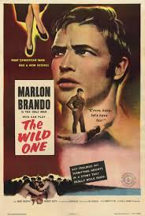
Culture and Hactivism
Technology
Disenfranchisement
2010 - 2011
Notes:
disenfranchised youngish people

Slide 47
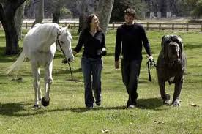
Culture and Hactivism
Technology
Disenfranchisement
2010 - 2011
Pranks
Notes:
“Internet Pranks as an Art Form,”

Slide 48

Culture and Hactivism
Technology
Disenfranchisement
2010 - 2011
Pranks
Empowerment
Notes:
empowerment

Slide 49

Culture and Hactivism
Technology
Disenfranchisement
2010 - 2011
Pranks
Empowerment
Hacking Culture
Notes:
and the hacking culture

Slide 50

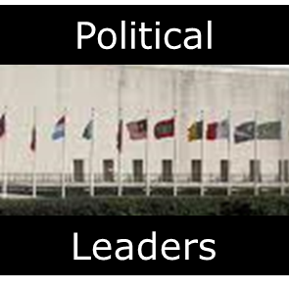
Culture and Hactivism
Technology
Disenfranchisement
2010 - 2011
Pranks
Empowerment
Hacking Culture
Notes:
that came together into a gigantic hairball of activity and energy that caused governments from around the world to double-clutch on some of their more severe policies and caused business leaders to actually fear the impact to their bottom line.

Slide 51
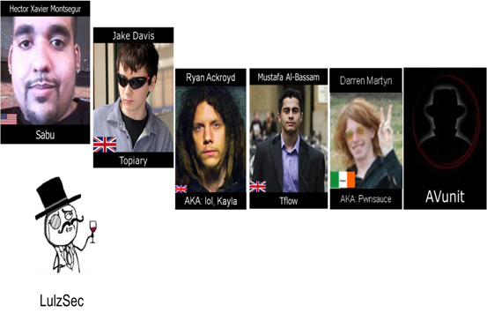
Culture and Hactivism
Notes:
Trying to understand that phenomena is quite the task and Parmy Olson, in this book is an apt guide. Through unprecedented access to some of the core players on many of the more infamous operations,

Slide 52
Culture and Hactivism
Essence
Notes:
Olson is able to capture the essence of how the hacktivist movement got started in earnest,

Slide 53
Culture and Hactivism
Essence
Drama
Notes:
to describe the inevitable drama between competing factions

Slide 54
Culture and Hactivism
Essence
Drama
Franchise Operations
Notes:
to provide insight into how this franchise operates.

Slide 55

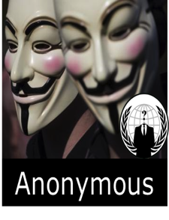

Culture and Hactivism
Feb 2011
Notes:
Arguably, the event that elevated the Anonymous movement to a force to be reckoned with in government and commercial circles was the HBGary attacks of February 2011. That hacktivist attack forced a corporation (HBGary Federal) to go out of business

Slide 56
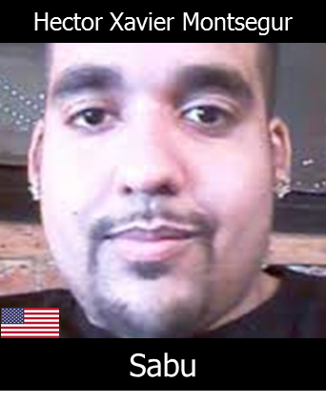
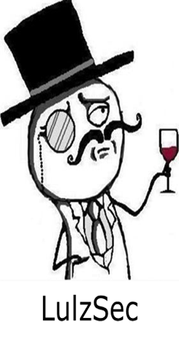
Culture and Hactivism
Apr 2011
Notes:
the core set of the HBGary hackers, led by this guy – Sabu, broke away from the Anonymous Franchise in April of 2011 to form LulzSec.

Slide 57
Culture and Hactivism
Apr 2011
50 Days
25+ Companies Ravaged
Notes:
For the next 50 days, LulzSec went on a hacking rampage and compromised over 25 companies: DDOS Attacks , Server Compromise and Doxing; the practice of stealing a companies private documents and posting them on the web for anybody to see.

Slide 58
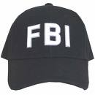
Culture and Hactivism
Notes:
At the end of that run, the FBI came a calling and gave Sabu a choice: go to jail forever or become a snitch for them.

Slide 59

Culture and Hactivism
Notes:
Sabu announces that he disbanding Lulzsec and reforming it under the banner of more political hactivism group called AntiSec. But, unbeknownst to his hactivist members , the FBI would be watching.

Slide 60
Culture and Hactivism
50 Days
15+ Companies Ransacked
Notes:
They go on another 50 day run.

Slide 61
Culture and Hactivism
Over 100 other Anonymous “Members” Arrested
Notes:
At the end, the FBI arrests five out of their six original members of LulzSec. One got away cleanly. To this day, nobody knows who or where AVUnit is.

Slide 62

Culture and Hactivism
Over 100 other Anonymous “Members” Arrested
Notes:
At the end, the FBI arrests five out of their six original members of LulzSec. One got away cleanly. To this day, nobody knows who or where AVUnit is.

Slide 63
Culture and Hactivism
Over 100 other Anonymous “Members” Arrested
Notes:
At the end, the FBI arrests five out of their six original members of LulzSec. One got away cleanly. To this day, nobody knows who or where AVUnit is.

Slide 64
Culture and Hactivism
You Should Have Read this by Now
Notes:
Ms. Olson gets the details right. If you want to understand the Anonymous movement, this is the book to read. You should have read this by now.

Slide 65
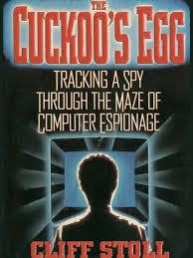
Cyber Espionage
Notes:
The next book is called The Cuckoo’s Egg by Cliff Stoll

Slide 66
Cyber Espionage
1989
Notes:
The Cuckoo’s Egg is my first love. Clifford Stoll published it in 1989, and the first time I read it, I devoured it over a weekend when I should have been writing my grad school thesis. It was my introduction to the security community and the idea that somebody had to protect these new-fangled gadgets called computers. Back in those days, authors put their email addresses in their books, and when I finished reading it, I sent Mr. Stoll a note explaining how much I enjoyed his book. He answered immediately and forever made me a fan.

Slide 67
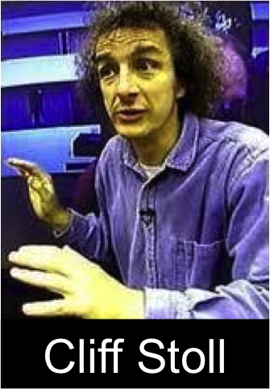

Cyber Espionage
1989
Notes:
Prior to 1989, Stoll was an astronomer at the Lawrence Berkley National Laboratory. He was the stereotypical absented minded hippie professor, but he as about to get layed off due to budget cuts, But everybody liked him. Instead of firing him, they gave him a job running the Unix machines in the IT department. His first task was to figure out a 45 cent accounting error in the student chage-back system.
As he troubleshoooted the problem, he slowly discovered that his computers had been infiltrated by a mercinary hacker group out of Germany, backed by the Russian government, who used the Berkley computers to break into all kinds of government computing systems from the military, the intelligence community and basic researchers.
The book is about how this leftie hippie professor tries to convince and ultimately work with all of these bastions of power from the extreme right.

Slide 68
Cyber Espionage
Information Sharing
1989
Notes:
Even 20+ years after it was published, the book still has something of value to say on persistent cyber security problems that we face today like information sharing,

Slide 69
Cyber Espionage
Information Sharing
1989
Privacy vs Security (R)
Liberty vs Control (D)
Notes:
privacy versus security (if you are a rightie), or liberty versus control (if you are a leftie),

Slide 70
Cyber Espionage
Information Sharing
1989
Privacy vs Security (R)
Liberty vs Control (D)
Cyber Espionage
Notes:
cyber espionage,

Slide 71
Cyber Espionage
Information Sharing
1989
Privacy vs Security (R)
Liberty vs Control (D)
Cyber Espionage
Intelligence Dilemma
Notes:
intelligence dilemma.

Slide 72
Cyber Espionage
You Should Have Read this by Now!
Notes:
If you are interested in the history of Cyber Espionage and the evolution of our culture as it responds to it, Cukoos’s egg is a great book and you should have read it by now.

Slide 73
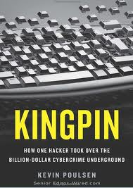
Culture and Cyber Crime
Notes:
The next book is called Kingpin by Kevin Poulsen.

Slide 74
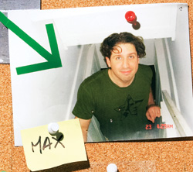
Culture and Cyber Crime
Max
Butler
Notes:
Kingpin tells the story of the rise and fall of a hacker legend: Max Butler.

Slide 75

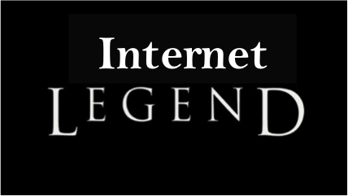
Culture and Cyber Crime
Max
Butler
Notes:
Butler is most famous for his legendary, hostile hacking takeover in August 2006

Slide 76

Culture and Cyber Crime
Max
Dark Market
TalkCash
ScandinavianCarding
Butler
TheVouched
Notes:
Of the four prominent criminal underground credit card forums of the time

Slide 77

Culture and Cyber Crime
Max
Dark Market
TalkCash
ScandinavianCarding
Butler
TheVouched
Notes:
In a 48 hour marathon session of hacking, Max compromised the servers running these four forums, stole the membership data for each, stole the credit card information stored there, installed them on his own forum called CardersMarket.com, and left a web defacement on each saying that he was now the Kingpin and everyone will use his site. Which they did.

Slide 78
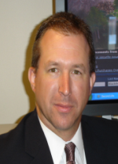


Culture and Cyber Crime
Max
Dark Market
Butler
Keith Mularski:
FBI Senior Cyber Crime Agent
AKA Master Splyntr
Notes:
It just so happens that Dark Market, one of the forums that Butler compromised, was also infiltrated by the FBI. Agent Keith Mularski, under his hacker name od Master Splinter, had worked his way up the food chain to become one of the administrators of the site and he kept meticulous backups. Darkmarket was the only one of the four that was able to reboot itself after the hostile takeover. Mularski was ultimately able to figure out who Butler was and get him arrested.

Slide 79


Culture and Cyber Crime
Max
Butler
Notes:
Butler’s transition from pure white-hat hacker into something gray—sometimes a white hat, sometimes a black hat—is a treatise on the cyber criminal world. The author of Kingpin, Kevin Poulsen, imbues the story with lush descriptions of how Butler hacked his way around the Internet and pulls the curtain back on how the cyber criminal world functions; how stealing credit card information is actually the easy part; trasnforming those cards into cash is a job.

Slide 80
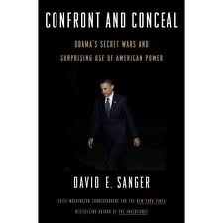
History and Cyber Warfare
Notes:
The next book is Confront and Conceal by David Sanger.

Slide 81
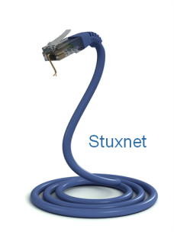
History and Cyber Warfare
Notes:
This book is really about the Stuxnet attacks; not the technical details about how the malcode worked but on the policy decisions that has changed the cyber security environment forever.

Slide 82



History and Cyber Warfare
Notes:
It is about how the US and Israel jointly put together a cyber attack plan under the codename: Olympic Games.

Slide 83


History and Cyber Warfare
Natanz Nuclear site
Notes:
For the purpose of delaying and degrading the production of enriched Uranium at an underground bunker in the middle of nowhere called Natanz.

Slide 84

History and Cyber Warfare
Natanz Nuclear site
Notes:
You See, the west believes that Iran is trying to build a nuclear bomb.

Slide 85

History and Cyber Warfare
Natanz Nuclear site
Notes:
Iran says it is developing its Nuclear program to provide power to its citizens.
You need Enriched Uranium to do both.

Slide 86


History and Cyber Warfare
Natanz Nuclear site
Notes:
President Bush was looking for a middle ground option. He was already at war with two other Middle Eastern Nations: Iraq and Afghanistan. He didn’t want to roll the tanks into a third. And yet, the current political course of sanctions and negotiations wasn’t working. He needed another option.

Slide 87

History and Cyber Warfare
Natanz Nuclear site
Notes:
His decision to launch a series of cyber attack designed to degarde and destroy the critical infrastructure of another country is unprecedented and created a very important historical cyber security milestone that we all will be looking back to as the beginning of it all.

Slide 88

History and Cyber Warfare
Notes:
It is the first occurrence ever of a nation state using a cyber vector along to destroy critical infrastructure. Pundits have been saying for years that it is possible to have a pure cyber war; where countries would only use cyber weapons to to cause damage and death on their enemies. We would roll out examples like Estonia and Georgia to prove our point. But Operation Olympic Games is the first documented case and the attempt.

Slide 89

History and Cyber Warfare
“We Have Crossed the Rubicon …”
Notes:
Regardless of how successful Olympic Games ultimately was in slowing down the Iranian nuclear program, using cyber tools to inflict physical damage against your adversaries is now a viable option. Operation Olympic Games represents the world crossing the line between theory and practice, and this book is your guide to understanding that decision. Sanger Quotes General Hayden, the former NSA Director, at the end of the book. He says that we have crossed the Rubicon and cannot go back.

Slide 90
Novel
Notes:
The last book that I a going to talk about today is Cryptonomicon by Neil Stephenson.

Slide 91

Novel
Notes:
The last book that I a going to talk about today is Cryptonomicon by Neil Stephenson.

Slide 92
Novel
Quintessential
Notes:
Cryptonomicon is the quintessential hacker novel.

Slide 93



Novel
Quintessential
Notes:
The author, Neal Stephenson, describes a story that is set around the intersection between the discovery of world-changing math insights and the incipient designs of our computer science founding fathers. Stephenson delights in explaining how all of these things go together.

Slide 94




Novel
Quintessential
Notes:
His collection of fictional and nonfictional characters like Ghering, Lt Ronald Reagan, Alan Turing and General McArthur, orbit each other across a thousand pages

Slide 95


Novel
Quintessential
Notes:
and propels the reader through dual timelines of World War II and the dot-com startup decade of the 1990s.

Slide 96


Novel
Quintessential
Notes:
The result is a multigenerational treasure hunt worthy of an Indiana Jones adventure,

Slide 97

Novel
Quintessential
Notes:
but unlike Indiana Jones, this is not a light read. It is dense with ideas. You do not skim through this looking for the good parts, but if you take the time to savor the journey, you will not be disappointed.

Slide 98
Novel
Cyber Security History
Quintessential
Notes:
You will be fed cyber security history,

Slide 99
Novel
Cyber Security History
Tragedy
Quintessential
Notes:
heartbreaking tragedy,

Slide 100
Novel
Cyber Security History
Tragedy
Adventure
Quintessential
Notes:
rollicking adventure,

Slide 101
Novel
Cyber Security History
Tragedy
Adventure
Geek Love Stories
Quintessential
Notes:
the pleasures and perils of a multigenerational family, and the awkwardness of several geek love stories all told from the hacker perspective.

Slide 102
Novel
You Should Have Read this by Now!
Notes:
There is something for everyone here, and you owe yourself the pleasure of finding your favorite part. In other words, it is part of the canon. You should have read this by now.

Slide 104
Questions?
Rick Howard: CSO Palo Alto Networks
Email: rhoward@paloaltonetworks.com
Twitter: @raceBannon99
https://paloaltonetworks.com/threat-research.html
https://paloaltonetworks.com/threat-research/cybercanon.html
http://cyberthreatalliance.org/

Slide 105
Questions?
Rick Howard: CSO Palo Alto Networks
Email: rhoward@paloaltonetworks.com
Twitter: @raceBannon99
https://paloaltonetworks.com/threat-research.html
https://paloaltonetworks.com/threat-research/cybercanon.html
http://cyberthreatalliance.org/

Slide 106
Apply What You Have Learned Today

Slide 107
Apply What You Have Learned Today
Next week you should:

Slide 108
Apply What You Have Learned Today
Next week you should:
  Go to the Canon Website and read the reviews

Slide 109
Apply What You Have Learned Today
Next week you should:
  Go to the Canon Website and read the reviews
In the first three months following this presentation you should:

Slide 110
Apply What You Have Learned Today
Next week you should:
  Go to the Canon Website and read the reviews
In the first three months following this presentation you should:
  Consider which books might be appropriate for study by your students

Slide 111
Apply What You Have Learned Today
Next week you should:
  Go to the Canon Website and read the reviews
In the first three months following this presentation you should:
  Consider which books might be appropriate for study by your students
Within six months you should:

Slide 112
Apply What You Have Learned Today
Next week you should:
  Go to the Canon Website and read the reviews
In the first three months following this presentation you should:
  Consider which books might be appropriate for study by your students
Within six months you should:
  Consider having your students submit book reviews to the Canon web site.

Slide 113
Apply What You Have Learned Today
Next week you should:
  Go to the Canon Website and read the reviews
In the first three months following this presentation you should:
  Consider which books might be appropriate for study by your students
Within six months you should:
  Consider having your students submit book reviews to the Canon web site.

Slide 114
Questions?
Rick Howard: CSO Palo Alto Networks
Email: rhoward@paloaltonetworks.com
Twitter: @raceBannon99
https://paloaltonetworks.com/threat-research.html
https://paloaltonetworks.com/threat-research/cybercanon.html
http://cyberthreatalliance.org/

Slide 115











Cybersecurity Canon Comittee
Christina Ayiotis
Jon Oltsik
Dan Ragsdale
Bob Clark
Co-Chair
Sr. Principal Analyst
Cyber Center of Excellence
ESG
Texas A&M
Georgetown Cybersecurity Law
Cyber Law Professor
US Military Academy
Neena Lakhani
Brian Kelly
Rie Hutchinson
Hannah Kuchler
Marketing Manager
CISO
Data Integration
Quinnipiac University
CISO
Journalist
Comm Solutions
Financial Times
Notes:
The first one is We Are Anonymous by Parmy Olson

