Slide 1
Cryptography: Practice
2016 JMU Cyber Defense Boot Camp

Slide 2
Prerequisites
This unit assumes that you have already known
  Symmetric-key encryption
  Public-key encryption
  Digital signature
  Digital certificate

Slide 3
To do what?
Protect files in a virtual container or on your USB drive
  Like a bank vault
To encrypt and digitally sign an email

Slide 4
Step 0
Use Firefox to log into your vCenter server and find your Windows 2003 VM
Use the “WLAN and Crypto Security” VM snapshot

Slide 5
Organization
Practice
  Truecrypt
  GPG
  BitLocker
We may not have enough time to finish all three practices.
You can do  afterwards

Slide 6
Road Map
Practice
  Truecrypt
  GPG
  BitLocker

Slide 7
TrueCrypt
Open-source disk/drive encryption software
  Not just encrypting single files, but the whole disk
Supports MS Windows, Linux, and Mac OS
  BitLocker only works on MS Windows
  http://www.truecrypt.ch/
Has been used by “bad people” to encrypt laptops and external hard disks

Slide 8
Step 1
Download and install
  https://truecrypt.ch/downloads/
NOTE: TrueCrypt has already been installed on your Windows 2003 VM under the “WLAN and Crypto Security” VM snapshot

Slide 9
Step 2: Run TrueCrypt
Start > All Programs > TrueCrypt > TrueCrypt
(You can also run it directly from a shortcut on your Desktop)

Slide 10
Step 2
Create a virtual encrypted disk (called file container)
  Then put all of your critical files there

Slide 11
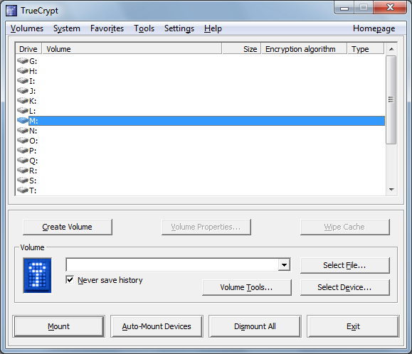

Slide 12
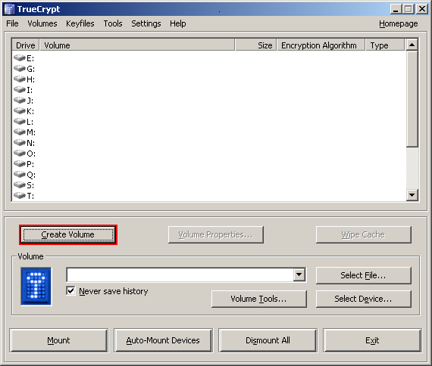
CREDITS: some of these screen snapshots are from https://download.truecrypt.ch/documentation/TrueCrypt%20User%20Guide.pdf


Slide 13
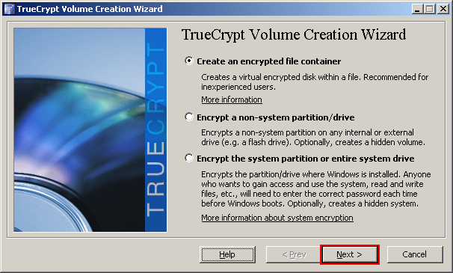
Use the default type


Slide 14
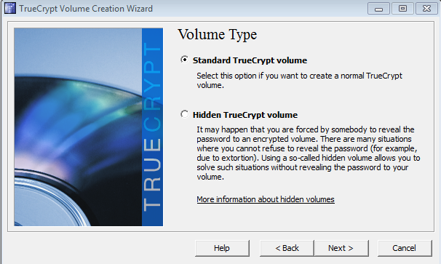
Use the default type

Slide 15
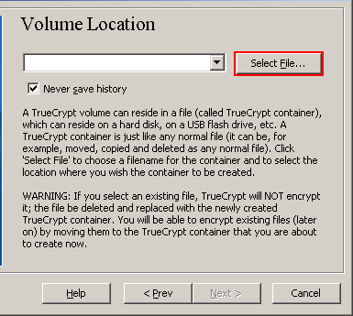
The Location of the Virtual Encrypted Disk
●

Slide 16
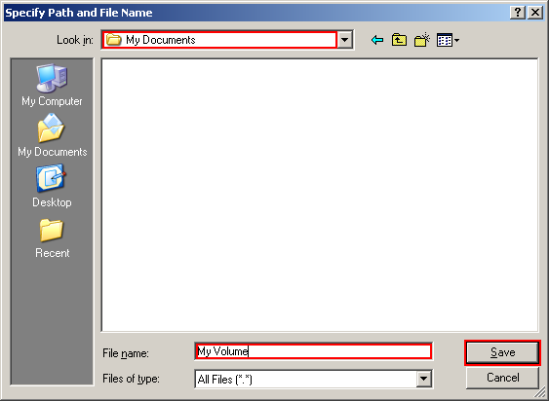
Select your directory
Choose your volume file name
❍

Slide 17
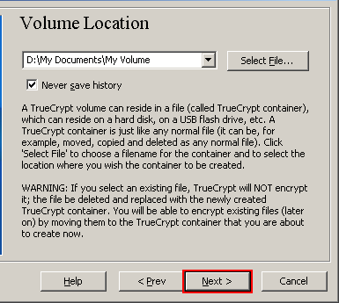
This is your virtual volume file. Please remember this path and we will use it later
■

Slide 18
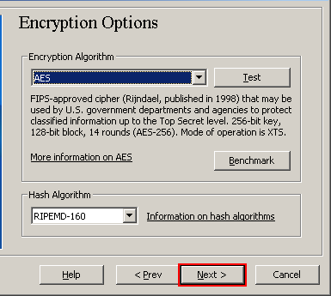
AES is a symmetric encryption algorithm standard
Select SHA-512, a US crypto hash standard
□

Slide 19
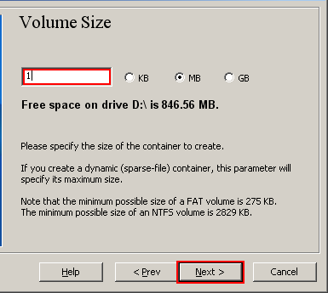
The size of your virtual encrypted disk; Let’s choose 2M bytes (in real life, you would pick a large size, say 2G)
❐

Slide 20
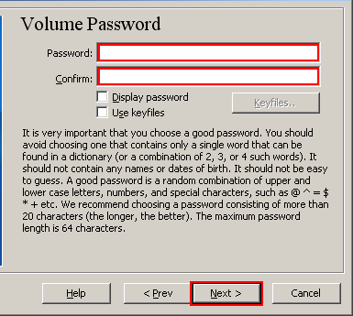
This is the password used to protect your virtual disk
You can also generate a random key and use it to protect your virtual disk. Let’s not do this now
❑

Slide 21
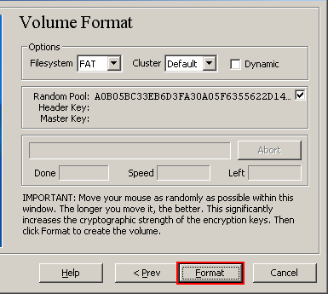
Move your mouse around for 10 seconds to generate some random bits
❒

Slide 22
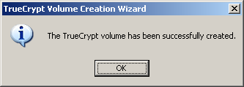
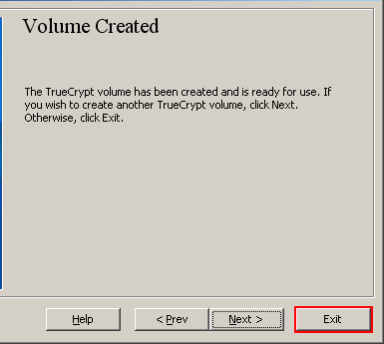
Now what?
We will use the virtual drive to store our critical files
⬧

Slide 23
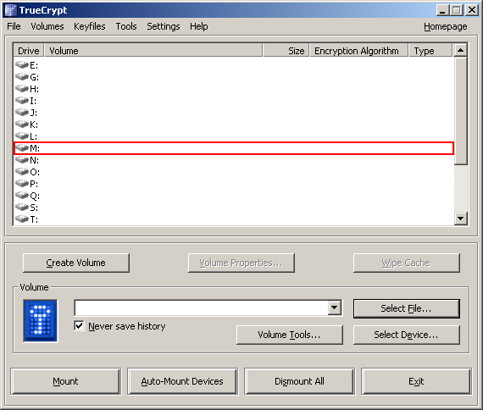
With this choice, your virtual disk will be mounted as M: drive

Slide 24
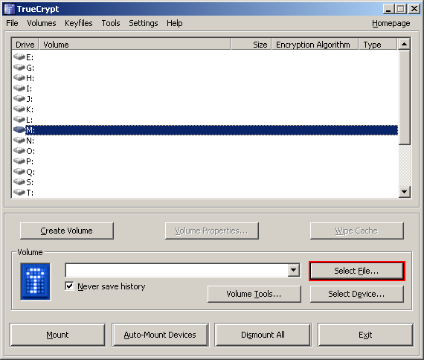


Slide 25
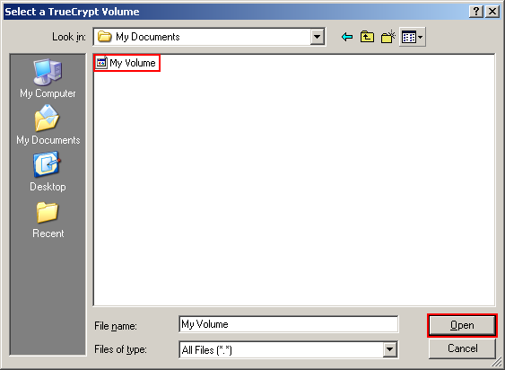
select your virtual disk file


Slide 26
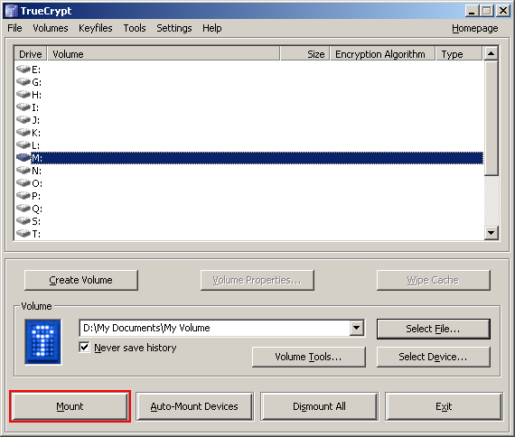
select an available drive letter first
●

Slide 27
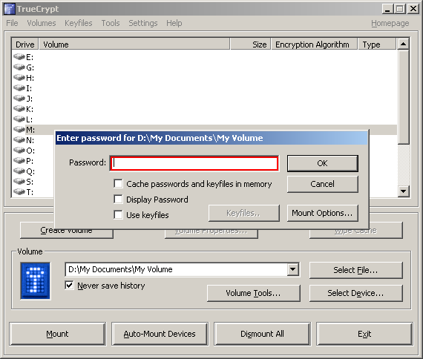
This is the password that you set earlier

Slide 28
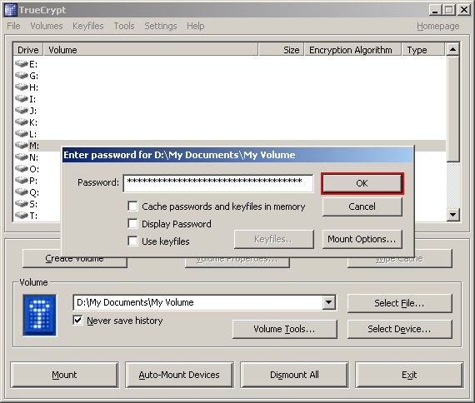
❍

Slide 29
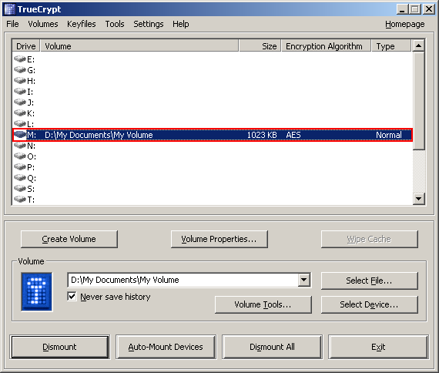
You now have a new M: drive

Slide 30
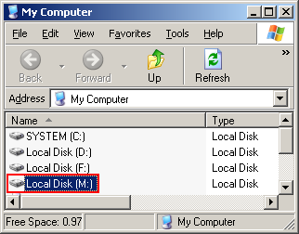
Copy your security-critical files to/from your M: drive

Slide 31
Security-critical Files?
Create a security-critical text file, finance.txt
  Save the following information to it
    your SSN and credit numbers in it
    Your online banking account information
    Your utility bill accounts information
    Your other “important” digital stuffs
Save it to your M: drive

Slide 32
At this moment, your files on M: are in the clear

Slide 33
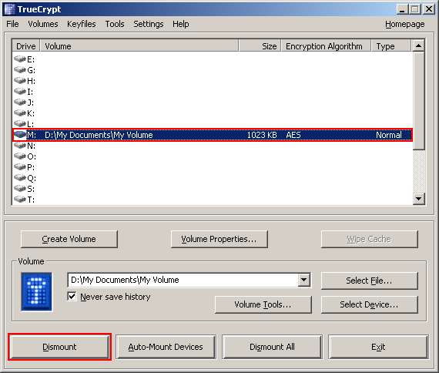
You can dismount your M: drive to protect it
■

Slide 34
Is It Really Secure?
Examine your virtual disk file
  Use Notepad to open your virtual disk file
    Mine is D:\My Documents\My Volume
If a hacker has stolen your virtual disk file, can he/she see your critical file finance.txt?
□

Slide 35
Exercise
Create a TrueCrypt virtual disk (filename: your_first_name-last_name)
Create a text file, finance.txt, with your real SSN and save it to your virtual disk
Dismount your virtual disk
Use Notepad to open file your_first_name-last_name: Can you can find any information about finance.txt?
Copy your_first_name-last_name to c:\tmp
Mount c:\tmp\ your_first_name-last_name (the new copy)
Open finance.txt

Slide 36
Do You Really Know What You are Doing?
Warning
If you pick a strong password and forget it, you will NOT be able to recover any data on the virtual disk
  Probably nobody will be able to help you
Know your risk!

Slide 37
Everybody likes a quiz
Quiz
TrueCrypt is a(n)
  Cryptographic algorithm created by the NSA
  Open-source disk encryption tool
  Program that allows you to create a digital signature on your e-mail
  Widely-used protocol used to protect Web communications
  None of the above

Slide 38
Road Map
Practice
  Truecrypt
  GPG
  BitLocker

Slide 39




Public Key Digital Signature
Do-not-modify channel
Alice’s public key
Alice’s public key
Eve
Dear Bob
Sell 20
shares of my
IBM stock
010101010…
(DIGITAL SIGNATURE)
public channel
Dear Bob
Sell 20
shares of
my IBM
stock
Y/N?
Sign
Verify
Alice’s private key
Notes:
Public key is shown in this diagram. Note that the message is encrypted with Bob’s public key and the encrypted message is decrypted with Bob’s private key.
Public key encryption assumes a reliable channel to distributed public keys.

Slide 40
Public Key Encryption
Do-not-modify channel
Bob’s
public key
Bob’s
public key
Eve
public channel
Dear Bob
Tell Albert
to get out of
there
$β♥♦♣
ƒϒ%ΩΛ
?}{|•℘
®gt…x
Dear Bob
Tell Albert
to get out of
there
Encrypt
Decrypt
Bob’s
private key
Notes:
Let’s take another look at public key encryption. In the public key cryptography, to send a message to Bob, Alice has to possess Bob’s public key. Thus, before Alice does the encryption, she has to somehow get Bob’s public key. If she mistakenly uses somebody else’s public key, the game is over. Bob’s public key is distributed through a reliable channel, marked in YELLOW.
Different from the symmetric key cryptography, Eve can read the public key distribution channel and this won’t help her decrypt the ciphertext.
Like the symmetric key cryptography, the ciphertext is sent over a public channel. Eve can read the ciphertext. We will discuss the details of public key encryption later.

Slide 41
Cryptography ≠ Encryption
Public-key cryptography can be used for digital signature
The digital counterpart of hand-written signature

Slide 42
Digital Signature
Alice uses her private key to digitally sign a message (a bit string)
  Everybody can use Alice’s public key to verify Alice’s digital signature
Algorithm buzzwords
  RSA digital signature
  Digital Signature Standard (DSS)
  Elliptic-curve digital signature algorithm (ECDSA)
(Do not confuse digital signature with email signature in MS Outlook!)

Slide 43
E-mail signature vs. Digital Signature
E-mail signature
Brett Tjaden, PhD
Department of Computer Science
James Madison University
E-mail: tjadenbc@jmu.edu
Tel: 540-568-2771
Digital signature
01110011001…
This is not secure! Anybody can change it

Slide 44
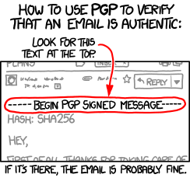
Verify an Email?

Slide 45
What if I Want to…
Encryption/sign a single file/email?
GNU Privacy Guard (GPG)
Windows version
Gpg4win
  http://www.gpg4win.org/

Slide 46
Step 1
Download Gpg4win and install it on your Windows 2003 VM
  http://gpg4win.org/
NOTE: Gpg4win has already been installed on your Windows 2003 VM under the “WLAN and Crypto Security” VM snapshot

Slide 47
Step 2
Run “Start -> All Programs -> Gpg4win -> Kleopatra”
(You can also run it directly from a shortcut on your Desktop)

Slide 48
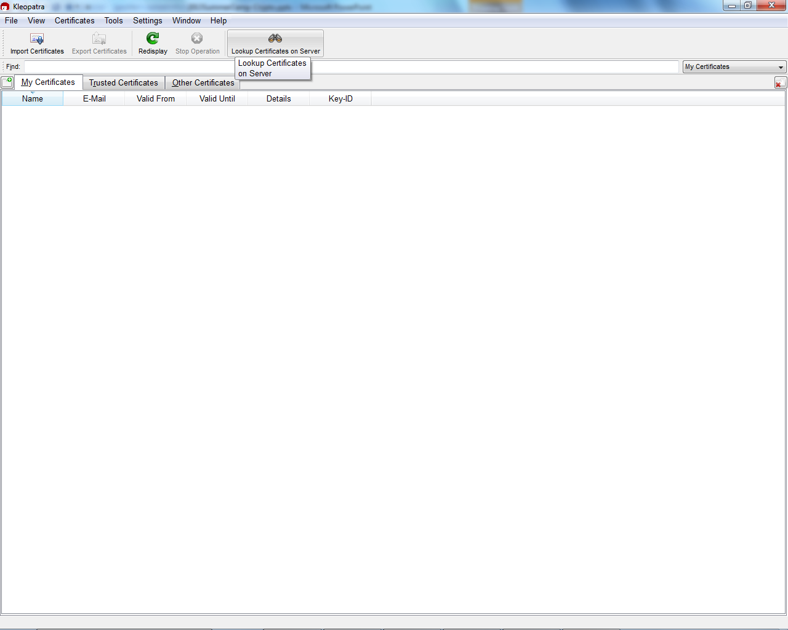
 “File -> New Certificates”

Slide 49
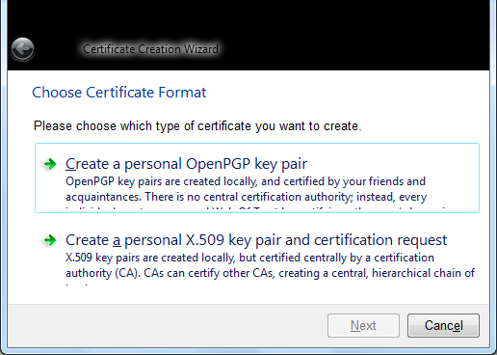
 Choose this one to generate your own public/private key pair

Slide 50
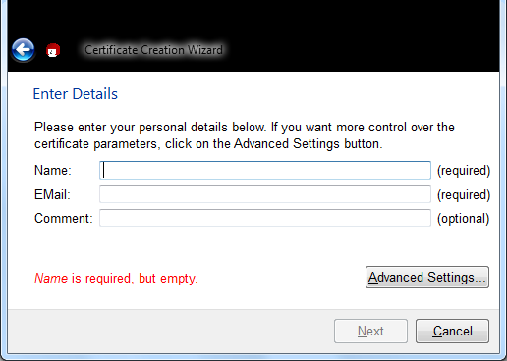
● Enter the required information

Slide 51
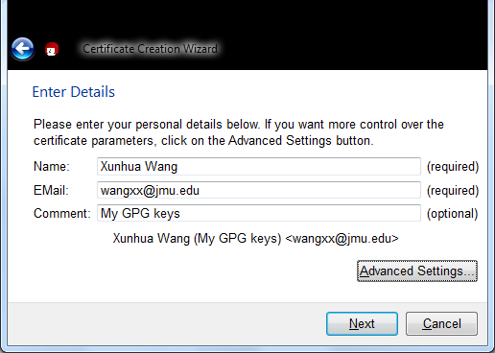
❍

Slide 52
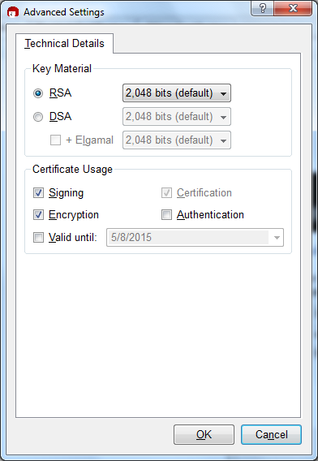
Choose the
algorithm
□ The purposes
of your key pair

Slide 53
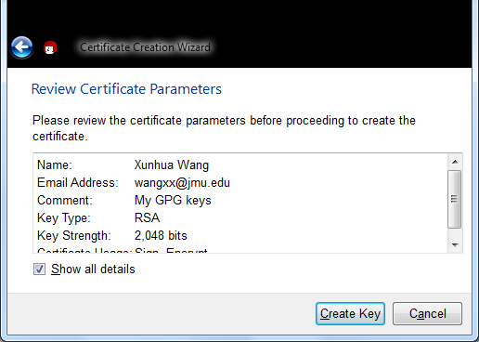

Slide 54
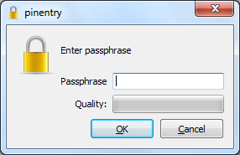
❐ Choose a password to protect your private key

Slide 55
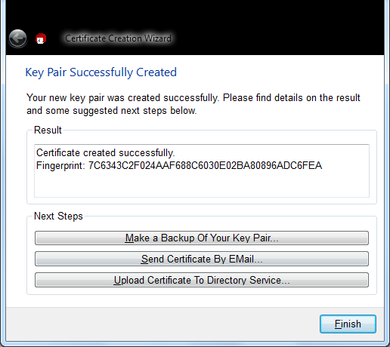
Click this to back up your private key to a file
Notes:
C:\Program Files\GNU\GnuPG

Slide 56
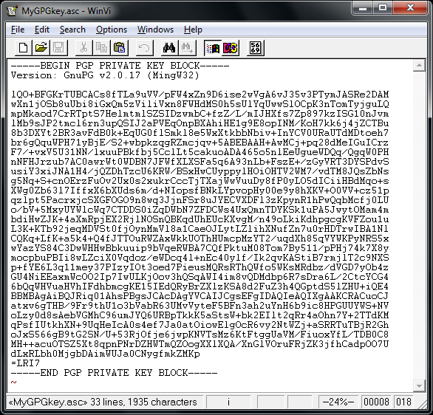
❒ Use Notepad.exe to open your private key file
This is your private key, it is supposed to be secret: do NOT lose it or send it to your friend

Slide 57
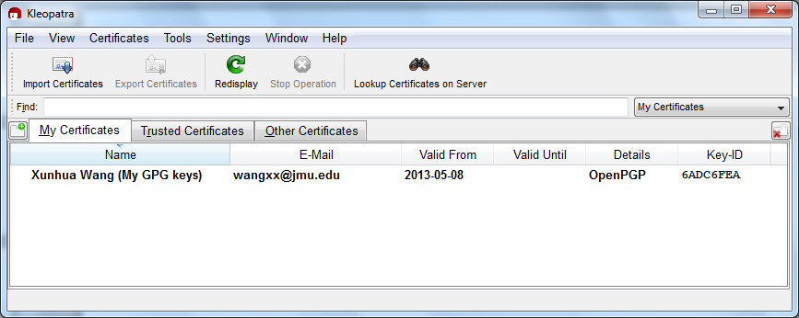
You want to send your PUBLIC KEY to your friend.
How?
You have a public/private key pair.
Now what?

Slide 58
Right click on this
Select export public key

Slide 59
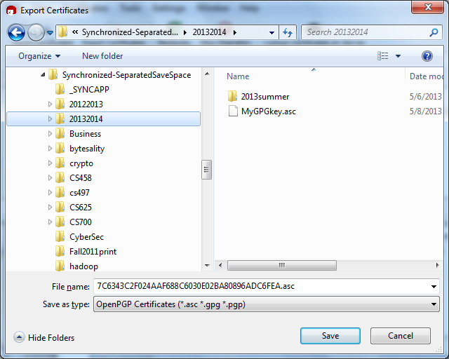
 Choose location and a name for your public key file

Slide 60
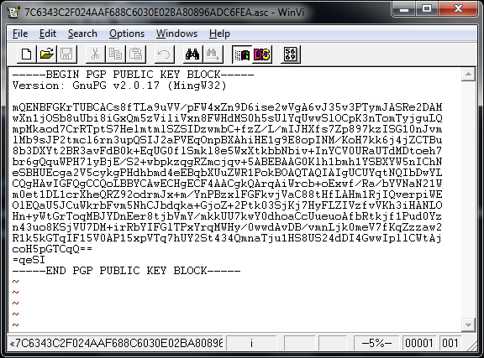
● Use Notepad to open your public key file to take a look

Slide 61
❍ Email your public key file to your friend

Slide 62
How to email your public key to your friend?
Run the web browser inside the VM
  Not from your local laptop
You attach your public key file

Slide 63
Exercise #1 (1/2)
Export your public key to a file and email it to the student next to you
Receive a public key from your classmate,

Slide 64
This is like
Do-not-modify channel
Alice’s public key
Alice’s public key
Eve
Alice’s private key
Notes:
Public key is shown in this diagram. Note that the message is encrypted with Bob’s public key and the encrypted message is decrypted with Bob’s private key.
Public key encryption assumes a reliable channel to distributed public keys.

Slide 65
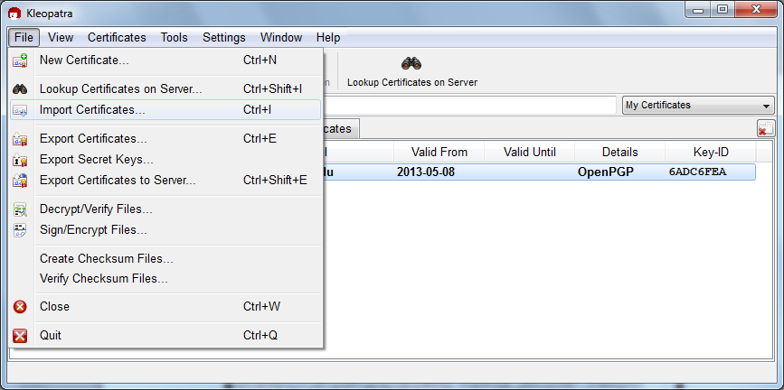
■ Click “File -> Import Certificates …” to import the public key received from your classmate

Slide 66
Imported public key
You should be able to see it
□ The imported public key should appear here

Slide 67
It is not done yet!
You must right click on the imported public key to certify it
  In this way, you mark the imported public key as trusted

Slide 68
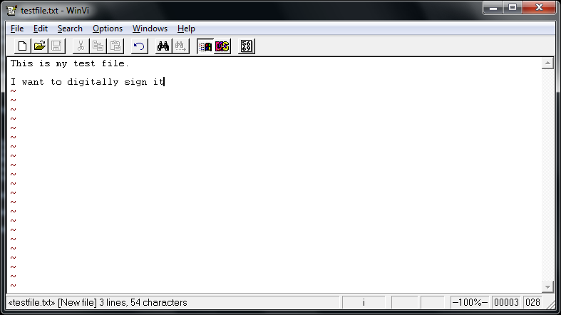
Now, I Want to digitally Sign a file and Send it to My Friend
❑ Create a text file, testfile.txt, to be digitally signed

Slide 69
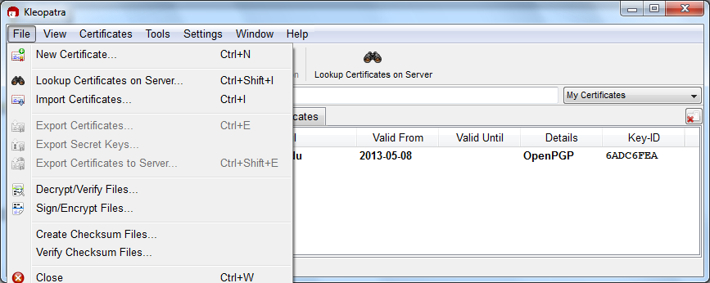
❒ Click “File -> Sign/Encrypt Files …”

Slide 70
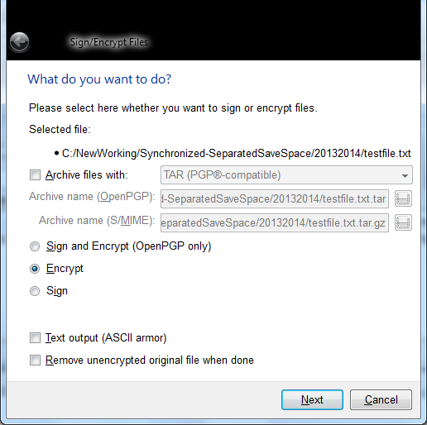
⬧ You have three choices
You can
Sign it (with your private key) and then encrypt it (with your friend’s public key)
Just encrypt it (with your friend’s public key)
Just sign it (with your private key)

Slide 71
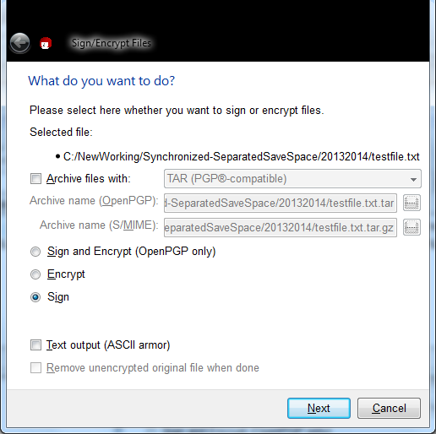
⬧ I want to digitally sign the file (choice 3) this time

Slide 72
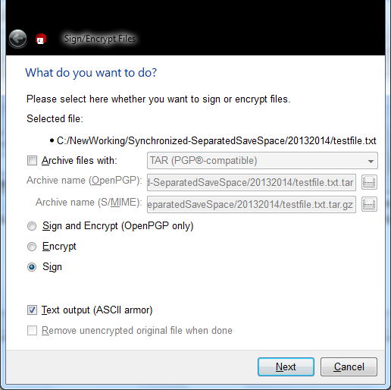
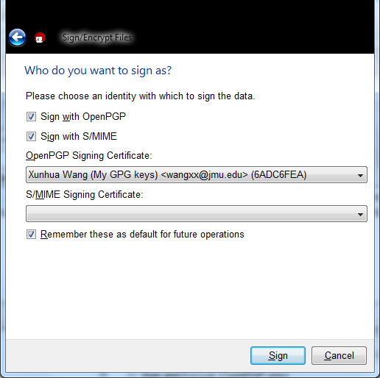
Choose the private key for digitally signing the file

Slide 73
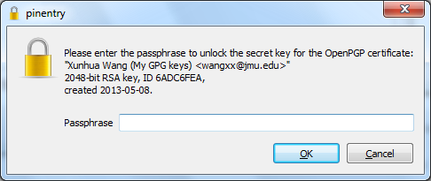
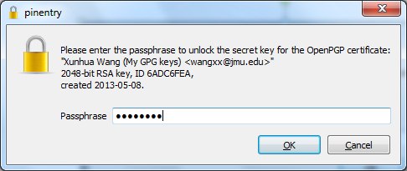
 My private key is protected by a password

Slide 74
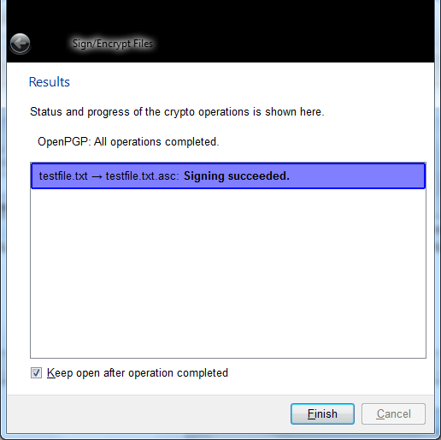
 Everything is cool
● So, where is the digital signature for my file?

Slide 75
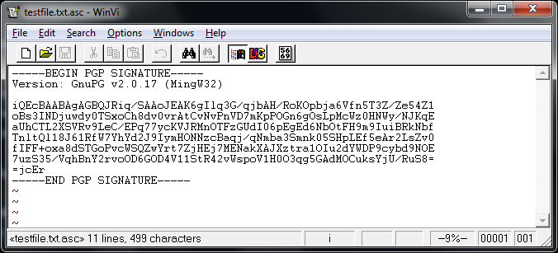
❍ Go to the parent directory of testfile.txt and the signature file is a separate file called testfile.txt.asc
Open it with Notepad

Slide 76
■ Email both testfile.txt and testfile.txt.asc to Bob (my classmate)

Slide 77
This step is like
testfile.txt
Eve
Dear Bob
Sell 20
shares of my
IBM stock
010101010…
(DIGITAL SIGNATURE)
public channel
Dear Bob
Sell 20
shares of
my IBM
stock
Sign
testfile.txt.asc
Notes:
Public key is shown in this diagram. Note that the message is encrypted with Bob’s public key and the encrypted message is decrypted with Bob’s private key.
Public key encryption assumes a reliable channel to distributed public keys.

Slide 78
Exercise
Wait for an email from your friend
  A text file, textfile.txt
  The corresponding signature file, testfile.txt.asc
You are going to verify your friend’s digital signature

Slide 79
The next step is like
Alice’s public key
Eve
Dear Bob
Sell 20
shares of my
IBM stock
010101010…
(DIGITAL SIGNATURE)
public channel
Y/N?
Verify
Notes:
Public key is shown in this diagram. Note that the message is encrypted with Bob’s public key and the encrypted message is decrypted with Bob’s private key.
Public key encryption assumes a reliable channel to distributed public keys.

Slide 80
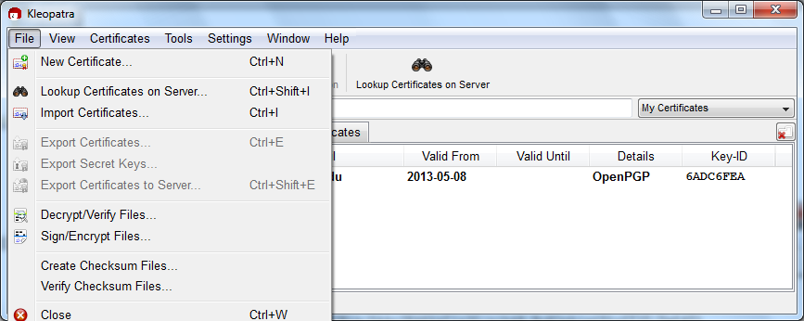
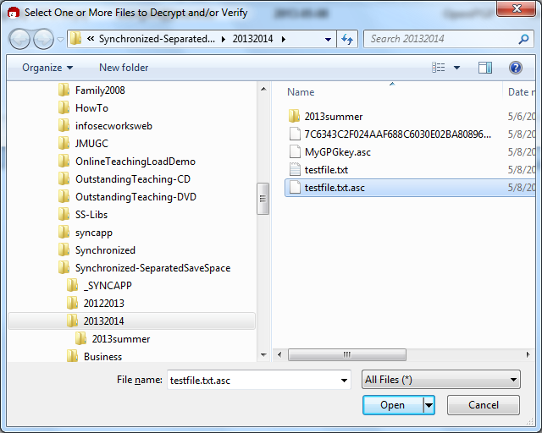
Bob:  Click “File -> Decrypt/Verify Files …”
Bob  selects the signature file received

Slide 81
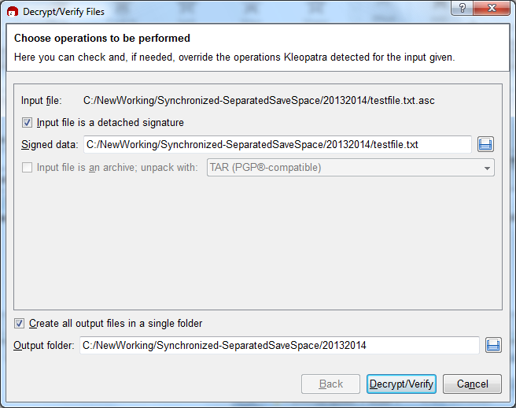
Bob: 

Slide 82
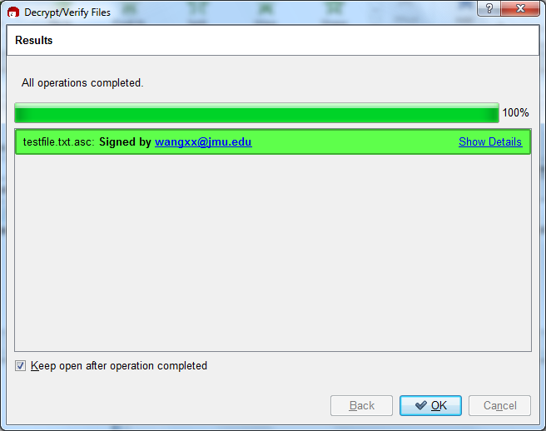
❍ It tells Bob that this file is really from me, not from an attacker
Notes:
Generate key pair
Key manager
Revocation certificate
Send your key to a keyserver

Slide 83
Exercise #2 (2/2)
Create a text file your_first_name-last_name-gpg4win.txt and digitally sign it
Email your_first_name-last_name-gpg4win.txt and the digital signature file to your classmate
After receiving the files from your classmate, try to digitally verify them

Slide 84
What if I want to digitally sign
An email?
  Not a file
GnuPG for Outlook (GpgOL)
  Use with Microsoft Outlook mail client

Slide 85
Road Map
Practice
  Truecrypt
  GPG
  BitLocker

Slide 86
Summary
Practice
  Truecrypt
  GPG
  BitLocker

