Slide 1
2016 Summer Camp: Wireless LAN Security Exercises
2016 JMU Cyber Defense Boot Camp

Slide 2
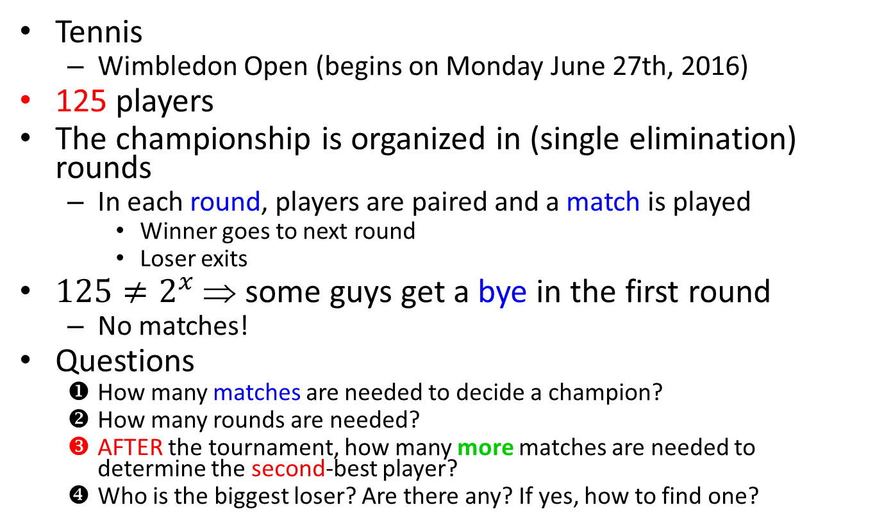
How Many Matches are Needed?
Tennis
  Wimbledon Open (begins on Monday June 27th, 2016)
125 players
The championship is organized in (single elimination) rounds
  In each round, players are paired and a match is played
    Winner goes to next round
    Loser exits
$125≠2^{x}$⇒ some guys get a bye in the first round
  No matches!
Questions
  How many matches are needed to decide a champion?
  How many rounds are needed?
  AFTER the tournament, how many more matches are needed to determine the second-best player?
  Who is the biggest loser? Are there any? If yes, how to find one?
Not the runner-up

Slide 3
Simple Solution!
Simplicity is important for security too
  Complexity is big enemy for security
Too complex security solutions?
  People will give up
  People will bypass
Effective security measures?
  “As simple as possible, but not simpler”
  Simple for developers
  Simple for end users
Cybersecurity principle #9

Slide 4
Questions on Wireless LAN (1/2)
Have you used a wireless local area network before?
  At home?
  At work?
  With your cell phone?
Have you configured a wireless AP before?
Which one do you use, WEP, WPA, or WPA2?
  How secure is it?
  Why?

Slide 5
Questions on Wireless LAN (2/2)
Have you heard these terminologies before?
  WiFi (Wireless Fidelity)
  Wireless access point (AP)
  Service set identification (SSID)
  Hot spots, evil twins
  WEP (Wired Equivalent Privacy)
  WPA (Wireless Protected Access)
    WPA-PSK (Pre-Shared Key)
  WPA2
Use different algorithms
Evolved over years

Slide 6
Wired Computer Networks
It is mature but …

Slide 7

Wired Computer Network: Inconvenience
It is mature

Slide 8


Wireless Would be Nice
Home use: share the same secret (private-shared key [PSK])
W
ESSID: name; JMU Official Wireless; LionsDen
W
W
W
W
W
?
W
Notes:
This slide gives a typical configuration of a wireless LAN.

Slide 9
Wireless Would be Nice
JMU Official Wireless
JMU-Official-Wireless
Enterprise: Use the help of an authentication server;
Notes:
This slide gives a typical configuration of a wireless LAN.

Slide 10
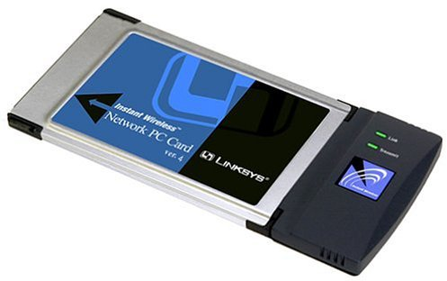
Hardware?
Wireless Access
Point (AP)
Wireless card (WiFi
adapter card)
Notes:
This slide shows the pictures of a wireless access point (AP) and the picture of a wireless adapter card for laptop. Wireless access points behave like a switch in the wired network.

Slide 11
Typical Wireless LAN Configuration
How secure are these configurations?
Algorithms: WEP, WPA-PSK, WPA2
Shared key: how long?
Notes:
This slide gives a typical configuration of a wireless LAN.

Slide 12
Organization
We will work on captured traffic, not live traffic
[airodump]
Exercises
  Cracking captured WEP traffic 1
  Crack captured WPA-PSK traffic 2
  Cracking captured WEP traffic 3
  Crack captured WPA-PSK traffic 4
Overview of wireless LAN security
  WEP
  WPA-PSK
  WPA2
Take longer

Slide 13
Road Map
Exercises
  Cracking captured WEP traffic 1
  Crack captured WPA-PSK traffic 2
  Cracking captured WEP traffic 3
  Crack captured WPA-PSK traffic 4
Overview of wireless LAN security
  WEP
  WPA-PSK
  WPA2

Slide 14
Step 0
Run Firefox to log into your vCenter server and find your Windows 2003 VM
Use the “WLAN and Crypto Security” VM snapshot

Slide 15
Aircrack-ng for Windows (1/2)
It has aircrack-ng for Windows
  You can download aircrack-ng at http://www.aircrack-ng.org/doku.php?id=main
Notes:
Need to compile your DLL to dump live traffic

Slide 16
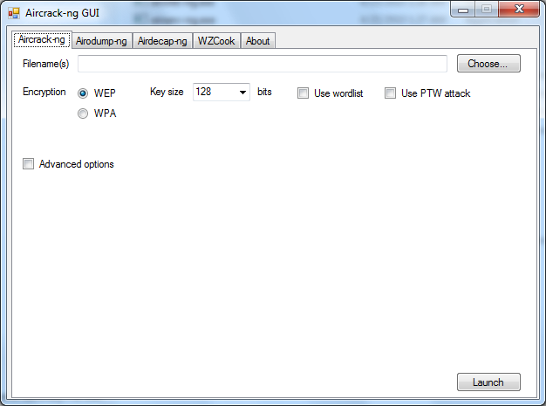
Aircrack-ng for Windows (2/2)
Run c:\wireless\wireless\aircrack-ng-1.1-win\aircrack-ng-1.1-win\bin\Aircrack-ng GUI.exe
(You can also
run it directly
from a
shortcut on
your Desktop)

Slide 17
Exercises
In this module, we will crack some real-world wireless local area networks with traffic captured in files
  Not live traffic
These traffic packets were captured with airodump-ng and wireshark

Slide 18
Road Map
Exercises
  Cracking captured WEP traffic 1
  Crack captured WPA-PSK traffic 2
  Cracking captured WEP traffic 3
  Crack captured WPA-PSK traffic 4
Overview of wireless LAN security
  WEP
  WPA-PSK
  WPA2

Slide 19
Task : WEP Cracking
The target wireless network is using WEP

Slide 20
WEP Cracking Steps with Live Traffic
a Purchase a wireless card that supports injection
⬥ Start airodump-ng to capture the IVs
b Select platform to run Aircrack-ng; Kali is the best; Ubuntu
 Use aireplay-ng to do a fake authentication with the access point
◆ Start the wireless interface in monitor mode on AP channel
 Start aireplay-ng in ARP request replay mode
❖ Test Wireless Device Packet Injection
 Run aircrack-ng to obtain the WEP key
Notes:
0. http://www.aircrack-ng.org/doku.php?id=compatibility_drivers#which_is_the_best_card_to_buy

Slide 21
WEP Cracking Steps with Captured Traffic
a Purchase a wireless card that supports injection
⬥ Start airodump-ng to capture the IVs
Skip steps  ~  &
Do  only
b Select platform to run Aircrack-ng; Kali is the best; Ubuntu
 Use aireplay-ng to do a fake authentication with the access point
◆ Start the wireless interface in monitor mode on AP channel
 Start aireplay-ng in ARP request replay mode
❖ Test Wireless Device Packet Injection
 Run aircrack-ng to obtain the WEP key
Notes:
0. http://www.aircrack-ng.org/doku.php?id=compatibility_drivers#which_is_the_best_card_to_buy

Slide 22
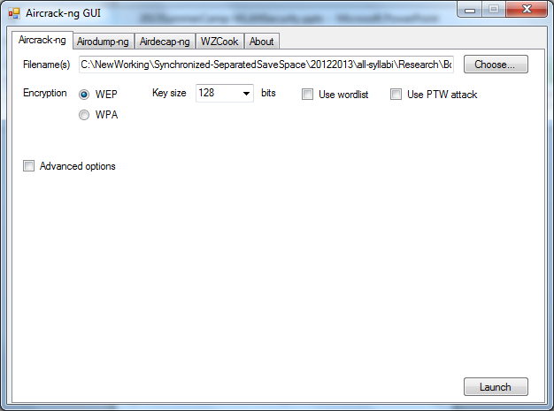
Task : WEP Cracking
Filename(s) c:\wireless\wireless\WEPFile01\wep3-01.cap

Slide 23
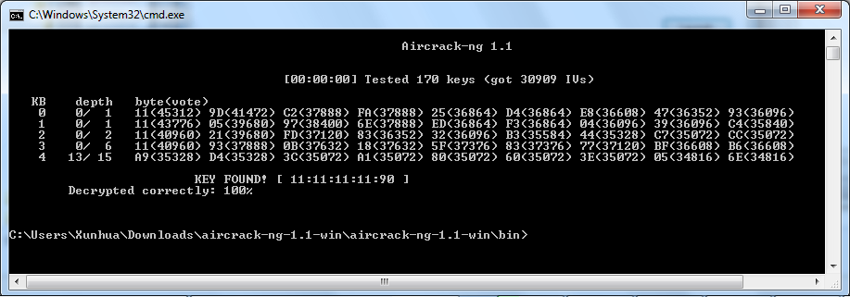
What did you get?
Mine
Now, close Aircrack-ng GUI.exe

Slide 24
Now What?
You can use the cracked WEP key
  To connect to the target AP
  To find other vulnerable computers on the network
  To steal data from the target network
Notes:
sudo nano -w /etc/network/interfaces
auto wlan0
iface wlan0 inet dhcp
wireless-essid MYNETWOTK
wireless-key FEFEFEFEFE
wireless-channel 11
wireless-mode managed
//////////////////////////////////////
Commands on Linux?
iwconfig wlan0 mode managed key the-key-that-you-have-cracked
iwconfig wlan0 essid "target-essid"
dhclient wlan0
ping a target-IP address

Slide 25
Road Map
Exercises
  Cracking captured WEP traffic 1
  Crack captured WPA-PSK traffic 2
  Cracking captured WEP traffic 3
  Crack captured WPA-PSK traffic 4
Overview of wireless LAN security
  WEP
  WPA-PSK
  WPA2

Slide 26
Task : WPA-PSK Cracking
The target wireless network is using WPA-PSK

Slide 27
WPA-PSK Cracking Steps with Live Traffic
a Purchase a wireless card that supports injection
⬥ use aireplay-ng to deauthenticate the wireless client
b Select platform to run Aircrack-ng; Kali is the best; Ubuntu
 Run aircrack-ng to crack the pre-shared key
◆ start the wireless interface in monitor mode on AP channel
❖ start airdump-ng to capture the Ivs
Notes:
0. http://www.aircrack-ng.org/doku.php?id=compatibility_drivers#which_is_the_best_card_to_buy
http://www.aircrack-ng.org/doku.php?id=cracking_wpa
aircrack-ng –w password.lst psk*.cap

Slide 28
Task : WPA-PSK Cracking with captured traffic Steps
a Purchase a wireless card that supports injection
⬥ use aireplay-ng to deauthenticate the wireless client
b Select platform to run Aircrack-ng; Kali is the best; Ubuntu
 Run aircrack-ng to crack the pre-shared key
◆ start the wireless interface in monitor mode on AP channel
Skip steps  ~  &
Do  only
❖ start airdump-ng to capture the Ivs
Notes:
0. http://www.aircrack-ng.org/doku.php?id=compatibility_drivers#which_is_the_best_card_to_buy

Slide 29
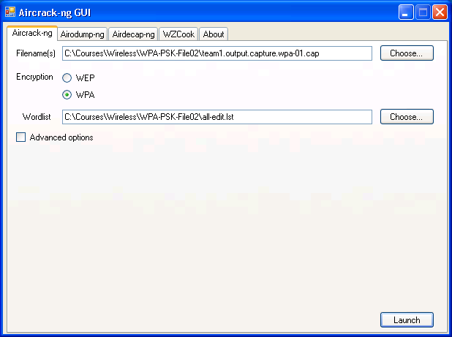
Task : WPA-PSK Cracking
Filename(s): c:\wireless\wireless\WPA-PSK-File02\team1.output.capture.wpa-01.cap
Wordlist:
c:\wireless\
wireless\
WPA-PSK-File02
\all-edit.lst
  Do not use all.lst

Slide 30
Task : WPA-PSK Cracking
Choose index 2 if you get prompted

Slide 31
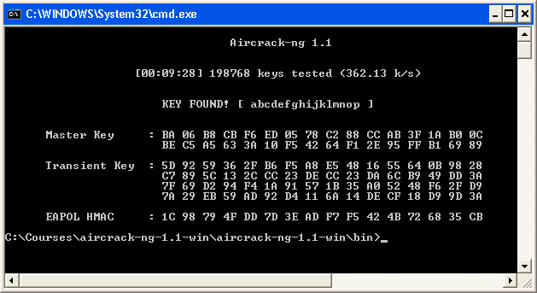
Task : What did you get?
This is almost 10 minutes
Mine
Now, close Aircrack-ng GUI.exe

Slide 32
Now What?
You can use the cracked WPA-PSK key
  To connect to the target AP
  To find other vulnerable computers on the network
  To steal data from the target network
Notes:
sudo nano -w /etc/network/interfaces
auto wlan0
iface wlan0 inet dhcp
wireless-essid MYNETWOTK
wireless-key FEFEFEFEFE
wireless-channel 11
wireless-mode managed

Slide 33
Road Map
Exercises
  Cracking captured WEP traffic 1
  Crack captured WPA-PSK traffic 2
  Cracking captured WEP traffic 3
  Crack captured WPA-PSK traffic 4
Overview of wireless LAN security
  WEP
  WPA-PSK
  WPA2

Slide 34
Task : WEP Cracking
The target wireless network is using WEP

Slide 35
Task : WEP Cracking – File 3
Filename(s) c:\wireless\wireless\WEPFile03\team4.output.capture-03.cap

Slide 36
Task : WEP Cracking – File 3
Choose index 2 if you get prompted

Slide 37
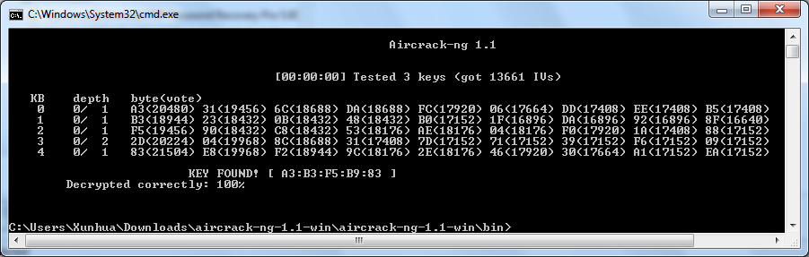
What did you get?
Mine
Now, close Aircrack-ng GUI.exe

Slide 38
Now What?
You can use the cracked WEP key
  To connect to the target AP
  To find other vulnerable computers on the network
  To steal data from the target network
Notes:
sudo nano -w /etc/network/interfaces
auto wlan0
iface wlan0 inet dhcp
wireless-essid MYNETWOTK
wireless-key FEFEFEFEFE
wireless-channel 11
wireless-mode managed

Slide 39
Everybody likes a quiz
Quiz
Which of the following wireless security algorithms is not considered weak:
  WEP
  WPA-PSK
  WPA2
  WPA-TKIP
  None of the above

Slide 40
Road Map
Exercises
  Cracking captured WEP traffic 1
  Crack captured WPA-PSK traffic 2
  Cracking captured WEP traffic 3
  Crack captured WPA-PSK traffic 4
Overview of wireless LAN security
  WEP
  WPA-PSK
  WPA2

Slide 41
Task : WPA-PSK Cracking
The target wireless network is using WPA-PSK

Slide 42
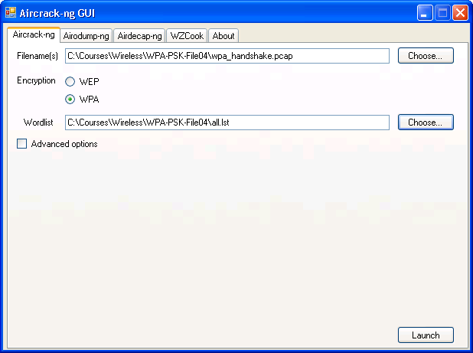
Task : WPA-PSK Cracking
Filename(s) c:\wireless\wireless\WPA-PSK-File04\wpa_handshake.pcap
Wordlist:
c:\wireless\
wireless\
WPA-PSK-File04
\all.lst

Slide 43
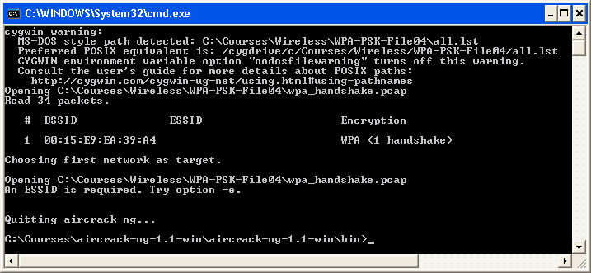
Task : What did you get?
What?

Slide 44
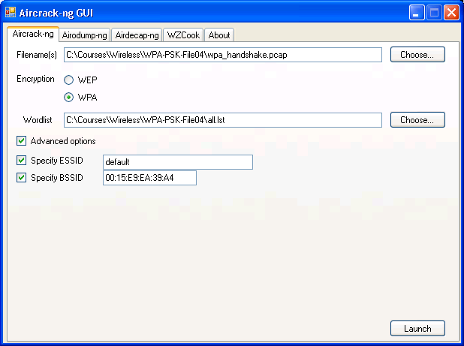
Task : WPA-PSK Cracking
Advanced
This ESSID is guessed
This BSSID is from last slide

Slide 45
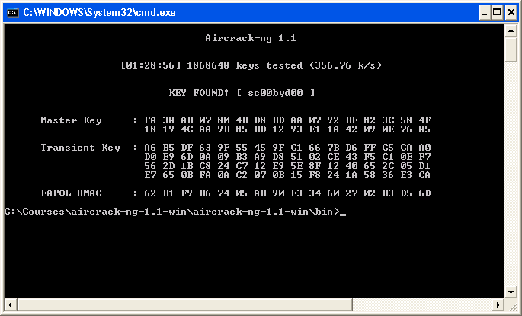
Task : What did you get?
This is almost 1.5 hours
Mine
Now, close Aircrack-ng GUI.exe

Slide 46
Now What?
You can use the cracked WPA-PSK key
  To connect to the target AP
  To find other vulnerable computers on the network
  To steal data from the target network
Notes:
sudo nano -w /etc/network/interfaces
auto wlan0
iface wlan0 inet dhcp
wireless-essid MYNETWOTK
wireless-key FEFEFEFEFE
wireless-channel 11
wireless-mode managed

Slide 47
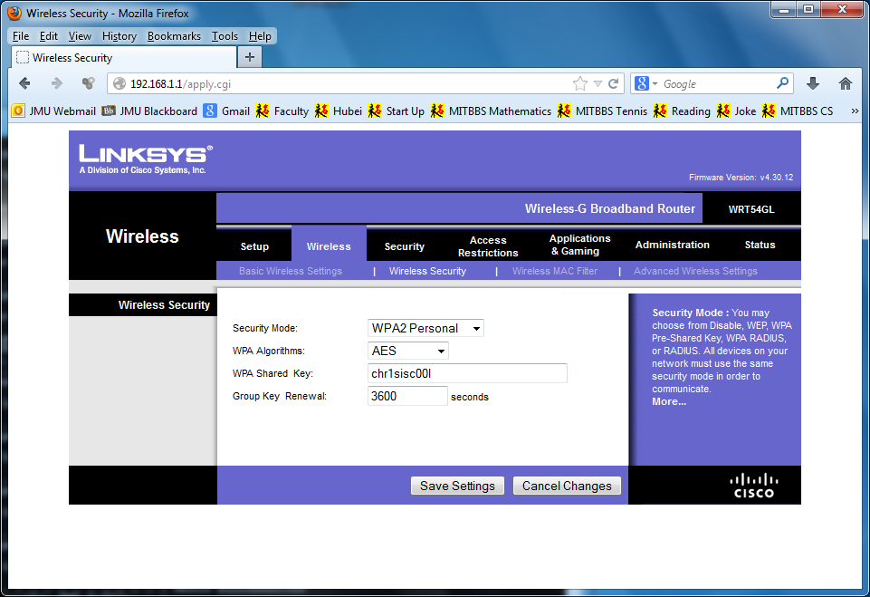
Lesson to protect your wireless LAN?
Use WPA2 if you can
  Definitely no WEP
  Avoid WPA-PSK if you can
Use a long passphrase for WPA2-PSK
  8 ~ 63 characters

Slide 48
Road Map
If you reach here, you are done with this exercise
The rest of the slides are for your information at home only
Exercises
  Cracking captured WEP traffic 1
  Crack captured WPA-PSK traffic 2
  Cracking captured WEP traffic 3
  Crack captured WPA-PSK traffic 4
Overview of wireless LAN security
  WEP
  WPA-PSK
  WPA2

Slide 49
Summary
Exercises
  Cracking captured WEP traffic 1
  Crack captured WPA-PSK traffic 2
  Cracking captured WEP traffic 3
  Crack captured WPA-PSK traffic 4
Overview of wireless LAN security
  WEP
  WPA-PSK
  WPA2

