Slide 1
Opera, Cantata and Oratorio at Mid-Century
MUS373
Norton

Slide 2
Overview
Public Opera
Monteverdi, L’Incoronazione di Poppea (1643)
Opera in Venice after Monteverdi
Cesti, Orontea (1656)
Opera in Rome
Opera abroad
New Vocal Genres
Cantata
Oratorio

Slide 3
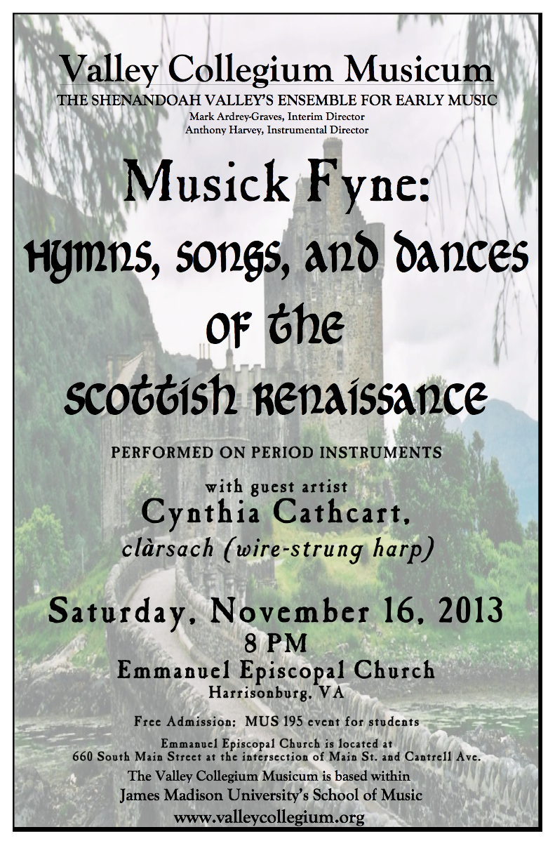
3

Slide 4
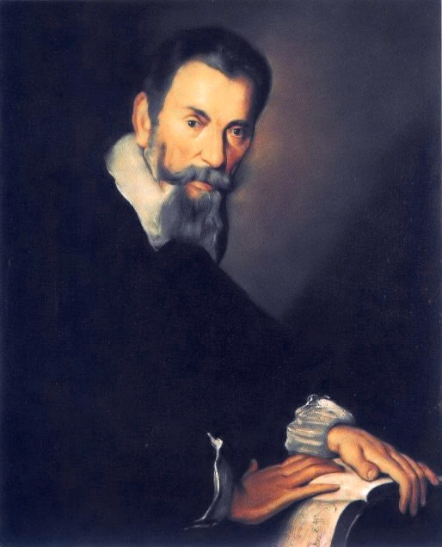
Public Opera: Monteverdi’s Late Operas
Monteverdi wrote Ritorno d’Ulisse (Return of Ulysses) for the new public opera house in 1640
Two years later, he wrote his masterpiece, L’Incoronazione di Poppea (Coronation of Poppea, 1642/3)
Written for performance during the Carnival season (between Christmas & Lent) in Venice
Monteverdi was in his mid-70s!
4

Slide 5
Monteverdi’s L’Incoronazione di Poppea (1643) [NAWM 75]
A markedly cynical plot!
Poppea is the mistress of the Emperor Nero
Their love wins out . . .
But only after Poppea’s lover is banished, and . . .
The Empress, Octavia, is set to sea, and . . .
Nero’s trusted advisor is forced to commit suicide
Act I, Scene 3
Nero and Poppea have just spent the night together
She pleads with him not to leave
He says that that their tryst must remain secret
She implores him to promise to leave his wife and return to her
He promises (she is very convincing!!)
A mixture of recitative, aria, & something in between (arioso) shows the varying & changing emotional states
#70, p. 432
5

Slide 6
A brief pause to talk about (shudder!) . . . the Castrato
Castrati became the biggest stars of Italian opera during the Baroque era and beyond.
Men who had been castrated before puberty sang treble parts in church because women were not permitted to sing in church.
Their voices remained in soprano/alto range
Years of intensive vocal training made them virtuoso singers
Castrato voice highly prized—more powerful & brilliant than a woman’s voice
In Rome, women were not permitted on stage, so castrati sang the treble roles.
Outside of Rome, castrati were called upon to sing the most important male roles instead
Heroes, romantic leads, & supporting roles
Causes problems for modern performances (countertenor, women playing men, or just rewritten for tenor)
The role of Nero was written for a castrato!!
6

Slide 7
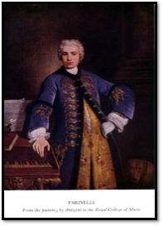
If you want to know more. . .
How the surgery was done
Farinelli (1995)
French film (much in Italian & English)
Won Golden Globe for best foreign film (1994)
Academy Award nominee for best foreign film (1995)
Highly fictionalized story of Carlo Broschi (stage name: Farinelli), the most famous castrato of the 18th century (based loosely on fact).
Castrato voice created digitally by combining sound of male countertenor (male alto/soprano) with that of coloratura soprano.
Also used recordings of the last castrato (1902–4).
A more accurate biography of Broschi can be found here.
Information on how they achieved the digital recreation can be found here.
7

Slide 8
Opera in Rome
Rome became the center for opera development in the 1620s.
The range of topics expanded to include epics, saints’ lives, and comedy.
Stage effects were spectacular (e.g., flames consuming devils).
Recitative and aria became more clearly defined.
Recitative became more speech-like.
Arias became melodious and were usually strophic.
Other musical elements include vocal ensembles
Extended finales for each act, including choral singing and dancing
Two-part instrumental sinfonias introduced the operas.
The first part is a slow chordal section.
The second part is a lively imitative canzona.
This two-part form became standard for the opening movements of seventeenth-century opera.
8

Slide 9
The Spread of Italian Opera
Librettos
Stories for librettos were chosen for their dramatic content and opportunity for special effects.
Sources for plots included mythology, classic epics, and Roman history.
A three-act structure replaced the earlier five-act convention.
Choruses and dances were limited due to financial constraints.
Recitative and aria became further delineated.
Arias became very lyrical, with persistent rhythmic motives and simple harmonies.
There were more arias per act.
Singers commanded high fees and had music written especially for them.
The main composers were associated with Venice:
Francesco Cavalli (1602–1676)
Antonio Cesti (1623–1669).
9

Slide 10
Italian Opera at Mid-Century
Recitative Style
The definitive style for the next hundred years
Used for most of the action
Many repeated notes, with modulating harmonies
Aria style
Strophic with some modification
Smooth, diatonic melody with easy rhythms
Instruments accompany the voice throughout.
Many style features established during this era would remain standard for Italian opera over the next two hundred years.
Concentration on solo singing
Separation of recitative and aria
Use of varied styles
Singers and spectacle replaced drama as the focus of interest.
10

Slide 11
Italian Opera Abroad
France
Italian operas were performed in Paris in the 1640s.
England
No known performance of Italian opera in England in the seventeenth century, but a copy of a Cavalli opera reached England
Austria
Austria became a major center of Italian opera.
Cesti composed operas for the archduke of Tyrol and for the imperial court at Vienna.
1654: Venetian-style opera house built for the archduke of Tyrol
Cesti’s most famous opera, Il pomo d’oro (The Golden Apple, 1667), was performed at the emperor’s wedding in Vienna.
11

Slide 12
Antonio Cesti, Orontea (1655)
Composed in 1656 for Innsbruck
Popular throughout Italy and German-speaking lands
The plot concerns love at first sight across social levels, not myth or history.
The libretto interweaves comic and romantic scenes.
Note the clear distinction between recitative & aria styles.
Recitative—voice & continuo only; carries the action of the story
Aria—voice, continuo, and strings; comments on the story
Let’s look at the translation (p. 493–94)
Now let’s listen: NAWM 76
12

Slide 13
Tension Between Drama and Spectacle
Opera began as an effort to place drama at the center of a staged musical performance, but solo singing and spectacle soon overcame this effort.
Later composers would seek to reform opera, bringing drama to the fore again.
Current theatrical productions face the same tension between drama and spectacle.
13

Slide 14
The Spillover
The new techniques and styles that developed in the early 17th century along with the new emphasis on expressing the emotion of the text are unified in the new genre of opera.
These, in turn, lead to new genres modeled on the types of song employed in the opera.
Concertato style (stile concertato—adding basso continuo) was common to a number of vocal genres.
Solo madrigals
Canzonettas
Arias
Recitatives
Dialogues
Monteverdi used instrumental accompaniment in his later books of madrigals
8 books of madrigals plus one published posthumously.
Later books include vocal ensembles, chorus, continuo, instrumental ensembles
Include dramatic works - styles range from madrigal style to stile concertato and operatic recitative
14

Slide 15
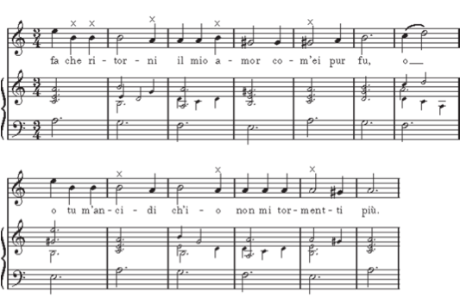
Ostinato Bass
Basso ostinato
Persistent, or obstinate, bass
Also called ground bass (bass that is the “ground” or the basis of the work
Repeated bass pattern
Common features
Triple or compound meter
Two, four, or six measure pattern.
Often features a descending tetrachord
Becomes a favorite device in opera
15

Slide 16
Ostinato Bass
Here is an example from Monteverdi, from Lamento della ninfa (Lament of the nymph) Book 8 of his madrigals (the 2nd part)
Here is the entire madrigal, with score.
The Nymph’s Lament
The god Phoebus had still to light
The great fires of the dawn
When the nymph left her dwelling.
Her face a pale temple in its ruins of grief;
Her cries sobbing from a heart, rending.
Hither and thither she went,
Stumbling through flowers,
Grieving the love she had lost:
Hear me, O Love, she begged the heavens,
Stock still now – rooted to the spot;
What happened to that traitor’s vow,
‘Togetherness and trust’?
I just want him back,
But as he was before.
If you cannot – then kill me;
I cannot bear this agony.
No more will I listen to his sighs,
Unless we are separated by a thousand seas –
No! No longer will I martyr myself for this.
I am destroying myself because of him,
And the worse it is, the more gorged,
The more satisfied he seems.
If I were to flee from him,
Perhaps then he might come begging?
That woman’s eyebrows
May be arched more perfectly than mine,
But sealed within my breast, O Love,
Lives a faithfulness still fairer.
And that woman’s mouth will never open
To give such kisses as I can give!
(Hush! Say nothing – you know only too well!)
With these cries she cast
Her anguish to the heavens.
And so it is that in the heart of every lover
Burns, side-by-side, love’s flame and ice.
16

Slide 17
Ostinato Bass
Turns up also in instrumental music
Chacona (Italian ciaccona)
Dance song with origins in Latin America
Pattern of chords (for guitar originally)
Passacaglia
Repeated harmonic pattern
17

Slide 18
Cantata
Originally simply a “piece to be sung” (as opposed to sonata - a piece to be played).
In the 17th century a secular composition on a lyrical or quasi-dramatic text
Usually for solo voice with continuo
Divided into several sections, including recitative and aria
Main composers:
Luigi Rossi
Antonio Cesti
Giacomo Carissimi
Barbara Strozzi
18

Slide 19
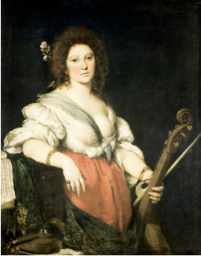
Barbara Strozzi (1619–1677)
Venetian singer and composer
Studied with Cavalli
Supported by her adopted father, the poet and librettist Giulio Strozzi and wealthy patrons.
Served as “mistress of ceremonies” for a Venetian academy (all male—akin to the Florentine camerata)
Published 8 collections of music in the mid-17th century—over 100 works altogether.
Published more cantatas than any other composer of the time.
19

Slide 20
Strozzi, Lagrime mie (1659)
Sections in recitative, arioso, and aria styles
Symmetrical design
recitative/refrain—arioso—recitative/refrain
aria (begins 1/2 way through the cantata)
recitative—arioso—recitative/refrain
Recitative uses descending line, minor mode, and augmented intervals to portray a weeping lover.
Other sections portray different emotions, using styles appropriate to each.
NAWM 77
Tears of mine, why do you hold back,
why don’t you wash away the pain
which takes my breath and crushes my heart?
Lidia, whom I adore,
Because she gave me a pitying glance,
Has been imprisoned by her severe father.
The innocent girl is locked up within walls
Which the sun’s rays cannot penetrate,
And what pains me most,
And increases my torment,
Is that I am the cause of my beloved’s suffering.
And you, my eyes, are not weeping!
Tears of mine, why do you hold back?
Alas, how I miss my Lidia, my idol,
I love so much!
She is shut up within marble walls and I sigh
but I do not die!
If death might be granted to me
now that I have no hope,
take my life,
(I beg of you) oh my sufferings!
But I am well aware that in order
to torture me even more.
Fate even denies me death, it is true then, oh God, that destiny desires only my tears.
20

Slide 21
The Oratorio
A religious, dramatic composition incorporating narrative, dialogue, and commentary (but no action!!)
Text was in Latin or Italian
Called “oratorio” because it was similar in function to the prayer hall (oratorio) wehre people met for nonliturgical worship
Likely performed in oratorios as well
Developed in Rome during the 17th century
Operas were prohibited during Lent!!
Like an opera in some regards, but different in others:
Almost never staged
Used a narrator (a singing role)
The chorus took on different roles and functions
21

Slide 22
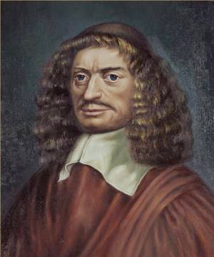
Giacomo Carissimi (1605–1674)
The leading composer of Latin oratorios in Rome.
Became maestro cappella at Assisi at age of 20.
Three years later at the Collegium Germanicum in Rome, a position he held until his death.
Composed cantatas
The leading composers, and one of the developers, of oratorios.
22

Slide 23
Carissimi, Jepthe (ca. 1648)
Exemplifies the mid-century oratorio.
Biblically based libretto (Judges 11:29–40) with paraphrasing and added material.
Jepthe promises God that he will sacrifice whatever creature first greets him on his way home if God will help him defeat the Ammonites.
The narrator introduces the story and describes the action in recitative.
The battle scene is depicted using the stile concitato (agitated style, usually with rapidly repeated notes)
The first creature he sees upon returning home after defeating the Ammonites is his daughter
23

Slide 24
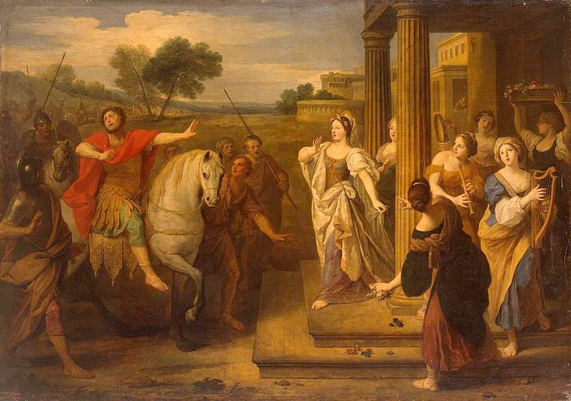
“Jepthe’s Return” by Bon Bouliogne, 2nd half 17th century
24

Slide 25
Carissimi, Jepthe (ca. 1648)
Jeptha’s daughter laments her impending death, accompanied by 2 sopranos and a small vocal ensemble (a chorus in many modern performances), using rhetorical devices such as a descending tetrachord in the bass.
25

Slide 26
Plorate colles (recitative) and
Plorate filii (ensemble or chorus)
NAWM 80
Mourn, you hills, grieve, you mountains,
and howl in the affliction of my heart!
Howl!
Behold! I will die a virgin, and shall not
in my death find consolation in my children.
Then groan, woods, fountains, and rivers,
weep for the destruction of a virgin!
Weep!
Woe to me! I grieve amidst the rejoicing of the
people, amidst the victory of Israel and
the glory of my father, I, a childless virgin,
I, an only daughter, must die and no longer live.
Then tremble, you rocks, be astounded, you hills, vales, and caves, resonate with horrible sound!
Resonate!
Weep, you children of Israel,
bewail my hapless virginity,
and for Jephthah's only daughter,
lament with songs of anguish."
Weep, you children of Israel,
weep, all you virgins,
and for Jephthah's only daughter,
lament with songs of anguish.
26

Slide 27
Glossary
Antonio Cesti
Barbara Strozzi
Basso ostinato (ground bass)
Cantata
Castrato
Francesco Cavalli
Giacomo Carissimi
Oratorio
Stile concertato
Stile concitato
27

