Slide 1
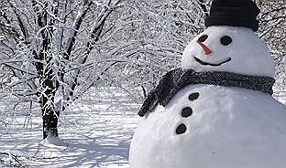
In case of snow

Slide 2
Quiz
Take individually to test yourself, then work with your group to figure out the answers.
This will be graded so do your best.
There will be a question like this on the midterm.

Slide 3
Deep and deeper – method calls
main
SOP(“I am in main”);
deep();
SOP (“I’m back in main”);
deep
SOP(“I am in deep”);
deeper();
SOP (“I’m back in deep”);
deeper
SOP(“I am in deeper”);

Slide 4
Passing Multiple Arguments
The argument 5 is copied into the num1 parameter.
The argument 10 is copied into the num2 parameter.
showSum(5, 10);
public static void showSum(double num1, double num2)
{
  double sum; //to hold the sum
  sum = num1 + num2;
  System.out.println("The sum is " + sum);
}
NOTE: Order matters!

Slide 5
The call stack

