Slide 1

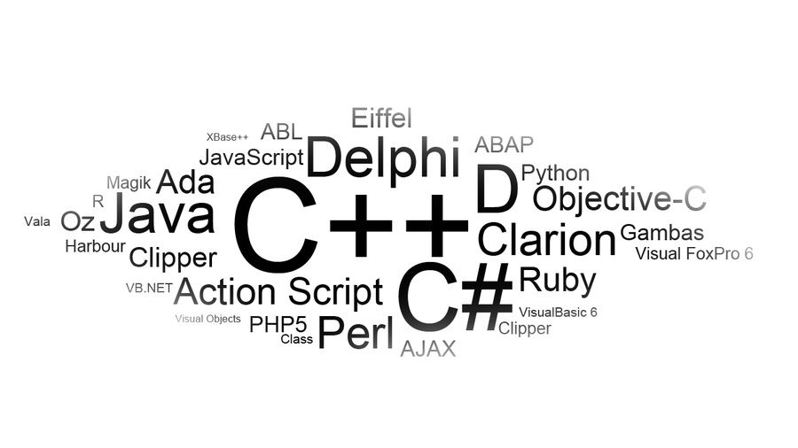
CS 139
Objects
Based on a lecture by Dr. Farzana Rahman
Assistant Professor
Department of Computer Science

Slide 2
Classes
A class is a collection of fields (data) and methods (procedure or function) that operate on that data.
The basic syntax for a class definition:
Bare bone class – no fields, no methods
  public class ClassName
  {
    [fields/var declaration]
    [methods declaration]
}
public class Circle
{
// my circle class
}

Slide 3
Adding Fields: Class Circle with fields
Add fields
The fields (data) are also called the instance variables/class variables
public class Circle
{
public double x, y; // centre coordinate
public double r; // radius of the circle
}

Slide 4
Instance Variables, and Methods
Instance variables belong to a specific instance of a class (i.e. any object)
Instance methods are invoked by an instance of the class (i.e. any object)

Slide 5
Adding Methods to Class Circle
public class Circle
{
public double x, y; // centre of the circle
public double r; // radius of circle
//Methods to return circumference and area
public double circumference()
{
return 2*3.14*r;
}
public double area()
{
return 3.14 * r * r;
}
}

Slide 6
Instantiating Objects
Example:
Circle myCircle = new Circle();
ClassName var_name;
var_name = new ClassName();
Example:
Circle myCircle;
myCircle = new Circle();
or

Slide 7
Visibility Modifiers
By default, the class, variable, or data can be accessed by any class in the same package.
public
The class, data, or method is visible to any class in any package.
private
The data or methods can be accessed only by the declaring class.
The get and set methods are used to read and modify private properties.

Slide 8
Class of Circle
Circle aCircle;
Circle bCircle;
aCircle, bCircle simply refers to a null, not an actual object.
aCircle
bCircle
null
null
Points to nothing (Null Reference)
Points to nothing (Null Reference)

Slide 9
Creating objects of a class
Objects are created dynamically using the new keyword.
aCircle = new Circle()
bCircle = new Circle()
Now aCircle and bCircle refer to Circle objects

Slide 10
Assigning one object to the other
aCircle = new Circle();
bCircle = new Circle() ;
bCircle = aCircle;
Before Assignment
Before Assignment
aCircle
bCircle
aCircle
bCircle
P
Q
P
Q

Slide 11
Garbage Collection
As shown in the previous figure, after the assignment statement bCircle = aCircle, aCircle points to the same object referenced by bCircle .
The object previously referenced by aCircle is no longer useful.
This object is known as garbage.
Java automatically collects garbage periodically and releases the memory used to be used in the future.

Slide 12
Constructors
Circle(double r) {
radius = r;
}
Circle() {
radius = 1.0;
}
myCircle = new Circle(5.0);
Constructors are a special kind of methods that are invoked to construct objects.

Slide 13
Constructors, cont.
A constructor with no parameters is referred to as a default constructor.
Constructors must have the same name as the class itself.
Constructors do not have a return type — not even void.
Constructors are invoked using the new operator when an object is created. Constructors play the role of initializing objects.

Slide 14
public class Word
{
private String inword;
public Word(String str)
{
inword = str;
}
public String makePossessive()
{
return inword+“’s” ;
}
…
…
…
}
Different objects will have different instance variables
Different objects will execute their own method

Slide 15
Instance variable tied to name object
Farzana
makePossessive()
Word name = new Word(“Farzana”);
…
Instance variable tied to fname object
Bob
makePossessive()
Word fname = new Word(“Bob”);
…
Instance variable tied to aname object
Cat
Word aname = new Word(“Cat”);
makePossessive()
…

Slide 16
Farzana
name.makePossessive();
makePossessive()
Farzana’s
…
Method works on object’s attribute
Bob
makePossessive()
fname.makePossessive();
…
Bob’s
Cat
aname.makePossessive();
makePossessive()
Cat’s
…

