Slide 1

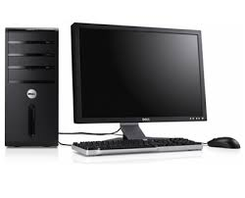
Lab computer environment
~/www
w3stu.cs.jmu.edu
login: jmu eid
like harrisnl
stu.cs.jmu.edu
ISAT/CS 250
When you log into the lab machines using your jmu eid
Your “home” directory is actually a directory on a server mounted to the PC in the lab.
Within your home directory is a link to another machine mounted on the file server which is a web server. You can reach your web space through this link or by using the URL w3stu.cs.jmu.edu/eid (where eid is your JMU eid)
You can use ssh to directly work on stu or use a tool such as Cyberduck (Mac), or WinSCP (Windows) or FileZilla (Linux). These tools provide a graphical interface and connect between your local machine and the server allowing you to drag and drop files in between.

Slide 2
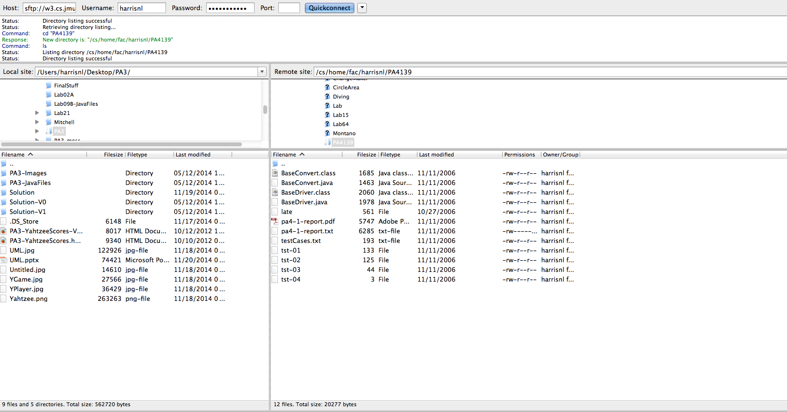
What FileZilla looks like

Slide 3

Install party Tuesday night
Get the JDK installed
Get Jgrasp installed and working with the JDK
Set up Windows “environment variables”
Install and test FTP tool
Lab during my 5-7pm office hours

Slide 4
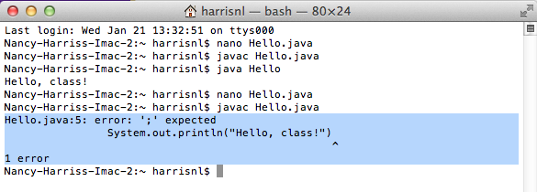
Reading a compiler error message
Name of file
Line number of the error
Description of the error
The line with the error (sometimes)
A pointer to where the error might be.

