Slide 1
Lab Introduction (lab01a)
Programming Fundamentals

Slide 2
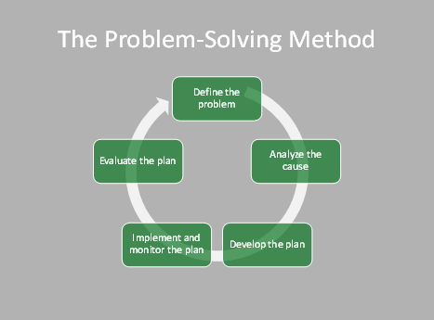
Problem solving
It’s not just about coding.
Don’t be surprised when you want to show me code, I will instead ask you to explain your strategy.

Slide 3
The Programming Process (Gaddis) 1.6
Clearly define what the program is to do. (Understand the problem)
2. Visualize the program running on the computer.
3. Use design tools to create a model of the program. (Design the solution)
4. Check the model for logical errors. (Test the design)
5. Enter the code and compile it. (Implement the solution)
6. Correct any errors found during compilation.
  Repeat Steps 5 and 6 as many times as necessary.
7. Run the program with test data for input. (Test the solution)
8. Correct any runtime errors found while running the program.
  Repeat Steps 5 through 8 as many times as necessary.
9. Validate the results of the program.

Slide 4
Lab 1a - Programming fundamentals
Input/output (getting data, providing results)
Assignment (storage of intermediary values)
Sequencing (putting steps in the correct order)
Decisions (choose whether an action occurs)
Loops (iteration/repetition)
Methods (subprograms (groups steps together))
Objects (data + methods)

Slide 5
Today’s lab
Focus on looking for examples of each of the structures.
  For each that you find the first time, describe the structure in the context of the tutorial and provide the module number in which you found it.
At the end, we’ll wrap up with what you found.

