Slide 1
More Loops
The For loop

Slide 2
Loop Control
All loops have four components:
1. Initialize 2. Test 3. Body 4. Update
// while loop version
number = 1;
while ( number <= 10)
{
System . out . println ( number );
number ++;
}
// do - while version
number = 1;
do
{
System . out . println ( number );
number ++;
} while ( number <= 10);

Slide 3
The for Loop Flowchart
boolean
expression?
true
statement(s)
update
for (int ii = 0; ii < 10; ii++)
{
… statements
}
In a for loop, the initialization, boolean expression and update are combined in one structure.
false
Another name is counted loop – You typically will execute a for loop based
on some counter. A for loop is also a precondition loop.

Slide 4
Counting to 10
The for loop header syntax combines initialize, test, and update
// for loop version
  for ( number = 1; number <= 10; number ++)
  {
  System . out . println ( number );
  }
// count backwards
for ( number = 10; number >= 1; number - -)
  {
  System . out . println ( number );
  }

Slide 5
for vs. while loops
The for loop is just a specialized form of the while loop.
  The following loops are equivalent:
  for (int num = 1; num <= 200; num = num * 2)
  {
  System.out.print(num + " ");
  }
// actually, not a very compelling use of a while loop
// In this case, for loop is better because the # of reps is definite
  int num = 1;
  while (num <= 200)
  {
  System.out.print(num + " ");
  num = num * 2;
  }

Slide 6
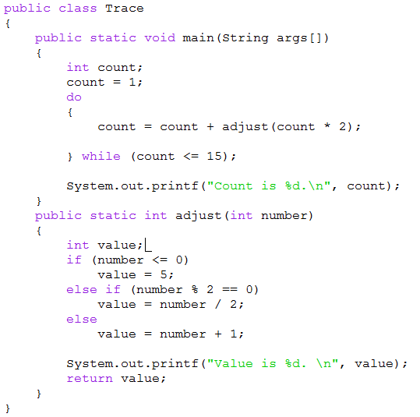
main method variables
count | count(inside loop)
1 | 2
 | 4
 | 8
 | 16
adjust method variables
number | value
2 | 1
4 | 2
8 | 4
16 | 8

Slide 7
Value is 1.
Value is 2.
Value is 4.
Value is 8.
Count is 16.
Program Output

