Slide 1
Introduction to Java
Data and Data Types

Slide 2
The following is a model for the revised Hello world program.
/***********************************************
* Prints a message, Hello World.
*
* @author - Nancy Harris, model solution
* @version - V1 - 09/09/2010
************************************************/
public class Hello
{
/********************************************
* entry point into the application
*
* @param args command line arguments - unused
*********************************************/
public static void main(String [] args)
{
// declarations
String message;
String message2;
// initialization
message = "Hello, World!\n”;
message2 = "I'm happy to be a programmer.”;
System.out.println(message + “ “ + message2);
}
}

Slide 3
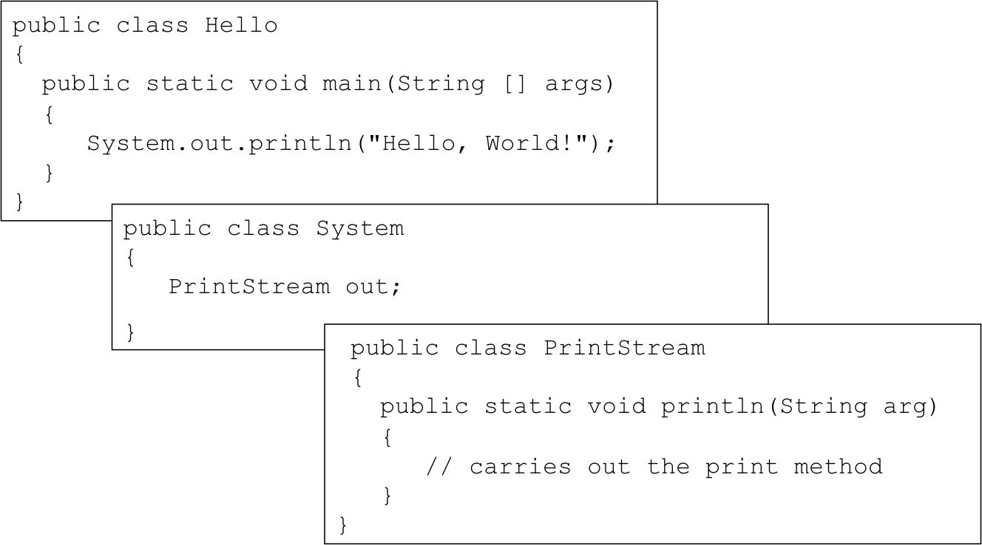
Classes in Java

