Slide 1
Algorithms

Slide 2
What are some properties of a good algorithm?
Simple – each step does one thing
Complete – the algorithm will finish
Right – the algorithm produces the correct results
Abstraction – the algorithm uses appropriate abstraction
Precise – the algorithm uses precise unambiguous language

Slide 3
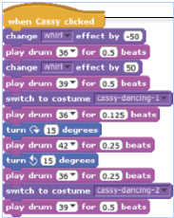

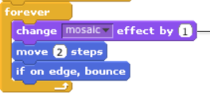
What are some structures we have seen?
Sequencing of steps
Decisions
Looping
Abstraction (each of the “motion”, “look” etc were subprograms with detail hidden elsewhere.

Slide 4
What have we learned about programming?
What strategies did you use?
How did you get unstuck?
How did you know that it worked?

Slide 5
Program example
What is a Java program?

