Slide 1

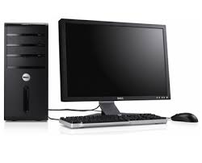
Lab computer environment
~/www
fs2.cs.jmu.edu
w3stu.cs.jmu.edu
login: jmu eid
like harrisnl
stu.cs.jmu.edu
ISAT/CS 248
When you log into the lab machines using your jmu eid
Your “home” directory is actually a directory on a machine mounted to the PC in the lab.
Within your home directory is a link to another machine mounted on the file server which is a web server. You can reach your web space through this link or by using the URL w3stu.cs.jmu.edu/eid (where eid is your JMU eid)
You cannot directly link to the fs2 server, but can reach it through another server, stu.cs.jmu.edu. This server has its home as the same directory on the fs2 server that you see in the lab. It too has the link to the www directory which is actually a folder on w3stu.
You can use ssh to directly work on stu or use a tool such as Cyberduck (Mac), or WinSCP (Windows). These tools provide a graphical interface and connect between your local machine and the server allowing you to drag and drop files in between.

