Slide 1

CS 345 – Software Engineering
Nancy Harris
ISAT/CS 217
harrisnl@jmu.edu

Slide 2
Welcome
Office hours
Who I am
Classroom style
A little about the project
Grading
Book
Syllabus and schedule

Slide 3
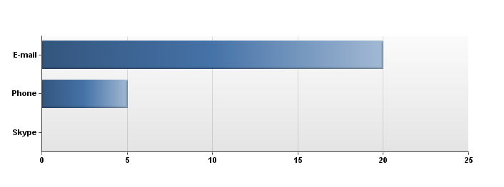
Who We Are
5 people don’t want a job
Most prefer e-mail

Slide 4
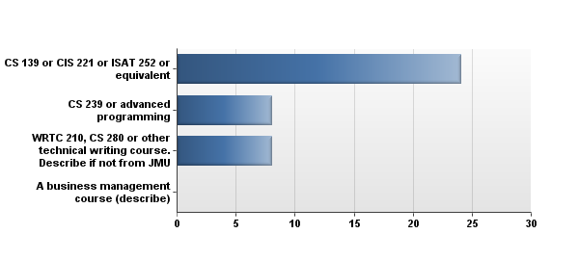
Some documentation skills

Slide 5
Reasons for taking the class
It's required for the Computer Science Degree.
Required for CS major.
I want to learn every aspect of computer science so that I can be the very best Computer Scientist. Also, this class is a major requirement
Major requirement.
Requirement in my major.
required, sounds fun.
The main reason is it is a major requirement but I am glad I am taking this course because it seems practical and proabably help me in the future.
because it is required to minor in cs
Learn about software
I am majoring in computer science. I am also looking ahead and thinking about possible internships and careers, and I feel that this class will help me prepare for the "real world." I hope to learn practical things and apply what I've learned from other computer science courses to this course.
part of the CS Minor
It is required for the Computer Science major. I also think this class will help me learn what its like to work as team on a project in the computer science field.
it is required. I think it is mendatory for people who work for computer science.
I need this class for my CS major. Also I would like to become a software engineer after college.
It is required for my degree.
I have a computer science minor and this class seemed really interesting.
used toward a CS major
CS Major
I need this class for my ISAT major
I want to make video games and hope that this class will help in some way.
I was hoping to complete a CS minor but I may not be able to by my anticipated graduation time. Therefore I am taking as many classes as I can simply because I like the subject and wish to absorb as much information about it as I can before pursuing my technical career.
This class is a requirement for graduation in CS.
For fulfillment of a major requirement and to take a serious in depth programming centered course.
It is recommended for the CS minor

Slide 6
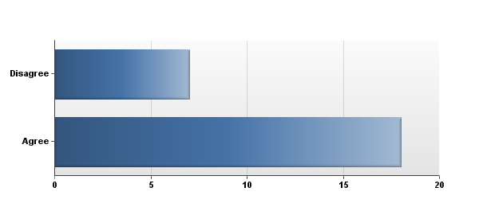
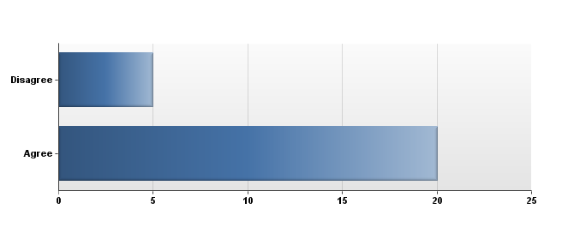
Classroom logistics
Read book before – play in class
Attendance
Take home exams

Slide 7
I learn best by
By listening to lectures that I can take notes on in class and ask questions as we go through the material. Then after class I can review my notes and re-write them, making them much more understandable for me to study and learn from.
Doing
Listening to lectures
teacher explaining things and using examples that correlate with the textbook.
Powerpoint notes and activities in class.(Visual)
doing and practicing the material, also seeing examples and lectures of it in class.
Hands on.
taking a note during lecture and compare it with the text book
Hands on experience
Listening and trying it myself.
Listening in class and making additional notes to a prepared outline of the day's lecture
I learn the best through power points lectures with (printout from blackboard) and in class lecture about the powerpoint
having lectures with multiple examples.
I don't like the lecturing which is by all oral statement, because i could miss some important point while I'm trying to understand your lecturing. So, I prefer lectures with powerpoint which incldues all of your oral lecturing which is very impossible though.
I learn by doing examples. I need hands on practice to learn something.
I feel like I learn best in hands-on environments, e.g. laboratory exercises or field experience.
When i am in a classroom or computer lab and i am being instructed by a teacher.
repetition-- repeated use of the material mostly by writing.
Online Lecture, Flipped classroom (in that order)
practicing.
I like seeing examples in class and the solutions to said problems as well.
doing hands-on assignments that actively apply the material and push you to figure some things out on your own.
Studying outside of class at my own pace and preferences, while using class time to go over questions.
doing. Especially with programming, theory can only do so much. I learn best by solving problems and writing real code.
A combination of lectures and activities.

Slide 8
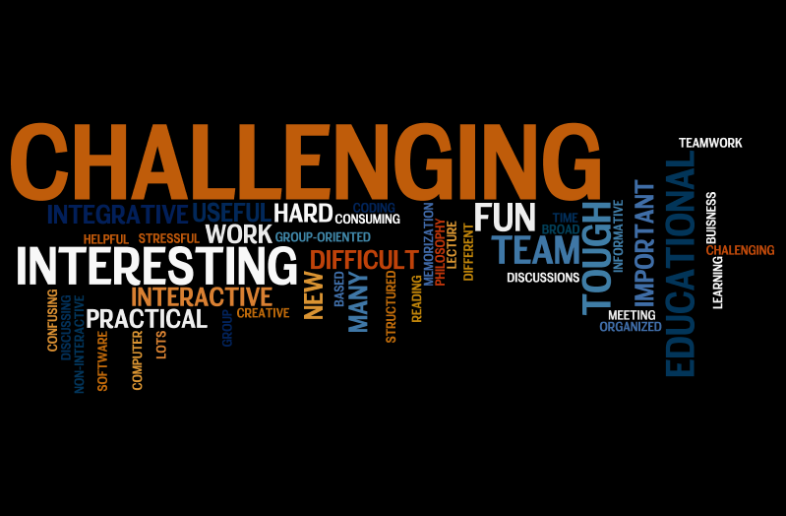
3 words

Slide 9
What is software engineering?
In impromptu groups, come up with a definition.

Slide 10
A process
Easy!

Slide 11
What can go wrong?
10 minutes to brainstorm all the ways this process can fail

Slide 12
Disasters
http://www.devtopics.com/20-famous-software-disasters/

Slide 13
Goals
That you gain an appreciation of the process of building high quality software
That you gain an appreciation for the role of communication in the process of building high quality software
That you learn and understand the terminology of software engineering
That you gain an appreciation for the many roles of people involved in software development

Slide 14
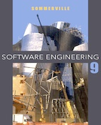
The book
Ian Sommerville
St. Andrews University, Scotland
http://www.software-engin.com/
Some online only chapters, link on BB or you can follow the link from the book.

Slide 15
Assignment for Thursday
Read chapter 1, paying particular attention to 1.2.
Come to class prepared to discuss the exercises in Chapter 1, page 25. You do not need to write out the answers, but you should read them and perhaps use them to guide your reading and to take notes.
Future assignments will be posted in BB in the assignments area.

