Slide 1
Requirements Engineering

Slide 2
Stakeholder
A person, group, or organization that has direct or indirect stake in an organization because it can affect or be affected by the organization's actions, objectives, and policies. Key stakeholders in a business organization include creditors, customers, directors, employees, government (and its agencies), owners (shareholders), suppliers, unions, and the community from which the business draws its resources.
Although stakeholding is usually self-legitimizing (those who judge themselves to be stakeholders are stakeholder ), all stakeholders are not equal and different stakeholders are entitled to different considerations. For example, a company’s customers are entitled to fair trading practices but they are not entitled to the same consideration as the company's employees. See also corporate governance.
Read more: http://www.businessdictionary.com/definition/stakeholder.html#ixzz26M5maO7c

Slide 3
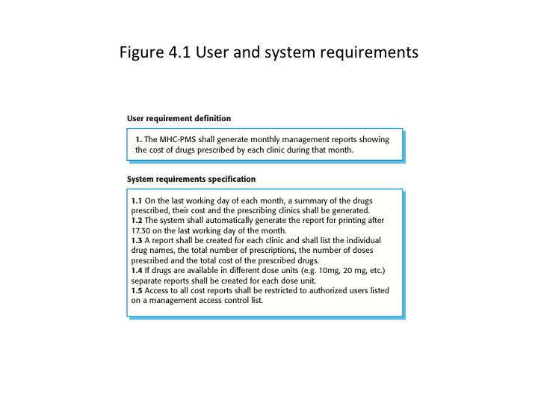

Slide 4
Functional / Non Functional
Functional – What it does. What the user sees and interacts with.
Non-functional – How it must operate. Requirements imposed by others. Constraints on the system.

Slide 5
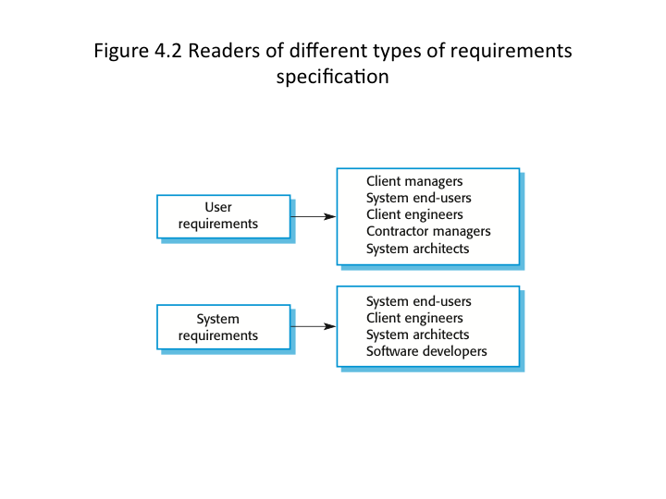

Slide 6
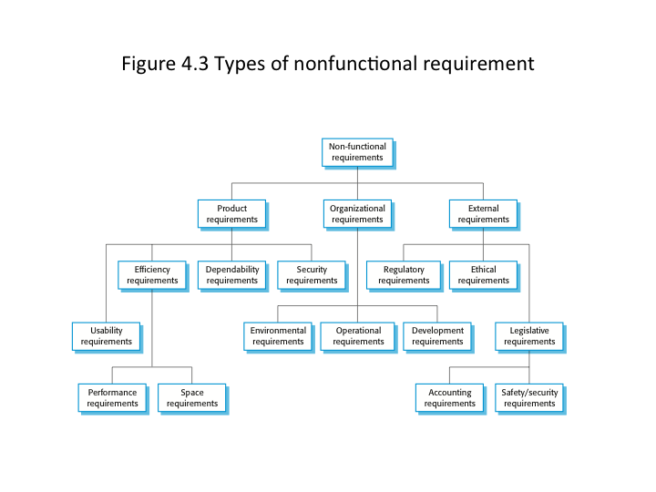

Slide 7
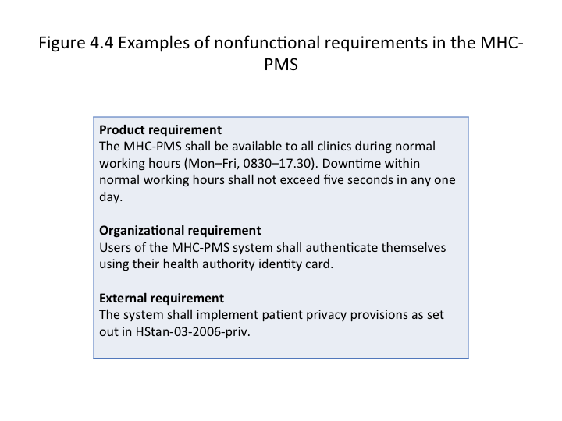

Slide 8
Metrics
Standards of measurement by which efficiency, performance, progress, or quality of a plan, process or product can be assessed.

Slide 9
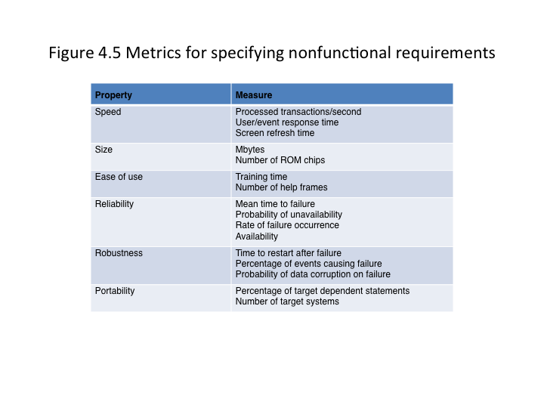

Slide 10
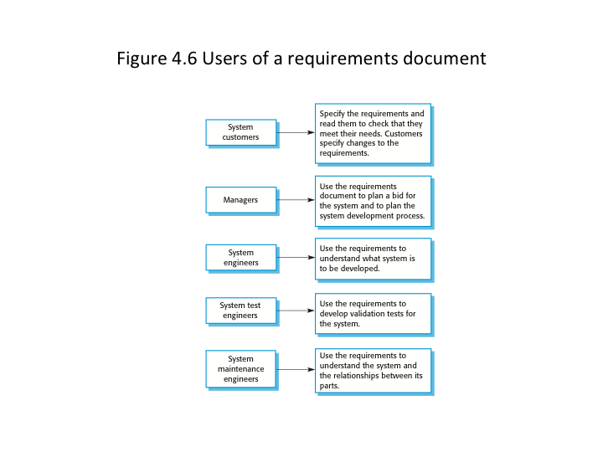

Slide 11
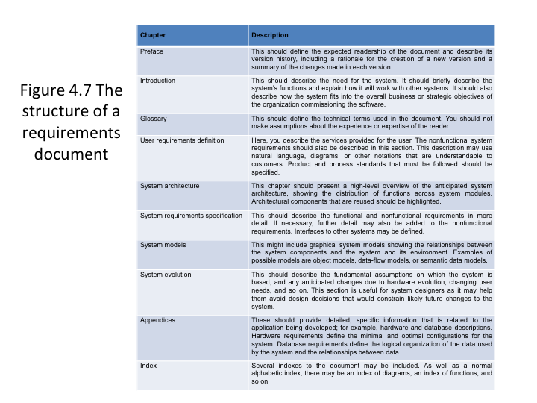

Slide 12
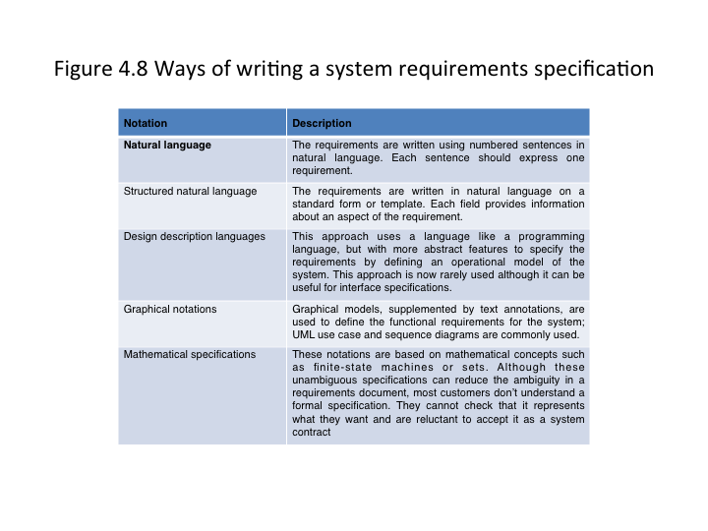

Slide 13
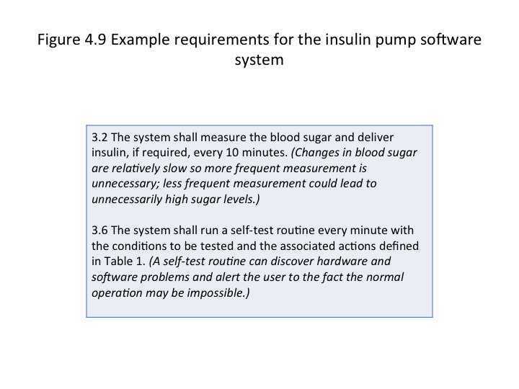

Slide 14
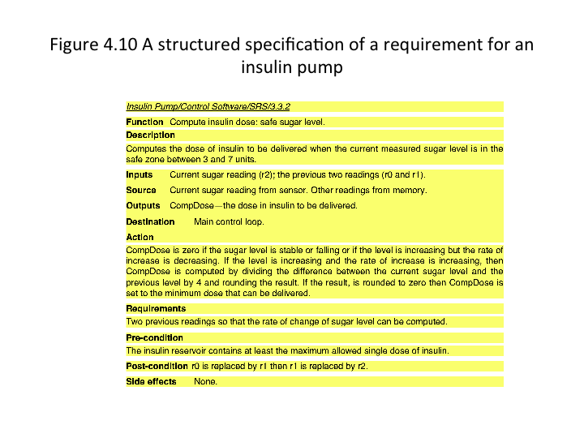

Slide 15
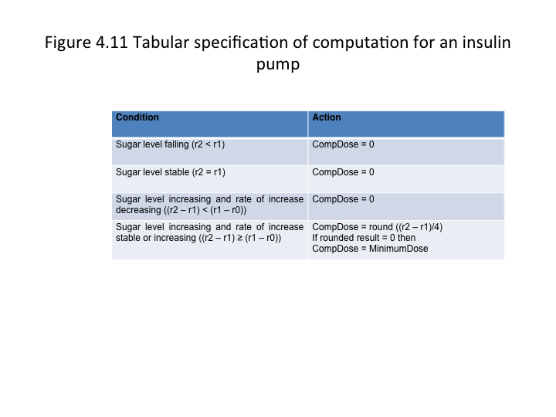

Slide 16
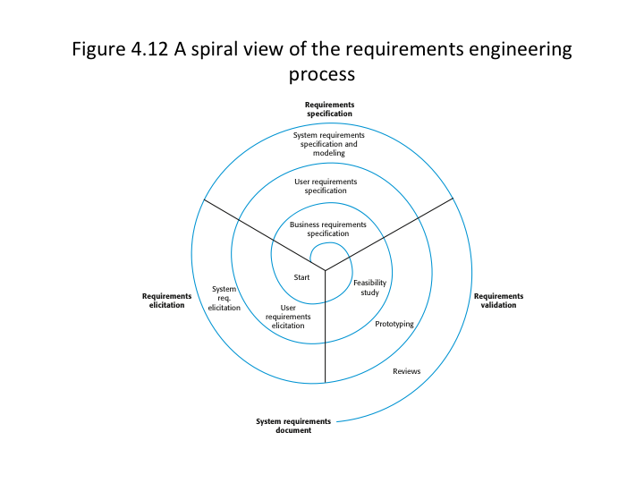

Slide 17
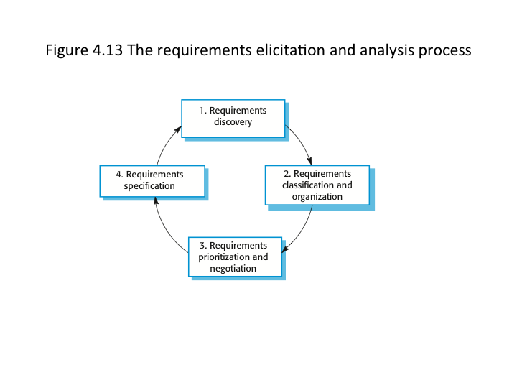

Slide 18
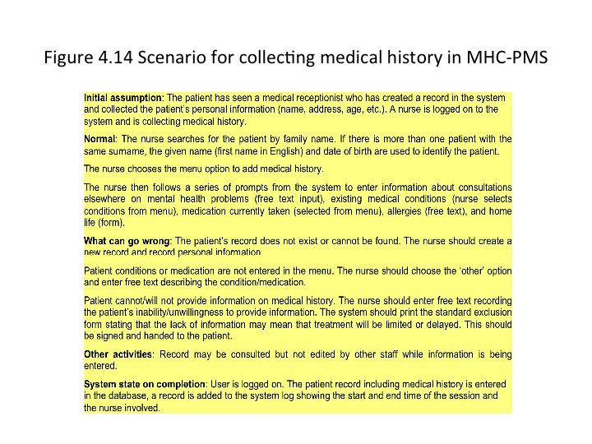

Slide 19
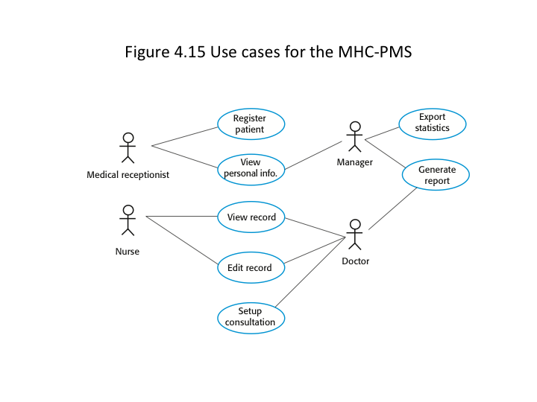

Slide 20
