Slide 1
Day 3 - Processes

Slide 2
Meet your team managers
Either real world managing experience
or articulated well what a manager must do with examples
or included a business management course or relevent experience
Many failed to make their case because while they said they are good at motivating people, for example, they did not say how they know they were good at motivating people.
About half of the class wants to be managers

Slide 3
The Seven Managers
Danny Gibney
Chris Chafin
Rachel Veal
Sean Best
Andrew Brathovde
Zachary Bolan
Indy Watson

Slide 4
The rest of the team
Spread the manager wanna bes among the rest of the groups (managers, watch your backs or embrace the opportunity to share some responsibilities)
Made sure each team had someone who wanted to do technical writing.
Made sure each team had someone who wanted to do quality control work.
Often a person wanted to do multiple things.

Slide 5
Rachel Veal
Mike Burke
Zachary Page
Sravya Kambalapally
Chris Chafin
Stanzi Sanders
Ian Van Zandt
Scott Taylor
Danny Gibney
Mike Smith
David Syhabandith
Robert Mercado
Nate Lee
Sean Best
Julianne Petrella
Will Sharp
John Hui
Andrew Brathovde
Brenton Schroeder
Kaleb Beasley
Brandon Wooten
Indy Watson
Lee Starnes
Matt Vetrano
Johnny Meier
Zachary Bolan
Seth Kuller
Cameron Rust
Brian Bui

Slide 6
Get into your teams
Fill out team organization worksheet – how will you operate as a group.
The project is unknown at this point, but will involve quite a bit of writing, some design, and development and implementation of a test plan.

Slide 7
Intro to project
Given the project description, give a critique. What is good about it? What is bad about it?
In your group, come up with questions that you have about the software that this individual is requesting? What does it not cover?
We will revisit this (with the questions answered) as we get into requirements documents.

Slide 8
Why have a development model at all?

Slide 9
Development Models
Waterfall
Spiral
Incremental Development
Reuse Oriented

Slide 10
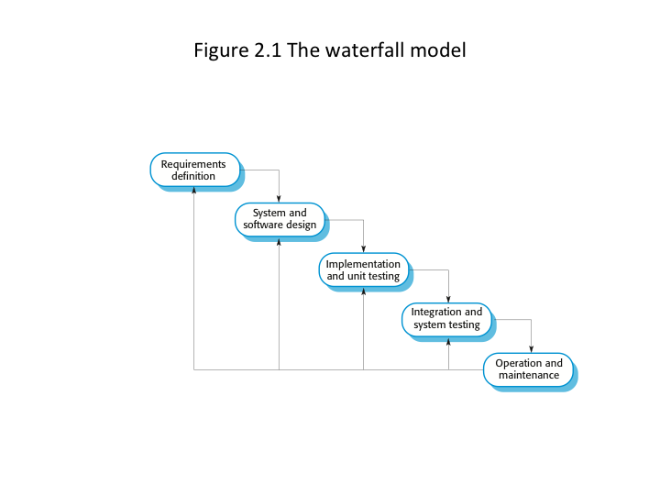
1970

Slide 11
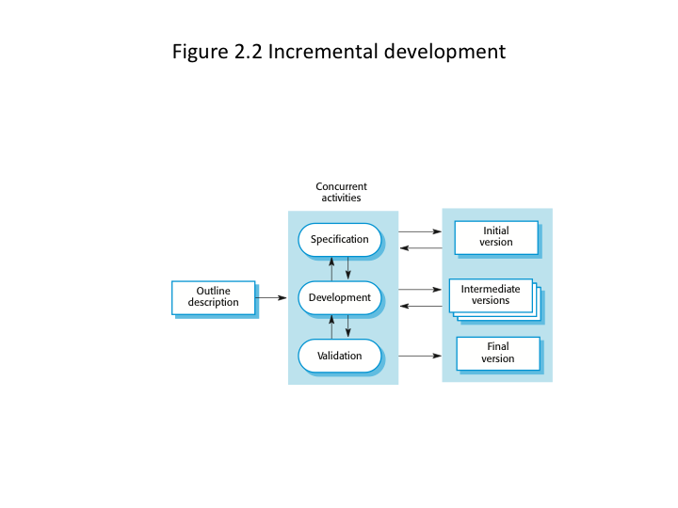

Slide 12
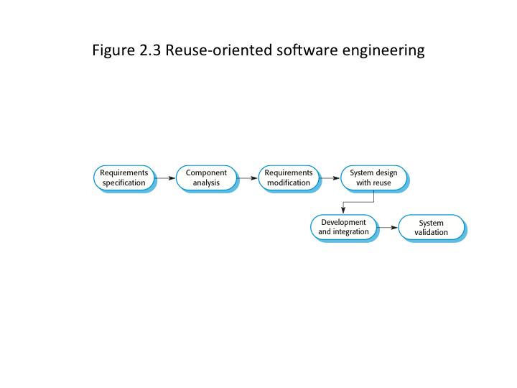

Slide 13
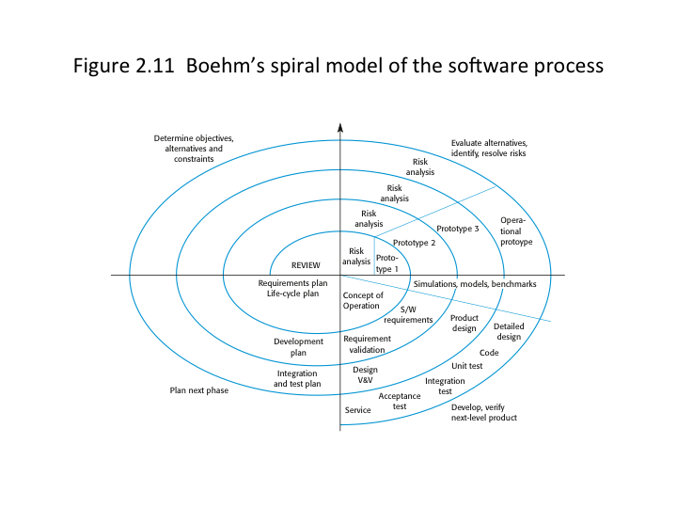

Slide 14
What do all of these models have in common?

Slide 15
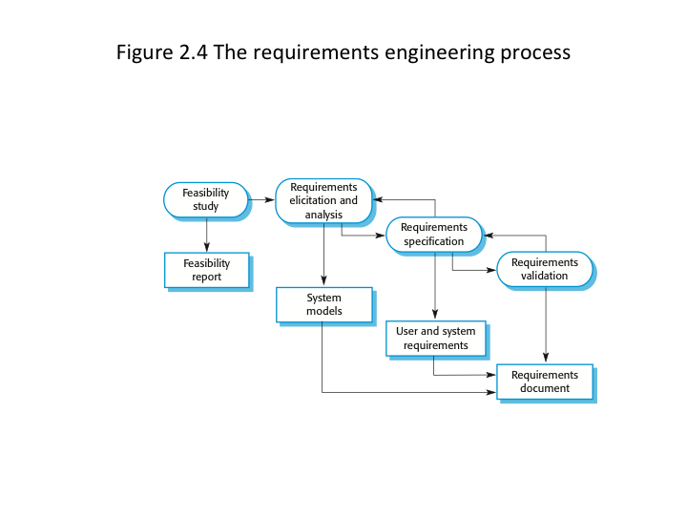
Software specification

Slide 16
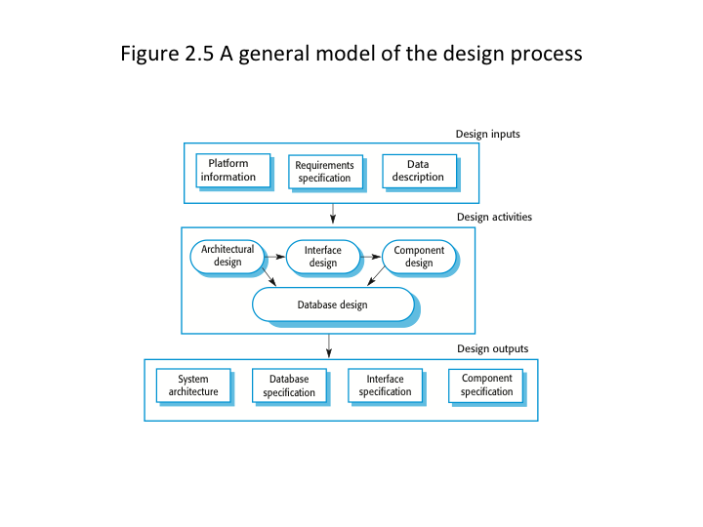
Software design and implementation

Slide 17
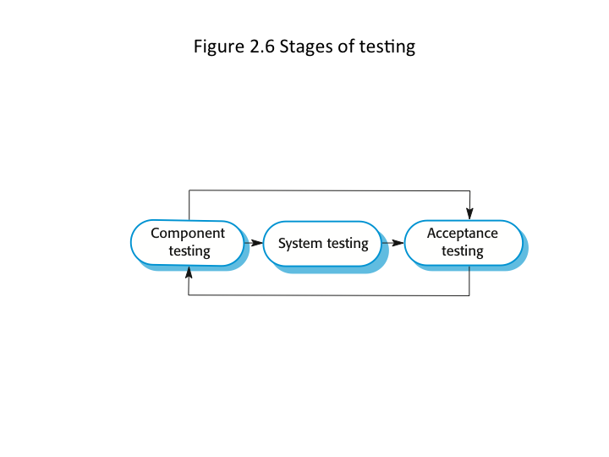
Software validation

Slide 18
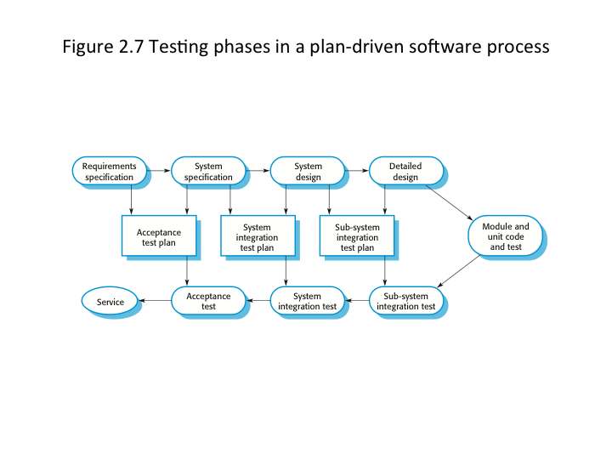
Software validation

Slide 19
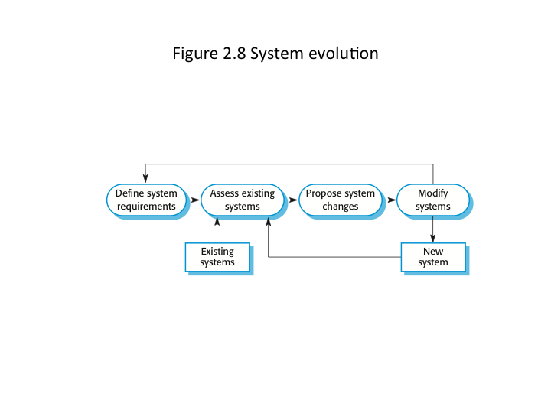
System evolution (maintenance)

Slide 20
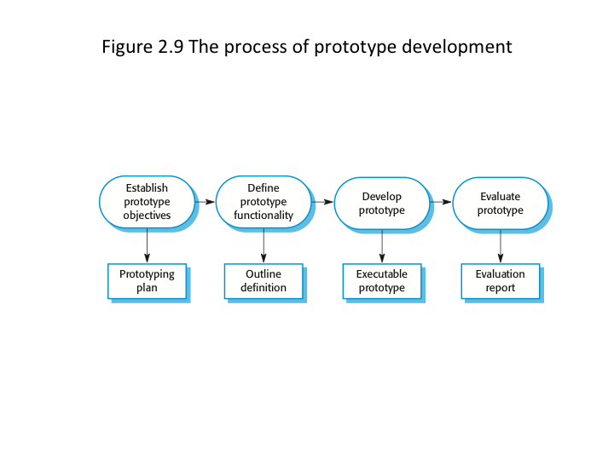

Slide 21
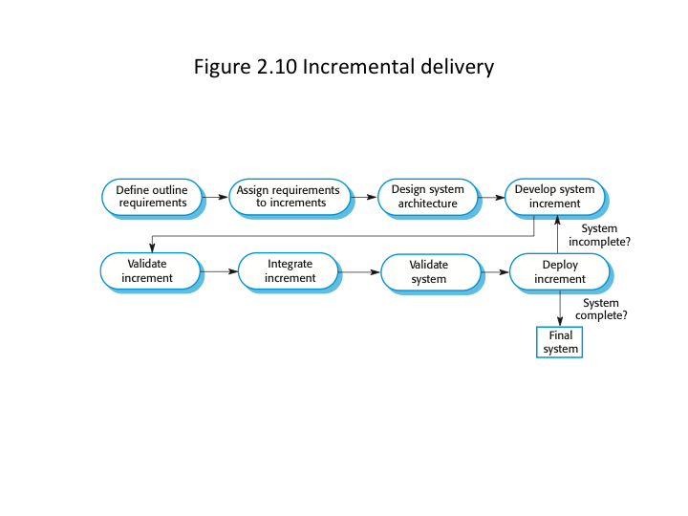

Slide 23
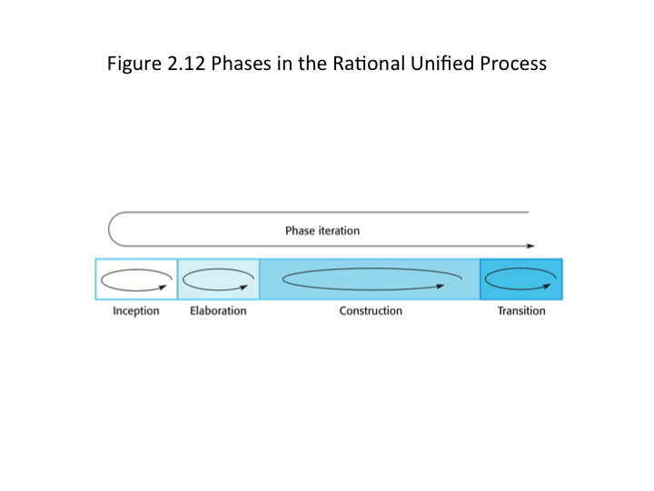

Slide 24
Questions
Why is incremental development better for business software systems? Why is this less appropriate for real time systems engineering?
Why do we make a distinction between user requirements and system requirements in the requirements engineering process?
Describe the main activities of the software design process and their outputs? How are these processes and outputs related?

Slide 25
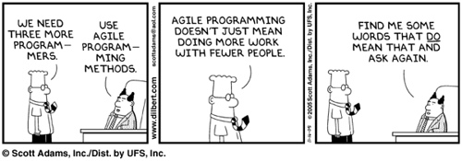
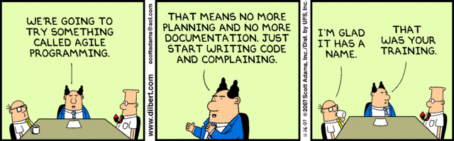
Agile methods

Slide 26
Fundamentals
Specification, design, and implementation are interleaved
Development is by a series of versions
User interfaces designed in an interactive development environment

Slide 27
Reality
Plan driven development is necessary for long critical systems development.
But, there is a cost …
That cost may be prohibitive for small systems
The time may be prohibitive for small systems that are trying to take advantage of market changes

Slide 28
Manifesto?
http://agilemanifesto.org/

Slide 29
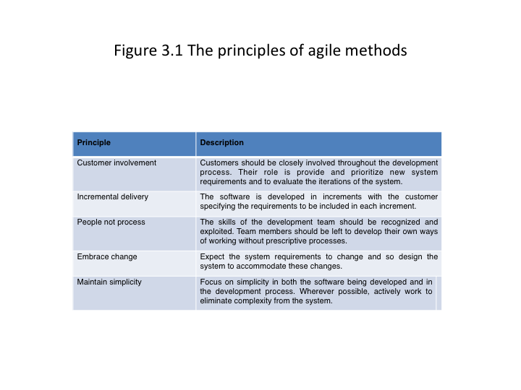

Slide 30
Issues
Customer involvement
Intense requirements of the development team
Scalability
With a less global view of the product, opportunities for reuse or simplification may be lost
Prioritizing changes may be difficult with different stake holders involved
Organizational culture
How do you know how much it will cost up front? Pay as you go can lead to bad feelings and conflict.
Maintenance

Slide 31
In practice
We often see processes developed that use a combination of agile and plan driven approaches

Slide 32
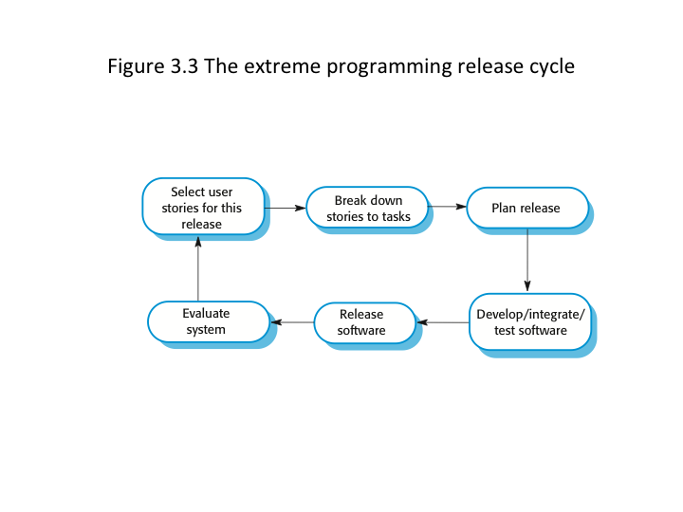
pair programming
Develop test plans
Beck 2000

Slide 33
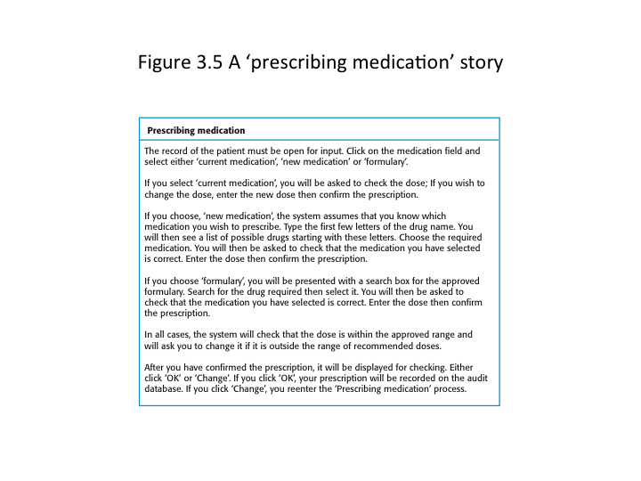

Slide 34
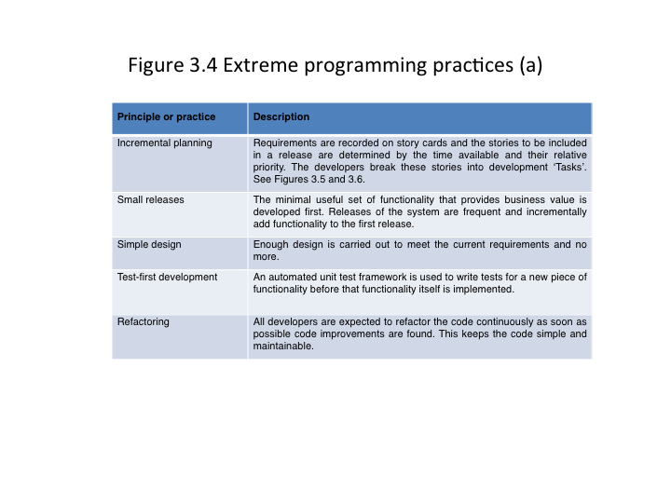

Slide 35
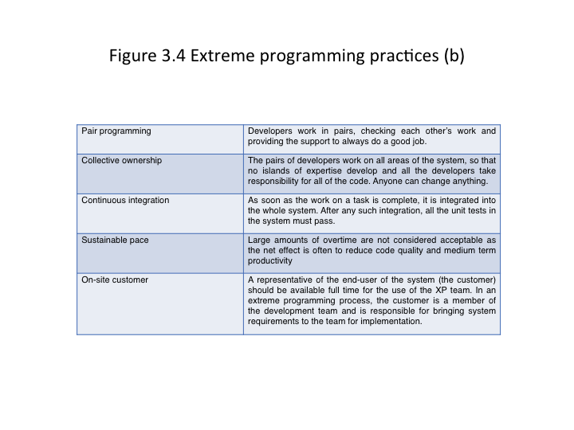

Slide 36
Issues and Advantages
Code degradation over time (no forethought or effort to plan for changes)
Refactoring?
Test first means we must fully understand the problem to develop the test cases. These will be reused throughout the development life cycle.

Slide 37
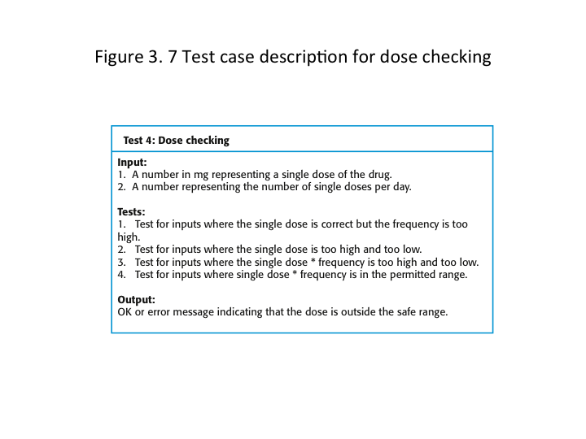

Slide 38
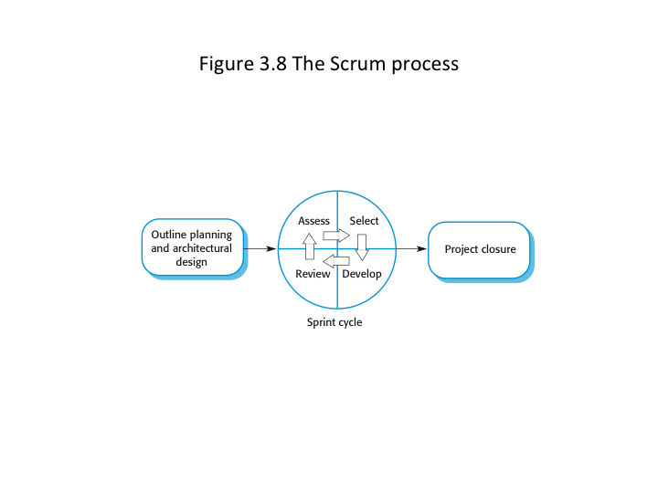
Scrum

Slide 39
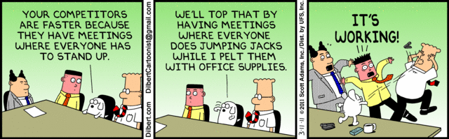
Scrum meetings

Slide 40
Questions
Suggest four reasons why the productivity rate of programmers working as a pair might be more than half that of two programmers working individually (3.6)
When would you recommend against using an agile method? (3.3)
Comment on the different strategies for developing software for aircraft (3.8)

Slide 41
Ethical question
Historically, the introduction of technology has caused profound changes in the labor market…
Does process automation lead to the reduction in need for software engineers? Why? Why not?
If it will reduce the need, is it ethical for engineers to resist the introduction of this technology? Why? Why not?

