Slide 1

CS 345 – Software Engineering
Nancy Harris
ISAT/CS 217
harrisnl@jmu.edu

Slide 2
Welcome
Office hours
Who I am
Classroom style
A little about the project
Grading
Book
Syllabus and schedule

Slide 3
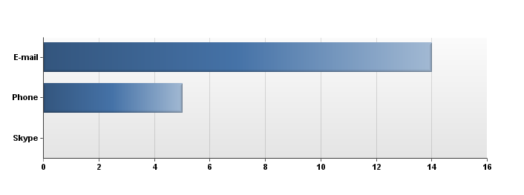
Who We Are
10 people don’t want a job
Most prefer e-mail

Slide 4
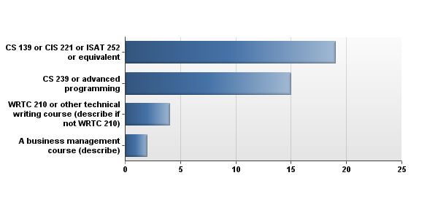
Some documentation skills and management skills

Slide 5
Why are you here?
Major requirement (11)
Minor (3)
Personal skills (1)
Interest in topic (10)
Advance programming knowledge (4) **

Slide 6
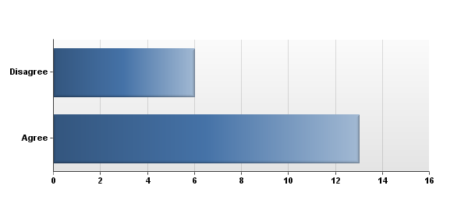
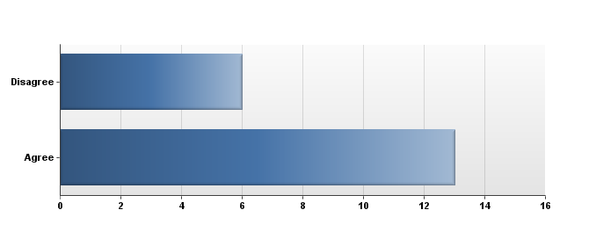
Classroom logistics
Read book before – play in class
Attendance
Take home exams

Slide 7
Learn best by
Lab/hand on/doing – 14
Listening to lecture – 3
Interacting with others

Slide 8

3 words

Slide 9
What is software engineering?
In impromptu groups, come up with a definition.

Slide 10
A process
Easy!

Slide 11
What can go wrong?
10 minutes to brainstorm all the ways this process can fail

Slide 12
Disasters
http://www.devtopics.com/20-famous-software-disasters/

Slide 13
Goals
That you gain an appreciation of the process of building high quality software
That you gain an appreciation for the role of communication in the process of building high quality software
That you learn and understand the terminology of software engineering
That you gain an appreciation for the many roles of people involved in software development

Slide 14

The book
Ian Sommerville
St. Andrews University, Scotland
http://www.software-engin.com/
Some online only chapters, link on BB or you can follow the link from the book.

Slide 15
Assignment for Thursday
Read chapter 1, paying particular attention to 1.2.
Come to class prepared to discuss the exercises in Chapter 1, page 25. You do not need to write out the answers, but you should read them and perhaps use them to guide your reading and to take notes.
Future assignments will be posted in BB in the assignments area.

