Slide 1
What is software engineering
01/09/2013

Slide 2
Software Products
Generic Products
Customizable Products
Bespoke (fully customized, unique) Products

Slide 3
“Software engineering is a systematic approach to the production of software that takes into account practical cost, schedule, and dependability issues, as well as the needs of the software customers and producers.”
Ian Sommerville

Slide 4
Types of systems
Stand-alone applications (Office, productivity software)
Interactive transaction based systems (business and web)
Embedded control systems (phone, car, washing machine, microwave)
Batch processing systems (People soft at end of semester, billing systems)
Entertainment systems (games, audio)
Modeling and simulation
Data collection systems (sensors sending data)
Systems of systems (systems composed of other systems (web applications wedding front end, browser, database management system))

Slide 5
Book examples
Embedded – Insulin pump
Information system (Interactive transaction based/system of systems) – Medical records system
Sensor based collection system – Wilderness weather station

Slide 6
Fundamentals of SE applicable to all types of systems
Well understood development process
Dependability and performance
Managing the requirements
Reuse

Slide 7
Some perspective
We didn’t always “engineer” software.
Technology too new. Schedule???? what schedule??? who knew what we might run into.
No packaged software although there was the beginnings of the idea of reusable components.
1950’s 1960’s began to consider what “software engineering” might be. How can you “build software” the same way you can build a bridge?

Slide 8
Historical beginnings
NATO Science Conference 1968 and 1969
Disasters in 60’s 70’s and 80’s also spurred some action toward building better software.
Some of this action was looking for the magic tool that would make software “programmer proof”. Tools may have helped productivity, but did not offer the silver bullet to solve software problems. (1986) Fred Brooks
Most models in the “plan driven development” genre were developed in 1970s.

Slide 9


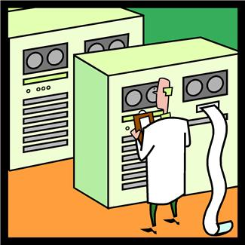

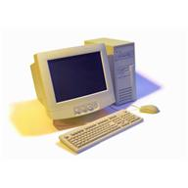

The “cloud”
change is good?

Slide 10
Ethical considerations
Use your power for good, not evil
The golden rule applies
Follow the law
Confidentiality
Competence (you are who you say you are)
Respect intellectual property
Use computing resources ethically

Slide 11
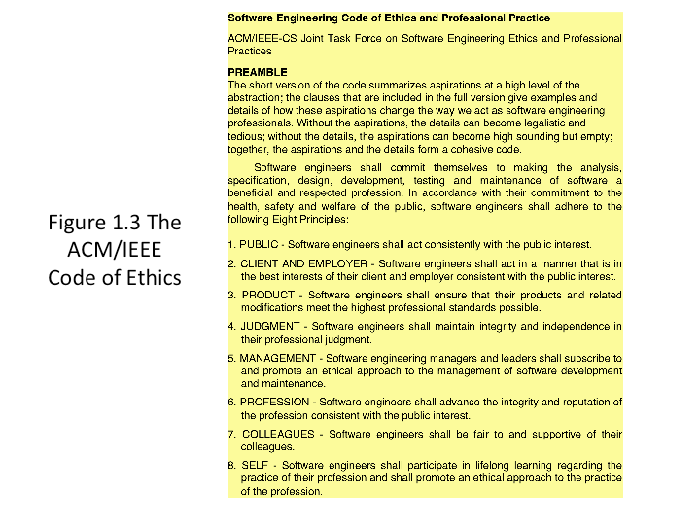

Slide 12
Discussion question
1.1 Why is professional software not just programs that are developed for a customer (or in what way?)
1.2 How are generic software products different from custom software products? How are they the same?

Slide 13
Building software
For each of the fundamental aspects of software engineering, explain why they are important.
a. Well understood process
b. Dependability and performance
c. Managing requirements
d. Reuse

Slide 14
Why is it so hard?
Why do you think we have to be concerned about processes and quality? Why does it seem to be so difficult to produce high quality useful software?

Slide 15
Ethical question
1.10 – To help counter terrorism, many countries are planning or have developed computer systems that track large numbers of their citizens and their actions. This has privacy implications (“Big brother is watching you.”)
Discuss the ethics of working on the development of this type of system.
http://www.youtube.com/watch?v=pbfGzFMxmHo

