Slide 1
The Edit/Save/Compile/Execute Cycle
Using the JGrasp Editor

Slide 2
Important Terms
Source file:
Save:
Compile:
Execute:
Byte code:
.java
.class

Slide 3
The Basic Cycle
Edit: You type in your source code.
Execute:Call the Java Virtual Machine (JVM) which translates the byte code to machine language and executes the file.
Edit
Save
Compile
Execute
Compile: Compiling checks the source for errors. If none, produces a .class file.
Save: You save the source file with the .java extension.

Slide 4
If you have compiler errors
Edit
Save
Compile

Slide 5
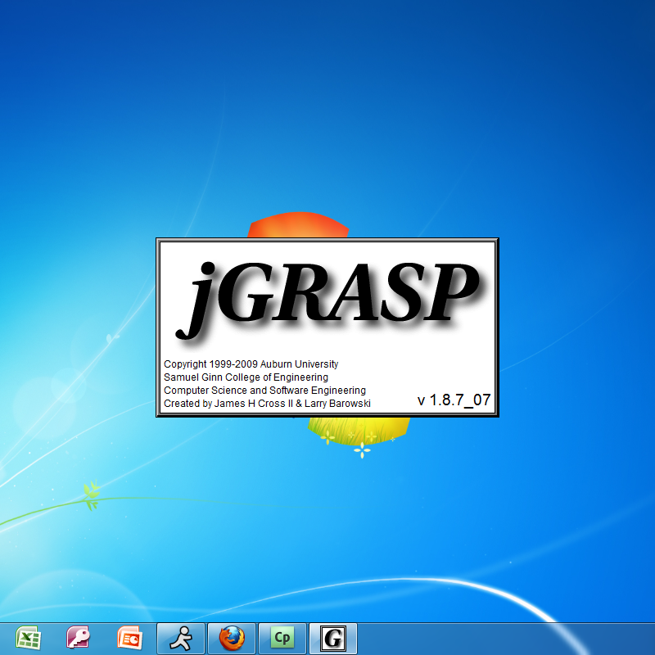
Now Let’s See a Demo using jGRASP

