Slide 1
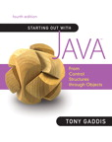
READ MORE ABOUT IT!
Chapter 1.6

