Slide 1
Next week Tuesday
Report on the project
  Demo of the working model. Today at the conclusion of lecture, class get together to figure out how you will present the final product.
  Short report (individually, contributions and effort, rank order of team member contribution)
  Short report (team, what went well in your estimation of your group work, what did not go so well, and what would you do in the future to improve how well your team succeeded in its tasks). This report should also include how your team fit into the work of other teams and what went well in that interaction and what did not go so well.
  All together – decide on what features/improvements you would make to the software, both internally and externally and prioritize those for correction prior to the last day of class.

Slide 2
Maintenance and Reengineering
Or after the fun is over and the product is no longer shiny and new!

Slide 3

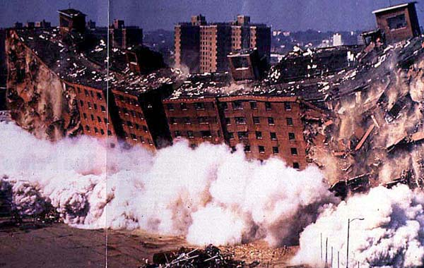
Maintenance vs Reengineering

Slide 4
Maintenance
Defect correction
Extend capabilities
  Changing environments
  Changing needs of customers (internally and externally driven)

Slide 5
Why do needs change?
Given a capability, users see new ways to use it.
Given a system, users see holes and gaps that they did not anticipate.
When given a system, users may find other things that they do that might be automated.
Users not involved originally may find uses (along with special adaptations)
Examples

Slide 6
Why do needs change
GOVERNMENT and other REGULATION
  The “government” is involved in many aspects of “business”
  Taxes (both payroll and other versions of taxation)
  Regulation (regulation requires documentation)
Other “outside agencies”
  Insurers
  Vendors
  Customers

Slide 7
How does the environment change?
Software has a long life – hardware does not
The explosion in hardware capabilities has altered the need for small storage and processing speed.
Central server with “dumb” terminals gave way to distributed systems in a client-server environment has given way to many internet based applications. What’s next?

Slide 8
Why is it so hard to do maintenance?
Maintenance folks are rarely the development folks.
People move on, if not from the company perhaps to new responsibilities.
Our code memory is short lived. Look at code you wrote 6 months ago and you probably will not recognize it.
Coders hate to do documentation and documentation I might write for myself may not make sense to another reader.

Slide 9
How do we improve maintainability?
Well documented development process.
  Why were decisions made?
  What is the scope of the existing product? ($$$$)
  What were the design decisions specifically?
  Standards maintained throughout the coding.
  Highly maintainable code is well compartmentalized.
  Highly maintainable code uses well understood patterns.
  All of the things that have led us to this point in the course.

Slide 10
Support includes
A mechanism for customers to report defects
A mechanism for recording and categorizing defects
  minor cosmetic issues may take a back seat to
  major functionality issues
A mechanism for systematically correcting defects, testing resulting code and deploying corrections.
This is all costly to the organization, but a necessary step.

Slide 11
How is support funded?
Built into the cost of the software. (Like OS and many other off the shelf products. We don’t pay maintenance fees, but at some point may be forced to upgrade to a later version.
Maintenance agreements. Based on the “normal” costs to maintain the software, a maintenance agreement provides a certain level of support. (Extended warranties).
Cost per service call. A specific charge is assessed the customer making each support call. Additional charges for coding changes usually apply.

Slide 12
Reengineering
Business
processes
IT
systems
Software
applications
Reengineering

Slide 13
Reengineering
At some point, the cost to maintain software becomes too great or the product is breaking down at an unacceptable rate.
OR Business needs change and you need to reengineer processes and along with that they software systems that support those processes.

Slide 14
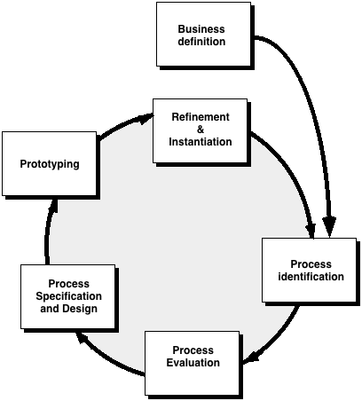
Business Process Reengineering
Goals broad categories:
cost reduction
time reduction
quality improvement
empowerment

Slide 15
BPR Principles
Organize around outcomes, not tasks.
Have those who use the output of the process perform the process.
Incorporate information processing work into the real work that produces the raw information.
Treat geographically dispersed resources as though they were centralized.
Link parallel activities instead of integrated their results. When different
Put the decision point where the work is performed, and build control into the process.
Capture data once, at its source.

Slide 16
Software Reengineering
Forward
engineering
inventory
analysis
Data
restructuring
document
restructuring
code
restructuring
reverse
engineering

Slide 17
Inventory Analysis
build a table that contains all applications
establish a list of criteria, e.g.,
  name of the application
  year it was originally created
  number of substantive changes made to it
  total effort applied to make these changes
  date of last substantive change
  effort applied to make the last change
  system(s) in which it resides
  applications to which it interfaces, ...
analyze and prioritize to select candidates for reengineering

Slide 18
Document Restructuring
Weak documentation is the trademark of many legacy systems.
But what do we do about it? What are our options?
Options …
  Creating documentation is far too time consuming. If the system works, we’ll live with what we have. In some cases, this is the correct approach.
  Documentation must be updated, but we have limited resources. We’ll use a “document when touched” approach. It may not be necessary to fully redocument an application.
  The system is business critical and must be fully redocumented. Even in this case, an intelligent approach is to pare documentation to an essential minimum.

Slide 19
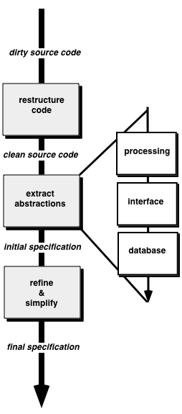
Reverse Engineering

Slide 20
Code Restructuring
Source code is analyzed using a restructuring tool.
Poorly design code segments are redesigned
Violations of structured programming constructs are noted and code is then restructured (this can be done automatically)
The resultant restructured code is reviewed and tested to ensure that no anomalies have been introduced
Internal code documentation is updated.

Slide 21
Data Restructuring
Unlike code restructuring, which occurs at a relatively low level of abstraction, data structuring is a full-scale reengineering activity
In most cases, data restructuring begins with a reverse engineering activity.
  Current data architecture is dissected and necessary data models are defined (Chapter 9).
  Data objects and attributes are identified, and existing data structures are reviewed for quality.
  When data structure is weak (e.g., flat files are currently implemented, when a relational approach would greatly simplify processing), the data are reengineered.
Because data architecture has a strong influence on program architecture and the algorithms that populate it, changes to the data will invariably result in either architectural or code-level changes.

Slide 22
Forward Engineering
1. The cost to maintain one line of source code may be 20 to 40 times the cost of initial development of that line.
2. Redesign of the software architecture (program and/or data structure), using modern design concepts, can greatly facilitate future maintenance.
3. Because a prototype of the software already exists, development productivity should be much higher than average.
4. The user now has experience with the software. Therefore, new requirements and the direction of change can be ascertained with greater ease.
5. CASE tools for reengineering will automate some parts of the job.
6. A complete software configuration (documents, programs and data) will exist upon completion of preventive maintenance.

Slide 23
Economics of Reengineering-I
A cost/benefit analysis model for reengineering has been proposed by Sneed [Sne95]. Nine parameters are defined:
    P₁ = current annual maintenance cost for an application.
    P₂ = current annual operation cost for an application.
    P₃ = current annual business value of an application.
    P₄ = predicted annual maintenance cost after reengineering.
    P₅ = predicted annual operations cost after reengineering.
    P₆ = predicted annual business value after reengineering.
    P₇ = estimated reengineering costs.
    P₈ = estimated reengineering calendar time.
    P₉ = reengineering risk factor (P₉ = 1.0 is nominal).
    L = expected life of the system.

Slide 24
Economics of Reengineering-II
The cost associated with continuing maintenance of a candidate application (i.e., reengineering is not performed) can be defined as
C_{maint} = [P₃ - (P₁ + P₂)] x L
The costs associated with reengineering are defined using the following relationship:
C_{reeng} = [P₆ - (P₄ + P₅) x (L - P₈) - (P₇ x P₉)] `
Using the costs presented in equations above, the overall benefit of reengineering can be computed as
cost benefit = C_{reeng} - C_{maint}

