Slide 1
Textbooks, Who Knew?
From a Workshop by the Madison Teaching Fellows
24 & 25 Jan. 2008
Updated for New Faculty Orientation - 2011

Slide 2
Today’s Agenda
The Big Picture
Professor / student disconnect
Demonstrations of textbook use
Lessons Learned
Reflection and Application

Slide 3
Why do we care?
We choose a text(s) that will complement our courses.
We assign the book.
We assign the reading.
The students choose to read or not.
So why should we care about textbooks and their use?

Slide 4
Textbooks:
Politics, Policy, & Profits

Slide 5
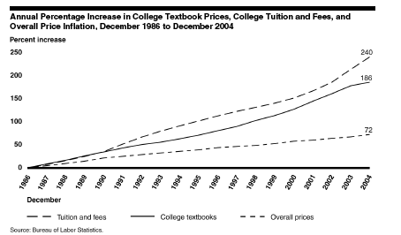
Politics
College costs are rising rapidly

Slide 6
College Tuition & Fees
Textbooks
Recreational Books

Slide 7
Politics - II
While tuition & fee costs have risen more rapidly than book costs, they are highly varied by state and campus.
In contrast, books are pretty much the same everywhere…
And textbooks are priced much higher than “trade books”…
Therefore, books are easier political agenda item…..

Slide 8
Politics - The Sad Reality of Faculty Lobbying
Students - Virginia21 (http://www.virginia21.org/)
  Started to get young people to register to vote
  Has morphed into a Public Interest Research Group
  Big time financial backing, full time lobbyists
Universities - Strong but agenda is often different than faculty, e.g. JMU stadium
Firms - Often have paid lobbyists
So who advocates for faculty……

Slide 9

Politics - Faculty Lobbying
AAUP - Academic Freedom (Hmm….)
The Faculty Senate of Virginia, aka, “Jim”
    Tries to represent faculty interests
    Jim talks to legislators
      e.g. “Academic Diversity”
    Jim’s full time job is professor
    http://fsva.asp.radford.edu/
The website is woefully out of date.

Slide 10
Results in Policies
HB 1478 (2006)
  Requires YOU:
    Justify changes to new edition
    Be aware of the cost of the book
    Justify book bundles
    Provide ISBN to the institution’s designated “clearing house”, in JMU’s case, the Book Store, in sufficient time
    Cannot receive compensation for picking a book
    Cannot sell books given to you for examination purposes
Now you know why faculty seemed like the bad guys when reading HB 1478.
JMU Policy: http://www.jmu.edu/JMUpolicy/2110.shtml

Slide 11
Profits
Bookstore
  Makes more money on used books than new
    25% margin on new books, prices used @75% of new,
    $100 new book, $80 wholesale = $20 profit, 25% margin
    Buys back from student at a maximum of $50, sells for $75, a 50% markup, and $5 extra profit over new book
    Plus all students don’t get 50% back, why adoption so key
  Makes the most from selling school spirit type items, not books.
  Only 4 national wholesalers (we have Follett)
Publishers
  Stuck on the new edition treadmill
  ISBN game (started by bundling) may actually have been made easier
  Industry consolidation, top 5 firms control 80%, makes very profitable

Slide 12
Rentals
New program allows students to rent a book for the semester.
About ½ the cost of a new book
Can make notes, highlight, etc
If the book is used for more than one semester, recommend that the students buy new.

Slide 13
Issues Going Forward
College costs continue to rise
Students & parents becoming more vocal
  Rise of “consumerism” model of higher ed
Bookstores & publishers still seek profits
Higher Ed & faculty especially, very easy targets for political action
Faculty generally inept or not present in debate
So, book you use/require will be a big deal
Expect increased tension in the consumerism position vs. “picking the best book to facilitate learning in class” faculty model

Slide 14
Table Questions
Entrance Pass
  Rate the relative importance of the textbook to student learning in your courses. (hi-med-lo)
  Rate the degree to which you think faculty implement a range of effective strategies for integrating textbooks in instruction.
  Rate what you believe to be the level of student satisfaction with textbook use.

Slide 15
The Disconnect
Survey of students regarding their use of the textbook – some selected classes

Slide 16
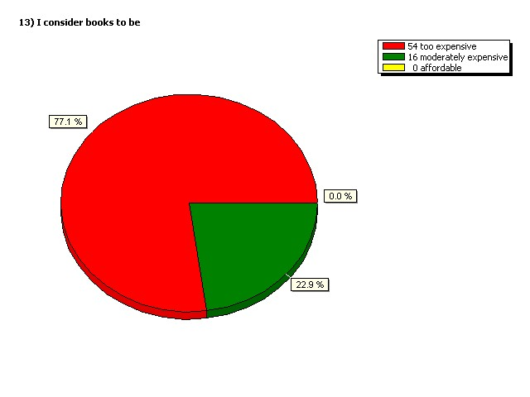
I consider books to be
Too Expensive
Moderately Expensive

Slide 17
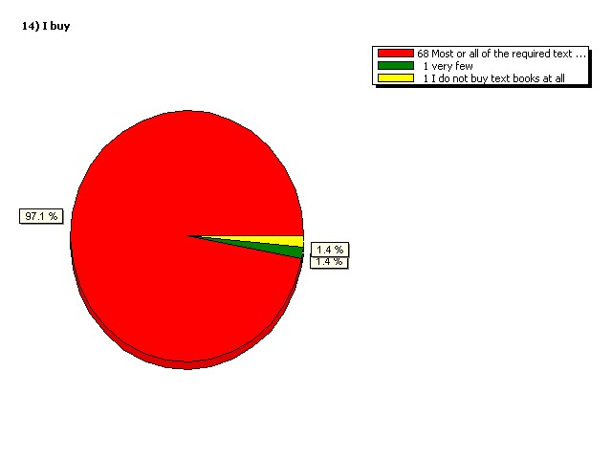
I buy
Most
None
Very few

Slide 18
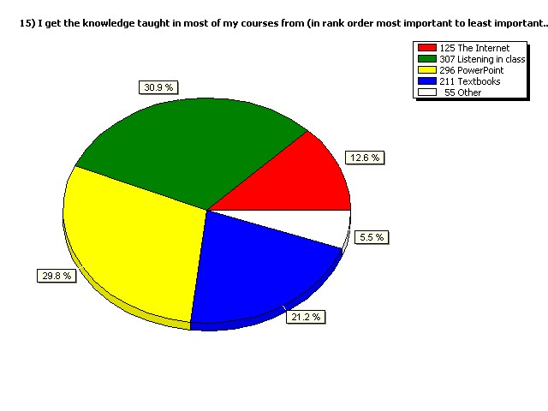
I get most of the knowledge in my courses from:
Listening in class
The Internet
PowerPoint
Textbooks

Slide 19
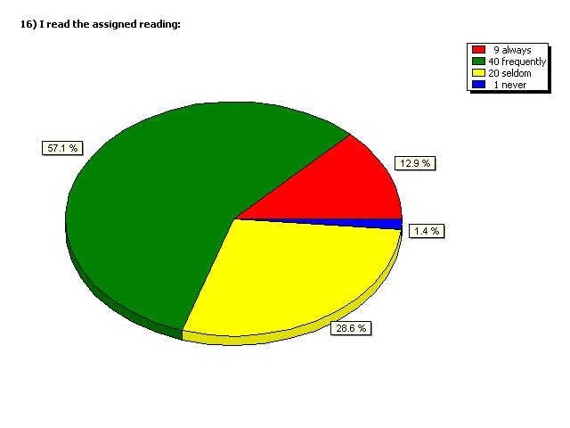
I read the assigned readings
frequently
always
never
seldom

Slide 20
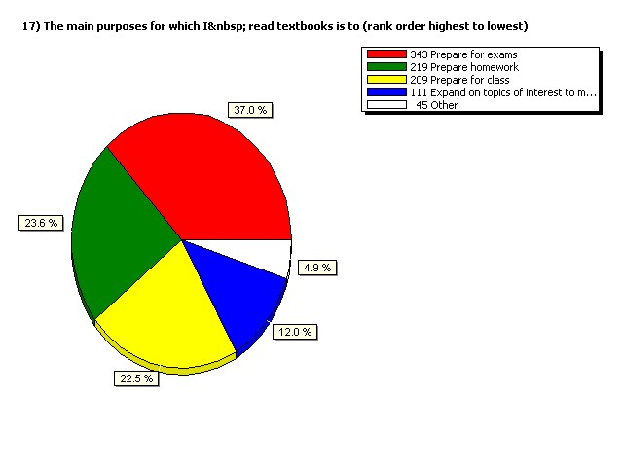
The main purpose for which I read the textbook is:
Exam prep
Homework
Expand on topics of interest
Class prep

Slide 21
What some students say
I feel like a lot of the textbooks are a waste of money. My book I spent like a hundred bucks on it and we don't use it. The teacher prints out a homework sheet and you turn it in at a study session. I'm never going to use that book.
Personally, I would die without my textbook. Personally, I wouldn't pass any of any tests without my textbooks because I use -- I am constantly reading.

Slide 22
What some students say, cont
But for the teacher to use it effectively, I find that they read the chapter when we're supposed to be reading it so they come to class and they're prepared. They're like okay, so I know this one section is awkward, go back or skip it if you need to. I understand. We'll cover it again. And they'll assign bookwork that they feel relates directly, not just random.
You've got these students, these parents scrimping money together who just dropped $100 on a book and I'm not going to need it? It's a waste. That's the biggest scam in college right there. I'm not going to lie. It's textbooks. This ain't just me talking. The biggest scam in college.

Slide 23
What past methods of using textbooks have been useful to you? In which ways were they beneficial to you?
Breaking up the readings so they aren't as overwhelming.
Using the CDs that come along with the books to apply the information that is discussed.
I often read the text first, then do the review questions or exercises at the end. If I am still struggling, I will sometimes use the CDs that come with the books to help me get another explanation.
I tend to read assigned readings when I have work based off the reading to turn in or, more commonly, before an exam.
The most useful is when teachers pull things out of them and expand on them. I've had teachers that don't use them at all, and it feels like a waste of money.
I rarely read the text before class; I mainly read them right before a test ,if at all.
I use textbooks to clarify difficult material and to refresh my memory on topics discussed in class.
Study guides and chapter summary have always been the most useful part of the text.
I usually read and highlight then take notes on what I highlighted.
I rewrite all my notes and the powerpoints and then I use the text to fill in the blanks or things I do not understand.
This class requires me to use the text because it gives the best description of anatomy that I can find.
I look for highlighted words to discern importance.
I compare my class powerpoints with the book for what is important.
I use the diagrams, graphs, and pictures. It's nice to have a visual .

Slide 24
In your opinion, how can professors encourage students to read the assigned readings before coming to class?
Assign some sort of homework that uses the book.
Give quizzes every once in a while to ensure that the students are reading. Also, include information from the text on exams.
Professors can assign homework on the chapter readings due on the day the readings should be completed.
Incorporate group activities during class (that may be graded), which can only be completed if group members have read the material.
Chapters tend to be long, so maybe telling us what pages are all right to skip would make us focus more on the important material.
I don't think there's really any way to encourage students to read the assigned readings because some students are just too lazy to read.
I think it’s worthwhile to refer to the book during class, and encourage class discussion.

Slide 25
Does it have to be this way?
CS 139 – Algorithm Development
End of semester evaluation of textbook (Value of the textbook(s))
Average response, 4.23 of 83 student responses.
Mean teacher response (Instructor overall rating) – 4.12 of 83 student responses.
How?

Slide 26
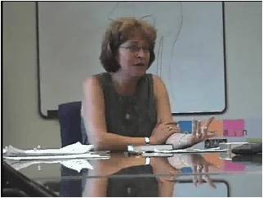
Preview: Show and Tell
Cindy O’Donoghue

Slide 27
Where in the book is…?
Scavenger hunt activity

Slide 28
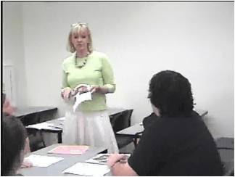
Preview: Textbook Picture Walk
Karen Santos

Slide 29
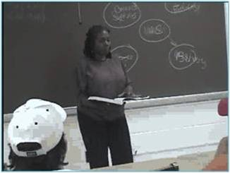
Preview: Analogy & Graphic Organizer
Cheryl Talley

Slide 30
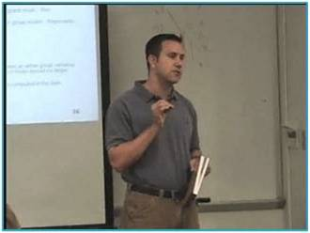
Before: What Does the Author Say?
Chris Watts

Slide 31
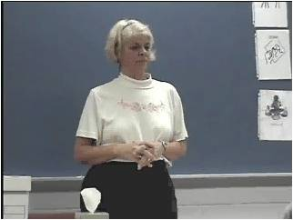
After: One minute Response
Brenda Fogus

Slide 32
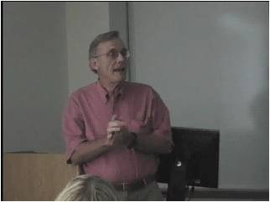
While: Just in time teaching (JITT)
Jim Benedict Psychology

Slide 33
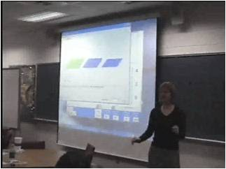
After: Personal Response System
Sharon Blatz and Andrea Adams

Slide 34
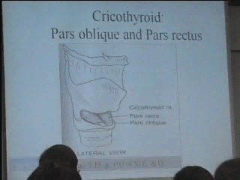
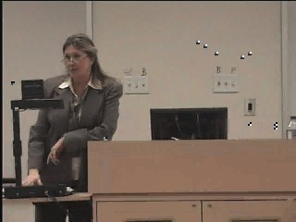
Emphasis: Show Book during Lecture
Brenda Seal

Slide 35
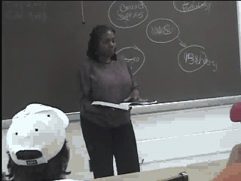
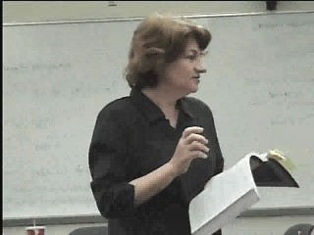
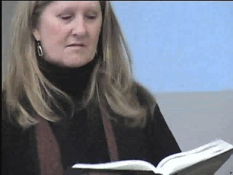
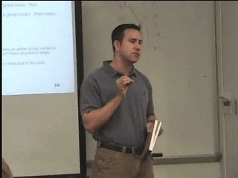
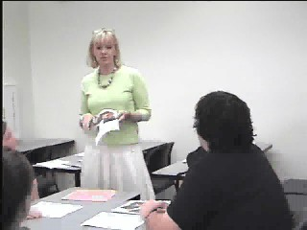
Emphasis: Bring textbook to class

Slide 36
How does a professor affect student opinion of the book?
Multi-sectioned course taught by many professors
All professors used the same book
Does professor’s opinion of the book affect the students’ opinions?
Does professor’s use of the book affect the students’ opinions?
Does professor’s use of the book affect students’ use of the book?

Slide 37
Methodology
Surveyed faculty on book opinion and book use
Surveyed students on book opinion and use

Slide 38
8 faculty teaching 15 sections
6 involved in selecting book; for 3 it was their top choice, 3 preferred another book
On a scale of 1-7 where 7 is best
Opinion of book average = 5
Use of book was very similar (regardless of opinion of book)
  Weekly or bi-weekly homework
  Used the book in the classroom

Slide 39
Student reported use (304 students)
Purchased?
  All but 1 student bought the book
Used it?
  85% used the book weekly or every couple of weeks
  10% used the book only for studying for exams

Slide 40
Professor’s effect on students
No relationship between the professor’s opinion and student’s opinion
Students were unable to separate professor’s use of the book from professor’s opinion of the book
E.g., <My professor liked the book>
  “because we had class assignments that we had to refer to the book, and also there were instances that we had to find definitions from the book”
  because “she uses many examples from the book”

Slide 41
Book use and class opinion
Student use and opinion of book were related¹
Student use and opinion of class were related²
Book opinion and class opinion were related³
Adjusted R² = .077, significance = .000, Standardized B = .284
Adjusted R² = .063, significance = .000, Standardized B = .257
Adjusted R² = .217, significance = .000, Standardized B = .469

Slide 42
Don’t shoot yourself in the foot
Why did you force me to buy this book if you
  Don’t use it?
  Don’t have me use it?
  Don’t like it?
This affects their opinion of the class
If you don’t tell them, they won’t know
Refer to page 39

Slide 43
Reflection and application
Sticky note votes – ideas I might want to use pg 16
Exit pass

