Slide 1

TAP into the Power of the TAP
May Symposium Conference Days – 2015
Nancy Harris, Computer Science
Smita Mathur, Early Elementary and Reading Education

Slide 2
Outline
Introductions
What is a TAP?
How is a TAP done?
How do I as a faculty member benefit? (group)
How do I as a consultant benefit?
How do my students benefit?
Anything else?

Slide 3
What is a TAP?
Mid semester – small group discussion followed by full class discussion
Prompt
  What helps your learning?
  What hinders your learning?
  What suggestion would you make?
Two perspectives
  Class/teacher
  Students themselves

Slide 4
How is it done?
Traditional – classroom up to about 75 students
Hybrid – large F2F classes
Online – online or predominately online classes

Slide 5

Traditional
Communication prior
  Classroom environment
  Syllabus
  Concerns
Day of
  Start with small group
  Put all responses on board
  Large group discussion
Followup
  Report produced
  Meeting with instructor
  Instructor follows up with students.

Slide 6
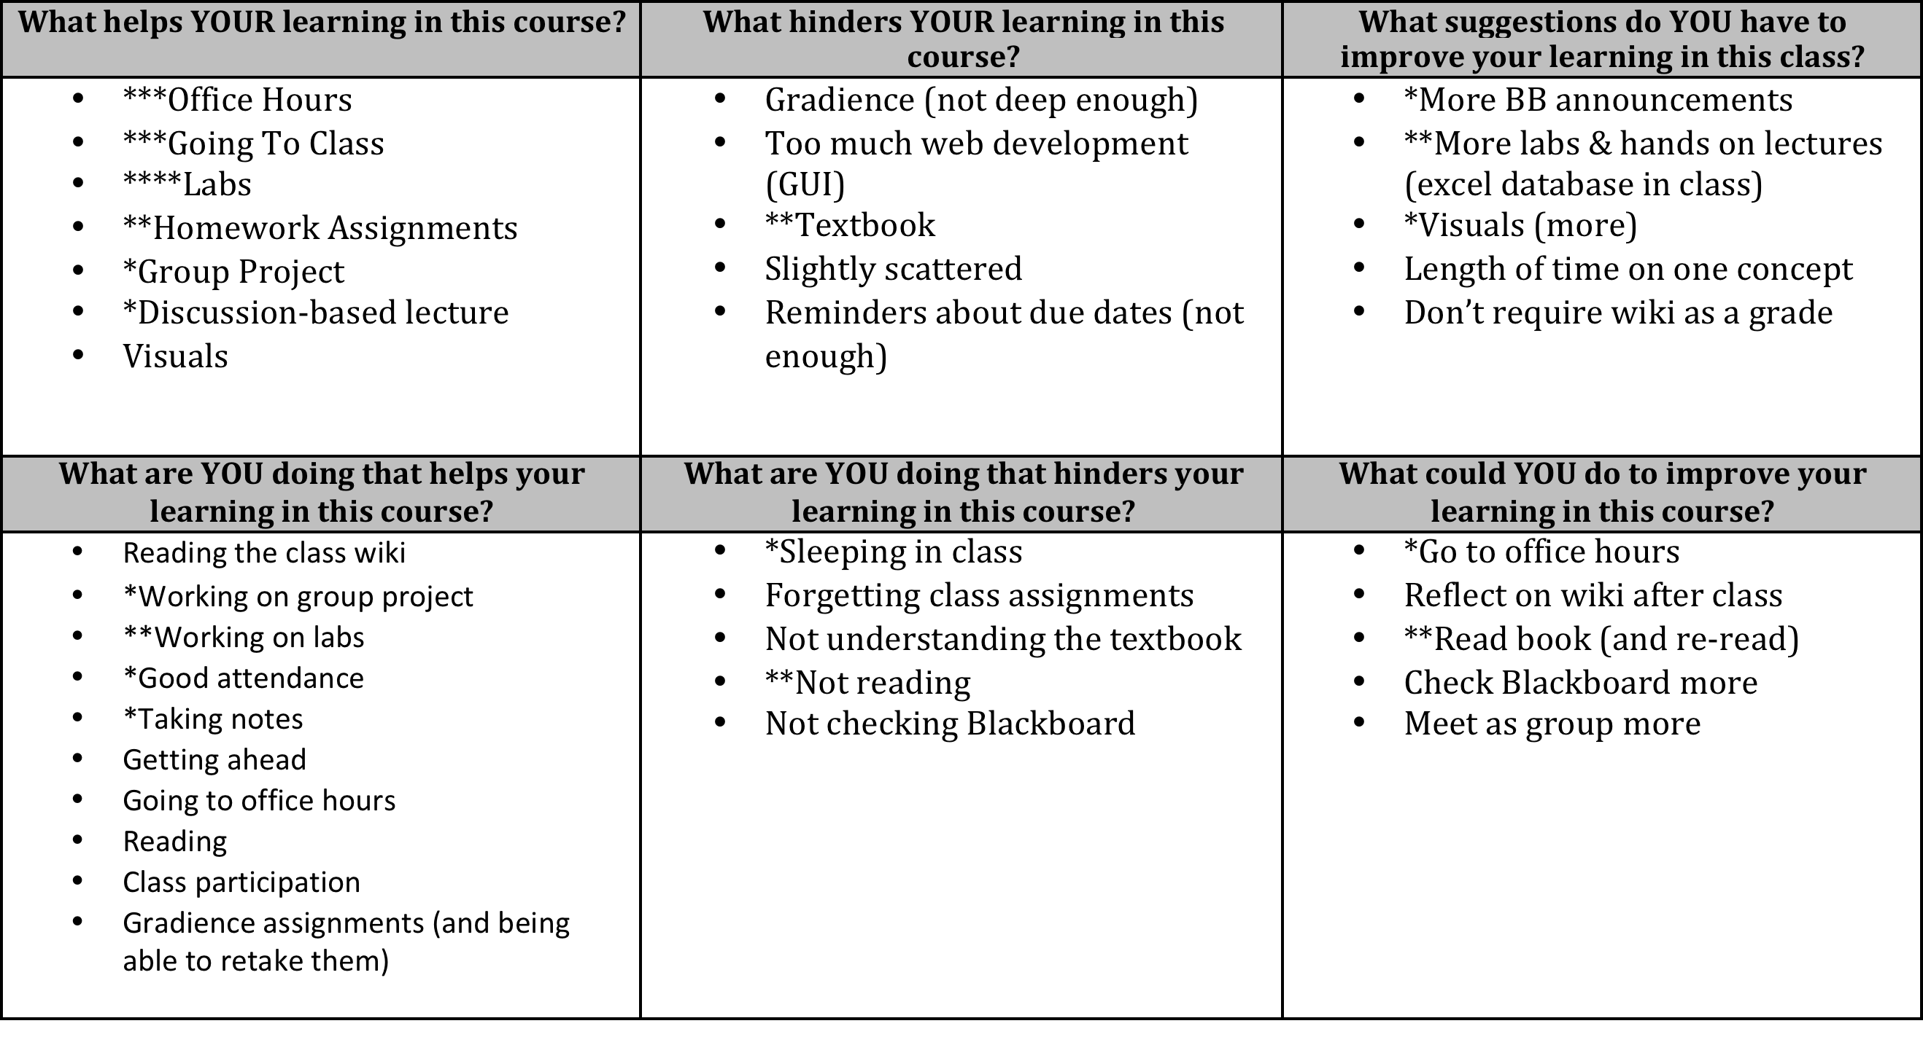
An example report

Slide 7
Hybrid
Communication prior
  Classroom environment
  Syllabus
  Concerns
Class period before
  Introduction
  Small group discussion
  Groups post to qualtrics
In between
  Summary of group responses
Day of
  Display summary
  Full class discussion
Followup
  Report produced
  Meeting with instructor
  Instructor follows up with students.

Slide 8
Studying & PowerPoints
What helps your learning? | PowerPoint’s are clear and easy to understand (16)
What hinders your learning? | No powerpoints before class (15) Powerpoints don’t have all of the information she discusses (2) abbreviations on the slides cause confusion
What suggestions do you have to improve learning? | Post powerpoints before class (12)
What are you doing to improve learning? | Taking notes and reviewing powerpoints (12)
What are you doing to hinder learning? | Not taking enough notes (5) Don’t always review notes (ppts) as much as we should (3)
What could you be doing to improve learning? | Take really good notes (3) Study notes and ppts after class (13) Compare notes with each other (4)

Slide 9
Online - new
Communication prior
  Classroom environment
  Syllabus
  Concerns
Part 1
  Qualtrics survey (3 days)
In between
  Consultant collates results
  Chooses several concerns
Part 2 (3 days)
  Piazza discussion board
Followup
  Report as before
  Faculty discusses results with students
Challenges
  Must incentivize students
  Time consuming for consultant

Slide 10
Benefits – Open Discussion
To you as an instructor
  See “the voice of instructors”
To you as a consultant
To your students – see study slides

Slide 11

Did you gain new insights about your course as a result of TAP?
  The TAP is probably one of the most useful tools available at JMU.
  I discovered that my students were not seeing a clear connection between the assigned course readings and the material being presented during class.
  it helped me have a good conversation with the students about the requirements and the materials.
  The information is more helpful to receive 'mid-stream' rather than in course evaluations, and I find students are better at seeing our class from both sides (i.e., mine and theirs) in this setting (on a course evaluation, they seem to only focus on what I have done "well" or "poorly" and not on how their contributions (or lack thereof) affected the class environment.

Slide 12

Unexpected Benefits of TAP
  Although I was not originally seeking feedback on the graduate students who teach the lab sections, the students in the course indicated some difficulty with the labs. In my consultation, I received several helpful ideas in how to better support my GAs and how I can improve the lab experience. Although this was unexpected, it was incredibly helpful.

Slide 13

Describe the ways in which your TAP feedback impacted your work.
  I was able to use the information from the TAP to significantly alter the 2nd half of the course, strengthen some assignments, and eliminate insignificant work the students did not find valuable.
  Mostly, it has helped me open the lines of communication--students have been coming to talk to me more now because they know--because I could demonstrate to them in a concrete way--that I care about their success and their experience in the classroom.
  I was
  refreshed, encouraged, and generally motivated.

Slide 14

TAP a Tool for Student Empowerment
In an unexpected way, it brought me closer to my students. They felt that I cared to listen and better myself. That earned me their respect.
giving students a structured way to reflect on the course.
It made the students feel like they had a voice in the course, and I think they took more ownership of the material as a result.

Slide 15
Survey Design & Results
Rate the degree to which you think the SGID influenced … | F |  | UF |  | NC
 | L | T | L | T | L | T
Instructor enthusiasm | 52.2% | 44.7% | 1.4% | 1.9% | 46.5% | 53.5%
Course organization | 61.4% | 56.8% | 1.4% | 2.0% | 37.2% | 40.3%
Your understanding of assignments & projects | 55.1% | 49.0% | 1.4% | 3.1% | 43.5% | 47.8%
Your understanding of exams, tests, and quizzes | 53.1% | 46.9% | 1.6% | 3.4% | 45.3% | 49.8%
Your interactions with classmates (p=0.022) | 47.8% | 40.9% | 0.3% | 2.0% | 52.2% | 57.2%
Your rapport with the instructor | 49.2% | 48.1% | 3.0% | 2.2% | 47.8% | 49.8%
Your learning of course material | 57.6% | 55.7% | 1.4% | 3.6% | 41.0% | 40.7%
Your preparation for this class (p=0.021) | 54.9% | 45.2% | 1.9% | 1.7% | 43.2% | 53.2%
Your enthusiasm for this class | 45.8% | 42.0% | 3.3% | 3.7% | 51.0% | 54.4%
The Center for Faculty Innovation

Slide 16
Rate the degree to which you think the SGID Influenced

Slide 17

Qualitative Results
Identify some things that you did as a result of the TAP (p=.025)
Qualitative comments were categorized:
  Learner behavior identified
  Course change identified
  Indicated no change in their behavior
Not included: not answering question
Responses: LC – 225, Trad - 212
The Center for Faculty Innovation

Slide 18
Sample Responses
“I started reading my book more and taking more thorough notes.” (Learner centered)
“We had an Exam Review day here we played team games with the course material” (Course centered)
“I did nothing different.” (No change)
The Center for Faculty Innovation

Slide 19
CFI Wants You!
Training
  Peer mentoring
  You go when you are ready
Time
  You choose how many
  About 2 hours including transit time, prep, report, and consultation

