Slide 1
Captivate Your Students by Providing Instruction When Your Students Need It
Nancy Harris
Department Of Computer Science

Slide 2
Outline/Objectives
Explore reasons for doing to “video lectures”
Look at some “simple” video’s
Explore some more advanced techniques
Some best practices
What this is not – A how to!
Think of it more is a what to or idea starter

Slide 3


Reasons
Notes:
In an article in Inside Higher Education, Lee Williams describes the shifts, as he sees them in his school…1st shift 8am, barely anyone one campus. Maybe between classes.
Second shift, students running errands going to and from activities, study groups, club groups.
Suggests that it is the dark of the night, the third shift that gets students into trouble.
My experience – Death march in the morning across I-81…It’s alive after dark especially around 8-9pm.
My experience. Late night is the time of work. I get many e-mails after midnight. This is when the students work.

Slide 4
Seven Principles
Chickering & Ehrman
Good practice encourages contacts between students and faculty
Good practice develops reciprocity and cooperation among students
Good practice uses active learning techniques
Good practice gives prompt feedback
Good practice emphasizes time on task
Good practice communicates high expectations
Good practice respects diverse talents and ways of learning
IMPLEMENTING THE SEVEN PRINCIPLES: Technology as Lever
http://www.tltgroup.org/programs/seven.html

Slide 5
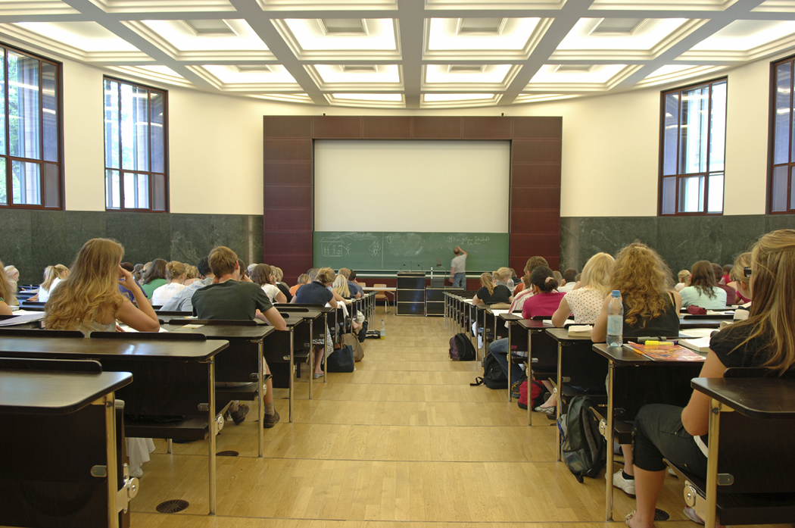

Normal Classroom Structure

Slide 6


Let’s turn it over
Let’s lecture at night when the students are most active
Let’s practice during the day and involve them in active learning with their colleagues

Slide 7
Let’s look at some example “lectures”

Slide 8
Easy, simple lecture with controlled audio
http://jmutube.cit.jmu.edu/users/harrisnl/presentations/SpringboardVideo.zip.content/
Video used with incoming freshman who could not attend Summer Springboard
Illustrates simple narration, linking, use of click boxes, and highlights.
Using the standard Powerpoint slides, this was done in probably 3 hours including narration.

Slide 9
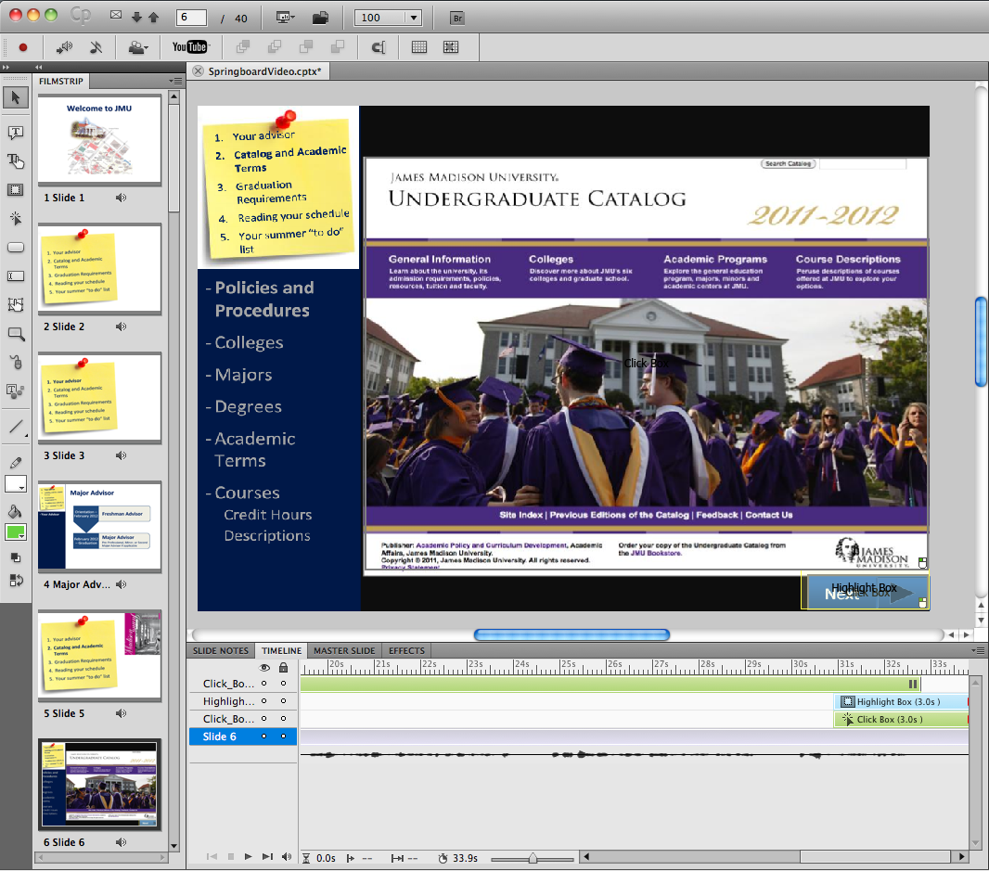
Highlight
box
One click box that is a hyperlink
One click box that moves to the next slide
Audio

Slide 10
How we did it
Started with a very nice beginning slide show
Altered it to fit needs of this population of students
Enhanced it with some interactive properties
Narrated it
Adjusted the timing of some of the slides to match the audio.
Published it to JMU tube

Slide 11
Video with a demonstration
http://jmutube.cit.jmu.edu/users/harrisnl/presentations/T15.zip.content/
Tutorial used to introduce students to a new topic
Narrated by a student
Includes an interactive “what do you think will happen” demo

Slide 12
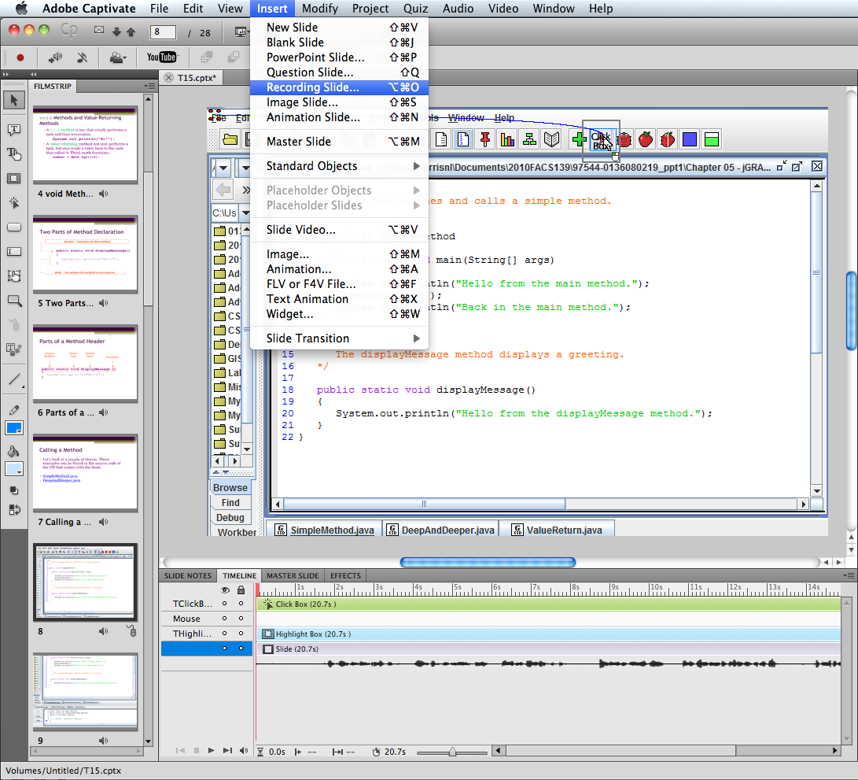
Prepare the demo at the point that you want to begin.
“Insert a Recording Slide”
Carry out the demo
You control whether you see typing or the mouse
Click box to see result advances to next slide

Slide 13
How we did it
Started with the basics of the slide contents.
In Captivate, used the recording tool to build the demo
Carried out the steps of executing the code; software automatically fires off a series of snapshots.
Adjusted the snapshots to capture only what we needed.
Added narration and click boxes to stop the action and force the student to do something.

Slide 14
Video with more interesting graphics and demo
http://jmutube.cit.jmu.edu/users/harrisnl/presentations/T11%281%29.zip.content/
Built by a grad student
Designed by the instructor
Narrated by a student

Slide 15
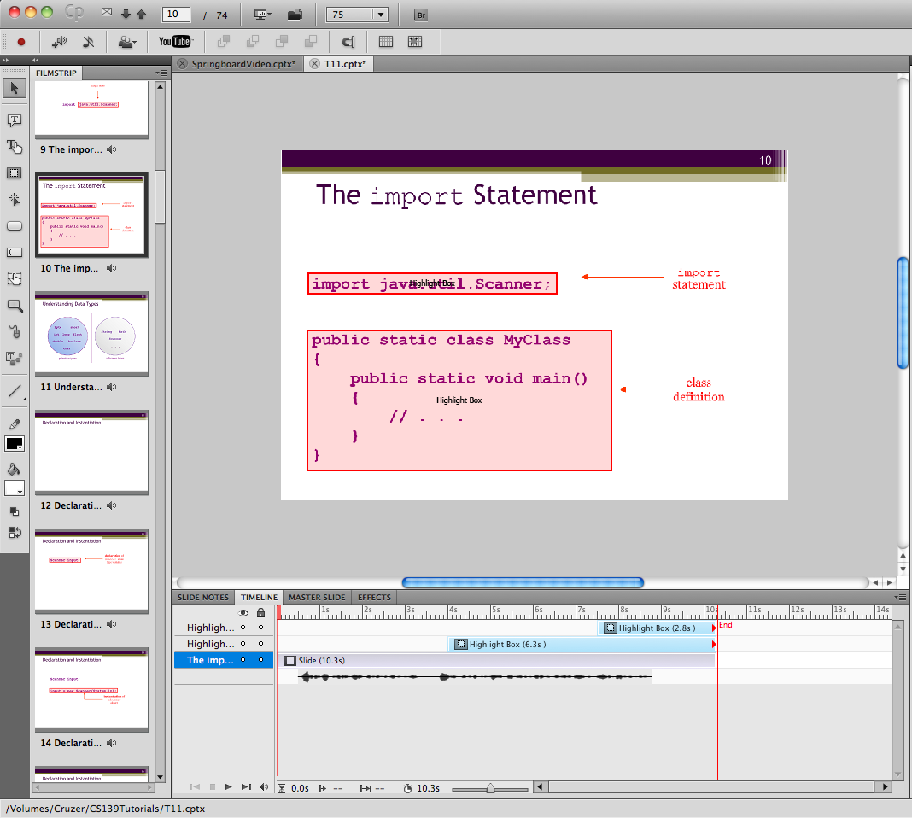
Highlighting
was added later
The highlight boxes were synched to the voice by sliding and changing the length of some of the highlight boxes.

Slide 16
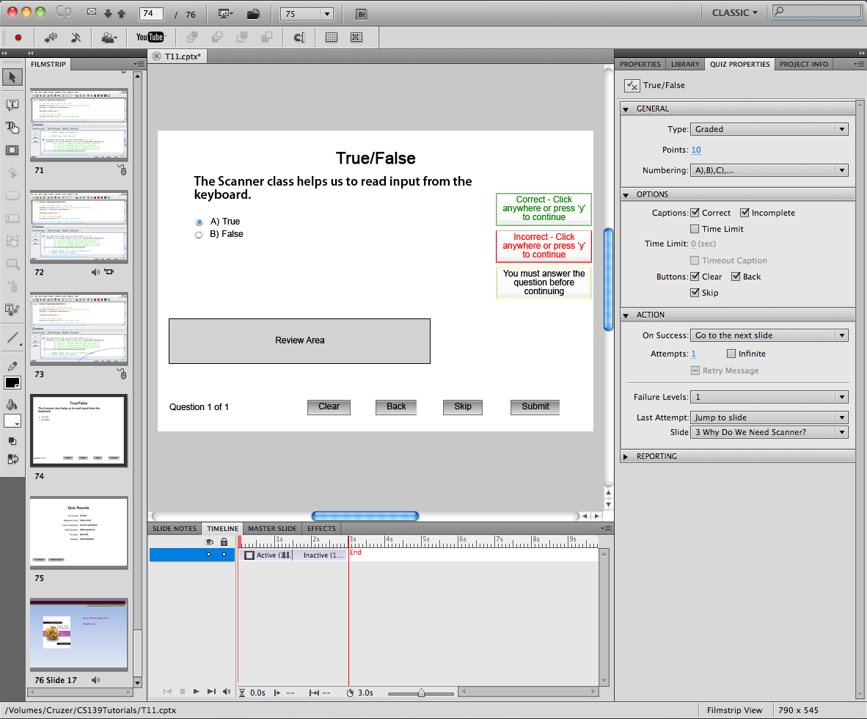

Slide 17
Use of highlight and click boxes
To call attention
To guide the user toward an action
To bring the user into the video
To teach the student to use a software tool
To create a hyperlink to another resource

Slide 18
Uses of Quizzes
Keep students alert
Let them test their knowledge
Break up a longer presentation
Make the process more active
Can “send” students back for more help or forward to skip something they already know.

Slide 19
Do Students Use Them?

Slide 20
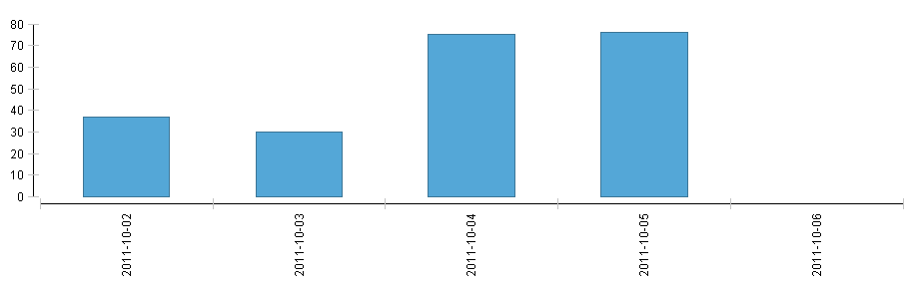
Do Students Use Them?
Number just after posting
By yesterday, the total number of hits had increased to 215 with about the same on the 4th and the 5th

Slide 21
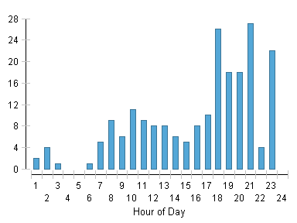
Time of Day

Slide 22
Number viewing and not viewing (this was through the 4th only

Slide 23
Good Practice
Tie them to particular work (make students responsible)
Don’t lecture on what you are “lecturing” on
Keep them short
Keep them interactive
Make them relevant

