Slide 1
Insert “Skill Bites” Into Your Course to Enhance Discipline Specific Development
Nancy Harris – Computer Science
Renee Herrell – Career and Academic Planning

Slide 2
Outline for Today
Introductions
Overview of JMU first-year students
Why should you care about this?
Some literature to support
Ralph Walters College project
Experience of a first-year teacher
Adaptation of an exercise to your students
Wrap up

Slide 3
Intro – Activity – 5 min
Individually, list 3 traits of your students that enhance their ability to learn in your class.
Individually, list 3 traits of your students that impede their ability to learn in your class.
Share with your group.

Slide 4
The Transition to College

Slide 5
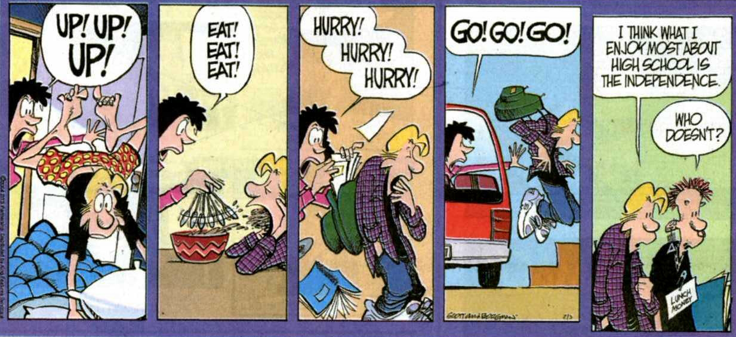
INDEPENDENCE?

Slide 6
The Changing American College Student:
Thirty-Year Trends, 1966-1996
Alexander W. Astin
“While each of the 30 freshman surveys since 1966 has revealed significant changes from the previous year’s survey, there have been two periods during which students have shown particularly rapid and widespread change: the late 1960s through the early 1970s, and the past 8 to 10 years covering the end of the 1980s to the present.” (Astin, 1998)

Slide 7
Recent Trends in First-Year Student’s Issues
(Astin)
Financial Concerns
Increased Stress
Grade Inflation/Competition and Academic Disengagement
Political Disengagement
Decreasing Reliance on Government
Mixed Trends on Social Issues

Slide 8
Highlights from Freshman Survey Data (Astin)
“Compared to their counterparts of the late 1960s, freshman women today have much higher educational aspirations and are much more interested in careers in traditionally “male” professions (business, law, medicine, engineering)”

Slide 9
Highlights from Freshman Survey Data (Astin)
“…women and men today are much more alike in their interests, aspirations, values, and behavior than they were three decades ago.”
About the only area where the sexes have diverged is politics: women lean to the left while men lean to the right

Slide 10
Activity – How well do you know our first year students?
These figures come from self-reports of the incoming 2007-2008 class. Of the 3748 students enrolled, 3592 participated in the survey.

Slide 11
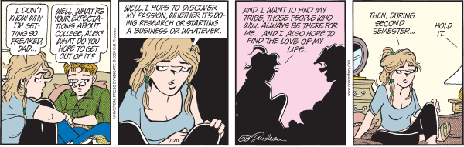
EXPECTATIONS
Notes:
11

Slide 12
First in the Family
Advice about College from First-Generation Students
Your College Years (2006)
By Kathleen Cushman
“I just feel a little intimidated, like it’s going to feel really weird to approach them. Maybe I’ll ask a question that they think is ridiculous. If I’m going about something that is really complicated to me, I don’t want them to think, Well, maybe she’s not right for this class.” - Jackie

Slide 13
Quotes from JMU Freshmen
“When students come to college many doubt their ability to succeed in a college environment. These students need someone who believes in their abilities and expects from the beginning that they will succeed.”
“Being the first person in my family to attend college, I knew little of what to expect….”

Slide 14
The James Madison University Student:
Before, During, and After Enrollment
1993 to the Present
The Office of Institutional Research at James Madison University
Between Fall 1995 and Fall 2006, JMU’s average SAT combined decreased slightly from 1,186 to 1,140.
The percentage who reported in the First Year Survey that their average grade in high school was in the
‘A’ range increased from 43 percent to 55 percent.
Within specific skills, students reported increased preparation in study habits, computer skills and vocational skills.
There was also a decline in the percentage that stated they were very well prepared students in mathematics and a slight decline in foreign languages preparedness.

Slide 15
JMU Admissions Website
2006 - 2007 Freshman Class Profile
Applications: 17,765
Applicants accepted: 62.6%
Applicants enrolled: 3,748
Average SAT Score: 1140
* SAT mid-50 percent range: 1080 - 1240
* ACT mid-50 percent range: 23 - 28
* Top third of high school class: 88%
First-year retention rate: 91.8%

Slide 16
How does JMU choose which students to admit?

Slide 17
JMU Admissions Requirements – from the JMU website
Quality of High School Academics
Academic Achievement
Standardized Tests
Secondary School Report and Recommendations
Extracurricular Activities

Slide 18
JMU Admissions Requirements, cont
2. Academic Achievement
Competitive candidates will have mostly As and Bs in the core academic areas: English, math, lab science, social science and foreign language.
3. Standardized Tests
When reviewing test scores we use the highest individual verbal and highest individual math scores from the SAT. For the ACT we use your single highest composite score.

Slide 19
JMU Admissions Requirements, cont
4. Secondary School Report and Recommendation
The high school guidance office completes this form. The Admissions Committee will learn if the applicant chose the most demanding program of courses, an average…
The guidance office tells us how competitive the high school class is by sharing with us how many students intend to go to a four year college next year.
And the office will rate the applicant in some areas such as academic potential, motivation, and leadership skills.

Slide 20
JMU Admissions Requirements, cont
5. Extracurricular Activities
JMU is looking for quality involvement rather than quantity of involvement.
Also interested in students who have been involved in community service or held part time jobs.

Slide 21
So what are the challenges we as faculty face?

Slide 22
National Survey of First-Year Curricular Practices
Summary of Findings by Betsy O. Barefoot, EdD
What, in your opinion, is the most significant problem or difficulty at your institution that affects the academic success of first-year students?
Lack of academic preparedness for college level courses
Poor time management strategies
General adjustment issues
Working too many hours off campus
Absence of motivation

Slide 23
National Survey of First-Year Curricular Practices
Summary of Findings by Betsy O. Barefoot, EdD
Six of the “Seven Principles for Good Practice in Undergraduate education” (Chickering & Gamson, 1987) are particularly relevant to the research on first-year curricular practices:

Slide 24
Seven Principles for Good Practice in Undergraduate education
Encourages contact between students and faculty
Develops reciprocity and cooperation among students
Encourages active learning
Gives prompt feedback
Emphasizes time on task
Communicates high expectations
Respects diverse talents and ways of learning

Slide 25
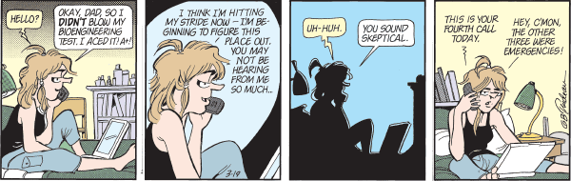
Students and Parents

Slide 26
How can we as faculty impact the development of our students?
Can we make a difference in their ability to learn?

Slide 27
What does the literature tell us?
Historically, developmental programs have been separated from the discipline specific classroom.
Railton and Watson state: “What we often end up doing is expecting students to adapt their practices to fit ours as if by osmosis: we expect students to speak the same language as us and intuitively understand the adjustments in their learning practice that higher education demands.”

Slide 28
Railton and Watson study
Discussed conditions in a first-year student class that encouraged small group discussion. What they found was that students were in roles of “student” to the teacher’s “teacher” rather than the role they wanted them to be, that of autonomous “learner” in a classroom facilitated by the “teacher” mentor and guide.
Specific strategies were developed to improve students’ deep reading ability and to create conditions where they were encouraged to learn on their own within groups of other learners.

Slide 29
And we see other skills that students struggle with
Historically, we have provided support to certain populations of students.
  Learning disabled students (when they were provided access to higher education.)
  Students coming into school with specific testable deficiencies (many community colleges see developmental education as a cornerstone of inclusion of all comers.)
The kinds of skills taught to the “learning disadvantaged” students are the same kind of skills that can benefit all students just as providing Universal Design can benefit all students.

Slide 30
And we see today
First year students struggle with time management, critical thinking skills, reading skills, and learning how to learn.
Traditionally non-disadvantaged students had to identify their own need and seek out those kinds of supports. (Such as our first year involvement programs.)
There is a certain stigma in seeking out such help. Students don’t take advantage of the help provided outside of the classroom in any great numbers.

Slide 31
And…
We are seeing more and more diversity in our classrooms.
College is no longer for the elite.
High schools also seem to be producing students less prepared for higher educational rigor…strategies that help them do well in high school with accountability testing do not always help them do well in college.
Students who did well in high school find that college work is more difficult than expected.

Slide 32
Retention
A number of schools have approached this problem from a retention perspective…how can we help our students to be successful?
JMU has an excellent retention rate. Somehow the students are succeeding.
So why are we interested in helping them to learn?

Slide 33
Rationale
By embedding some learning strategies into course content, we can help our students to become better learners and ease the transition to college academics.
Research suggests that students will retain the skills better if taught with direct applicability to the content.
  See Burchard, Arendale
Different disciplines require different strategies. Students should read a programming text differently than a history text differently than a novel.

Slide 34
Skill bites
Booklet was developed by Raymond Walters College (University of Cincinnati) and the RWC Smart Connections Learning Community in 2006.
Specifically, they were looking at supporting their incoming students and helping them to begin to think and learn like others in the discipline.
Exercises include very general skills (time management, study habits, etc), but also weave in discipline specific skills and learning about the discipline.

Slide 35
My classes
I teach the two course introductory programming sequence in Computer Science (CS 139/239).
Students are primarily first-year Computer Science majors.
These students have varying backgrounds in CS from no prep in the field to AP or dual enrollment.
I also teach a gen-ed critical thinking course, GISAT 160 in Cluster 1.

Slide 36
What I have done - CS
I looked at some of the things that trouble the students the most in my classroom.
  Cheating (sadly it is often an issue)
  Learning to learn for Computer Science
  Time management – large projects get away from them (and large projects will be an ongoing theme of their CS work)
  Learning to use a wide range of tools to direct their own learning … it is a necessity in our changing field.

Slide 37
My theme is to try to make them successful in my classroom
Making the textbook a partner in their education.
Understanding learning styles – learning how they learn.
Understanding and preventing cheating on programming assignments.
Using a quiz “gatekeeper” to encourage reading and study before lab activities
Applying time management principles to larger projects.
Working in groups.

Slide 38
I also use exercises directly related to being a JMU college student
We use exercises where students must program:
  Calculation of a weighted average.
  Calculation of a GPA (which gets into what quality points are and what grades affect their GPA).
  Creating a program to calculate a target test score to achieve a particular grade.
Despite having these students as advisees, they don’t seem to know how to do these things.

Slide 39
Ongoing
I purposefully model strategies to learn and discover from the software that we use.
I use the tools that they are learning to explore different problem solving strategies.
I purposefully model the notion that in solving computer problems, there is often no “right” answer but many equally right answers. (Getting them away from black and white thinking.)

Slide 40
GISAT 160
This course is different in that it is a more general skills course.
I use many of the activities from the Skill Bites book in that class room directly.
They are learning how to think and to think and read more critically.
I tell the students that I am trying to help them become more strategic consumers of information.

Slide 41
Differences between these populations.
CS Students don’t like just doing what they perceive as unnecessary skills development. The Learning Style exercise was a bust from their point of view (heard about it in TAP and at the end of the semester review).
If I “hide” development skills in a big dose of CS “sugar”, they accept it and seem to learn from the activities.
The GISAT students, because of the nature of the course, seem to enjoy the self-discovery activities.

Slide 42
Skill bites book
Examples and exercises with classroom instruction and homework.
Most are designed to take 20 minutes or less of classroom time.

Slide 43
Specific examples of adaptation of a general skill to classroom specific learning.
Textbook introduction
  Teaches them how to use the textbook and what resources are there Textbook Scavenger Hunt.doc
Example of a lab quiz (using Blackboard adaptive release to control access to lab material)
  They need to pre-prepare for the lab with the basic concepts required for that lab
Learning style activity
  To help them to see how they might have to approach the course material.Learning Styles.ppt and Index of Learning Styles
Cheating case studies – demo This is in your booklet
  Yeo article – students don’t always perceive actions as being honor violations that we in fact treat as such.
Time management exercise – adaption of a Skills Bite exercise for my class – demo This is in your booklet
  Help students to plan for and execute a large project.

Slide 44
Other learning strategy sources
http://www.studygs.net Landsberger
http://coe.jmu.edu/learningtoolbox/ JMU College of Education
http://www.rwc.uc.edu/library/librarypdfs/quickskillsbites.pdf

Slide 45
Now your turn…
Choose one thing in your classroom that you would like to see your students do better or that will help them to learn the material better.
  Note taking
  Time management
  Critical reading
Choose an activity that you would like to adapt to your specific discipline.
In the time remaining, work out how you might adapt that activity to the specific issue that you have in class.
Discuss with your colleagues how you will proceed.

Slide 46
Insert a Skill Bite into your course
What one learning deficiency do you want to address?
At what point in the course does this become an issue? Or at what point in the course would you like to address it so that it does not become an issue?
What are your specific objectives in doing this activity?
Can it be tied into another assignment or is it a stand-alone or new activity?
Is there an existing strategy on which you can model your activity? What is it?
How will you adapt that strategy for your specific class?
How will you sustain the new student behavior throughout the rest of the semester?

Slide 47
Share
What one thing will you try in your class, if not this semester, then next.

Slide 48
Resources
We have a number of the resources (papers, books) available to peruse after the workshop.

