Slide 1
Welcome to Summer Springboard
Please log on to Blackboard
blackboard.jmu.edu

Slide 2

Nancy Harris - Chris Mayfield
the part of Chris Mayfield is played by Mary Morsch today
harrisnl@jmu.edu
540-568-8771
ISAT/CS 217
Skype - csharrisnl
mayfiecs@jmu.edu
540-568-3314
ISAT/CS 208
Notes:
Notes to Advisor: You can copy and paste your own building image from the Campus Map webpage: http://www.jmu.edu/map/

Slide 3
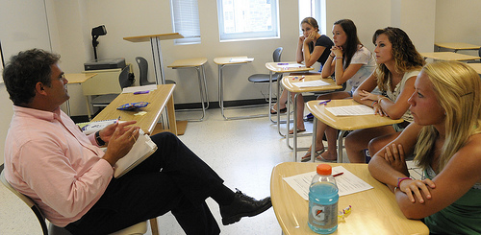
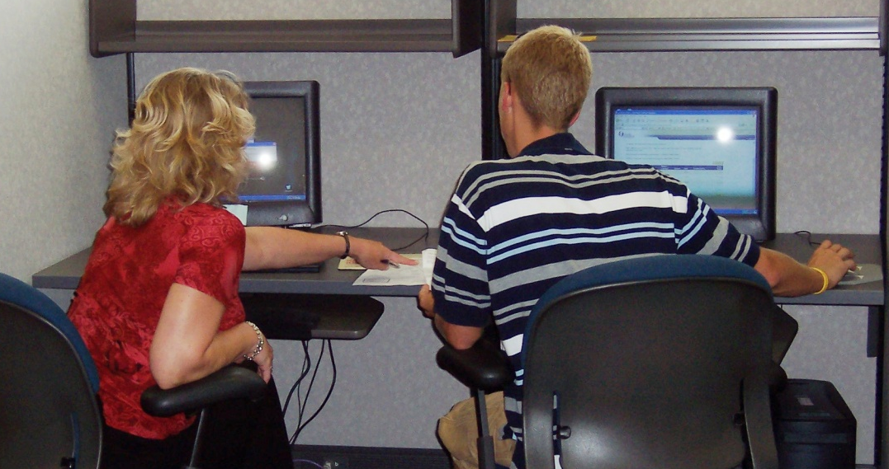
Group Session
1:00 – 2:25
Individual Sessions
2:40 – 4:45
Notes:
Talking Points:
For the rest of today, we will use the group session to explain policies and procedures.
We will then meet individually in my office to complete your registration for the rest of your fall classes and to get to know each other.

Slide 4

Our Roles
Graduation Requirements
Your Schedule
Your “To Do List”
Notes:
Talking Points:
These are the items that we will discuss during the group session.
Please take notes on the lined sheet in your Orientation packet.
You will receive a “To Do List” at the end of the session for you to complete before returning in the fall.

Slide 5
Our Roles
Graduation Requirements
Your Schedule
Your “To Do List”

Slide 6

Your Role
Our Roles
Graduation Requirements
Your Schedule
Your “To Do List”
Focus on your role as a student:
hold yourself accountable for academic rigor-it is your education
Responsible for your decisions, choices, and actions
Seek advice, information, resources, and support
Knowing and fulfilling degree, major, and general education requirements
Choosing a major and career path
Use MyMadison for academic planning and resources
Contact your advisor, who serves as your main resource for academic questions
Your Role
Freshman Advisor’s Role
Major Advisor
Notes:
Talking Points:
As students these items are your responsibility.
In essence, you are responsible for your education.
Of course, as your advisor, I am helping you to learn how to find information.

Slide 7
Freshman Advisor’s Role
Our Roles
Graduation Requirements
Your Schedule
Your “To Do List”
Helps you to develop realistic academic goals
Serves as your main resource while teaching you to be independent and responsible
Teaches you how to navigate through academic policies and procedures
Helps with transition from high school to college
Your Role
Freshman Advisor’s Role
Major Advisor
Notes:
Talking Points:
College is very different from high school
The way classes are scheduled, how much time you have to devote outside of class to studying, much more reading, your grade may be based on two exams and a paper, your syllabus for the class will list your assignments and you are not reminded of them, and you have much more freedom.
I will help you to understand the policies and procedures and work with you to become more independent.

Slide 8
Major Advisor
Our Roles
Graduation Requirements
Your Schedule
Your “To Do List”
  Freshman Advisor
Your Role
Freshman Advisor’s Role
Major Advisor
Orientation – February
February – Graduation
  Major Advisor
  Pre-Professional, Minor, or Second Major Advisor if applicable
Notes:
Talking Points:
You Will have several advisors during your time at JMU.
Freshman Advising will end in February 2012.
If you declare a pre-professional program, minor, or second major, you may have an additional academic advisor for these programs.

Slide 9

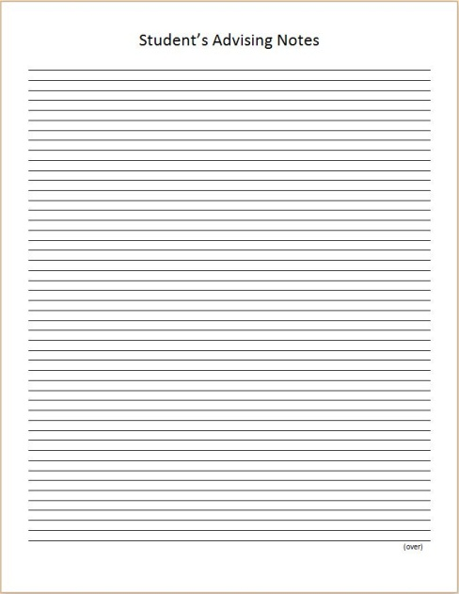
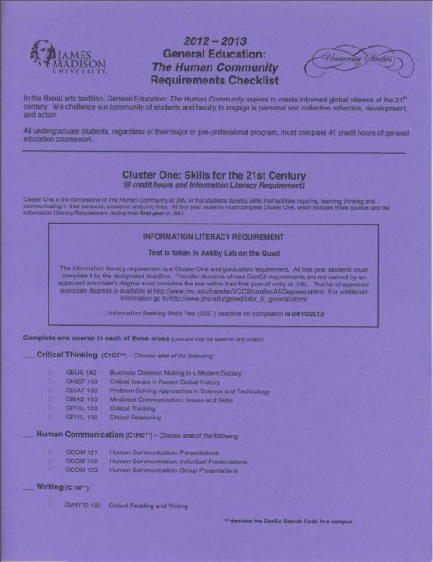
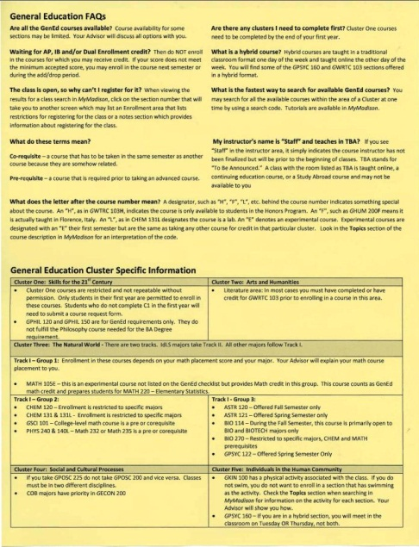

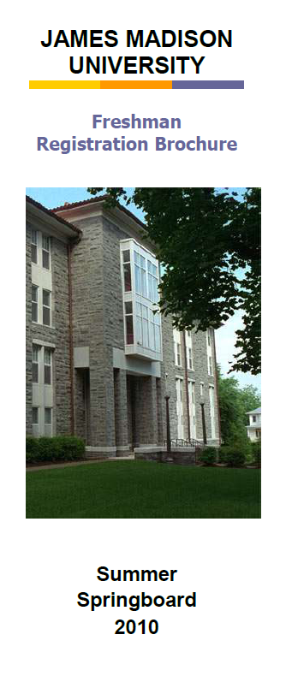
Our Roles
Graduation Requirements
Your Schedule
Your “To Do List”
Notes:
Talking Points:
There are courses that you must take in order to graduate from the university.
Please take out from your Orientation packet the pink GenEd checklist, the lime green insert, and the Freshman Registration Brochure.

Slide 10
120 Credit Hours
Our Roles
Graduation Requirements
Your Schedule
Your “To Do List”
Graduation requirements broken down…
120 Credit Hours
Major
Degree
General Education
Electives
Pre-Professional
Minor
Double-Major
Notes:
Notes to Advisor: To change the credit hour data in the pie chart, click on the pie chart. You’ll notice new ribbons appear in your title bar under the umbrella, “Chart Tools”. In the “Design” tab underneath “Chart Tools”, click “Edit Data”.
Talking Points:
You need 120 credit hours in order to graduate.
However, they cannot be just any courses.
You have General Education, major, and degree requirements. Whatever credit hours left over after these can be used as electives which could go towards a minor, another major, or a prehealth program such as pre-med.

Slide 11
Our Roles
Graduation Requirements
Your Schedule
Your “To Do List”
F ‘12
S ’13
F ‘13
S ‘14
F ‘14
S ‘15
F ‘15
S ‘16
120 Credit Hours
Major
Degree
General Education
Electives
Pre-Professional
Minor
Double-Major
Average 15 credits per semester
Take 14-16 credits each semester
about 4-5 classes each semester
12 credits is “officially” full-time status
Notes:
Talking Points:
Full-time status means that you are registered for 12 credit hours. If you drop below this level, you are considered part-time and it can affect your financial aid, health insurance, car insurance, staying in the residence hall (mainly they just need to be notified), athletic eligibility if you are on a scholarship sport
team, and possibly other areas.
Most students register for 14-16 credit hours their first semester. You can see from this chart how the credit hours spread out over the four years.

Slide 12
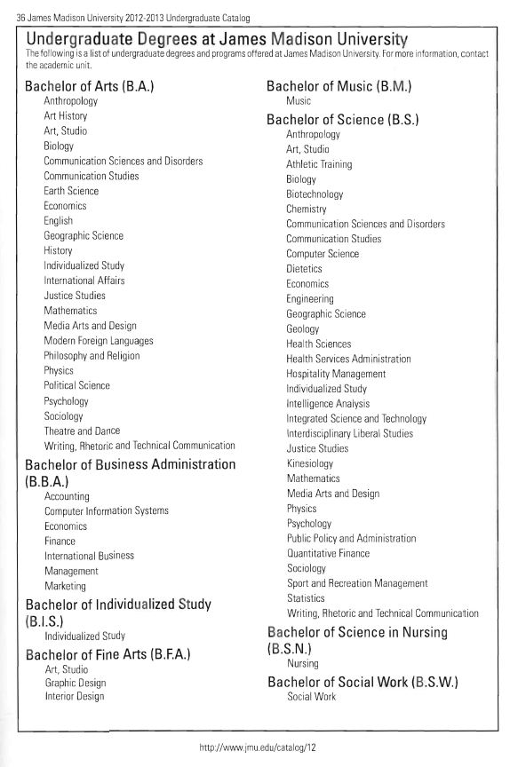
Page 36
Our Roles
Graduation Requirements
Your Schedule
Your “To Do List”
120 Credit Hours
Major
Degree
General Education
Electives
Pre-Professional
Minor
Double-Major
Notes:
Talking Points:
Turn to page 36.
When you graduate from JMU, you will have a degree and a major. The major determines which degree you will earn. You also may have a minor or double major.
This page shows you the degrees with the corresponding majors underneath.
As you can see, many majors are under the Bachelor of Arts (B.A.) or the Bachelor of Science (B.S.). You also can see that some majors are in both columns
because you can choose whether to earn a B.A. or a B.S. degree for those majors.
If you have chosen a major, look at the list and tell me which degree will you be earning.

Slide 13
Computer Science
Our Roles
Graduation Requirements
Your Schedule
Your “To Do List”
The Computer Science department strives to be an intellectual community that continually explores the broad field of computing, applies this knowledge to solve problems in a variety of domains, and engages with the profession and society at large.
Undergraduates join this community when they become majors, participating with faculty and other students in exploring computing through classes, projects, clubs, and internships.
120 Credit Hours
Major
Degree
General Education
Electives
Pre-Professional
Minor
Double-Major
Notes:
Notes to Advisor: To change the credit hour data in the pie chart, click on the pie chart. You’ll notice new ribbons appear in your title bar under the umbrella, “Chart Tools”. In the “Design” tab underneath “Chart Tools”, click “Edit Data”.
Talking Points: tailor this slide to major(s) you’re advising
Mission and goals of the major
Plan of study
First semester and upper-level courses
Relation to GenEd
Progression/Admission standards, if applicable

Slide 14
Computer Science
Our Roles
Graduation Requirements
Your Schedule
Your “To Do List”
120 Credit Hours
Major
Degree
General Education
Electives
Pre-Professional
Minor
Double-Major
50 required hours (including CS 139)
GenEd includes 4 hours of Calc
29 elective hours
Notes:
Notes to Advisor: To change the credit hour data in the pie chart, click on the pie chart. You’ll notice new ribbons appear in your title bar under the umbrella, “Chart Tools”. In the “Design” tab underneath “Chart Tools”, click “Edit Data”.
Talking Points: tailor this slide to major(s) you’re advising
Mission and goals of the major
Plan of study
First semester and upper-level courses
Relation to GenEd
Progression/Admission standards, if applicable

Slide 15
CS – First Year
Our Roles
Graduation Requirements
Your Schedule
Your “To Do List”
First Semester | Second Semester
CS 139 - Java | CS239 – Java
Math 235, 231, 155 | CS227 – Discrete Math
Cluster 1 | Calculus Math 236, 232, 231
Cluster 1 or gen ed | Cluster 1
 | Gen-ed (opt)
120 Credit Hours
Major
Degree
General Education
Electives
Pre-Professional
Minor
Double-Major
Notes:
Notes to Advisor: To change the credit hour data in the pie chart, click on the pie chart. You’ll notice new ribbons appear in your title bar under the umbrella, “Chart Tools”. In the “Design” tab underneath “Chart Tools”, click “Edit Data”.
Talking Points: tailor this slide to major(s) you’re advising
Mission and goals of the major
Plan of study
First semester and upper-level courses
Relation to GenEd
Progression/Admission standards, if applicable

Slide 16
Math Placement
Our Roles
Graduation Requirements
Your Schedule
Your “To Do List”
Calc
  < 15 Math 156
  15 – 22 – Math 231 AND Math 199E
OR Math 155
  23 – 29 – Math 231 -> 232 -> 236
  30 – 45 – Math 235 -> Math 236
Stats
  < 16 – Math 105E before Math 220
  OR Take calculus first
  16 – 30 – Math 220
120 Credit Hours
Major
Degree
General Education
Electives
Pre-Professional
Minor
Double-Major
Notes:
Talking Points:
Two scores – Stats and Calculus
Placement indicates the starting point
Math 199E is a self paced set of modules with a test to show completion. Tests are given Friday from 5-8pm. Drop in anytime during that time period.
We will discuss your math score and recommend a beginning class based on that score. In ENGR this has resulted in a particular class being put on your schedule.

Slide 17
Engineering
Our Roles
Graduation Requirements
Your Schedule
Your “To Do List”
School of engineering graduates will improve the sustainability of our world by analyzing problems and designing solutions in the context of technical, economic, environmental, and social impacts.
120 Credit Hours
Major
Degree
General Education
Electives
Pre-Professional
Minor
Double-Major
Notes:
Notes to Advisor: To change the credit hour data in the pie chart, click on the pie chart. You’ll notice new ribbons appear in your title bar under the umbrella, “Chart Tools”. In the “Design” tab underneath “Chart Tools”, click “Edit Data”.
Talking Points: tailor this slide to major(s) you’re advising
Mission and goals of the major
Plan of study
First semester and upper-level courses
Relation to GenEd
Progression/Admission standards, if applicable

Slide 18
Engineering
Our Roles
Graduation Requirements
Your Schedule
Your “To Do List”
120 Credit Hours
Major
Degree
General Education
Electives
Pre-Professional
Minor
Double-Major
69 required hours
GenEd includes Physics (240), Math 235, Bio 222/Geol 210
9 elective hours
Notes:
Notes to Advisor: To change the credit hour data in the pie chart, click on the pie chart. You’ll notice new ribbons appear in your title bar under the umbrella, “Chart Tools”. In the “Design” tab underneath “Chart Tools”, click “Edit Data”.
Talking Points: tailor this slide to major(s) you’re advising
Mission and goals of the major
Plan of study
First semester and upper-level courses
Relation to GenEd
Progression/Admission standards, if applicable

Slide 19
ENGR – First Year
Our Roles
Graduation Requirements
Your Schedule
Your “To Do List”
First Semester | Second Semester
Math 235: Calculus I | Math 236: Calculus II
Phys 240/140L | Phys 250/150L
ENGR 112 or gen ed | ENGR 112 or gen ed
Cluster 1 | Cluster 1
120 Credit Hours
Major
Degree
General Education
Electives
Pre-Professional
Minor
Double-Major
First Semester | Second Semester | Summer
Math 231: Calc w/ Func I | Math 232: Calc w/Func II | Math 236
GGEOL 210/BIO 222 | Gen Ed
ENGR 112 or gen ed | ENGR 112 or gen ed
Cluster 1 | Cluster 1
There may be some variation especially for students that do not place into Math 231
Notes:
Notes to Advisor: To change the credit hour data in the pie chart, click on the pie chart. You’ll notice new ribbons appear in your title bar under the umbrella, “Chart Tools”. In the “Design” tab underneath “Chart Tools”, click “Edit Data”.
Talking Points: tailor this slide to major(s) you’re advising
Mission and goals of the major
Plan of study
First semester and upper-level courses
Relation to GenEd
Progression/Admission standards, if applicable

Slide 20
Intelligence Analyst
Our Roles
Graduation Requirements
Your Schedule
Your “To Do List”
The IA program prepares students to solve problems in national, international or business intelligence settings.
They will apply the principles of logic and reasoning, data mining and data synthesis with the influences of cultural and political factors to arrive at a holistic solution.
This requires the student to have a firm understanding of logic, reasoning, and aspects of how the human mind operates (cognitive psychology) joined with an understanding of cultural and political factors that may influence the relevance of data and a solid understanding of different technologies that facilitate the collecting and evaluation of data.
120 Credit Hours
Major
Degree
General Education
Electives
Pre-Professional
Minor
Double-Major
Notes:
Notes to Advisor: To change the credit hour data in the pie chart, click on the pie chart. You’ll notice new ribbons appear in your title bar under the umbrella, “Chart Tools”. In the “Design” tab underneath “Chart Tools”, click “Edit Data”.
Talking Points: tailor this slide to major(s) you’re advising
Mission and goals of the major
Plan of study
First semester and upper-level courses
Relation to GenEd
Progression/Admission standards, if applicable

Slide 21
Intelligence Analyst
Our Roles
Graduation Requirements
Your Schedule
Your “To Do List”
120 Credit Hours
Major
Degree
General Education
Electives
Pre-Professional
Minor
Double-Major
Major includes 57 hours
GenEd has some recommended courses
Scientific literacy and quantitative reasoning
15 hours of electives
Notes:
Notes to Advisor: To change the credit hour data in the pie chart, click on the pie chart. You’ll notice new ribbons appear in your title bar under the umbrella, “Chart Tools”. In the “Design” tab underneath “Chart Tools”, click “Edit Data”.
Talking Points: tailor this slide to major(s) you’re advising
Mission and goals of the major
Plan of study
First semester and upper-level courses
Relation to GenEd
Progression/Admission standards, if applicable

Slide 22
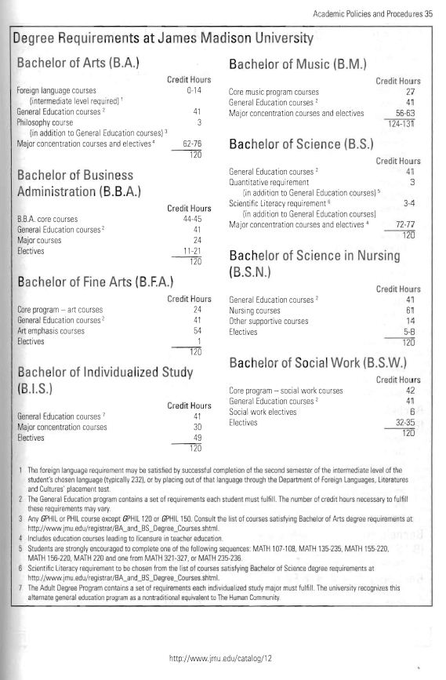
Page 35
Our Roles
Graduation Requirements
Your Schedule
Your “To Do List”
120 Credit Hours
Major
Degree
General Education
Electives
Pre-Professional
Minor
Double-Major
Notes:
Talking Points:
Page 35 shows you the requirements for each of the degrees.
For example, the B.A. degree requires that you complete courses through the intermediate level of a foreign language and a philosophy course that is not counting in General Education.

Slide 23
IA – First Year
Our Roles
Graduation Requirements
Your Schedule
Your “To Do List”
First Semester | Second Semester
Cluster 1 | Cluster 1
Cluster 1 or gen ed | Cluster 1 or gen ed
Gen ed | Gen ed
Gen ed | Gen ed
Gen ed or language | Gen ed or language
120 Credit Hours
Major
Degree
General Education
Electives
Pre-Professional
Minor
Double-Major
C1 - GPHIL 120 – Critical thinking
C2 - GREL 101 – Religions of the World
C3 - GISAT 251 or MATH 220*
C4 – GECON 200* GPOSC200 or GPOSC 225
C5 – GPSYC 101
Korean, Chinese, Persian, or Arabic
* Required
Notes:
Notes to Advisor: To change the credit hour data in the pie chart, click on the pie chart. You’ll notice new ribbons appear in your title bar under the umbrella, “Chart Tools”. In the “Design” tab underneath “Chart Tools”, click “Edit Data”.
Talking Points: tailor this slide to major(s) you’re advising
Mission and goals of the major
Plan of study
First semester and upper-level courses
Relation to GenEd
Progression/Admission standards, if applicable

Slide 24
General Education:
The Human Community
Our Roles
Graduation Requirements
Your Schedule
Your “To Do List”
Enables students to achieve a well-rounded education
Serves as the common core academic program at JMU
Teaches students to understand how distinct disciplines look at the world from different points of view
Aspires to create informed global citizens of the 21st century
Helps develop skills and knowledge which upper level courses use as a foundation and that employers seek
Provides the opportunity for students to try academic areas that they may not have considered
120 Credit Hours
Major
Degree
General Education
Electives
Pre-Professional
Minor
Double-Major
Notes:
Talking Points:
College is very different from high school
The way classes are scheduled, how much time you have to devote outside of class to studying, much more reading, your grade may be based on two exams and a paper, your syllabus for the class will list your assignments and you are not reminded of them, and you have much more freedom.
I will help you to understand the policies and procedures and work with you to become more independent.

Slide 25
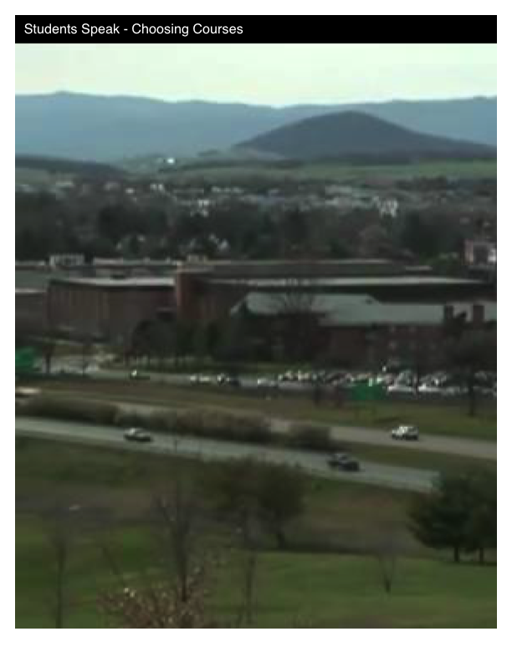
Next Slide
Notes:
<object width="640" height="360"><param name="movie" value="http://www.youtube.com/v/qI_Gui8aqwM&hl=en_US&feature=player_embedded&version=3"></param><param name="allowFullScreen" value="true"></param><param name="allowScriptAccess" value="always"></param><embed src="http://www.youtube.com/v/qI_Gui8aqwM&hl=en_US&feature=player_embedded&version=3" type="application/x-shockwave-flash" allowfullscreen="true" allowScriptAccess="always" width="640" height="360"></embed></object>

Slide 26
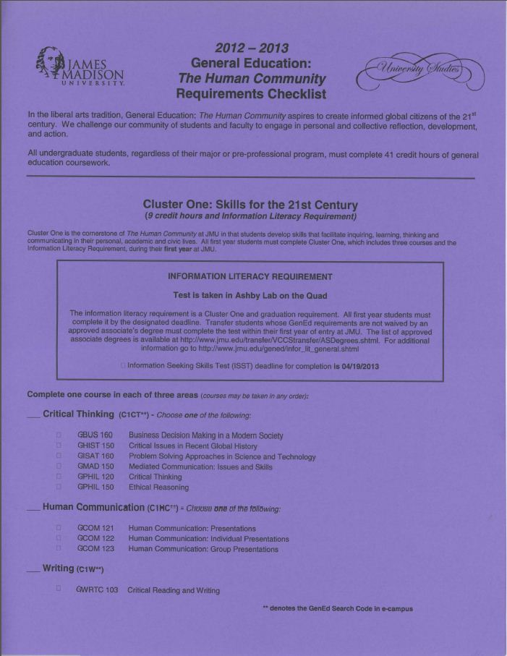

Our Roles
Graduation Requirements
Your Schedule
Your “To Do List”
120 Credit Hours
Major
Degree
General Education
Electives
Pre-Professional
Minor
Double-Major
Notes:
Notes to Advisor: To change the credit hour data in the pie chart, click on the pie chart. You’ll notice new ribbons appear in your title bar under the umbrella, “Chart Tools”. In the “Design” tab underneath “Chart Tools”, click “Edit Data”.
Talking Points:
What is General Education? Why is it important?
We will be going over the purple General Education (GenEd) checklist and the yellow insert. Please make sure you do not lose these papers because you will need these to keep track of your progress in completing your GenEd requirements.

Slide 27
Our Roles
Graduation Requirements
Your Schedule
Your “To Do List”
120 Credit Hours
Major
Degree
General Education
Electives
Pre-Professional
Minor
Double-Major
Notes:
Talking Points:
Cluster One: Skills for the 21st Century consists of courses that teach you critical thinking, communication, and writing.
All of these skills are necessary for your success in the other courses that you take at JMU so that is why this is the only cluster that needs to be completed
your first year.
Everyone has been preregistered into one of these courses, and you will take the rest next semester.
The Information Literacy Requirement listed in the box must be completed by the date listed.
The ISST tests your research ability online and using the library. You must take it in Ashby Lab and pass it by April 19, 2013.

Slide 28
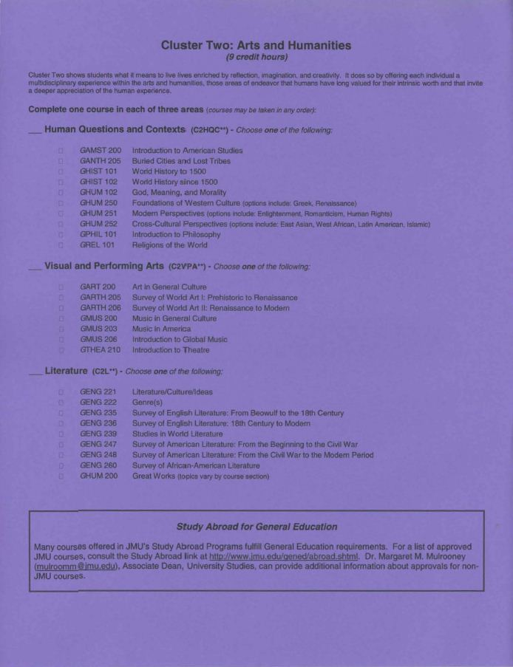
Our Roles
Graduation Requirements
Your Schedule
Your “To Do List”
120 Credit Hours
Major
Degree
General Education
Electives
Pre-Professional
Minor
Double-Major
Notes:
Talking Points:
In Cluster Two: Arts and Humanities, you will eventually take three courses: one from Human Questions and Contexts, one from Visual and Performing Arts, and one from Literature.
The GHUM 250, 251, and 252 courses have different topics as listed on your sheet. The section of the course determines the topic.
The courses in the Visual and Performing Arts are appreciation courses and not courses in drawing or playing an instrument.
If you look on the yellow insert under Cluster Two, you will see that you should complete or have credit for GWRTC 103 prior to taking a literature course.
The GHUM 200 courses also have different topics listed by sections.

Slide 29
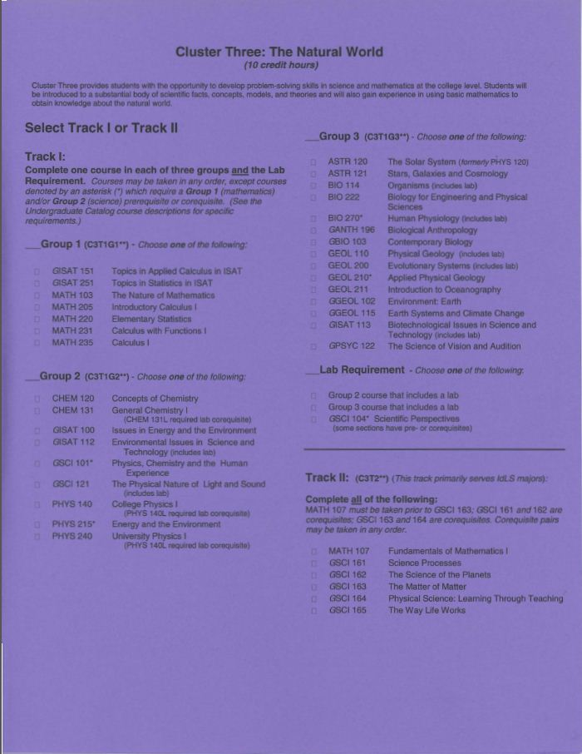
Our Roles
Graduation Requirements
Your Schedule
Your “To Do List”
120 Credit Hours
Major
Degree
General Education
Electives
Pre-Professional
Minor
Double-Major
Add: MATH 105E: Quantitative Reasoning
Notes:
Talking Points:
Cluster Three: The Natural World includes your math and science courses.
Most of you will choose from the Track I courses, and those of you who are majoring in IDLS will take Track II.
In Track I, you choose one math course from Group 1, one science course from Group 2, and one science course from Group 3. One of the science courses must include a lab. Or, if it doesn’t, you need to take the GSCI 104 course which meets the lab requirement. This course has numerous topics depending on the section of the course.
Please review the yellow insert to see information about these courses. Note that there is one course not listed on the purple sheet but listed on the yellow sheet:
MATH 105E Quantitative Reasoning: Sets and Venn diagrams, numbers in the real world, financial mathematics, statistical reasoning and characterizing data, basic probability, risk assessment, mathematical models. Only used for students who need MATH 220 but their placement score recommends MATH 105E first.
In Track II, all of the courses must be taken.

Slide 30
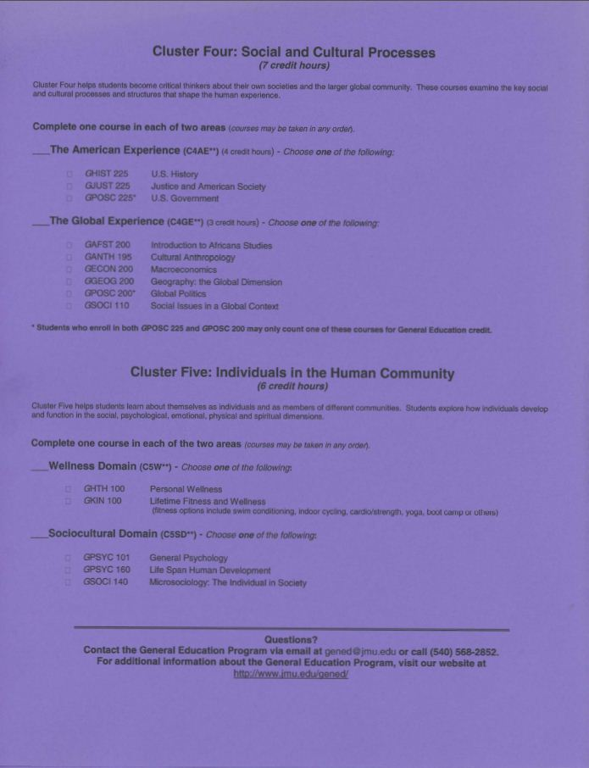
Our Roles
Graduation Requirements
Your Schedule
Your “To Do List”
120 Credit Hours
Major
Degree
General Education
Electives
Pre-Professional
Minor
Double-Major
Notes:
Talking Points:
Cluster Four: Social and Cultural Processes requires that you take one course from The American Experience and one course from The Global Experience.
The courses in The American Experience are four-credit hour courses because they are three hours of instruction and one hour of discussion in the case of GHIST 225, and for GJUST 225 and GPOSC 225, there are three hours of instruction and one evening every few weeks that consists of a film and discussion.
You cannot take GPOSC 225 and GPOSC 200 to meet the requirements because the courses have to be from different disciplines.
Cluster Five: Individuals in the Human Community requires that you take one course from the Wellness Domain and one course from the Sociocultural
Domain. The GKIN 100 has different activities depending on the section: Such as yoga, cardio/strength, swimming (intermediate), running.
Some of the sections of GPSYC 160 are hybrid courses which means that they meet once per week for 75 minutes either on Tuesday or Thursday and the rest of the course is online.

Slide 31
Our Roles
Graduation Requirements
Your Schedule
Your “To Do List”
120 Credit Hours
Major
Degree
General Education
Electives
Pre-Professional
Minor
Double-Major
CS – Electives could include minors or subjects of interest
ENGR – Electives should be selected from the “approved” technical electives
IA – Electives may include foreign language (recommended), minors, or subjects of interest
Notes:
Notes to Advisor: To change the credit hour data in the pie chart, click on the pie chart. You’ll notice new ribbons appear in your title bar under the umbrella, “Chart Tools”. In the “Design” tab underneath “Chart Tools”, click “Edit Data”.
Talking Points:
Tailor this slide to possible electives such as minors, double majors, or pre-professional programs.
Some majors have more options for electives than others—students think there is a list of electives.

Slide 32
Our Roles
Graduation Requirements
Your Schedule
Your “To Do List”
Notes:
Talking Points:
There are courses that you must take in order to graduate from the university.
Please take out from your Orientation packet the pink GenEd checklist, the lime green insert, and the Freshman Registration Brochure.

Slide 33
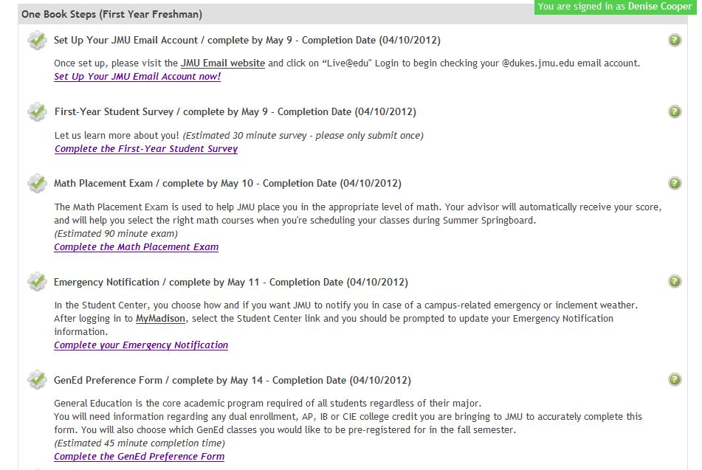
Our Roles
Graduation Requirements
Your Schedule
Your “To Do List”
Fall Courses
Course Descriptions
Daily Schedule
Complete/ Change Schedule
2-3 Courses
Cluster I… at least one
Major Courses
Cluster II: Visual & Performing Arts
Cluster IV: American Experience
Cluster V: Wellness
Notes:
Talking Points:
You were preregistered into courses depending on the choices you selected in Step 2 GenEd Preference Form and your major.

Slide 34
Our Roles
Graduation Requirements
Your Schedule
Your “To Do List”
Let’s look at your schedule – MyMadison.jmu.edu
or follow Blackboard link
Fall Courses
Course Descriptions
Daily Schedule
Complete/ Change Schedule
Notes:
Talking Points:
You were preregistered into courses depending on the choices you selected in Step 2 GenEd Preference Form and your major.

Slide 35
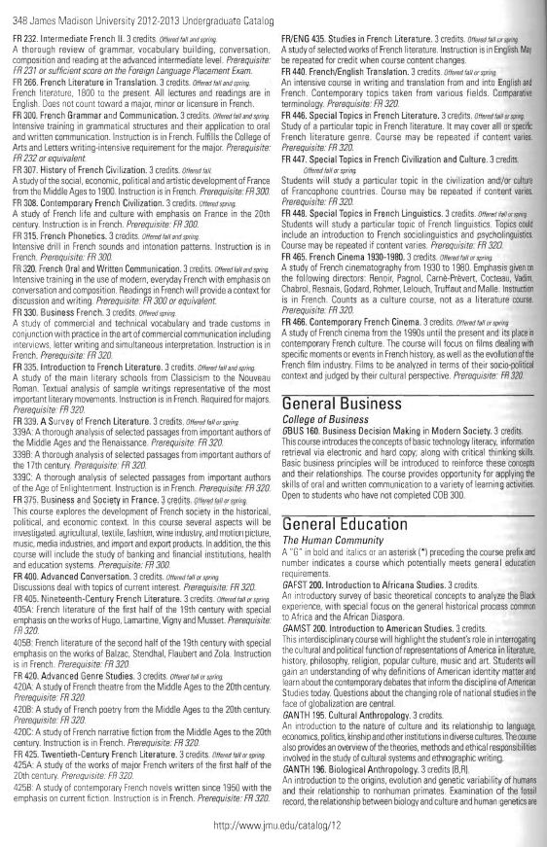
Page 348
Our Roles
Graduation Requirements
Your Schedule
Your “To Do List”
Fall Courses
Course Descriptions
Daily Schedule
Complete/ Change Schedule
Notes:
Talking Points:
The descriptions of the courses are in the back of the catalog.
Turn to page 348 because this is where the descriptions for the General Education courses are listed, and these are the courses you mostly will be taking.

Slide 36
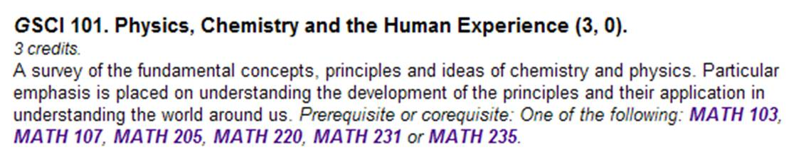
Our Roles
Graduation Requirements
Your Schedule
Your “To Do List”
Fall Courses
Course Descriptions
Daily Schedule
Complete/ Change Schedule
Notes:
Talking Points:
This is what the description of the course looks like.
The prefix refers to the subject area SCI for science and the G means a General Education class; other examples, are GHIST or GART.
It tells you that the course is 3 credit hours.
The next few lines describe the course.
At the end and in italics are listed any prerequisites (courses that have to be completed before you take this course) or corequisites (courses that you must take at the same time as this course). In this example, you can take one of the math courses listed prior to taking this course or while you are taking this course.

Slide 37
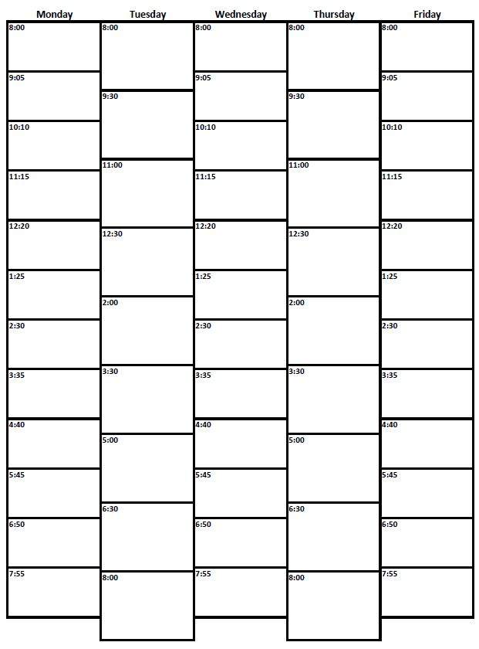
Our Roles
Graduation Requirements
Your Schedule
Your “To Do List”
50 min
50 min
50 min
Fall Courses
Course Descriptions
Daily Schedule
Complete/ Change Schedule
3 credits
75 min
75 min
75 min
75 min
2 hrs
50 min
Notes:
Talking Points:
Credit hours refer to the amount of time that you are in the class. One credit hour means 50 minutes of course instruction, so three credit hours can be scheduled in several formats.
Three 50-minute sections on MWF or two 75-minute sections on T/TH or M/W
Some courses are just one credit hour such as this 50-minute section, but labs are one credit hour and you are in class for 2 hours and 50 minutes or more.
Some four credit hour classes meet for instruction for two 75-minute time slots and a 50-minute discussion time or three 50-minute instruction slots and one 50-minute discussion time.
Some science classes are four credit hours because the lab is built into the schedule; for example, three 50-minutes of instruction and one 2 hour and 50 minute lab.

Slide 38
Our Roles
Graduation Requirements
Your Schedule
Your “To Do List”
2 hrs
50 min
50 min
Fall Courses
Course Descriptions
Daily Schedule
Complete/ Change Schedule
1 credit
100 min
180 min
Notes:
Talking Points:
Credit hours refer to the amount of time that you are in the class. One credit hour means 50 minutes of course instruction, so three credit hours can be scheduled in several formats.
Three 50-minute sections on MWF or two 75-minute sections on T/TH or M/W
Some courses are just one credit hour such as this 50-minute section, but labs are one credit hour and you are in class for 2 hours and 50 minutes or more.
Some four credit hour classes meet for instruction for two 75-minute time slots and a 50-minute discussion time or three 50-minute instruction slots and one 50-minute discussion time.
Some science classes are four credit hours because the lab is built into the schedule; for example, three 50-minutes of instruction and one 2 hour and 50 minute lab.

Slide 39
Our Roles
Graduation Requirements
Your Schedule
Your “To Do List”
75 min
50 min
50 min
50 min
Fall Courses
Course Descriptions
Daily Schedule
Complete/ Change Schedule
4 credits
50 min
75 min
50 min
75 min
75 min
75 min
2 hrs
50 min
Notes:
Talking Points:
Credit hours refer to the amount of time that you are in the class. One credit hour means 50 minutes of course instruction, so three credit hours can be scheduled in several formats.
Three 50-minute sections on MWF or two 75-minute sections on T/TH or M/W
Some courses are just one credit hour such as this 50-minute section, but labs are one credit hour and you are in class for 2 hours and 50 minutes or more.
Some four credit hour classes meet for instruction for two 75-minute time slots and a 50-minute discussion time or three 50-minute instruction slots and one 50-minute discussion time.
Some science classes are four credit hours because the lab is built into the schedule; for example, three 50-minutes of instruction and one 2 hour and 50 minute lab.

Slide 40
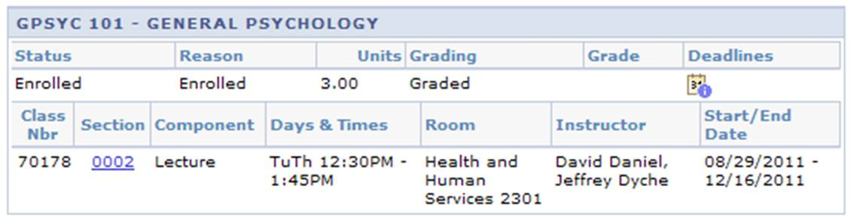
Reading Your Schedule
Our Roles
Graduation Requirements
Your Schedule
Your “To Do List”
Course # and Name
Credit Hours
Fall Courses
Course Descriptions
Daily Schedule
Complete/ Change Schedule
When & Where
Dates (full semester
or block course?)
Notes:
Talking Points:
You can view your schedule as I go over the parts on this slide.
Course number and name at the top and credit hours are listed under Units.
The days and times; building and room are listed.
Start/End dates show the first day of classes and the last day of exams. The first day of classes is Monday, August 27, and in the example the class meets on
Tuesdays and Thursdays so the first day of this class is Tuesday, August 28.
If you are taking a block course, it meets for half the semester, so the dates would be 8/27/2012-10/12/2012 for first block and 10/15/12-12/7/12 for second block.

Slide 41
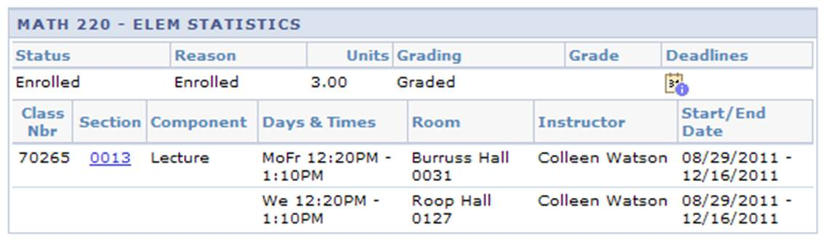
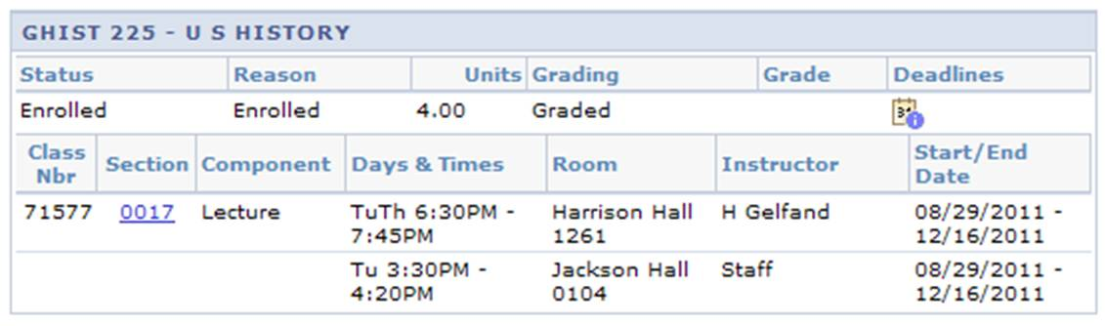
Reading Your Schedule
Our Roles
Graduation Requirements
Your Schedule
Your “To Do List”
Fall Courses
Course Descriptions
Daily Schedule
Complete/ Change Schedule
Notes:
Talking Points:
This slide shows examples of various meeting times and instructors.
The GPSYC 101 has two instructors.
The MATH 220 meets MWF but in one location for Monday and Friday and another location for Wednesday.
The GHIST 225 meets twice a week for lecture and once a week on Tuesdays at 3:30 for discussion.
Staff means that the instructor has not been determined yet.

Slide 42

Our Roles
Catalog and Academic Terms
Graduation Requirements
Your Schedule
Your “To Do List”
Our Roles
Graduation Requirements
Your Schedule
Your “To Do List”
Fall Courses
Course Descriptions
Daily Schedule
Complete/ Change Schedule
Individual Sessions
2:40 – 4:45
2-3 Courses:
General Education
GWRTC if you need it
Alert me during our meeting if you are:
Joining ROTC
Joining the Marching Band
Earning an Associate’s Degree
Expecting College Credit from AP, IB, etc.
Notes:
Talking Points:
We will go to my office now so that you will know where it is.
As I meet with my 2:45 student, my 3:10 student should wait right outside the office.
If you do not arrive on time for your appointment, I will not be able to meet with you; you will not be able to complete your schedule today.

Slide 43
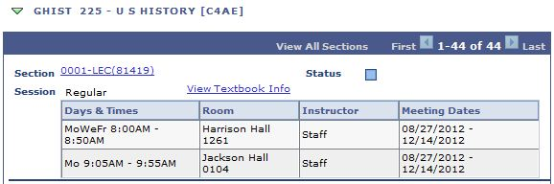
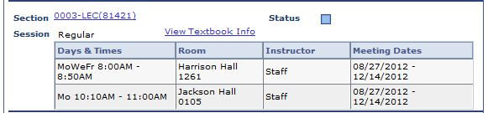
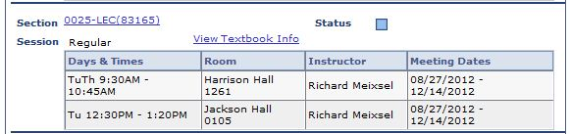
Searching on MyMadison
Our Roles
Graduation Requirements
Your Schedule
Your “To Do List”
Fall Courses
Course Descriptions
Daily Schedule
Complete/ Change Schedule
Notes:
Talking Points:
This slide shows examples of various meeting times and instructors.
The GPSYC 101 has two instructors.
The MATH 220 meets MWF but in one location for Monday and Friday and another location for Wednesday.
The GHIST 225 meets twice a week for lecture and once a week on Tuesdays at 3:30 for discussion.
Staff means that the instructor has not been determined yet.

Slide 44
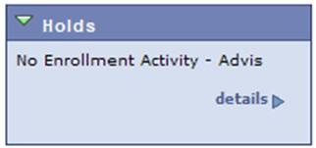
Freshman Advising Hold
“No Enrollment Activity – Advis”
Our Roles
Graduation Requirements
Your Schedule
Your “To Do List”
Beginning July 23 @ 12:00 a.m. (EDT), you can attempt to swap class sections, not courses.
 GPSYC 160 ←→ GPSYC 101
 GPSYC 160 ←→ GPSYC 160
Make sure you pay attention to the Can I Get There On Time chart.
You can attempt to swap courses (GPSYC 160 ←→ GPSYC 101) with your advisor’s permission after August 23.
Fall Courses
Course Descriptions
Daily Schedule
Complete/ Change Schedule
Notes:
Talking Points:
If you look on your MyMadison, you will see an advising hold that says there is no enrollment activity. You are registered for courses but this keeps you from making any changes.
We say attempt to swap because it depends on course availability.
The Can I Get There On Time chart is a link on MyMadison and shows you a map of the parts of campus and which ones you can get to from each other.
Students need your permission to change courses, not sections.
You will be able to complete add/drop forms after the group advising session on August 23. Students will be able to process these starting August 24.
Please look at the Freshman Registration Brochure in your packet. The orange box titled “Schedule Changes” lists the only cases in which your schedule can be changed over the summer prior to the 1787 Orientation advising session.

Slide 45
Our Roles
Graduation Requirements
Your Schedule
Your “To Do List”
Notes:
Talking Points:
There are courses that you must take in order to graduate from the university.
Please take out from your Orientation packet the purple GenEd checklist, the yellow insert, and the Freshman Registration Brochure.

Slide 46

Connect
Our Roles
Graduation Requirements
Your Schedule
Your “To Do List”
Go to www.piazza.com and register as a student for JMU 101. Use your official JMU e-mail address.
This is a site where you can engage with others in your entering class and your advisors. We will monitor the site, but feel free to answer one another’s questions as well. You can get e-mail notification when new posts are made.
Feel free to start a discussion with your fellow advisees.
After Today:
Piazza
Preface
Disability Services
AP/IB, CIE, DE
Checklist
Today:
While Waiting to Meet
Individual Meeting

Slide 47
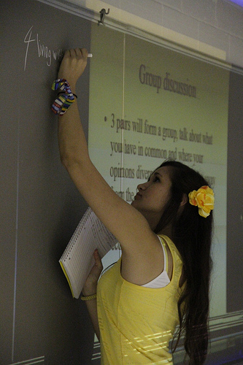
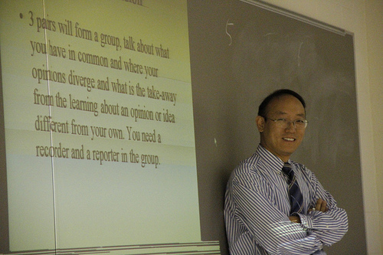
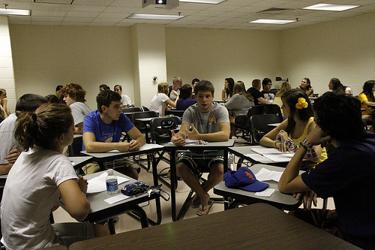
Your first assignment @ JMU
Our Roles
Graduation Requirements
Your Schedule
Your “To Do List”
Be ready to discuss with a JMU Faculty member @ 1787 Orientation.
www.jmu.edu/orientation/preface
Professors use the text in class.
So, you might see it again!
After Today:
Piazza
Preface
Disability Services
AP/IB, CIE, DE
Checklist
Today:
While Waiting to Meet
Individual Meeting

Slide 48
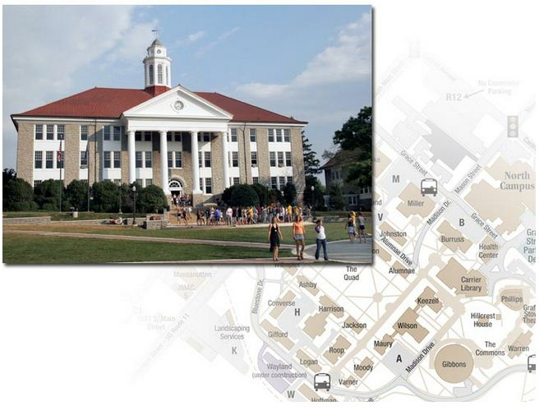
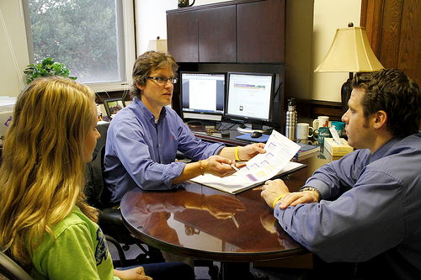
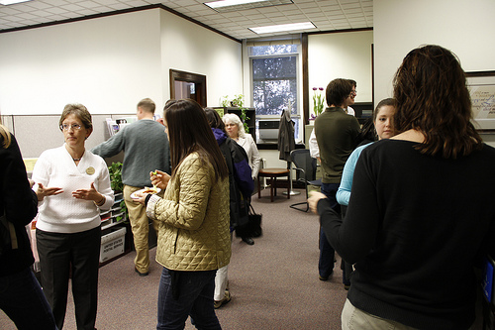
Register with
Disability Services
Our Roles
Graduation Requirements
Your Schedule
Your “To Do List”
540-568-6705
disability-svcs@jmu.edu
Wilson Hall 107
www.jmu.edu/ods
After Today:
Piazza
Preface
Disability Services
AP/IB, CIE, DE
Checklist
Today:
While Waiting to Meet
Individual Meeting
Notes:
Talking Points:
If you have a diagnosed disability, register with the Office of Disability Services to request accommodations.
If you have an undiagnosed disability, instructors at college won’t make accommodations for your testing or learning without documentation as you may have
had in high school. Contact the Office of Disability Services about screening and assessment.
During the individual meeting today, feel free to discuss your special needs with me.

Slide 49
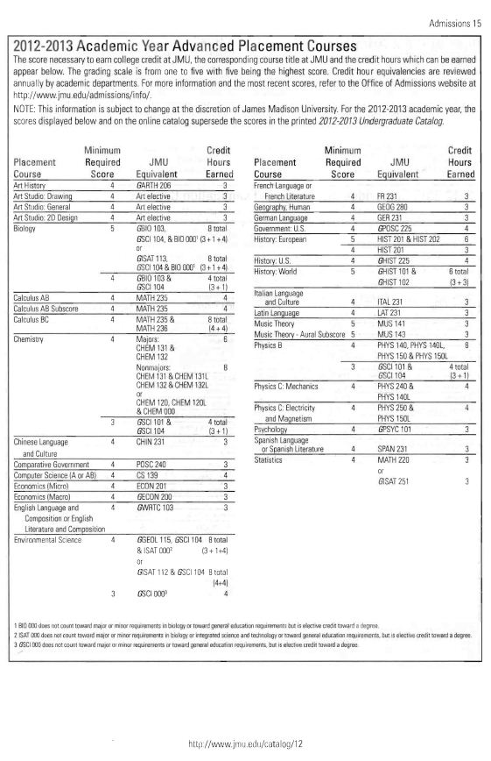
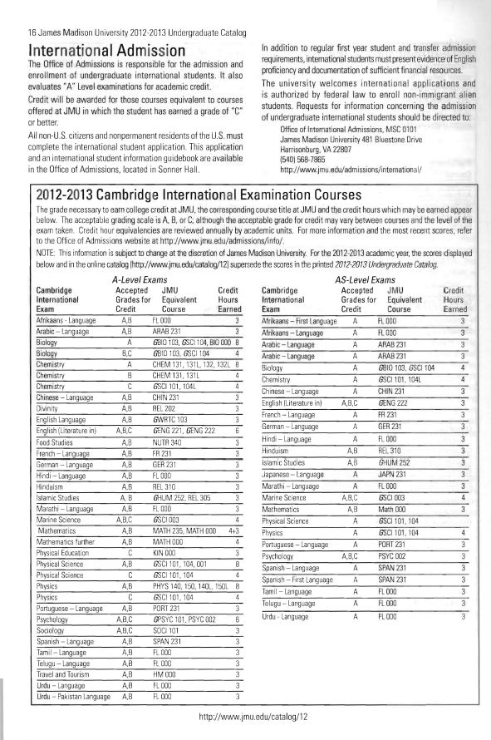
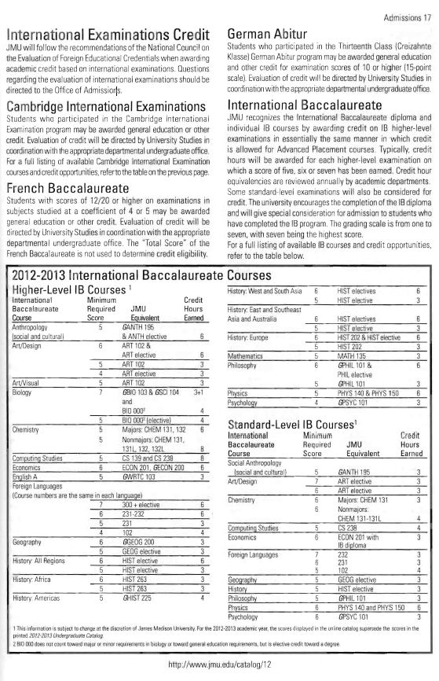
AP: 15
CIE: 16
IB: 17
Our Roles
Graduation Requirements
Your Schedule
Your “To Do List”
After Today:
Preface
Disability Services
AP/IB, CIE, DE
Checklist
Today:
While Waiting to meet
Individual Meeting
Notes:
Talking Points:
If you have taken the AP or IB tests that you pay for, it is your responsibility to be sure that the scores are sent to the JMU Admissions Office.
I cannot take your student reports; the Educational Testing Service (ETS) needs to send them to JMU.
If you are not sure how to do this, I have an instruction sheet for you to use.
Certain test scores will provide credit for specific courses; please see page 15 in your catalog for AP scores and page 17 for IB scores.
If the JMU equivalent has three zeroes such as BIO 000 or HIST elective, then you will receive elective credit that goes towards your 120 credits to graduate
but does not count for a specific course.
If you took college courses at your high school and earned a C or better, you may have earned college credit at JMU called dual enrollment (DE)
You need to have the college that offered the courses send an official transcript to JMU’s Registrar’s Office—information is on the instruction sheet with the AP/IB credit
It is your responsibility to have this transcript sent.

Slide 50
Other Items on Checklist
Our Roles
Graduation Requirements
Your Schedule
Your “To Do List”
See the checklist in Blackboard
After Today:
Preface
Disability Services
AP/IB, CIE, DE
Checklist
Today:
While Waiting to Meet
Individual Meeting
Notes:
Talking Points:
In addition to the items we have just reviewed, remember to use your JMU email. We do not use other email addresses when sending information to you.
On your checklist, there is a website listed with information about Blackboard. Many professors use this for their classes so you need to become familiar with
it.
Completing your Health Record was one of the steps on the One Book website. Please make sure this is completed so that you do not have a hold placed on your record.
Make sure that your high school sends your final transcript to the JMU Admissions Office so that a hold is not placed on your record keeping you from making adjustments to your schedule or registering for the spring semester.
If you have declared a major, become familiar with the major and requirements listed in your catalog and online through University Advising (website listed on
your checklist).
If you have not declared a major, spend time looking through these resources to learn more about majors that might be of interest.

Slide 51
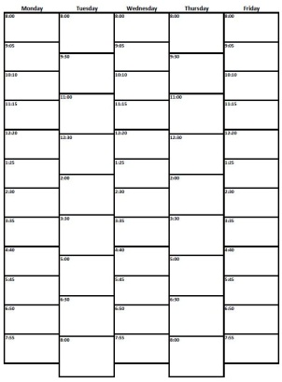
While Waiting to Meet
Our Roles
Graduation Requirements
Your Schedule
Your “To Do List”
Look up GenEd course descriptions
Preference all courses within each GenEd requirement
Fill in your Daily Planner with current schedule (class, time, and location)
Go to Help Room for OPA help in ISAT/CS 236 or Wilson 303
Arrive on time for appointment or you will not complete your schedule today
Complete Scavenger Hunt Worksheet
After Today:
Preface
Disability Services
AP/IB, CIE, DE
Checklist
Today:
While Waiting to Meet
Individual Meeting
Notes:
Talking Points:
If you would like some help from the OPAs in completing your worksheet, you can go to the Help Rooms listed.
However, do not be late for your appointment with me. If you are not here or miss it entirely, you will not be able to complete your registration of classes
today.
If you have completed your worksheet and your Daily Planner, you also could use the time doing the Catalog Scavenger Hunt worksheet.

Slide 52
Our Roles
Graduation Requirements
Your Schedule
Your “To Do List”
MATH 155
Roop
Math 155
Roop
MATH 155
Roop
GMUS200
HHS
GMUS200
HHS
After Today:
Preface
Disability Services
AP/IB, CIE, DE
Checklist
Today:
While Waiting to Meet
Individual Meeting
GPOSC200
Miller
GPOSC200
Miller
GPOSC200
Miller
GHTH 100
HHS
GHTH 100
HHS
GCOM 123
Harrison
GCOM 123
Harrison
Notes:
Talking Points:
This slide shows a full schedule on the Daily Planner, listing the course and the building.
Please note how they are spread out, and on Tuesday, the student has one class at 8:00am and the next one is at 6:30pm.

Slide 53
Our Roles
Catalog and Academic Terms
Graduation Requirements
Your Schedule
Your “To Do List”
Our Roles
Graduation Requirements
Your Schedule
Your “To Do List”
After Today:
Preface
Disability Services
AP/IB, CIE, DE
Checklist
Today:
While Waiting to Meet
Individual Meeting
Individual Sessions
2:40 – 4:45
Please arrive at least 10 minutes early for your appointment
Notes:
Talking Points:
We will go to my office now so that you will know where it is.
As I meet with my 2:40 student, my 3:05 student should wait right outside the office.
If you do not arrive on time for your appointment, I will not be able to meet with you; you will not be able to complete your schedule today.

