Slide 1
1787 Orientation
Advising Session

Slide 2
Transition to College
What attracted you to JMU?
What concerns do you have?

Slide 3
What Is JMU?
We are a community committed to preparing students to be educated and enlightened citizens who lead productive and meaningful lives.
- JMU mission statement
Educated and enlightened citizens
discover, question, be challenged, grow
Leading productive and meaningful lives
find your path, contribute to your community

Slide 4
JMU Values
Our student-centered community values:
Excellence
The state or quality of being outstandingly good or proficient
Integrity
Adherence to moral principles; honesty
Mutual Respect
Show consideration for; treat courteously or kindly

Slide 5
Your Goals – Write these on the provided note cards
By the end of your first semester, what do you want to have accomplished?
How will you accomplish these goals?

Slide 6
Decisions
You accomplish your goals through decisions you make—
Choosing JMU
Choosing a major
Choosing activities – Student Organization Night Sept. 7, 6:30-8:30pm, UREC Turf
Choosing how you socialize
Choosing to seek help when needed

Slide 7
Resources
JMU provides resources to help with:
study skills, time management, test-taking skills
math and science classes
writing
preparing and giving speeches
supplemental instruction sessions for certain courses
learning styles
English Language Learning
homesickness, roommate issues, relationship issues, etc.
choosing a major, exploring career paths

Slide 8
Our Roles
My Role
  Help with your transition from high school to college
  Provide information about course requirements for General Education and your major
  Serve as your main resource while teaching you to be independent & responsible
  Teach you how to navigate through academic policies and procedures
  Help you develop academic goals

Slide 9
Our Roles
Your Role
  Take ownership of your education
  Set academic goals and strive for them
  Attend class and work hard
  Meet with me, keep me informed
  Know and fulfill GenEd, major, and degree requirements
  Learn how to find academic policies and procedures
  Use ecampus for academic planning and resources

Slide 10
Our Communication
My contact information: Nancy Harris, harrisnl@jmu.edu, ISAT/CS 217, AIM: harrisnl55
Best way(s) to contact me are e-mail (from your JMU account) and AIM
Responses, generally during the day within a few hours. Generally not between 11pm and 7am
I will e-mail you with important information so don’t just ignore e-mail.
Office hours: M/W/F 10-11am and M/T 2-3pm.
First week, most of the afternoon from 1-5pm.

Slide 11
Changing Your Major
Let me know during this session if you want to change your major, and I will turn it in so that the change will be made. You may need to change your schedule.
AFTER August 26:
After August 26, see me to change your major or to add a 2nd major or minor
Some departments have additional requirements or deadlines for declaring-check with the department.

Slide 12
Cluster One
Cluster 1 Courses must be completed by the end of your first year-you should be in at least one Cluster One course this semester
You will be preregistered into the remaining Cluster One courses in the spring semester
Technology Competency Tests
(remember, can only be taken in Ashby lab, which is on the Quad)

Slide 13
Technology Competency Tests
Required component of Cluster One.
Tech Level I: Basic Competency is designed to build your competency in 3 areas: Word, PowerPoint, and Excel
Must take Tech Level I and pass all 3 components by November 19, 2010.
Information Seeking Skills Test (ISST) covers knowledge of, and skills in information retrieval, electronic databases, and the use of the Internet.
Must take ISST and pass by April 22, 2011.
Ashby Lab hours:
Hours posted on the door to the lab and on GenEd website under Info. Literacy tests.

Slide 14
Fall 2010 Dates and Deadlines
Classes Begin
Semester/First Block Monday, August 30
Second Block Monday, October 18
End of Drop Period: "W" Grade will apply after this date
Semester/First Block Tuesday, September 7 by 5pm
Second Block Monday, October 25 by 5pm
End of Add Period: Instructor/Dept. Head Signatures required after this date
Semester/First Block Tuesday, September 7 by 5pm
Second Block Monday, October 25 by 5pm
Last Day to Add a Class with Signatures-come to Reg. Ser. by 5pm
Semester/First Block Thursday, September 16
Second Block Monday, November 3
Tuition Refund Deadline for Withdrawal from the University
(must withdraw from all classes to be eligible)
Semester/First Block Friday, September 17
Deadline for withdrawing with “W” grade from a class or changing course credit options (Course withdrawals or credit option changes such as repeat forgive will not be processed after the end of the course adjustment period)
Semester Thursday, October 28
First Block Tuesday, September 28
Second Block Thursday, November 18
Classes End
Semester/Second Block Friday, December 10
First Block Friday, October 15
Final Examination
Semester December 11-17
First Block Last Class Meeting
Second Block December 11-17
Thanksgiving Vacation November 22-26
Spring semester advance registration begins: Monday, November 1

Slide 15
GPA
Average for each credit hour you have taken
Your term GPA at the end of the fall = cumulative GPA at JMU
A 4-credit course is valued higher than a 3-credit course.

Slide 17
Academic Standing
GPA= Grade Point Average
President’s List
(3.9 semester GPA, 12 credit hours)
Dean’s List
(3.5-3.89 semester GPA, 12 credit hours)
Good Standing
(at least 2.0 cumulative GPA)
Academic Warning
(semester GPA below 2.0)
Academic Probation
(cumulative GPA below 2.0)
Academic Suspension
(cumulative GPA below minimum required- see chart in catalog)

Slide 18
Student Center-more than classes
■Drop down box for “other academic”
●Buy My Books: click on this which
takes you to your schedule, scroll to the
bottom and then click on “Buy My
Books”
●Unofficial transcript
●View test scores
■On right side of Student Center
●Holds: Advisor Hold
●To Do List: High School transcript
●Advisor

Slide 19
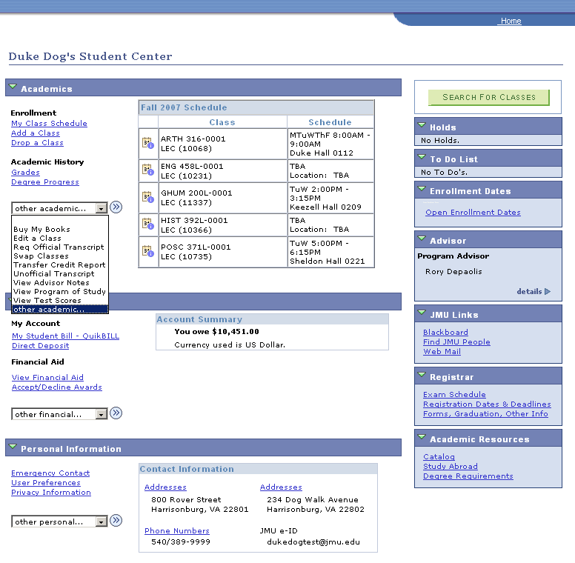

Slide 20
Schedules
Log onto e-campus, click on Student Center
Schedule listed on Student Center is based on current date so will not show 2nd block classes
Click on My Class Schedule under Enrollment to see all classes

Slide 21
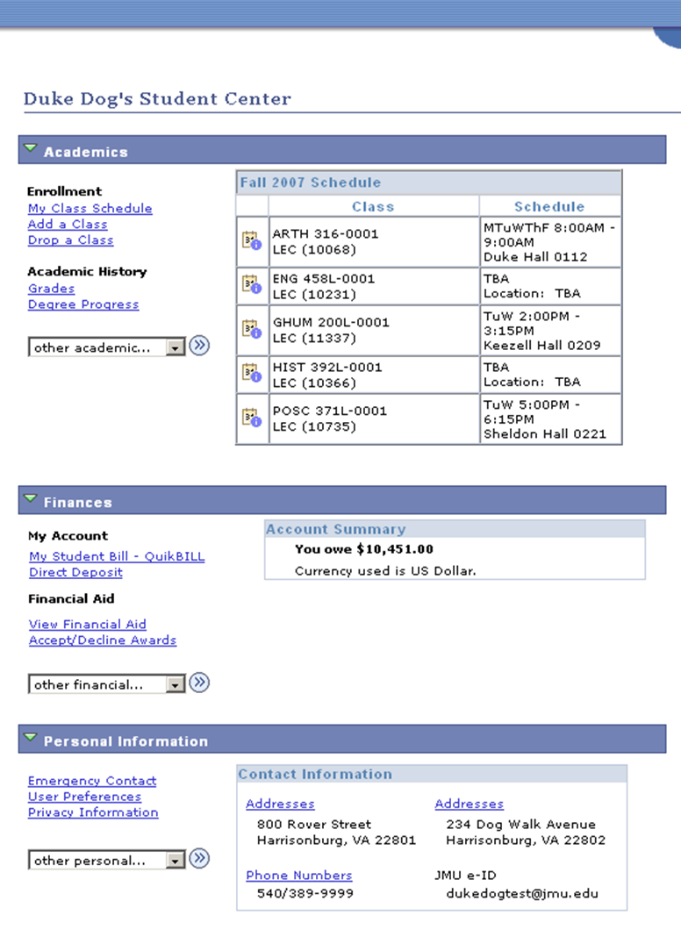

Slide 22
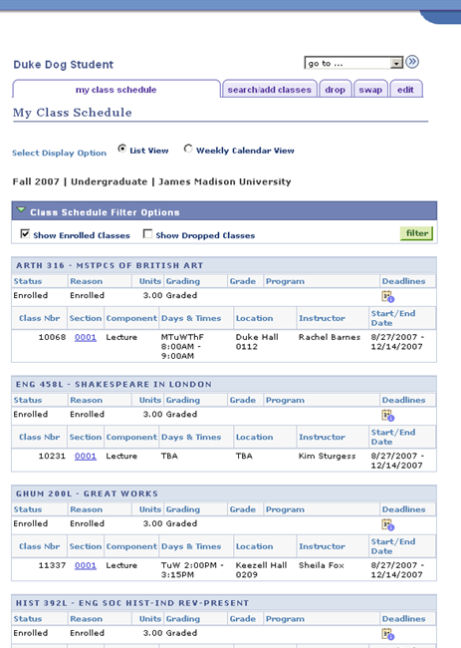

Slide 23
Where are your classes located?
Walk your entire class schedule route to determine room locations and commute time
Learn the Inner Campus Shuttle bus schedule if needed

Slide 24
Campus Map
Campus Map

Slide 25
Caution!
Be Aware of Attendance Policies
~ Each college may have first week attendance policies
~ Many classes have attendance policies for the semester
~More than X number of classes missed could result in a drop in letter grade or an “F” at the end of the term

Slide 26
Schedules
You have good schedules—you have had input into the choices
Each class is meeting a requirement or special interest of yours
Different from high school—have some breaks between classes-review notes, study, etc. Some start at 8:00 a.m.; some finish at 8:00 or 9:00 p.m. or later
You are the only one who is able to change your schedule in person with your advisor
Will register in mid-November for new classes in the spring semester

Slide 27
Making Changes to Your Schedules
Because you have good schedules, there should be no need to make changes
However, if you want to try and make changes…
1st semester freshmen must have advisor signature for adding or dropping different classes such as GPOSC 200 for GANTH 195 for the Fall semester—must meet with advisor to make these changes
Using ecampus, can swap the same class (such as one GHTH 100 for another GHTH 100) for a different day and time without advisor’s signature—
Beware of location—make sure that you can get from one class to the next if you swap

Slide 28
Making Changes to Your Schedule
No changes made on Thurs., August 26
Course Adjustment Hours:
Friday, August 27: 7:30am-9:30am and
noon -2:00pm, take add/drop slip signed
by me to Hillside Hall; Computer Lab is in basement
BRING A COPY OF YOUR SCHEDULE
Registration Services open (3rd floor,
Warren Hall):
Saturday, August 28: 12noon-5:00pm
Sunday, August 29: 12noon-5:00pm
Monday, August 30: 8:00am-6:00pm
Tuesday, Aug. 31 return to regular
schedule:
Monday-Friday, 8:00am-5:00pm

Slide 29
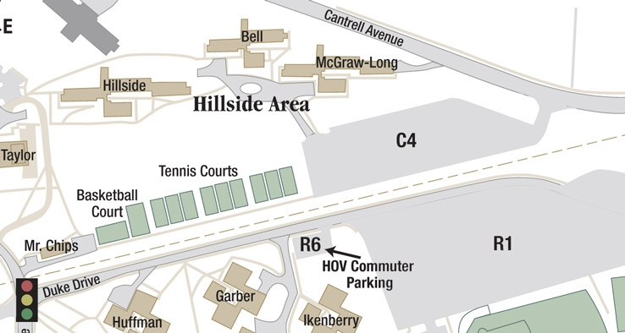
Friday Registration Lab

Slide 30
Assessment Sessions
Must attend assessment session which is listed on the label on your mappy—you will attend either 10:00 a.m.-1:00 p.m. or 2:00-5:00 p.m.
If you do not attend, a hold will be placed on your record, and you will not be able to register for the spring semester

Slide 31
Major & Pre-professional Meetings
Saturday, August 28 at 9:30 a.m. or 11:00 a.m.
Must attend if your major is presenting
Great opportunity to learn about majors, requirements, progression standards, etc.
Pre-med, pre-physical therapy, pre-law, etc. will be presenting
Information listed in your mappy

Slide 32
Resources
You can access the following document on the web—you will receive an email next week with the link
Career and Academic Planning - James Madison University
Click on How to Succeed at JMU

Slide 33
Honor Code Tutorial and Test
Students must complete the JMU Honor Code test by October 1.
The test is online and can be taken from any location
JMU - Honor Code Test

Slide 34
Finding Information on the Web
James Madison University - Current Students
Click on Current Students tab at top
Student Services
Blackboard
Registrar
Find JMU People--professors
Quick Links with drop down menu
Click on Academics tab at top
Click on your Area of Academic interest on right
JMU Site Index
Search feature on JMU Web site

