Slide 1
Check-In with Advisor
Nancy Harris
harrisnl@jmu.edu
540-568-8771
ISAT/CS 217
Notes:
Some advisors are combining during the 1787 session. This slide can show where you want your particular students to sit. Or, if you are by yourself, just change to one listing of an advisor.

Slide 2
Icebreaker
You each have a 3x5 card with a name on it.
It is the name of another student in your freshman class.
And someone has your name.
Find the person with your name. Give them your card (which is probably not their name) and take your own. Help them to find their card. Continue until you have about 4-5 people in a group each with their own names.
Together – figure out one thing that you have in common. It cannot include that you are CS students or are taking the same CS or Cluster 1 courses. It can include anything such as hometown, favorite hobbies, favorite movies, favorite game sites, pets, family, etc.

Slide 3
Presentation by Cyber Defense and ACM!

Slide 4

Your Role… as an Advisee
Our Roles
Academics and Success
Advising Materials
To-Do List
Contact Me
Responsible for your decisions, choices, and actions
Seek advice, information, resources, and support
Knowing and fulfilling degree, major and general education requirements
Choose a major and career path
Use e-campus for academic planning and resources
Contact your advisor, who serves as your main resource for academic questions
YOU

Slide 5
My Role… as an Advisor
Our Roles
Academics and Success
Advising Materials
To-Do List
Contact Me
Help with your transition from high school to college
Serves as your main resource while teaching you to be independent and responsible
Teaches you how to navigate through academic policies and procedures
Helps you develop academic goals

Slide 6

What are your goals?
Our Roles
Academics and Success
Advising Materials
To-Do List
Contact Me
Notes:
Being a student is a full-time job and you must be engaged in the process – not just keeping a seat.

Slide 7
What are your goals?
Our Roles
Academics and Success
Advising Materials
To-Do List
Contact Me
On the back of your name card, write one thing that you want to accomplish this semester.
Notes:
Being a student is a full-time job and you must be engaged in the process – not just keeping a seat.

Slide 8

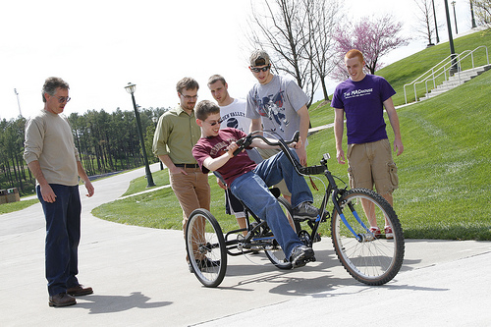


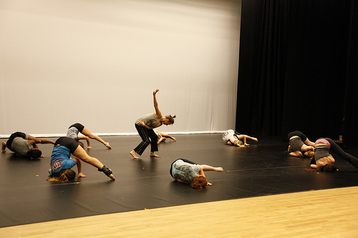

Our Roles
Academics and Success
Advising Materials
To-Do List
Contact Me
Academics
Co-Curricular
Wellness
Professional
Notes:
Pick a variety of courses that are challenging. These slides show a variety of classroom settings or projects.

Slide 9
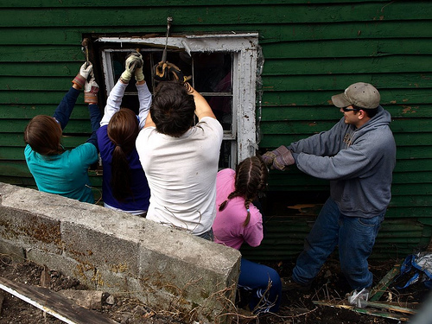

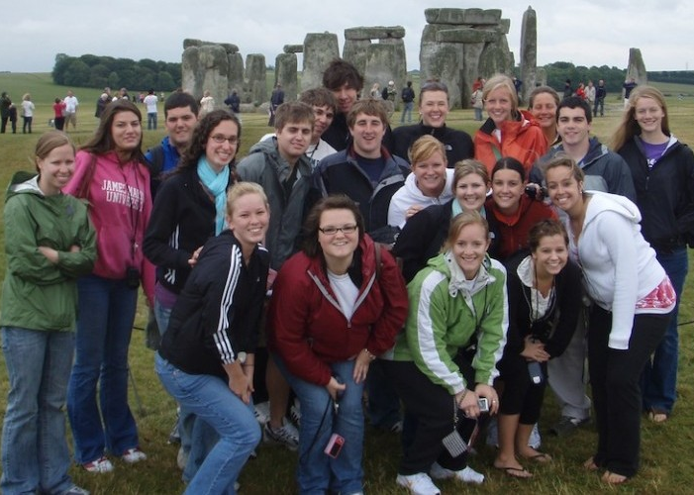

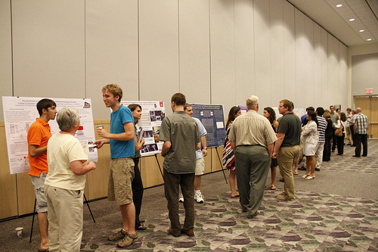
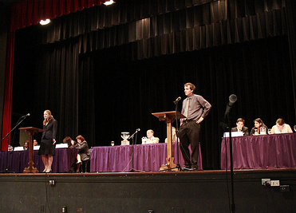
Our Roles
Academics and Success
Advising Materials
To-Do List
Contact Me
Academics
Co-Curricular
Wellness
Professional
Notes:
Connect theories to practice through independent research projects, internships, clubs and organizations, and service learning
Gain perspectives outside the U.S. – study abroad, foreign language courses, courses about global issues and other countries

Slide 10
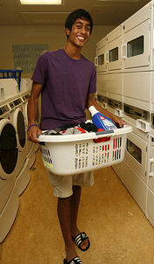
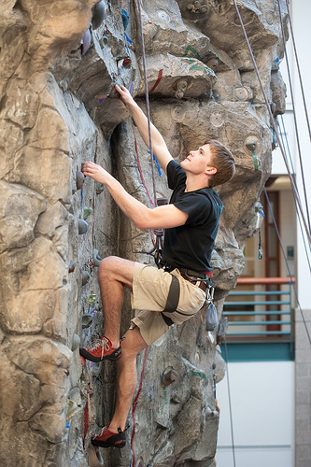
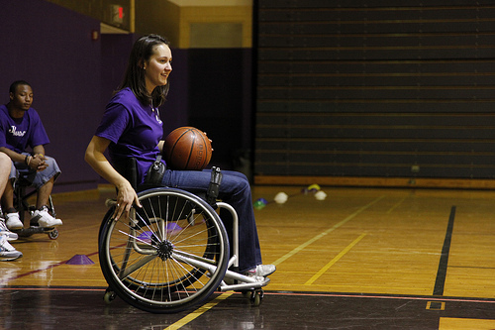

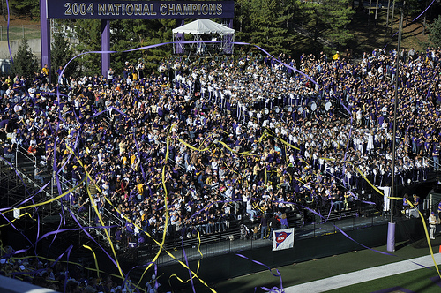
Our Roles
Academics and Success
Advising Materials
To-Do List
Contact Me
Academics
Co-Curricular
Wellness
Professional
Notes:
Taking responsibility and gaining independence
Take care of you – make friends and take care of your health and wellbeing

Slide 11

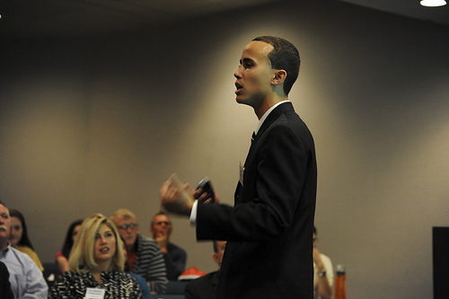
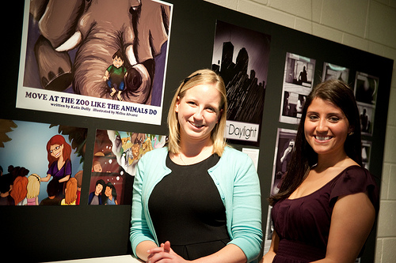

Our Roles
Academics and Success
Advising Materials
To-Do List
Contact Me
Academics
Co-Curricular
Wellness
Professional
Notes:
Build skills and gain professional experience

Slide 12

Our
Goal
Our Roles
Academics and Success
Advising Materials
To-Do List
Contact Me
Notes:
Our goal is to get you here…

Slide 13
Academic Standing
Our Roles
Academics and Success
Advising Materials
To-Do List
Contact Me
President’s List
(3.9 semester GPA, 12 credit hours)
Dean’s List
(3.5-3.89 semester GPA, 12 credit hours)
Good Standing
(at least 2.0 cumulative GPA)
Academic Warning
(previous semester GPA below 2.0)
Academic Probation
(cumulative GPA below 2.0)
Academic Suspension
(cumulative GPA below minimum required based on credit hours earned)
Academic Dismissal
(a student who is suspended a third time will be
permanently dismissed from the university)
Notes:
When setting goals, it is good to know the target.

Slide 14
Time Management
Our Roles
Academics and Success
Advising Materials
To-Do List
Contact Me
For every credit hour, you should spend
at least 2 hours studying for that class.
So...
15 credit hours
x 2 hours studying
30 study hours per week
Out of Class!
15 in-class + 30 out-of-class studying
45 hours for academics
Notes:
Advisors may want to adjust this as they see fit.

Slide 15
Time Management 40 Hour Work Week
Our Roles
Academics and Success
Advising Materials
To-Do List
Contact Me
 | Monday | Tuesday | Wednesday | Thursday | Friday
8:00
9:00
10:00
11:00
12:00
1:00
2:00
3:00
4:00
5:00
6:00
7:00
 | Monday | Tuesday | Wednesday | Thursday | Friday
8:00
9:00
10:00
11:00
12:00
1:00
2:00
3:00
4:00
5:00
6:00
7:00
study
MATH 220
study
MATH 220
study
travel
travel
travel
GKIN 100
travel
GKIN 100
GKIN 100
study
travel
study
travel
travel
travel
study
study
study
travel
travel
travel
GGEOG 200
GGEOG 200
GGEOG 200
travel
travel
travel
lunch
travel
lunch
travel
lunch
lunch
lunch
travel
travel
travel
travel
travel
GHIST 101
study
GHIST 101
study
GHIST 101
travel
travel
travel
study
study
study
travel
travel
GPOSC 225
GPOSC 225
travel
travel
travel
travel
travel
dinner
dinner
dinner
dinner
dinner
travel
travel
travel
travel
travel
study
GPOSC 225
study
study
study
Notes:
Of course, it is important to exercise, spend time with friends, do fun things. All can be fit into the schedule since this is only looking at 40 hours within the week.

Slide 16

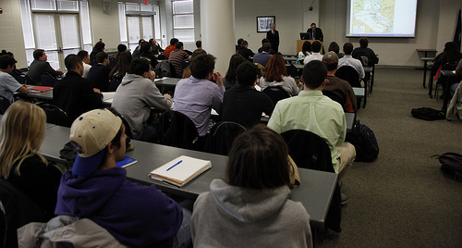

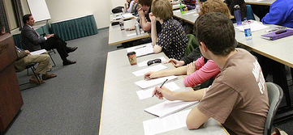
Classroom Behavior
Our Roles
Academics and Success
Advising Materials
To-Do List
Contact Me
Ask Questions
Engage in Discussion
Arrive on Time
Take Notes
Notes:
Classroom Behavior:
Arrive early and be prepared to start class on time.
Take Notes
Ask Questions
Engage in Discussion

Slide 17
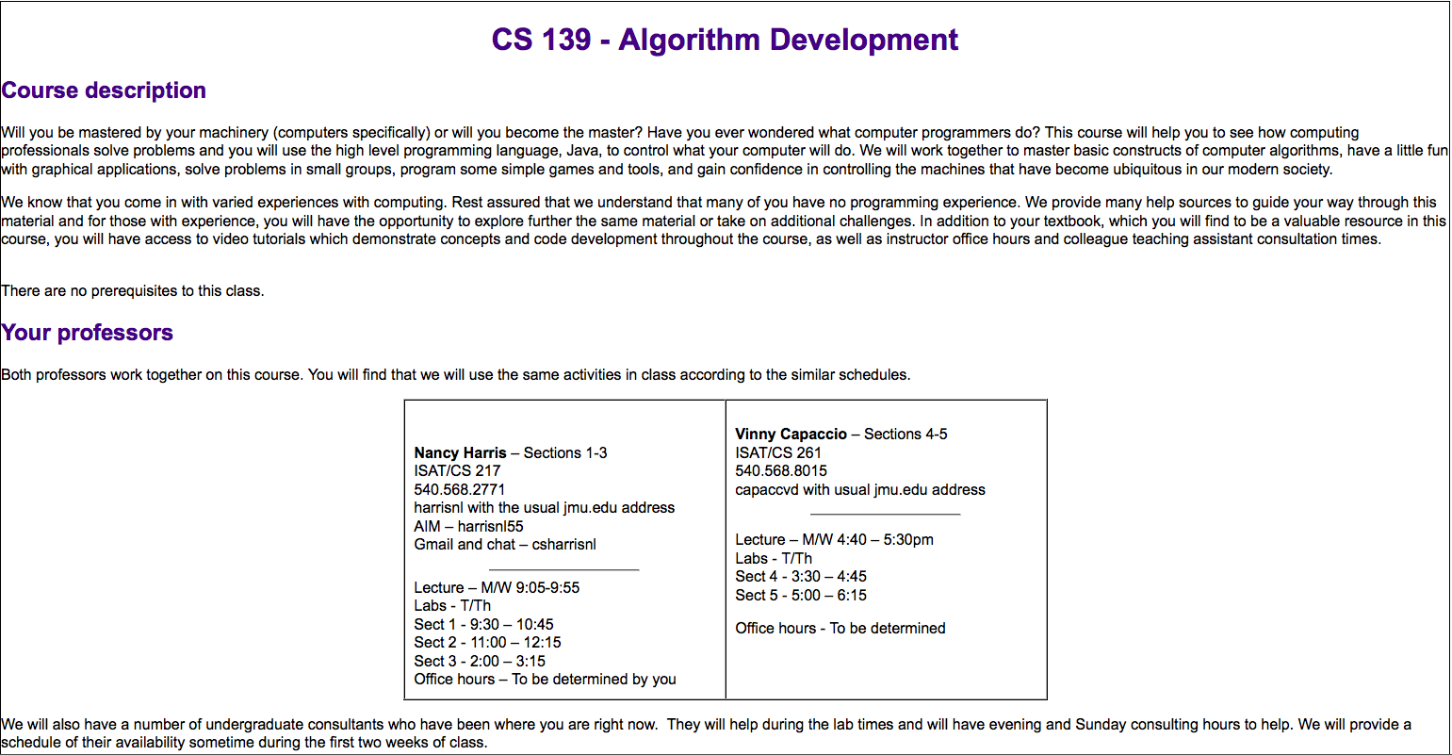
Syllabus
Our Roles
Academics and Success
Advising Materials
To-Do List
Contact Me
Faculty Contact Info
Office Hours
Materials
Assignments
Attendance Policy
Grading
Any other classroom expectations
Notes:
Read Syllabus
Different Sections for each course – content is the same but how it’s taught is different

Slide 18
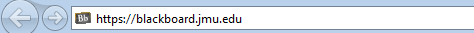
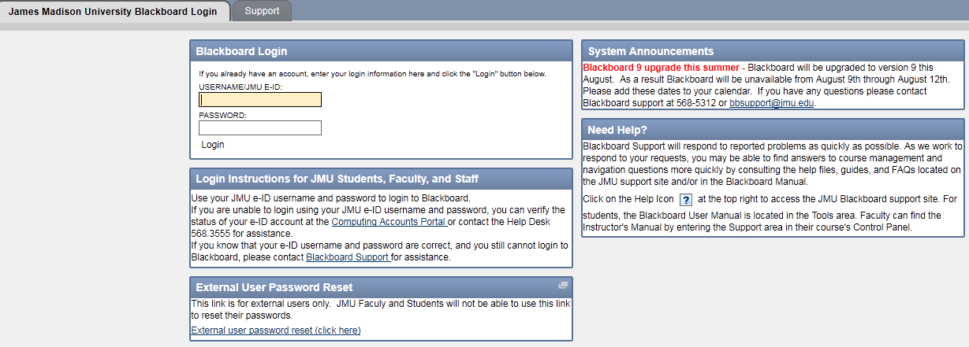
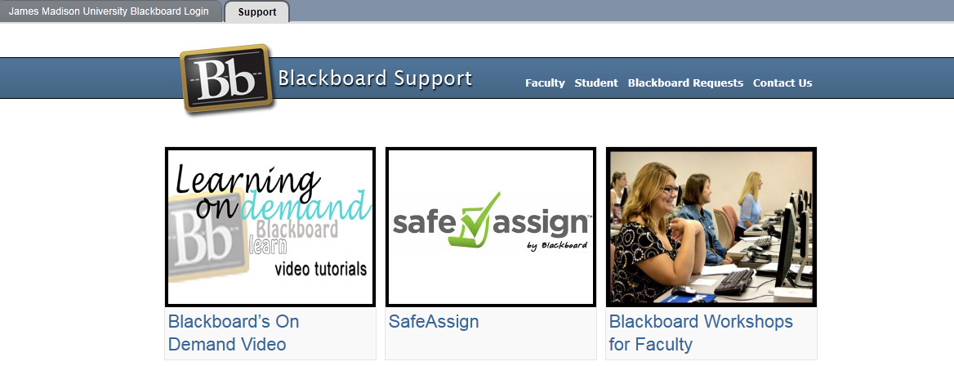

Blackboard
Our Roles
Academics and Success
Advising Materials
To-Do List
Contact Me
Notes:
Not all courses use Blackboard

Slide 19


Learning Centers
Our Roles
Academics and Success
Advising Materials
To-Do List
Contact Me
Notes:
These are some of the learning centers on campus.

Slide 20
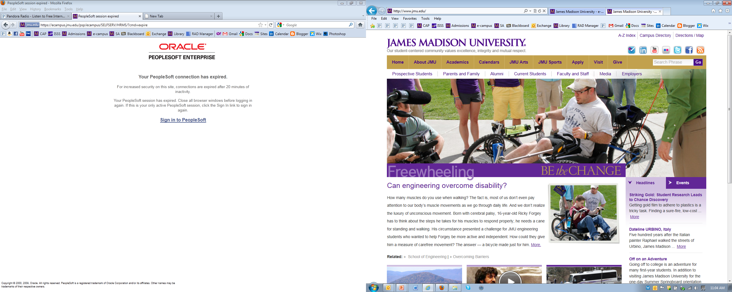
JMU Homepage
Our Roles
Academics and Success
Advising Materials
To-Do List
Contact Me
Notes:
Learn to navigate the JMU website which has lots of important information. Campus Directory helps you to find information about professors such as offices, emails, and phone numbers.

Slide 21
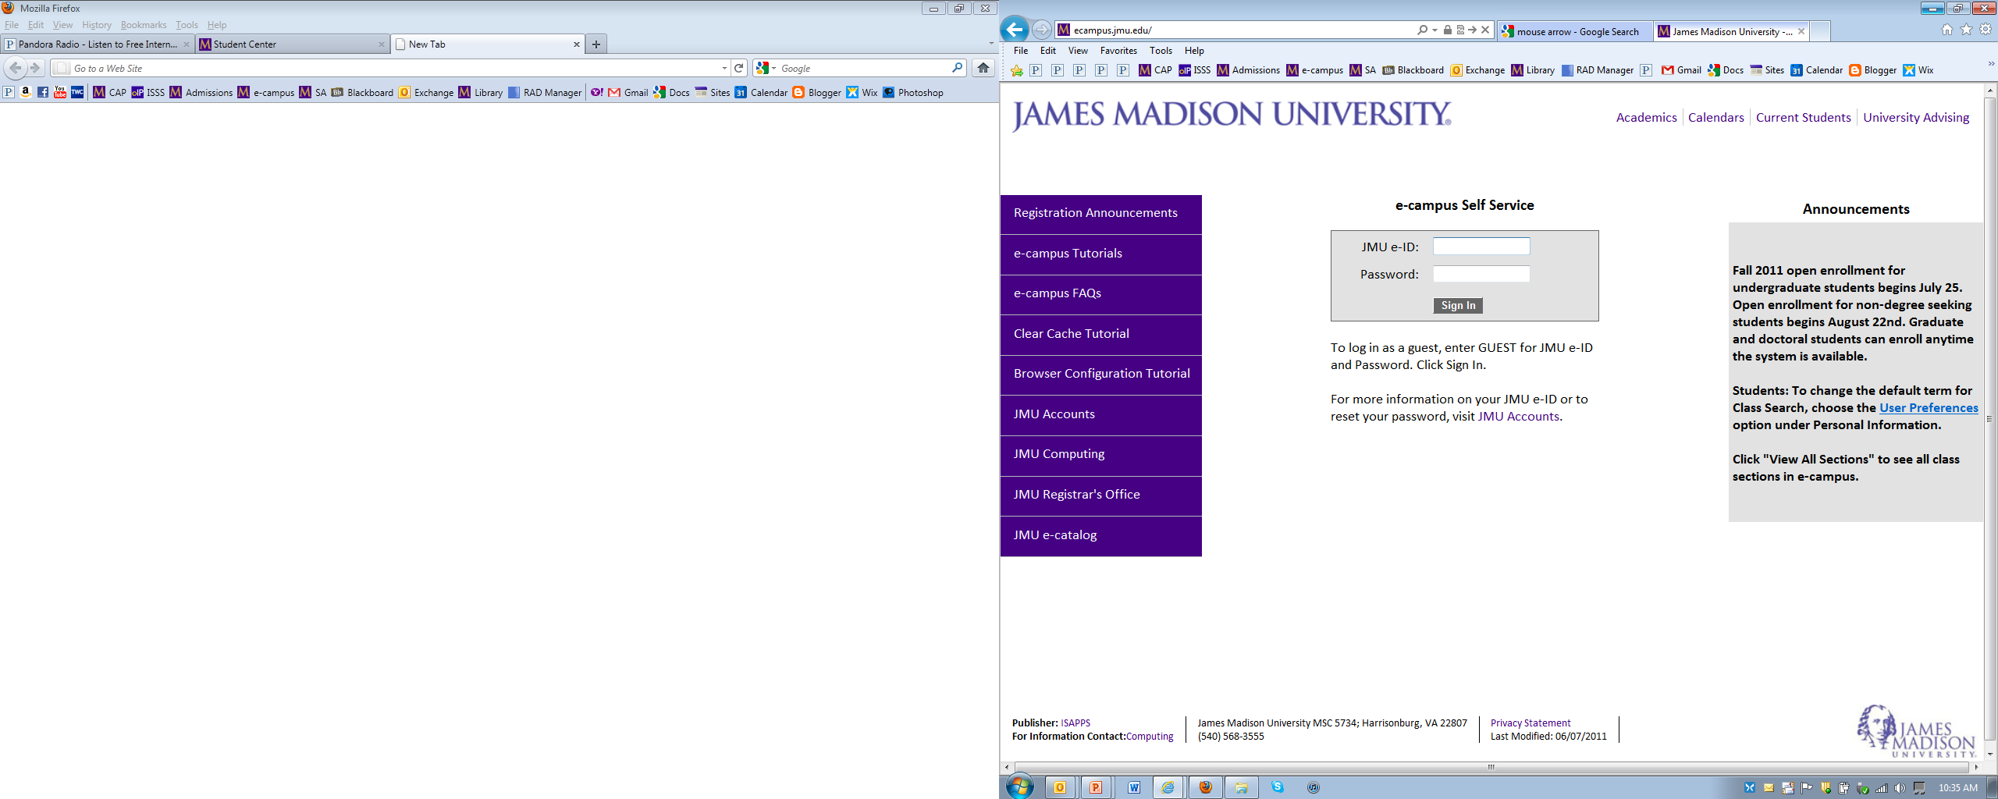
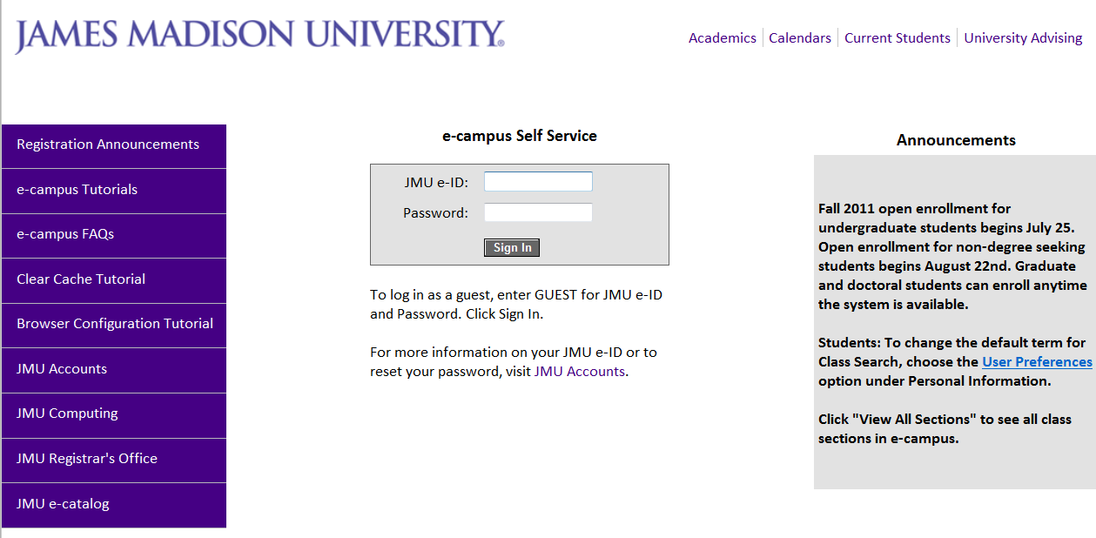
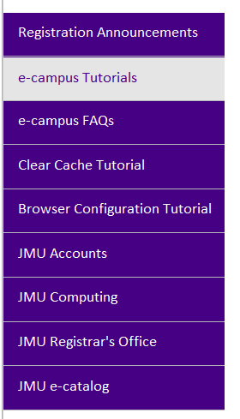
Ecampus
Our Roles
Academics and Success
Advising Materials
To-Do List
Contact Me
Notes:
Please note under Announcements, the second paragraph describes how to set the default term for the class search; otherwise, it shows up as a different semester than the present one.

Slide 22
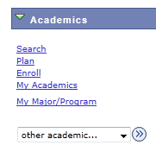
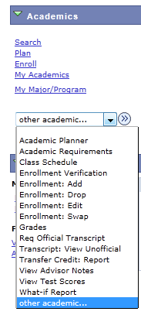
Our Roles
Academics and Success
Advising Materials
To-Do List
Contact Me
Notes:
Ecampus can be used for much more than registering for classes. Be sure that your dual enrollment and any credit from AP/IB have shown up on your transcript.

Slide 23
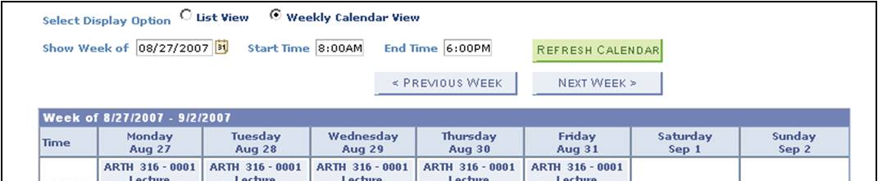
Our Roles
Academics and Success
Advising Materials
To-Do List
Contact Me
Default Schedule View
Weekly Calendar View
Notes:
When using the weekly calendar view, be sure to have the appropriate week showing at the top. Block courses only show up in the dates they are offered.

Slide 24
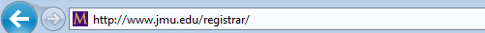
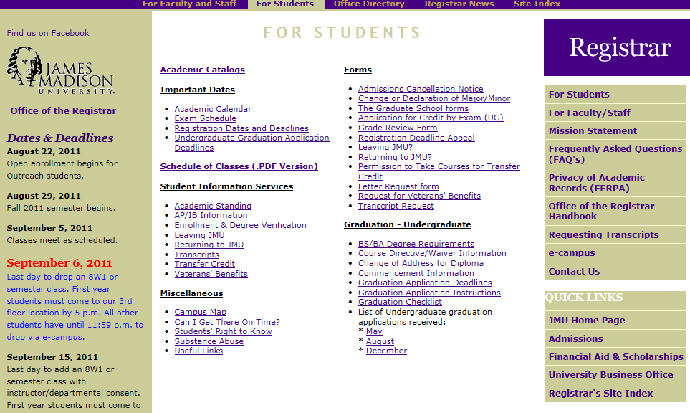
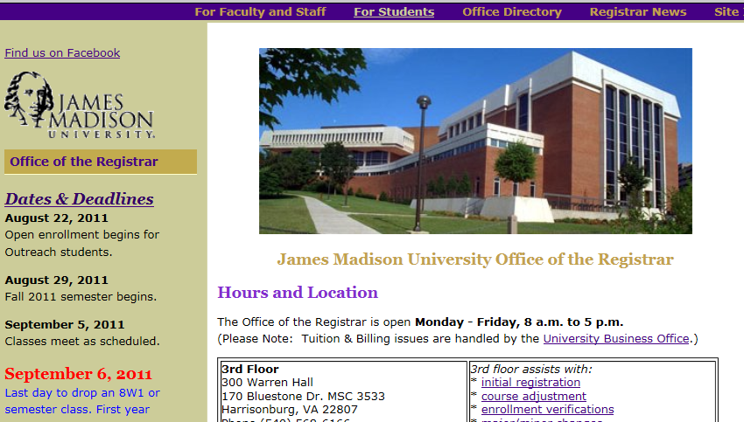
Registrar’s Office
Our Roles
Academics and Success
Advising Materials
To-Do List
Contact Me
Notes:
Should bookmark this page. Note the dates and deadlines on the left hand side.

Slide 25

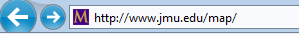
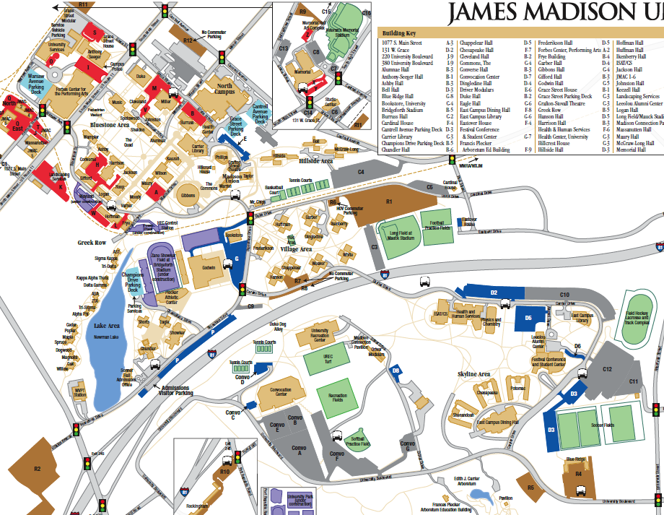
[Title Here]
Our Roles
Academics and Success
Advising Materials
To-Do List
Contact Me
Walk Schedule
Assessment
Major and Pre-Prof. Meetings
Honor Code Tutorial and Test
Alcohol-Wise: II
Tech Level I
ISST
Schedule Changes
- Declare or Change Major
…
Notes:
This is your To Do List to start your semester.

Slide 26
[Title Here]
Our Roles
Academics and Success
Advising Materials
To-Do List
Contact Me
Friday, August 26
All first-year students must attend their assessment session at their designated time and location.
10 am – 1 pm
or
2 pm – 5 pm
check your mappy for
your specific time and location
Failure to attend your assessment will result in a hold on your record.
✓
Walk Schedule
Assessment
Major and Pre-Prof. Meetings
Honor Code Tutorial and Test
Alcohol-Wise: II
Tech Level I
ISST
Schedule Changes
- Declare or Change Major
…
Notes:
Your mappy has the schedule for each day of Orientation. The assessment times are on there under Friday, August 26. Your specific time and location are on the label of your mappy.

Slide 27
[Title Here]
Anthropology
Art & Art History
Athletic Training
Chemistry & Biochemistry
College of Business (Accounting, Computer Information Systems, Economics, Finance, International Business, Management, Marketing, and Quantitative Finance)
Communication Sciences & Disorders
Communication Studies
Dietetics
Engineering
Geographic Science
Geology & Earth Science
Health Sciences
Health Service Administration
History
Hospitality, Sport & Recreation Management
Intelligence Analysis
Interdisciplinary Liberal Studies (Education)
Integrated Science & Technology (ISAT)
International Affairs
Justice Studies
Mathematics and Statistics
Media Arts and Design (SMAD)
Military Science
Modern Foreign Language
Music
Nursing
Physics
Political Science
Pre-Health
Psychology
Public Policy & Administration
Social Work
Theatre and Dance
Our Roles
Academics and Success
Advising Materials
To-Do List
Contact Me
✓
Walk Schedule
Assessment
Major and Pre-Prof. Meetings
Honor Code Tutorial and Test
Alcohol-Wise: II
Tech Level I
ISST
Schedule Changes
- Declare or Change Major
…
✓
NO CS Meetings
Saturday
August 27
9:30 – 10:30
or 11 – 12
check mappy
Notes:
Please go to the major and/of pre-health presentation on Saturday morning that applies to you. If you are Undeclared, this is a great opportunity to find out about two different majors.

Slide 28
[Title Here]
Our Roles
Academics and Success
Advising Materials
To-Do List
Contact Me
Special meetings for students that I have not yet met:
Sign up for a time on the sign in if you have not done so:
9:30 – 11:10 am on Saturday
Open Office Hours from 11:30 – 12:00 noon on Saturday.
Next week, I will try to be available most afternoons. See my class schedule outside my door for availability.
✓
Walk Schedule
Assessment
Major and Pre-Prof. Meetings
Honor Code Tutorial and Test
Alcohol-Wise: II
Tech Level I
ISST
Schedule Changes
- Declare or Change Major
…
✓
Notes:
Please go to the major and/of pre-health presentation on Saturday morning that applies to you. If you are Undeclared, this is a great opportunity to find out about two different majors.

Slide 29
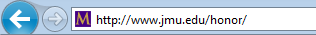
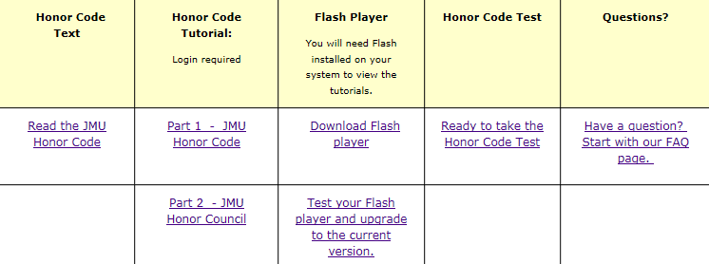
[Title Here]
Our Roles
Academics and Success
Advising Materials
To-Do List
Contact Me
✓
Deadline for Completion:
Saturday, October 1
Walk Schedule
Assessment
Major and Pre-Prof. Meetings
Honor Code Tutorial and Test
Alcohol-Wise: II
Tech Level I
ISST
Schedule Changes
- Declare or Change Major
…
✓
✓
Notes:
The Honor Code is an important aspect of being a student at JMU. You can violate it if you do not know what it is. Take the Honor Code as soon as possible. You can take the Honor Code test from any computer. We will review the tutorial at the end of this presentation.

Slide 30
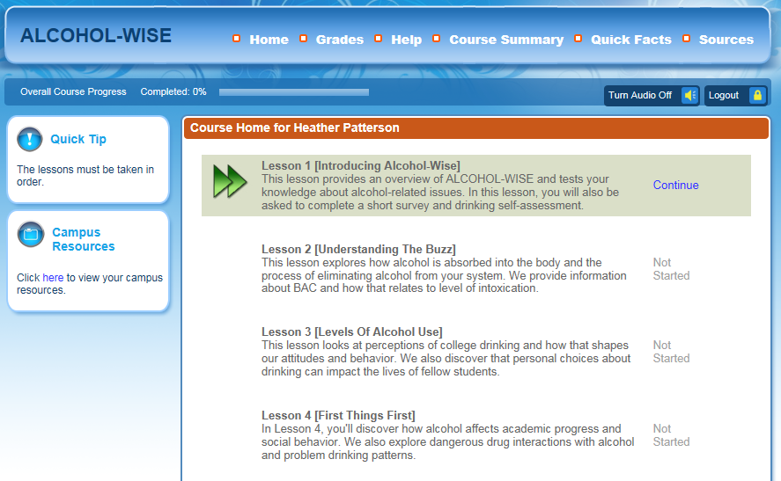
[Title Here]
Our Roles
Academics and Success
Advising Materials
To-Do List
Contact Me
✓
Deadline for Completion:
Monday, October 10
Walk Schedule
Assessment
Major and Pre-Prof. Meetings
Honor Code Tutorial and Test
Alcohol-Wise: II
Tech Level I
ISST
Schedule Changes
- Declare or Change Major
…
✓
✓
✓
Notes:
You should have done Part One of the Alcohol-Wise in the summer. The second part is due October 10.

Slide 31
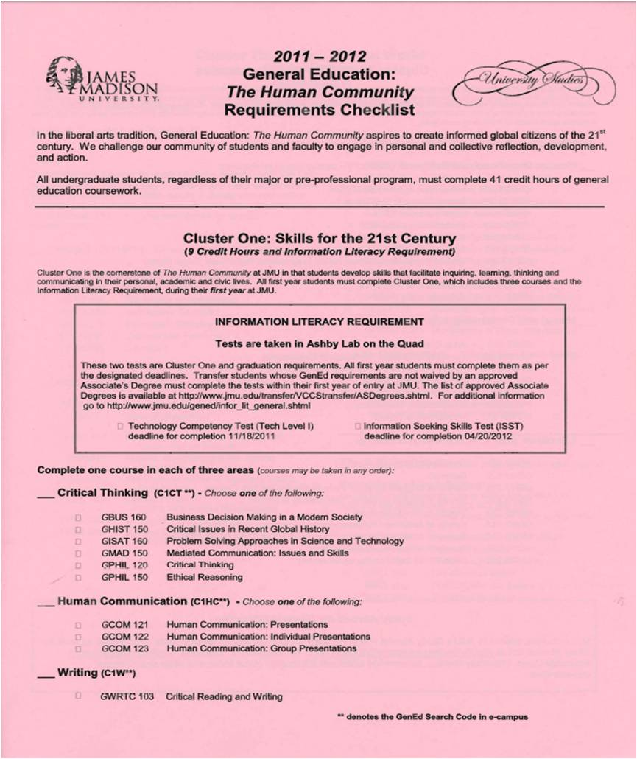
[Title Here]
Our Roles
Academics and Success
Advising Materials
To-Do List
Contact Me
✓
Deadline for Completion:
Friday, November 18
Walk Schedule
Assessment
Major and Pre-Prof. Meetings
Honor Code Tutorial and Test
Alcohol-Wise: II
Tech Level I
ISST
Schedule Changes
- Declare or Change Major
…
✓
✓
✓
✓
Notes:
It would be smart to take these tests sooner rather than later since they help you with the courses you are taking your first semester.

Slide 32
[Title Here]
Our Roles
Academics and Success
Advising Materials
To-Do List
Contact Me
✓
Deadline for Completion:
Friday, April 20, 2012
Walk Schedule
Assessment
Major and Pre-Prof. Meetings
Honor Code Tutorial and Test
Alcohol-Wise: II
Tech Level I
ISST
Schedule Changes
- Declare or Change Major
…
✓
✓
✓
✓

Slide 33
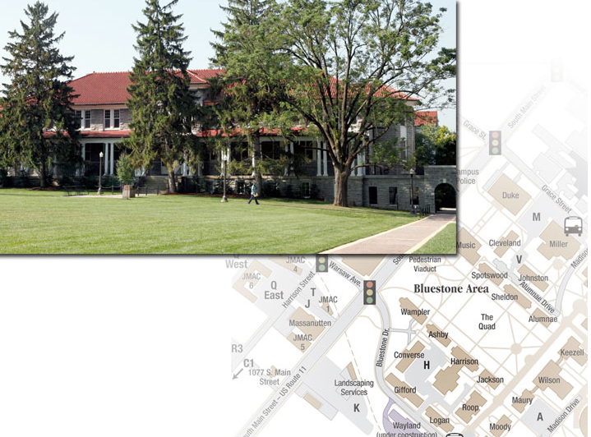
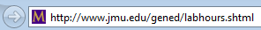
[Title Here]
Our Roles
Academics and Success
Advising Materials
To-Do List
Contact Me
✓
Ashby Lab
Walk Schedule
Assessment
Major and Pre-Prof. Meetings
Honor Code Tutorial and Test
Alcohol-Wise: II
Tech Level I
ISST
Schedule Changes
- Declare or Change Major
…
✓
✓
✓
✓
Notes:
You can only take the Tech Level I and ISST tests in Ashby Lab during the designated hours.

Slide 34
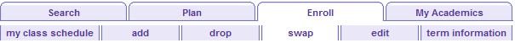
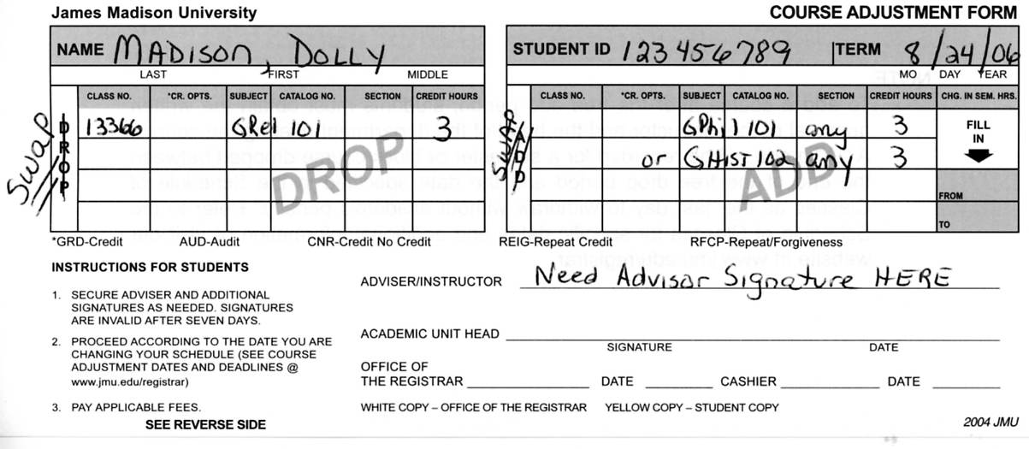
[Title Here]
Our Roles
Academics and Success
Advising Materials
To-Do List
Contact Me
✓
Course Sections
example – GPSYC 160 for GPSYC 160
Walk Schedule
Assessment
Major and Pre-Prof. Meetings
Honor Code Tutorial and Test
Alcohol-Wise: II
Tech Level I
ISST
Schedule Changes
- Declare or Change Major
…
✓
✓
✓
Courses
example – GPSYC 160 for GPSYC 101
✓
✓
Notes:
Remember, you can go online through ecampus on your own to swap the days and times of a class that you are currently in. If you want to change to a different class, you need your advisor’s signature and you must take the form to the Registrar’s Office on 3rd floor Warren.

Slide 35
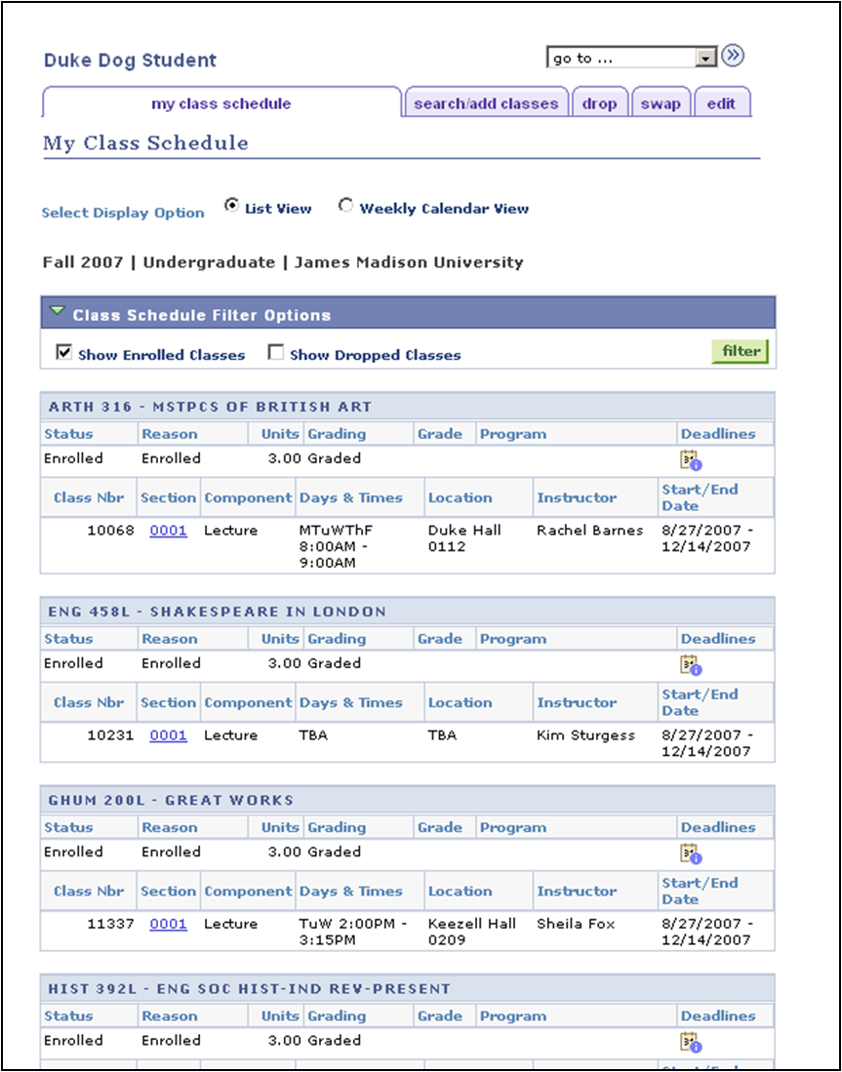
[Title Here]
Our Roles
Academics and Success
Advising Materials
To-Do List
Contact Me
✓
Deadline to Adjust Schedule is Tuesday, September 6 @ 5pm
Walk Schedule
Assessment
Major and Pre-Prof. Meetings
Honor Code Tutorial and Test
Alcohol-Wise: II
Tech Level I
ISST
Schedule Changes
- Declare or Change Major
…
✓
✓
✓
✓
✓
Notes:
The last day to drop or add a course or swap a section is Tuesday, Sept. 6 at 5:00pm

Slide 36
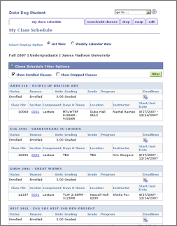
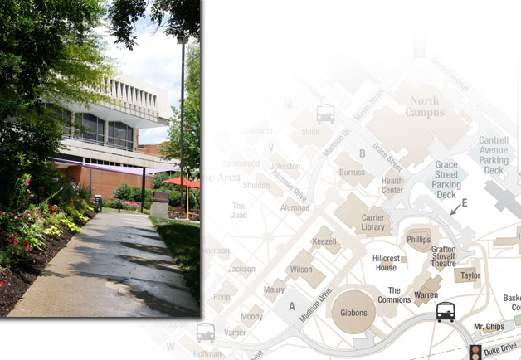
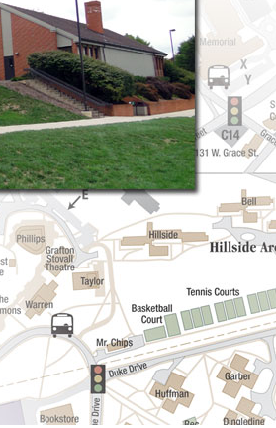
[Title Here]
Our Roles
Academics and Success
Advising Materials
To-Do List
Contact Me
✓
Registrar’s Office
Walk Schedule
Assessment
Major and Pre-Prof. Meetings
Honor Code Tutorial and Test
Alcohol-Wise: II
Tech Level I
ISST
Schedule Changes
- Declare or Change Major
…
✓
Hillside Hall – Computer Lab
Friday (8/26) 7:30 – 9:30 am
12 – 2 pm
Warren Hall – 3rd Floor
Saturday (8/27) 12 – 5 pm
Sunday (8/28) 12 – 5 pm
Monday (8/29) 8 am – 6 pm
Tuesday (8/30) resume regular hours
M–F 8 am – 5 pm
✓
✓
✓
✓
Notes:
To help with your schedule changes, special times have been set up at Hillside Lab (where you took the Orientation survey this summer) for you to bring your course adjustment form with your advisor’s signature and a copy of your schedule.

Slide 37
[Title Here]
Our Roles
Academics and Success
Advising Materials
To-Do List
Contact Me
✓
Deadline to declare majors within the Department of Health Sciences is Thursday, September 15 @ 5pm
Walk Schedule
Assessment
Major and Pre-Prof. Meetings
Honor Code Tutorial and Test
Alcohol-Wise: II
Tech Level I
ISST
Schedule Changes
- Declare or Change Major
…
✓
✓
✓
Athletic Training
Dietetics
Health Sciences
  Health Assessment & Promotion
  Health Studies
  Public Health
Health Service Administration
✓
✓
Notes:
The Health Sciences Dept. has a deadline for the fall semester to declare one of these majors: Athletic Training, Dietetics, Health Sciences, and Health Services Administration. After this deadline, you will need to wait until the spring semester to declare any of these majors. In all of these majors, you have to be declared in order to register for certain classes—registration for the spring semester is held in November.

Slide 38
[Title Here]
Our Roles
Academics and Success
Advising Materials
To-Do List
Contact Me
✓
Deadline to declare
Studio Art as a major without submitting a portfolio for review is
Friday, December
16 @ 5pm
Walk Schedule
Assessment
Major and Pre-Prof. Meetings
Honor Code Tutorial and Test
Alcohol-Wise: II
Tech Level I
ISST
Schedule Changes
- Declare or Change Major
…
✓
✓
✓
✓
✓
Notes:
After this deadline, you have to submit a portfolio for review in order to declare the major.

Slide 39
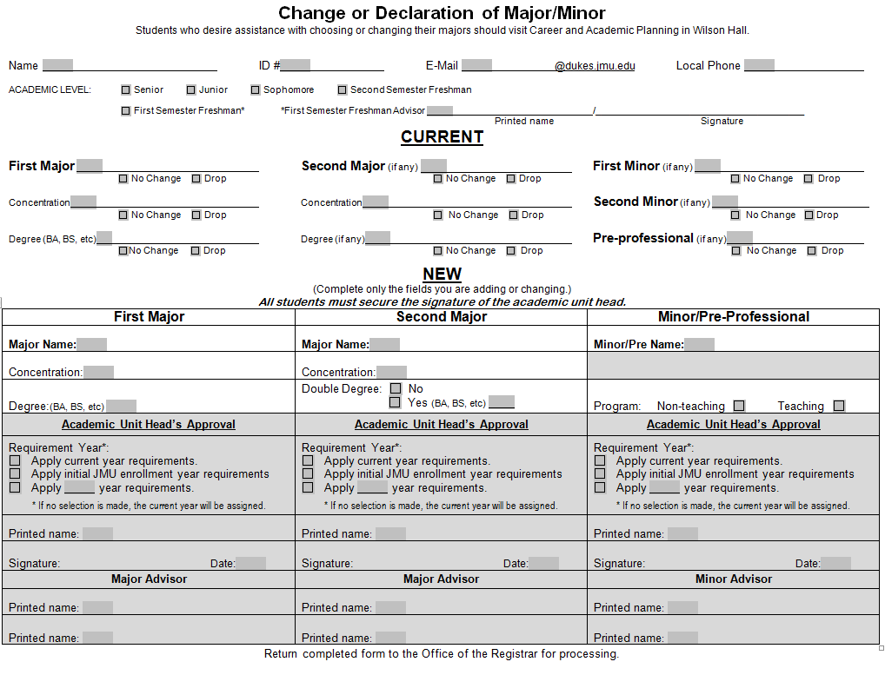
[Title Here]
Our Roles
Academics and Success
Advising Materials
To-Do List
Contact Me
✓
Walk Schedule
Assessment
Major and Pre-Prof. Meetings
Honor Code Tutorial and Test
Alcohol-Wise: II
Tech Level I
ISST
Schedule Changes
- Declare or Change Major
…
✓
✓
✓
✓
✓
→ Registrar’s Office
Notes:
The Change or Declaration of Major form is online on the Registrar’s website. You must complete the top line, your academic level is First Semester Freshman no matter how much credit you brought into the university. Your current major must be listed next to First Major and check the box that says drop. Under New, you must list the major and degree (if you know which one you are pursuing), and you must obtain the department head’s signature and your freshman advisor’s signature and then take the form to the Registrar’s Office on 3rd floor Wilson.

Slide 40
Office Hours (a.k.a. Walk-In Hours)
Our Roles
Academics and Success
Advising Materials
To-Do List
Contact Me
Friday (8/26): … None, I may be available between 11 and 1 and 3-5.
Monday (8/29): … 6-8pm. May be available 10am – 3:30pm.
Tuesday (8/30): … after 3:30.
Wednesday (8/31): … after 1pm, 5-6pm
Thursday (9/1): … after 3:30.
Friday (9/2): … before 1pm
Monday (9/5): … Normal office hours
Tuesday (9/6): … Normal office hours
Notes:
Advisors will want to adjust this slide to note when they will be able to meet with students.

Slide 41
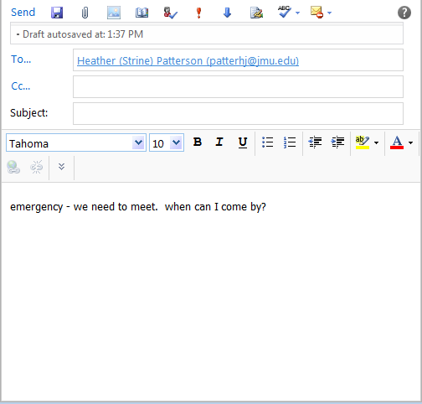
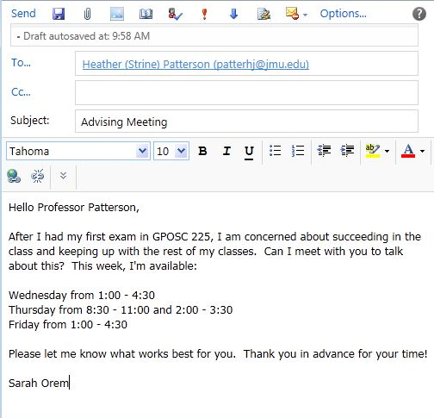
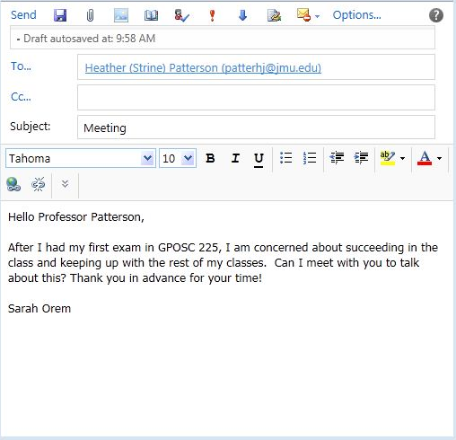
Email Correspondence
Our Roles
Academics and Success
Advising Materials
To-Do List
Contact Me

Slide 43
Course Adjustment Form needed? Any course changes.
Declaring or changing your major or pre-professional program?
Come on Down!
Our Roles
Academics and Success
Advising Materials
To-Do List
Contact Me
Changes we can make now!
Notes:
This is the time for you to talk individually with students about schedule changes and to complete the course adjustment forms so that they can take them to Hillside Lab on Friday.

